Slide 1
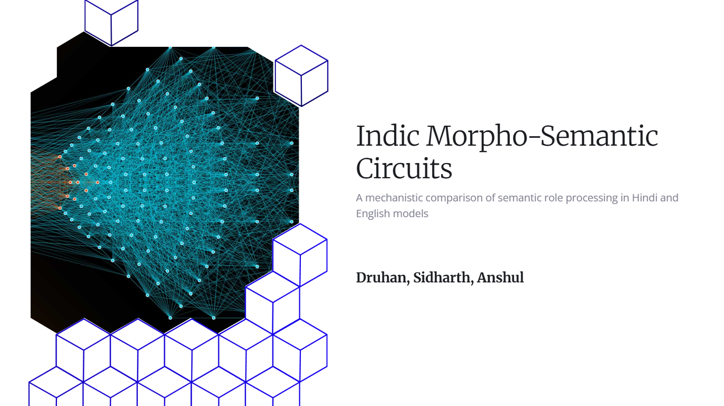

Slide 2
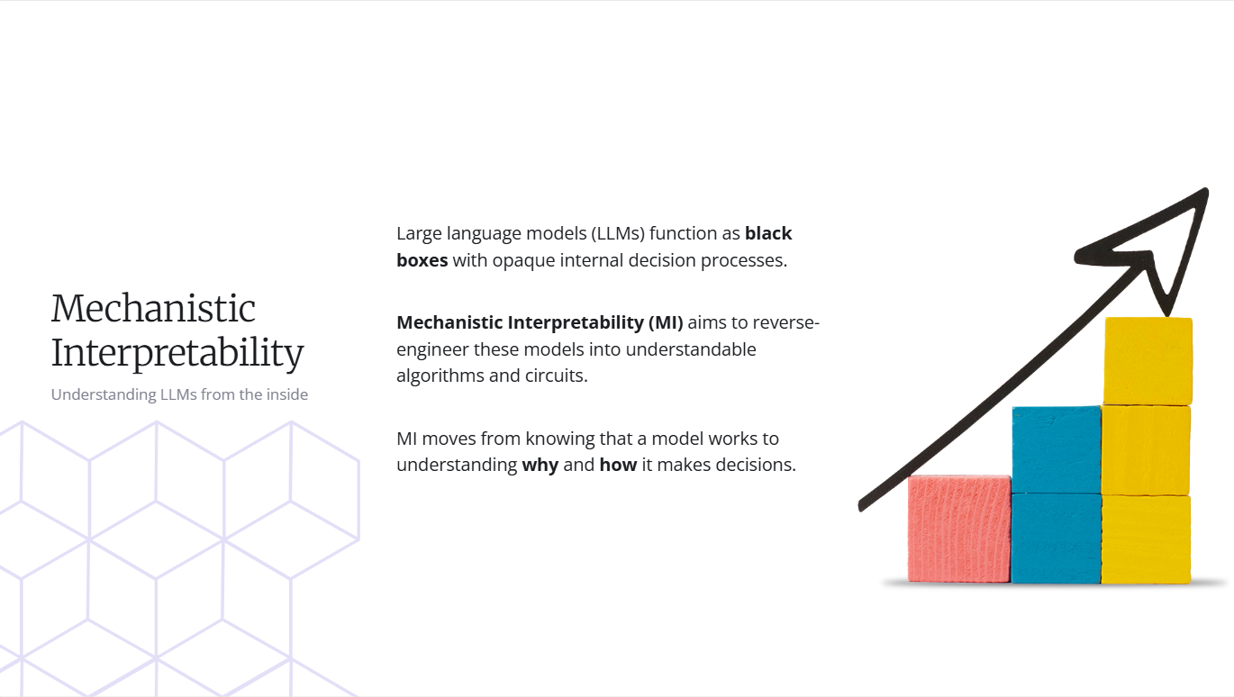

Slide 3
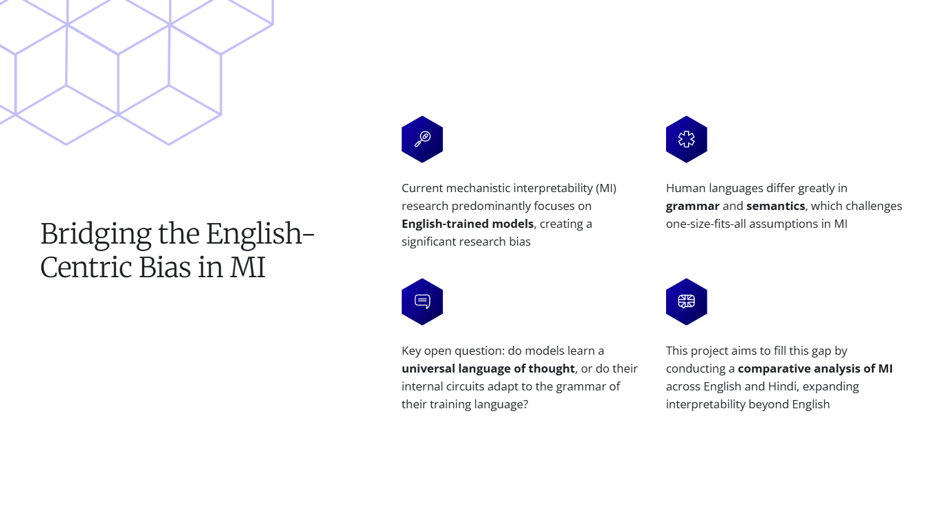

Slide 4
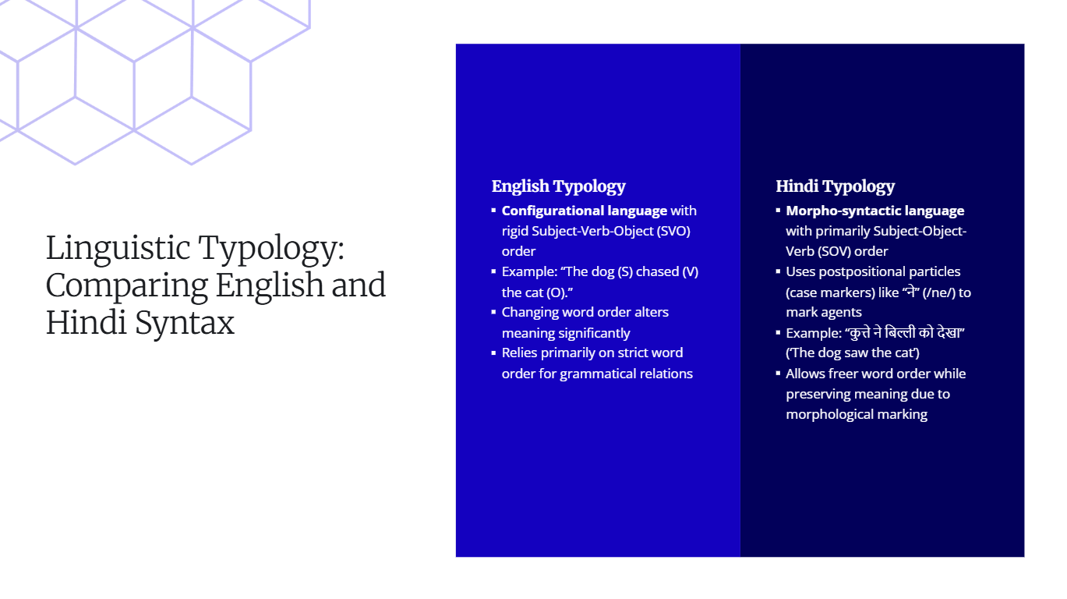

Slide 5
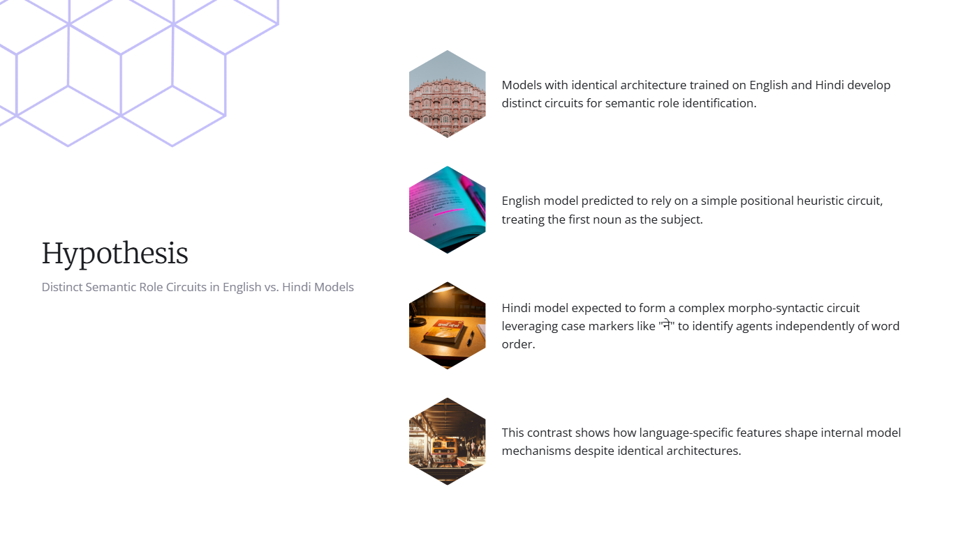

Slide 6
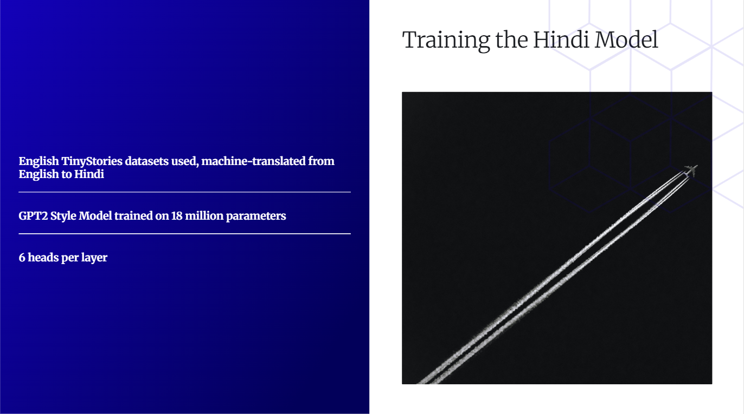
https://github.com/DruhanShah/indic-morpho-semantic-circuits/blob/main/Code/shenanigans/analysis.ipynb
https://github.com/DruhanShah/indic-morpho-semantic-circuits/blob/main/Code/hindi-tinystories.ipynb
https://github.com/DruhanShah/indic-morpho-semantic-circuits/tree/main/Code/mech

Slide 7
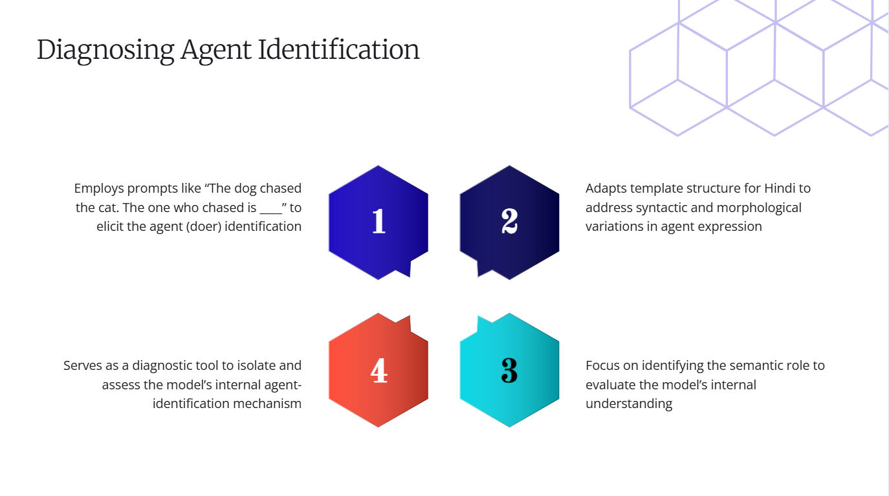

Slide 8
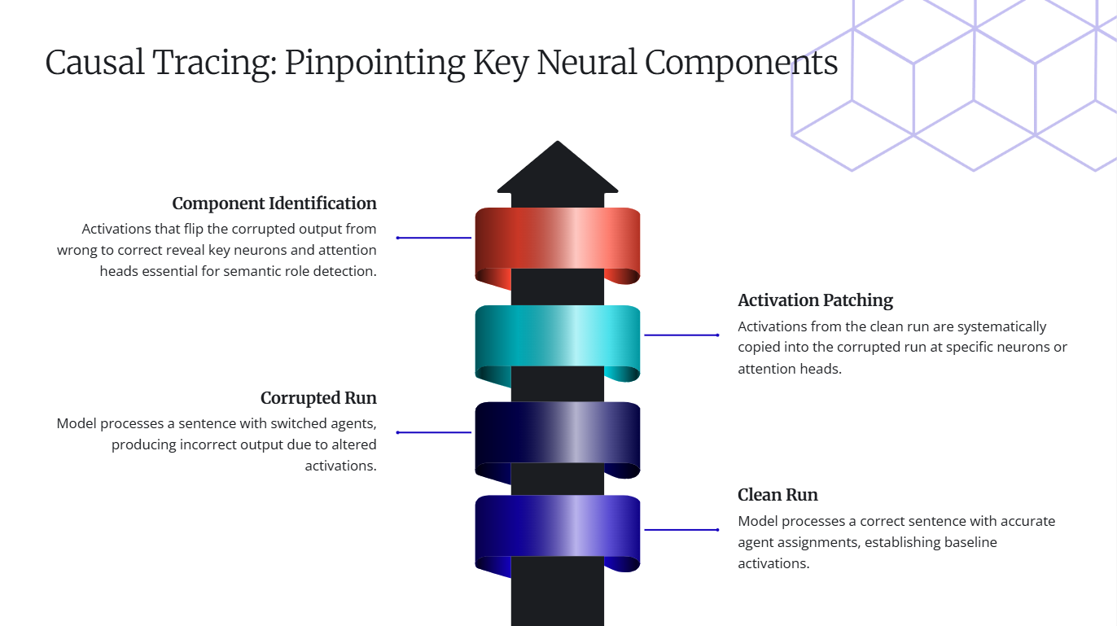

Slide 9
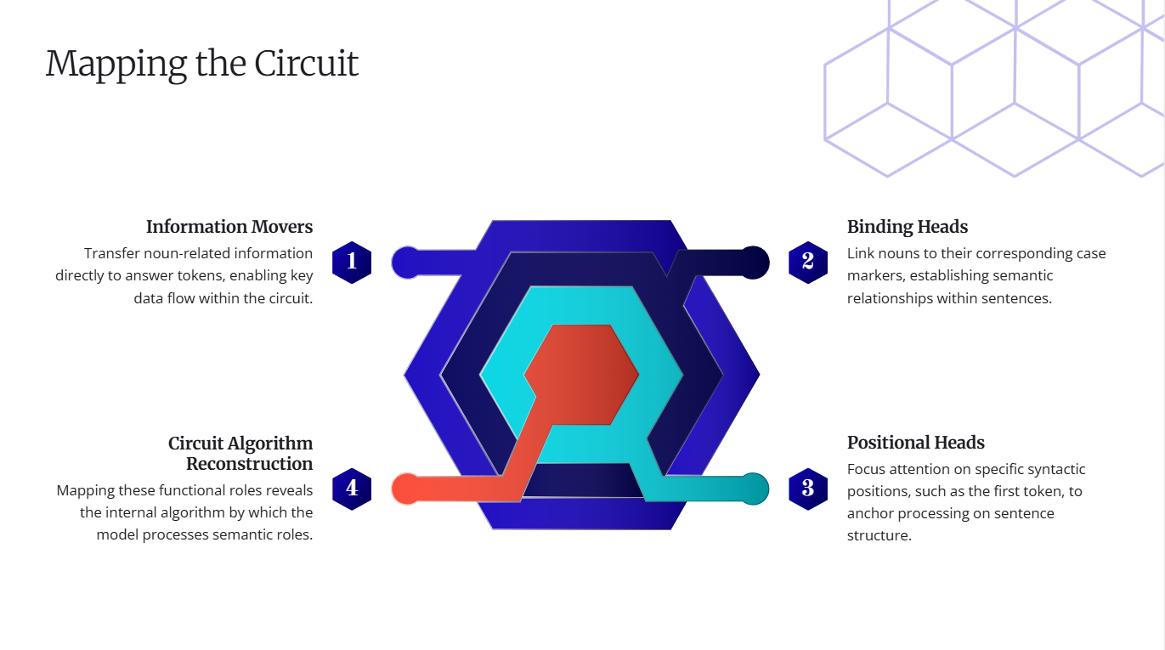

Slide 10
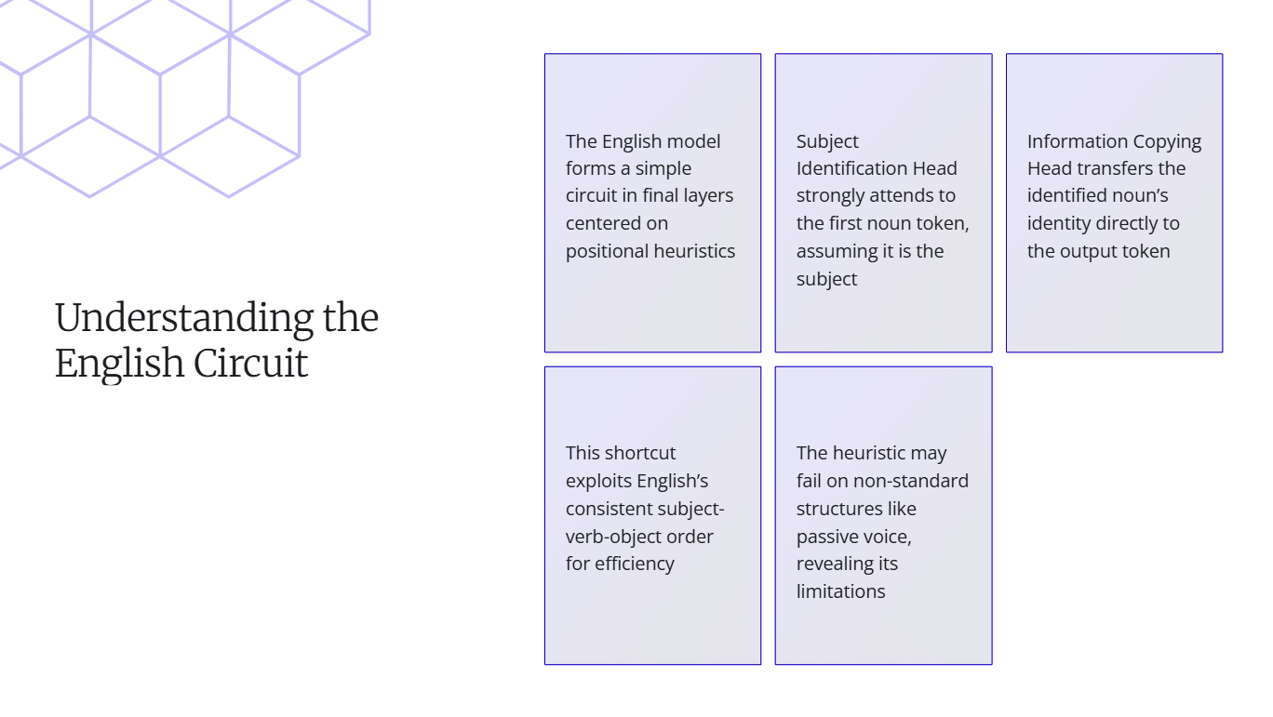

Slide 11
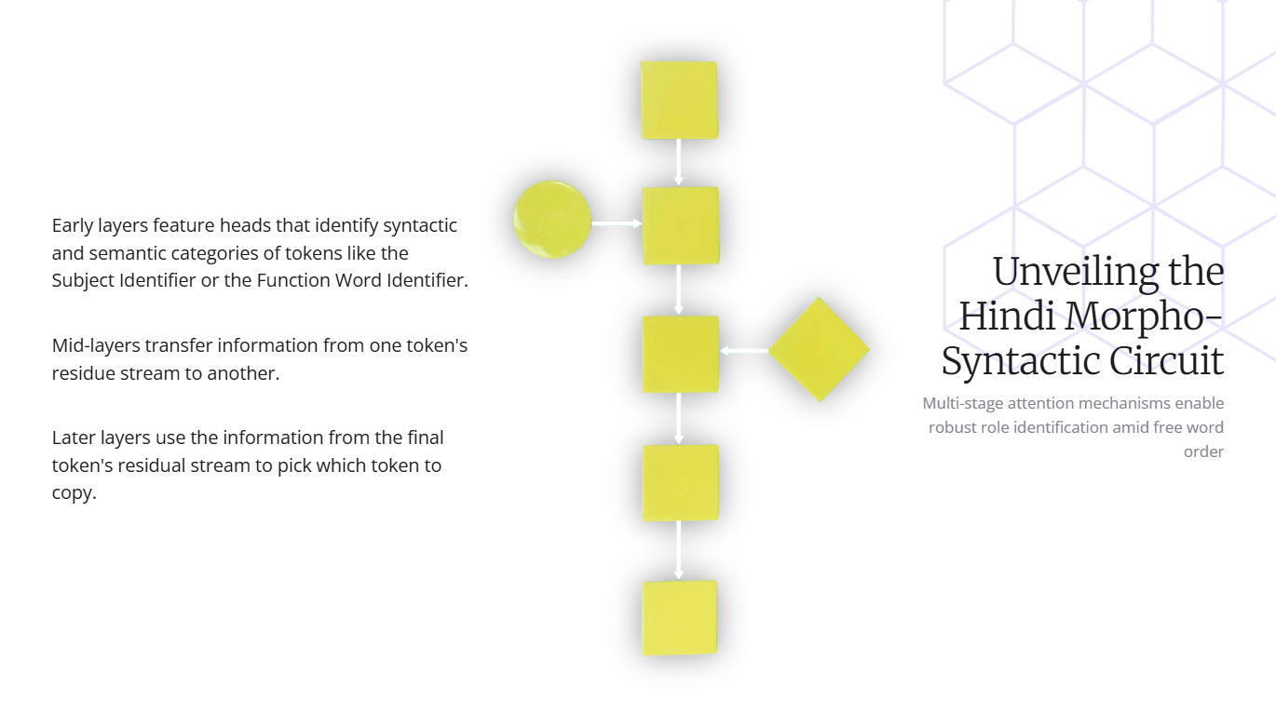

Slide 12
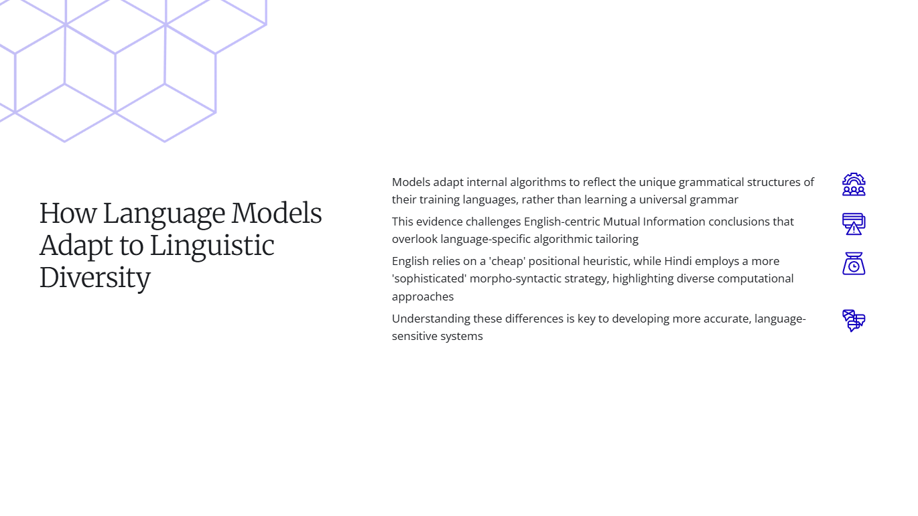

Slide 13
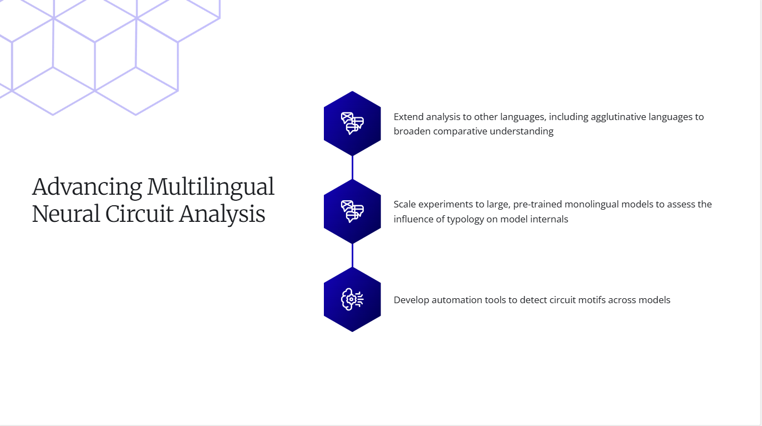

Slide 14
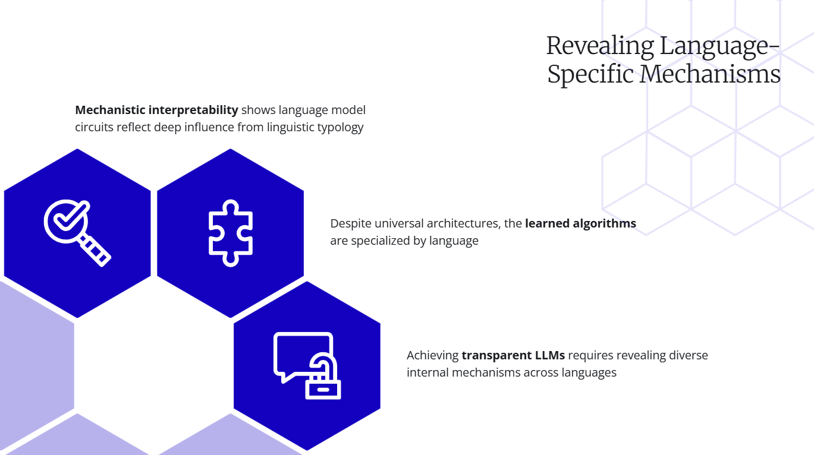

Slide 15


