Slide 1
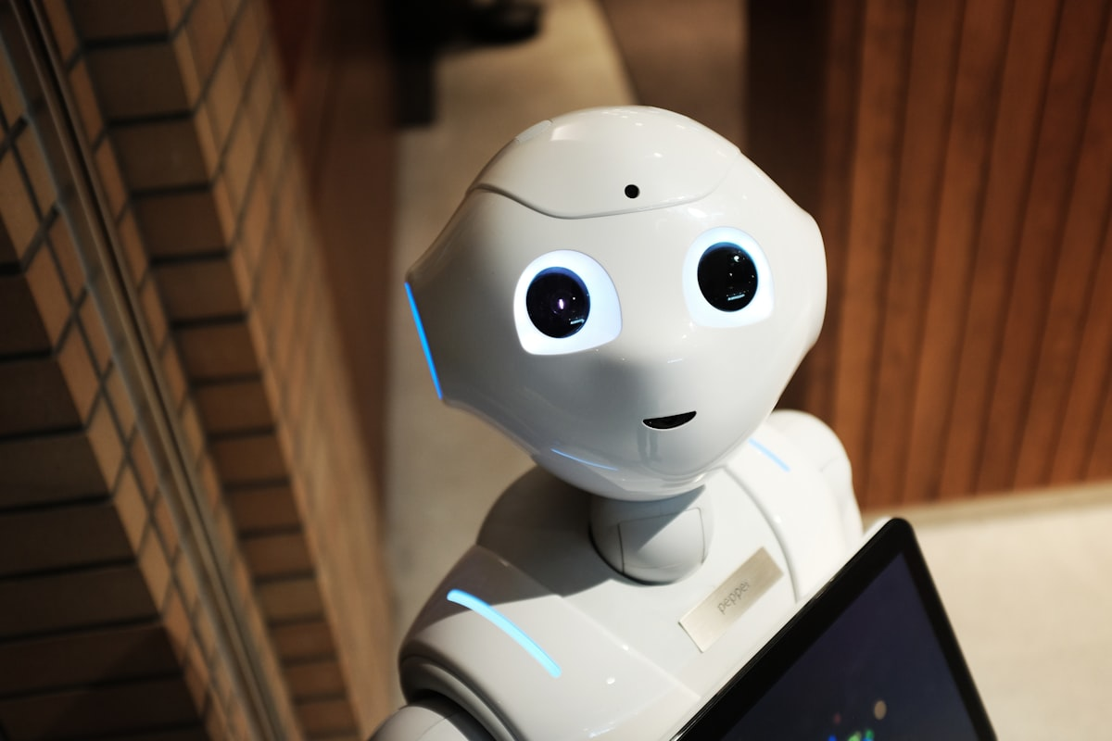
What Are AI Agents? 🤖
Key Differences from Regular AI:
Regular AI (ChatGPT):
You ask → It answers
Passive conversation
One response at a time
AI Agents:
You give a goal → It figures out how
Active problem-solving
Multiple actions until goal achieved
Simple Analogy:
Regular AI = Smart encyclopedia that answers questions
AI Agent = Capable employee who handles entire projects
The Magic Word: AUTONOMOUS
They can think, decide, act, and learn - all without constant human input!

Slide 2
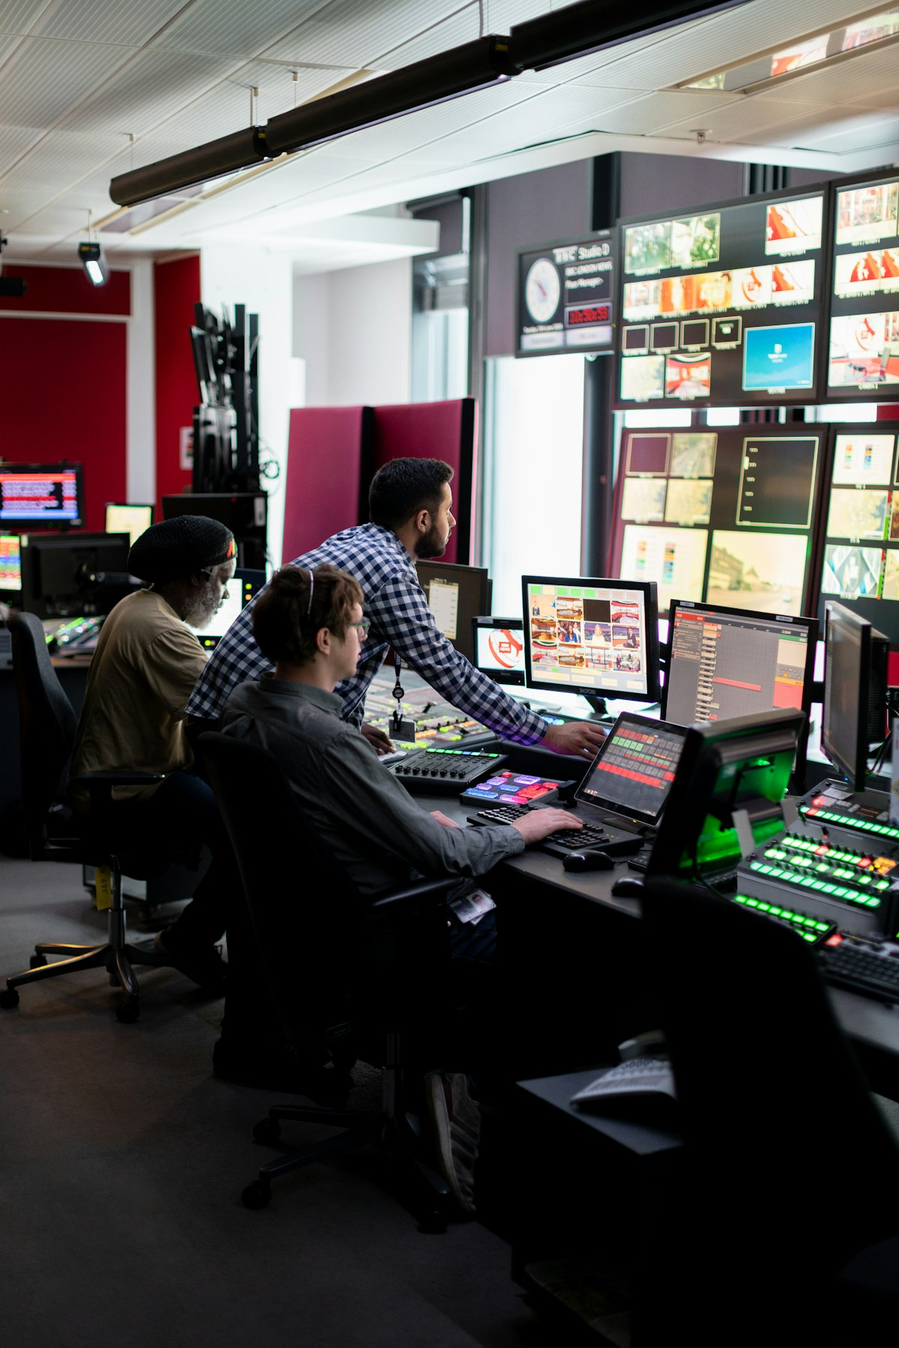
How They Work & Examples You Know 🔄
The 4-Step Cycle:
👁️ PERCEIVE - Gather information from environment
🧠 THINK - Analyze and plan actions
🤖 ACT - Take real-world actions
📚 LEARN - Improve from results
This cycle repeats until the goal is achieved
You Already Use AI Agents:
🗺️ Google Maps/Waze: Monitors traffic, reroutes, learns patterns
🏠 Smart Home Systems: Learns routines, adjusts automatically
🎵 Netflix/Spotify: Analyzes preferences, suggests content, improves over time

Slide 3

Why This Matters & What's Next 🚀
Benefits for You:
✅ Save Time - Handle routine tasks automatically
✅ Never Forget - Continuous monitoring and reminders
✅ Work 24/7 - No breaks needed
✅ Personalized - Adapt to your preferences
✅ Cost Effective - Cheaper than human help
Coming Soon:
Personal AI Assistants for your digital life
Business Automation for complex workflows
Smart Cities optimizing services
Healthcare Companions monitoring health
Key Takeaway:
AI Agents aren't replacing human intelligence - they're amplifying it.
They handle routine tasks so you can focus on what matters most.
The Bottom Line:
We're moving from tools that help us work → tools that work for us

