Slide 1



FERRIS WHEEL
Mr. Drupad S (4MN20CS015)
Mr. Syed Zeeshan (4MN20CS050)
Under the guidance of:
Mr. Bharath Bharadwaj B S,
Assistant Professor,
Dept. of Computer Science & Engineering,
Maharaja Institute of Technology Thandavapura
Computer graphics laboratory with mini-Project – 18CSl67

Slide 2
CONTENTS
Introduction
Aim
Overview
Outcome
Hardware and Software Requirement
Algorithm
Flow Chart
Snapshots
Computer graphics laboratory with mini-Project – 18CSl67

Slide 3
INTRODUCTION
Computer graphics refers to a technology that generates images on a computer screen. It's used in digital photography, film and television, video games, and on electronic devices and is responsible for displaying images effectively to users. Graphics provides one of the most natural means of communicating within a computer
Computer graphics laboratory with mini-Project – 18CSl67

Slide 4
AIM
The aim of the project is to visually demonstrate and explain how the Ferris wheel work using graphics and animations.
The main aim of this project is to implement the concepts of computer graphics using OpenGL.
Computer graphics laboratory with mini-Project – 18CSl67

Slide 5
OVERVIEW
This project contains Ferris Wheel. When the user presses ‘c/C’ key, wheel will start rotating and viceversa.
The user can control the speed of rotation by pressing ‘v/V’ or ‘x/X’ keys from keyboard where ‘v/V’ increases the speed and ‘x/X’ decreases the speed.
When the user press ‘w/W’,’s/S’, ’a/A’ & ’d/D’ key, it will rotate the whole wheel into Top, Bottom, Right and Left direction.
The user can also increase and decrease the number of cabins by pressing key ‘+/1’ and ‘-/0’ respectively.
Computer graphics laboratory with mini-Project – 18CSl67

Slide 6
OUTCOME
The project demonstrates keyboard interface for specific action that needs to be carried out.
This project is purely made for university purpose. Any student who are studying BE and B.Tech in CSE can use it as their Computer Graphics Mini Project.
Computer Graphics used in the development of educational software for making computer-aided instruction.
Computer graphics laboratory with mini-Project – 18CSl67

Slide 7
HARDWARE AND SOFTWARE REQUIREMENT
HARDWARE REQUIREMENT | SOFTWARE REQUIREMENT
Processor-intel i5 7th gen | Operating system-Windows 10/Linux
Memeory-8GB RAM | Code::Blocks 17.12
Keyboard | OPENGL library files-GL,GLU,GLUT
Display device | Language used-c/c++
Computer graphics laboratory with mini-Project – 18CSl67

Slide 8
ALGORITHM
1. Initialize the necessary libraries and variables.
2. Set up the menu options for selecting sunlight or moonlight.
3. Define the lighting properties for both sunlight and moonlight.
4. Create two display lists: one for the wheel and one for the cabin.
5. In the wheel display list, define the geometry for the wheel structure, including the center, spokes, and outer ring.
6. In the cabin display list, define the geometry for the cabin structure, including the bar and cone.
7. Implement the `draw_scene` function to render the scene.
8. In the `draw_scene` function, based on the selected lighting mode, set up the lighting properties and enable the corresponding light source.
9. Draw the background scenery, such as the ground and trees.
10. Translate and rotate the scene to the appropriate position.

Slide 9
11. Draw the Ferris Wheel by calling the display lists for the wheel and cabin.
12. Implement the menu function to handle the sunlight and moonlight options.
13. Based on the selected option, update the `isSunLight` variable.
14. Redisplay the scene to reflect the lighting changes.
15. Set up the main program loop and event handling using GLUT.
16. Initialize the window, set the display mode, and register the callback functions.
17. Enter the main event loop to handle user interactions and redraw the scene when necessary.
18. Terminate the program gracefully.

Slide 10
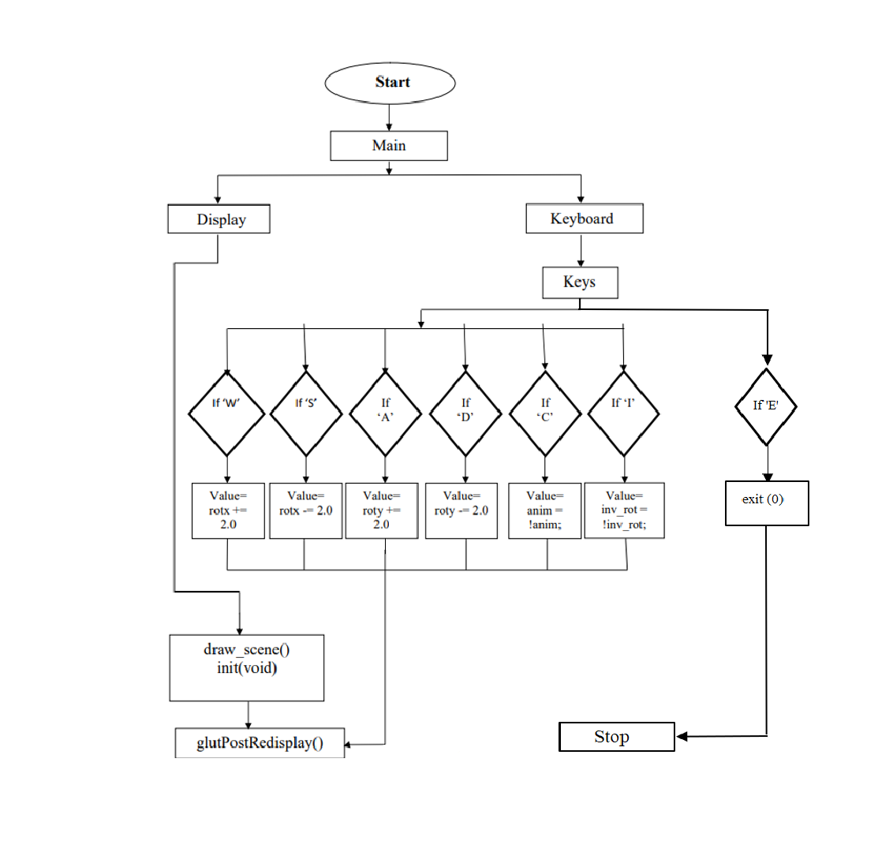
FLOW CHART

Slide 11
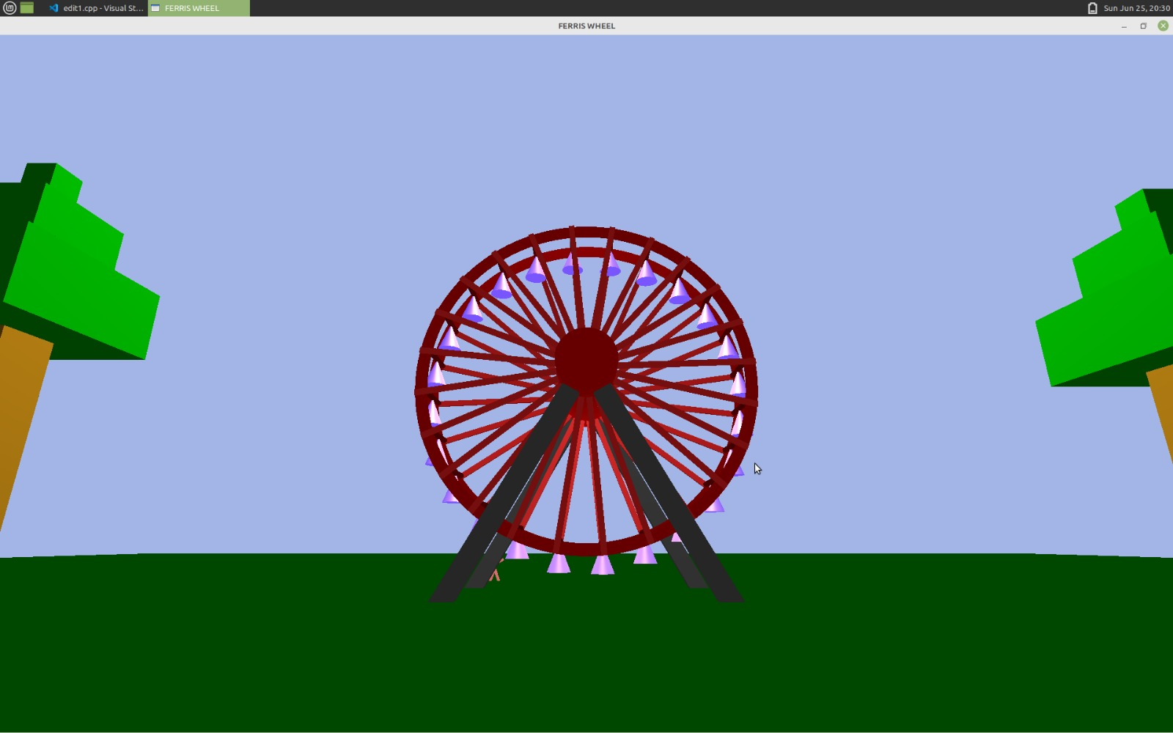
SNAPSHOTS

Slide 12
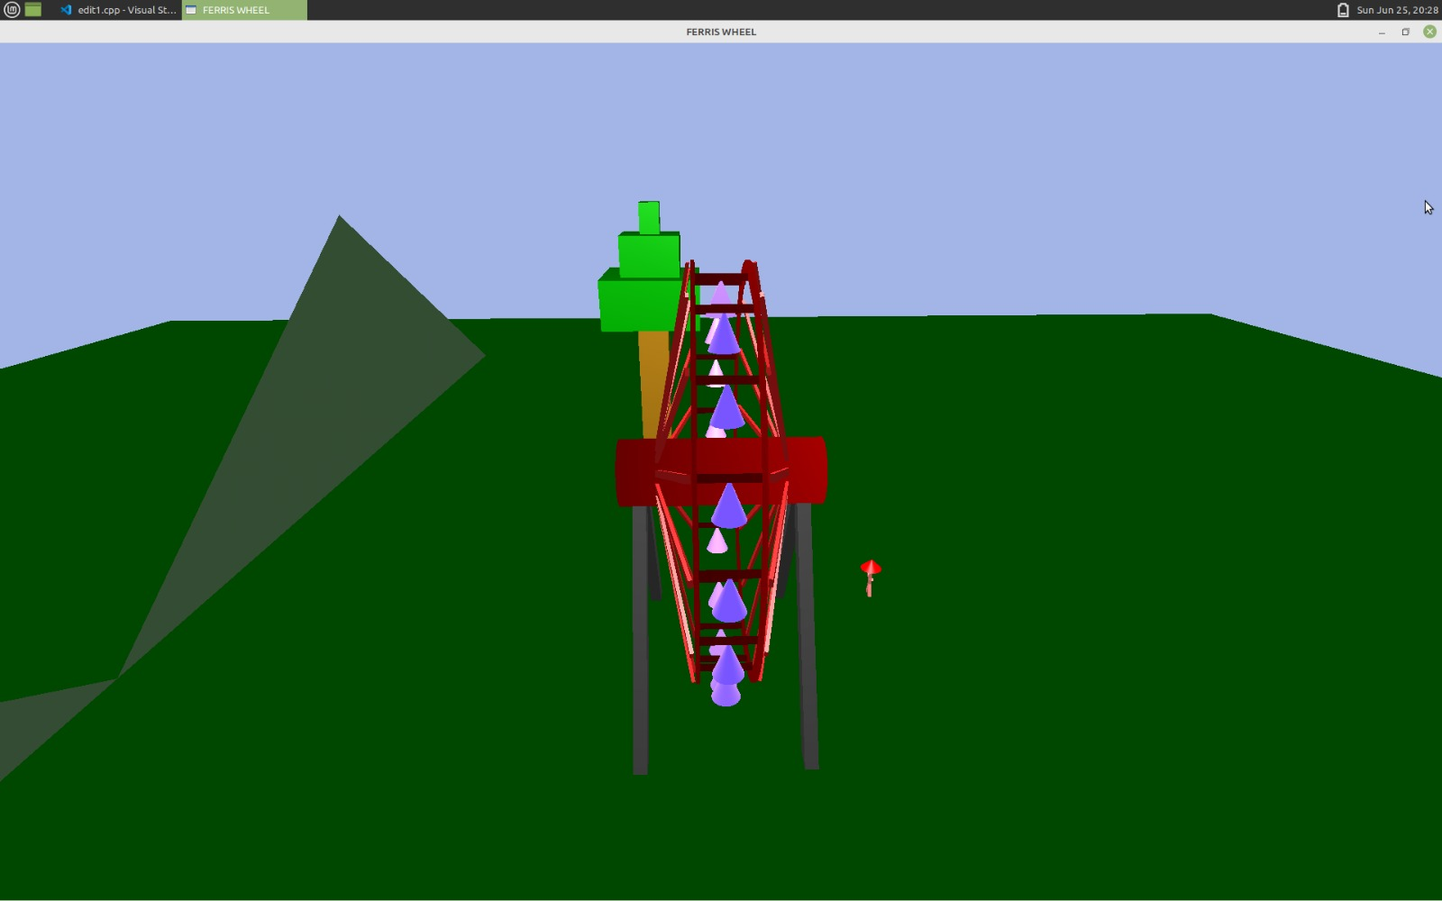

Slide 13
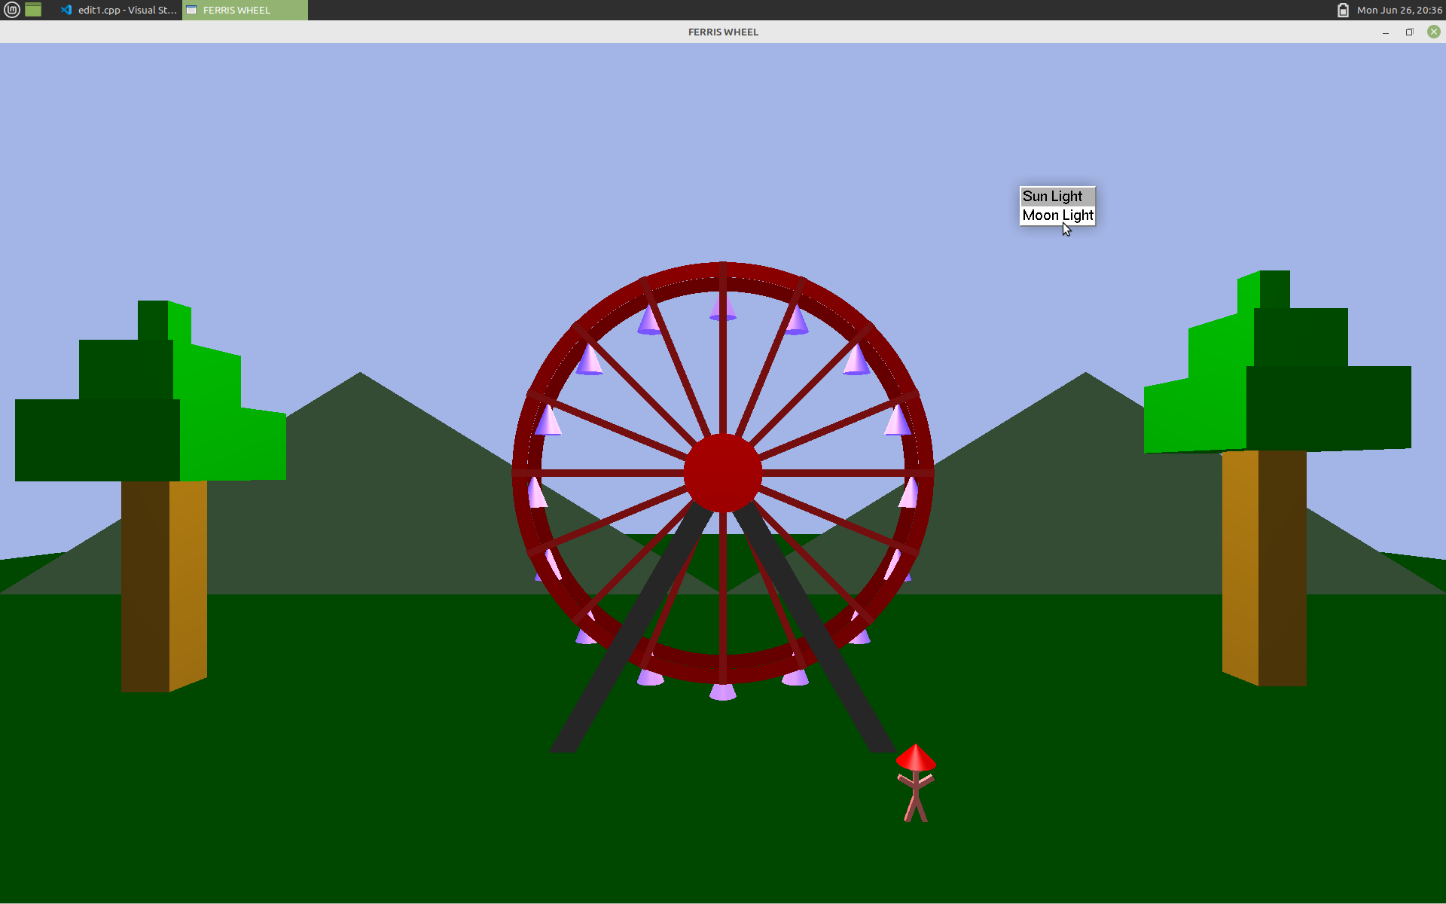

Slide 14

Any suggestions!
Computer graphics laboratory with mini-Project – 18CSl67

Slide 15

Thank You Listeners!
Computer graphics laboratory with mini-Project – 18CSl67

