Slide 1
Multisite & Aegir
Maciej Lukianski

Slide 2
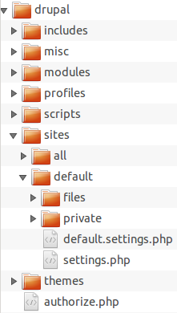

Components of a Drupal website
`
Codebase
Files
Database

Slide 3
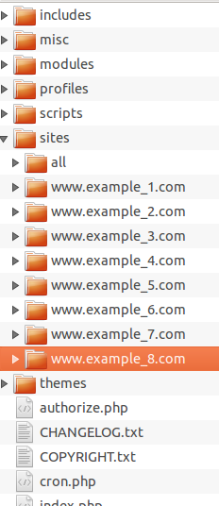
MULTISITE
More than one domain on the same installation

Slide 4

How it works
Drupal looks for settings.php
in:
* 1. sites/www.example.com
* 2. sites/example.com
* 3. sites/com
* 4. sites/default
(more details in settings.php)

Slide 5
Easy 60 websites
One multisite
Same modules
Same base theme
Final themes are really small
Majority of settings are identical (and in Features)
Install profiles set everything up for a new website

Slide 6
Benefits
Super fast installation (new site in 15 minutes)
Super fast code deployment:
  A change (new module, patch, update) is added/applied once
Much better control of code:
  All websites are in the same version of modules and have same modules available
  Patch is applied only once
Migration between servers quicker
Updating is much quicker
You need less RAM for APC

Slide 7
Problems
Upgrades can be more difficult and stressfull
  Go to update.php on each website?
  Run drush updatedb for each website,
  … in a script?
  If the third one fails how do you roll back?

Slide 8
AEGIR SOLVES THESE PROBLEMS

Slide 9
Platform approach
Codebase is a platform
Let's see

Slide 10
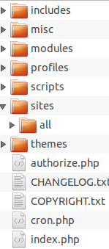
Upgrade in aegir
It works the other way round.
Platform D7.21
Platform D7.22

Slide 11
How it happens?
Go to off-line
Backup
Copy tarball to a new platform
  Unpack
  Create new db and import dump
  Run updatedb
Caches are cleared
apache vhost and site alias are updated to reflect the new path (new platform) and settings.php for new database credentials
site gets brought back out of maintenance mode.
Remove the old copy of the site from the previous platform (it wasn't touched til now)
Source: http://community.aegirproject.org/node/23

Slide 12
Aegir does more
Installs:
  Sets up database and connects drupal
  Creates vhost for apache
Updates
  Ensures update is safe and correct
Backs up (http://drupal.org/project/hosting_backup_queue)
Clones – makes a copy of a site

Slide 13
Benefits
Safe
Quick
Cost effective
  You do not need a developer or high level access to update sites
  You do not need admin access to the sites themselves
  Updating is quick
More security
  settings.php protected
  file permissions are set for you

Slide 14
Still not convinced?
How about a mass update?
Maybe 60 sites at once?
  … with one a 4 line script?
1. #!bin/bash
2.
3. while read site; do
4.
5. drush @$site provision-migrate @YourPlatformAlias
6. drush @hostmaster hosting-import @$site
7.
8. done < path/to/list/of/sites/one/domain/per/line.txt

Slide 15
Good practices
Use version control.
Use version control – really!
Test – it's easy (vagrant, aegir-up).
Update via code (Grzegorz Bartman's presentation)
  hook_update_N
  module_enable
  module_disable
  drupal_module_uninstall
Backup – it's so easy with Aegir
Act only as aegir user
Sufficient resources (2G RAM min)
Large files dirs should be symlinked

Slide 16
More
http://community.aegirproject.org/
drush help
http://drupal.org/project/aegir-up
http://www.vagrantup.com

Slide 17
Questions / Contact
Maciej.Lukianski@droptica.com
www.droptica.com

