Slide 1

Faster and easier solution
to Drupal e-commerce with
Commerce KICKSTART 2
and family

Slide 2


Commerce Guys is...
… the software company behind Drupal Commerce, the eCommerce solution that capitalizes on the virtues and power of Drupal, the premier open-source content management system. We focus our knowledge and expertise on providing online merchants with the powerful, responsive, innovative eCommerce solution they need to thrive.

Slide 3
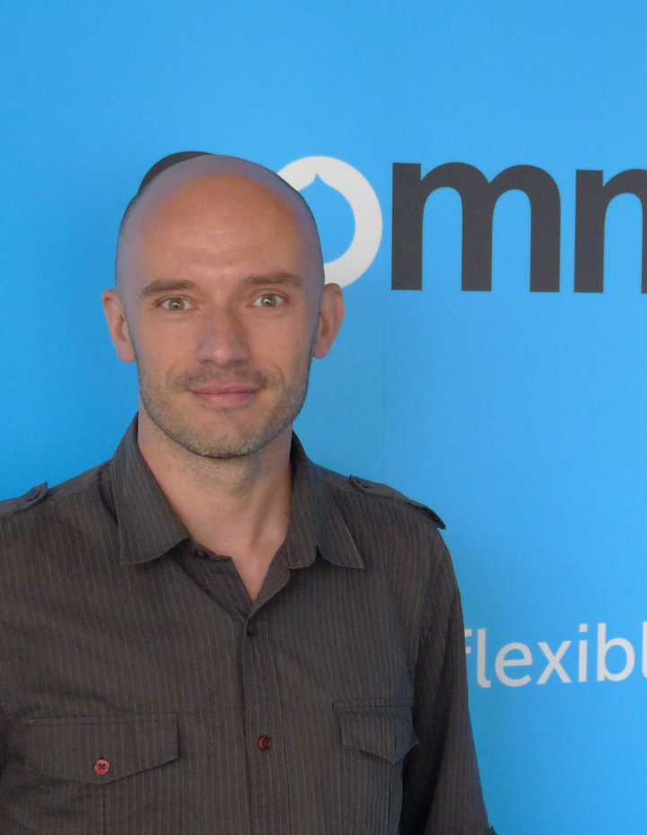
Commerce Guy is...
Maciej Zgadzaj
doing Drupal since 2007
coding for CG since 2012
@maciejzgadzaj
irc: mzgadzaj
http://linkedin.com/in/maciejzgadzaj
http://facebook.com/maciej.zgadzaj

Slide 4
We have a vision.
For Drupal Commerce to be
the number one open source eCommerce platform in the world.

Slide 5
How we talked about Drupal Commerce before:
optimized for developers:
flexible ecommerce framework built on top of Drupal 7
no hard-coded business logic thanks to Rules and Views
completely dependent on Drupal's fieldable entities
essential contributed modules maintained with core
distributions prepared to reach vertical markets
accessible experts and integrators

Slide 6
What about store administrators?
How will this software help me make money?
How can I see what's happening in my store?
Wait, what's this about products again?

Slide 7


Everything to drive your online business

Slide 8



Our Products
Pre-configured eCommerce software
built on Drupal Commerce
An app store for proven
Drupal Commerce enhancements
for Mobile
Cloud-based hosting,
optimized for Drupal Commerce
An iOS native mobile app

Slide 9
Commerce Kickstart 2
- shifts priority to end users:
targets store administrators and their user experience
complete eCommerce application out of the box
test ride: install it, play and decide
targets a market segment and optimizes for it
speaks the merchant's language
preconfigures not only the content, but the whole store

Slide 10
Yada yada yada...
Show me the juicy stuff!

Slide 11

I can haz questions?

