Slide 1
Part I Object-Oriented Programming (OOP)

Slide 2
Why Objects?
what problem gave rise to objects as a solution?

Slide 3
Basic Programming Model
Assembly Language
Fortran
Cobol
C
global data
read and write
code
code
code
Dave Parnas (Early pioneer of Software Engineer):
Came up with the concept of "Software Aging"

Slide 4
Object Model
Combine data and code into entities called objects
Distribute the data to where the code lives that reads and writes that data
Don't allow other objects to directly access the data owned by another object
local data
local data
local data
code
code
code
object1
object2
object3
BUT, what if object3 needs the data held by object1?
Provide functions (methods in OO speak) to allow other objects to access the data. These methods are called get and set methods.

Slide 5
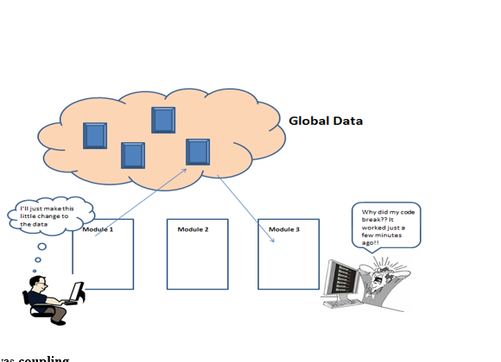

Slide 6

Evolution of Object Oriented Languages I
Simula - Introduced the Class concept – a template for creating objects that all had the same data and code. Used to build simulations
1967
Simula
OOP was introduced in the mid-1960s with Simula 67, a programming language designed to model and simulate Norwegian Oil Tankers traveling around the world.
Simula was created at Norwegian Computing Center in Oslo.
Simula introduced the notion of classes and instances as part of the OO programming paradigm.
This concept of Objects based on Classes led to a variety of OO languages...

Slide 7
Object Oriented Languages II
1978 - 1980
Smalltalk @ Xerox Parc
1979
C++ Bjarne Stroustrup
1983
Objective-C
1995
Java: Sun Microsystems
1995
JavaScript
Smalltalk – Xerox ran a research institute that gave us the mouse, graphic interfaces and an OO language. Steve Jobs' visit was inspiration for the Macintosh.
C++ added objects to the C language
Objective-C was the language for the new Mac
Java was THE OO language that could run on any platform due to the Java Virtual Machine
JavaScript – not designed as an OO language but the authors thought that if it had 'Java' in the name, it would be popular .. ha ha

Slide 8
The Big Three Concepts of OO
Encapsulation
Inheritance
Polymorphism

Slide 9
Encapsulation
An Object is an encapsulated package of data and code
An Object is data structure with associated code
Do other objects have direct access to the data of another object?
Class
Vehicle
-----------------------
position-x
position-y
speed
direction
-----------------------
getSpeed()
setSpeed(int)
...
In Java and C++ you declare object data as private or public. In Python it's all public.
Data
(called attributes or properties in oo-speak)
the methods of an object have access to the data of the object
Code (functions)
(called methods or in oo-speak)

Slide 10
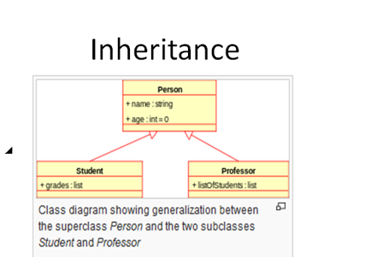
Inheritance
This feature was seen as the pathway to flexible code.
In practice, it often leads to very difficult to understand code. Beware! Use carefully

Slide 11
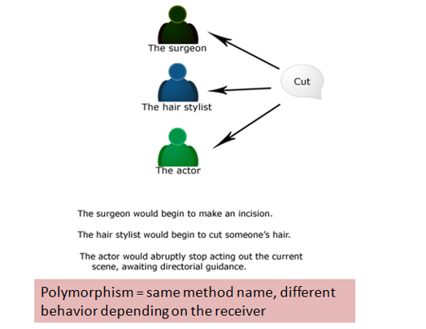
Polymorphism
Polymorphism is a fancy word that means when you tell an entity to do something, what gets done depends on the receiver of the message.
For example, in the real world, the command “cut” when given to different individuals has different effects.

Slide 12
Complexity of OO Encapsulation in Java and C++

Slide 13
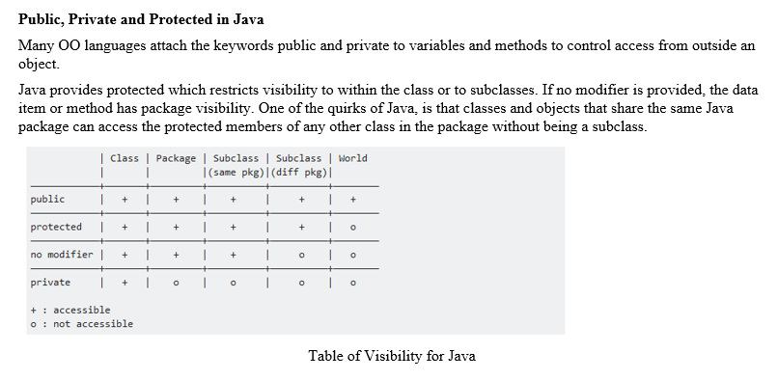

Java

Slide 14

C++
C++ also has public, private and protected.
However, C++ also has its own quirky behavior regarding violating encapsulation for private and protected members.
In C++, one may define a friend function of a class outside that class' scope but with the right to access all private and protected members of the class.

Slide 15

Python
Python has Objects and Classes BUT does NOT have public, private and protected syntax
Python is not a pure object-oriented language
Functions play a BIG role in Python programming
All data that is part of an object can be accessed by any other part of a program
Python provides guidelines for controlling access to data in objects but it is not enforced by the compiler

