Slide 1
Part II Object-Oriented Programming in Python

Slide 2
Python and Objects
Everything in Python is an object (under the hood)
Every datatype (dict, String,..) is based on a Class that is hidden
Let's look at what you already know how to do in Python, thru an object lens

Slide 3
All Python data types are objects
my_dict = {} # where's the object?
Python shorthand that constructs a dict object based on the Class dict
name of the object instance of the Class dict
dict
value: None
All the methods defined in the class
To execute an object's methods we use the dot notation.
my_dict.clear()
executes the clear method of the object my_dict
Notes:
go to jup – go to w3c list of methods

Slide 4
Defining Your Own Classes

Slide 5
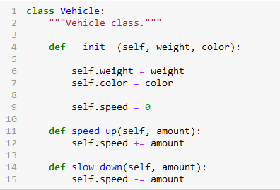
Vehicle Class in Python
constructor method used to initialize an object. All method definitions start with self – to distinguish them from regular functions
data (attributes) of our object defined with prefix self. Note that speed is by default set to 0
methods of our object defined with prefix self. Methods can modify attributes using prefix self.

Slide 6
Review Account Class from Deitel Textbook

Slide 7
Hacking Semi-Private Data

Slide 8
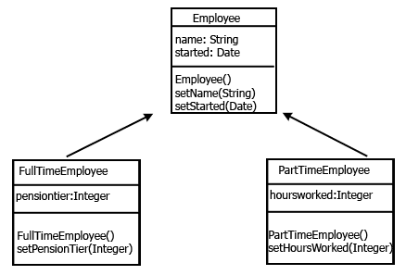
Inheritance
see: https://www.programiz.com/python-programming/inheritance
superclass
subclass
Inheritance allows to define is-a relationships between classes

Slide 9
Summary
The reason for OOP is to reduce the complexity of software
OOP provides
Encapsulation
Polymorphism
Inheritance
Key concepts:
defining classes – using keyword self
public and private data
overriding methods in a superclass

