Slide 1

Part IV Object Orientation Inheritance and Polymorphism (Deitel 10.7 & 10.8)

Slide 2
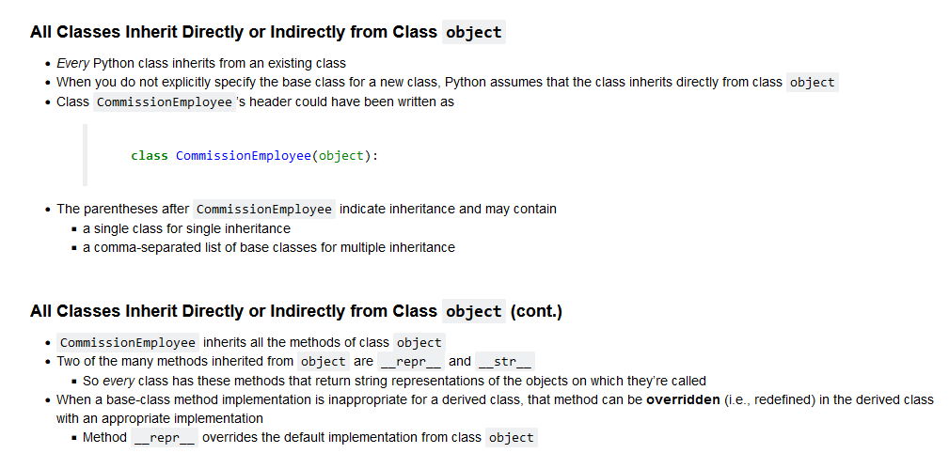
Inheritance

Slide 3
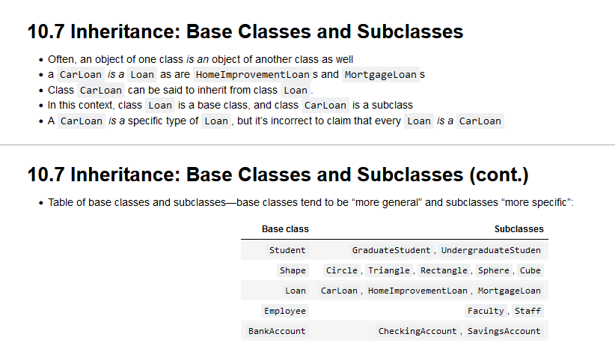
Base and SubClasses

Slide 4
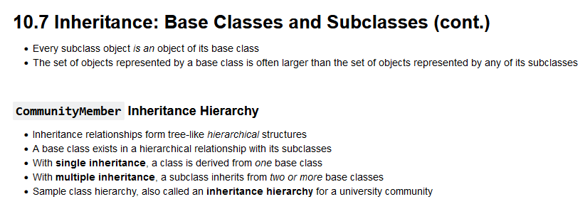
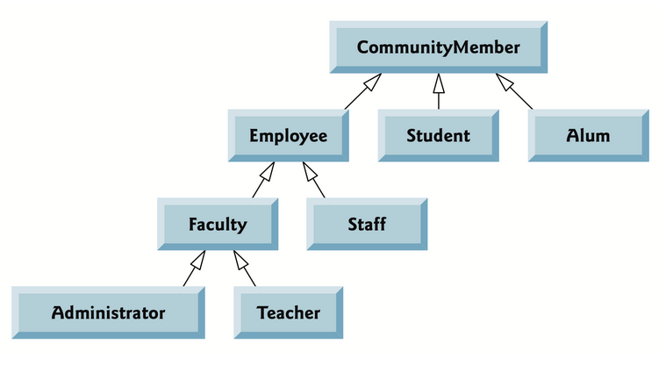
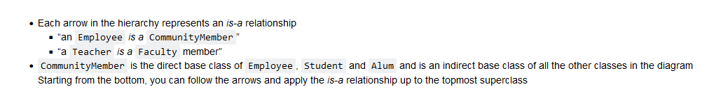

Slide 5
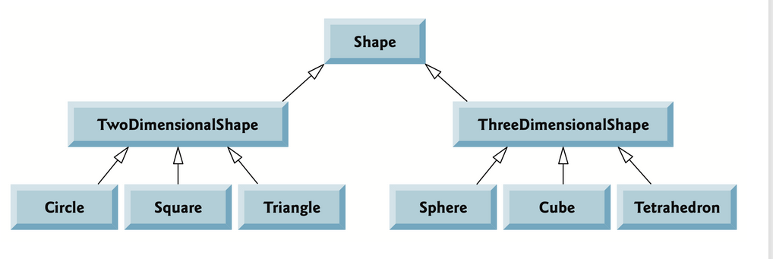
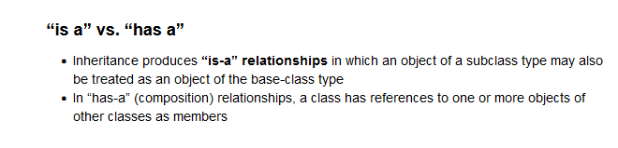
Shape Inheritance Hierarchy

Slide 6
Abstract Classes
An abstract class can be considered as a blueprint for other classes.
A class which contains one or more abstract methods is called an abstract class.
An abstract method is a method that has a declaration but does not have an implementation.
When we want to provide a common interface for different implementations of a component, we use an abstract class.

Slide 7
Why Abstract Classes
By defining an abstract base class, you can define a common Application Program Interface(API) for a set of subclasses.
This capability is especially useful in situations where a third-party is going to provide implementations, such as with plugins
Allows you to easily add subclasses to your app

Slide 8
Python and Abstract Classes
By default, Python does not provide abstract classes.
Python comes with a module that provides the base for defining Abstract Base classes(ABC) and that module name is ABC.
ABC works by decorating methods of the base class as abstract and then registering concrete classes as implementations of the abstract base.
A method becomes abstract when decorated with the keyword @abstractmethod.

Slide 9
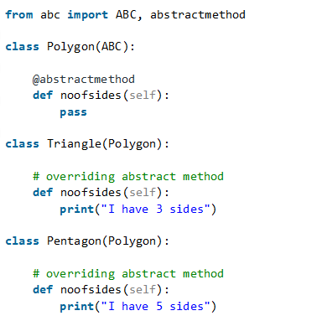
Example Abstract Methods

Slide 10
UML The Unified Modeling Language A way to graphically specify your object-oriented design

Slide 11
UML Class Diagram
Shape
-x : int
-y : int
+color : string
+set_color(c)
+set_x (x)
+set_y (y)
+get_area()
Class name (italics means abstract)
Attributes : + means public; - means private
for Python: private means @property
methods: (italics means abstract)

Slide 12
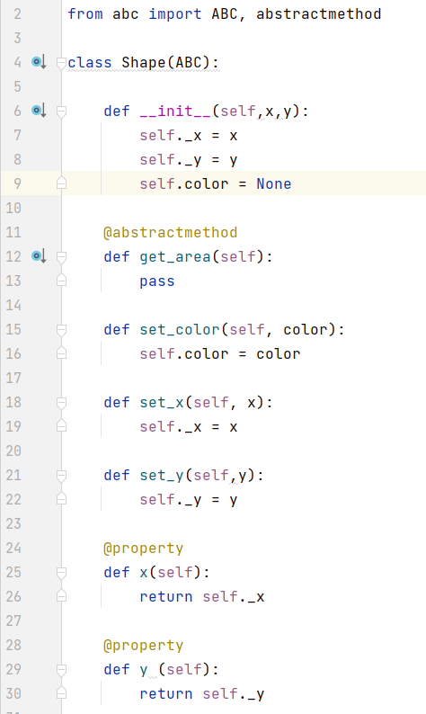
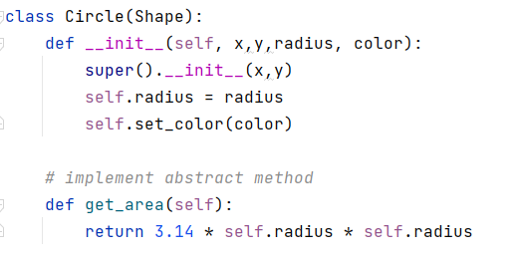
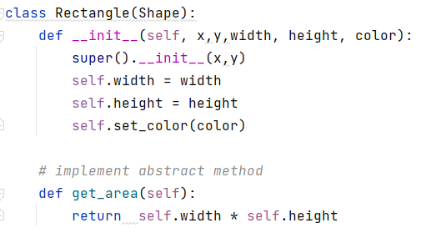
Shape
-x : int
-y : int
+color : string
+set_color(c)
+set_x (x)
+set_y (y)
+get_area()

Slide 13
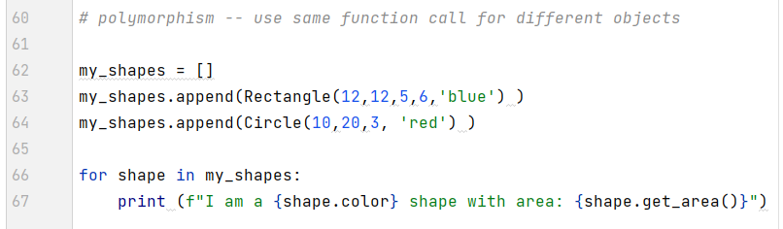

Polymorphism

Slide 14
Summary
Inheritance is an OO technique for reusing code and data from base classes (also called super classes)
Polymorphism is when the same method name has different behavior
Abstract classes define an API for application subclasses
Abstract classes are NOT meant to have object instances
UML is used to graphically describe objects and classes
minus (-) means private (in Python think: @property)
plus (+) means public

