Slide 1
M.Sc Thesis proposal
Reducing Project Duration : Investigating whether Digital Twin can make impact to uninterrupted workflow thus reducing project duration on a large scale Building Construction jobsite.

Slide 2
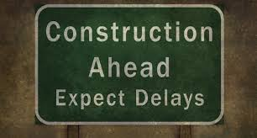
The Problem: Delays in Construction Industry Projects.
In the United Kingdom, the IHS Markit/Chartered Institute of Purchasing and Supply Purchasing Managers carried out survey of 170 construction companies that found time performance is one of the most crucial factors when working on a project for the contractor company working on it. It is every contractor’s (as well as customer’s) aim that work is completed in time. However, a good number of projects experience time overruns.
The survey found top four reasons for the delays:
1 . Poor original planning/unrealistic scheduling
2. Lack or delay in information about the project
3. Changes to the initial specifications
4. Resource availability
From the above it can be summarised that poor project planning, information and resource availability are the major cause of production delays. The author’s intention is to search for automated technological solution for uninterrupted information and material flow to UK Building construction job site.

Slide 3
Rationale
The subject of this proposal raised from my personal involvement in the residential and commercial- development in the UK building industry in developer-contractor environment. Project teams facing ever increasing pressure to deliver projects as efficiently as possible with minimum waste. To meet these demands, teams are faced with the need to explore various construction strategies and using new technologies in order to meet delivery demands.
Production processes can be conceived in at least three different ways: 1) as a process of converting inputs to outputs, 2) as a flow of materials and information through time and space, and 3) as a process for generating value for customers. All three conceptions are appropriate and necessary. Information that coordinates the flow of labour and equipment, material deliveries, and completion of prerequisite work impact workflow predictability. When there is predictable workflow, project runs more smoothly and efficiently. Improving reliability is beneficial to project performance.
ISO characterizes ‘Digital Twin is a digital model of a particular physical element or process that enable convergence at appropriate rate of synchronization’. Live data receive through sensors and IoT from a construction site to a Digital model and subsequent synchronization may predict labour and equipment requirements, logistic simulation and prerequisite of works that may help to ensure uninterrupted workflow which improves productivity.
The aim of this research is to investigate what impact Digital Twin may make to enhance information and material flow thus improving workflow reliability resulting reduced project duration on a large scale Building Construction jobsite.

Slide 4
Research Question
Reducing Project Duration : Investigating whether Digital Twin can make impact to uninterrupted workflow thus reducing project duration on a large scale Building Construction jobsite.

Slide 5
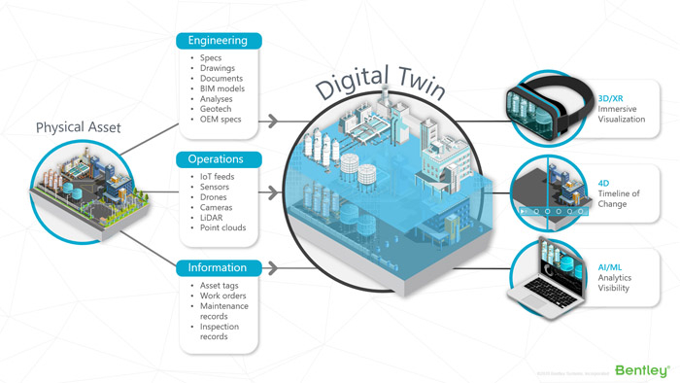
Sub Questions
Investigating whether Digital Twin can make impact in order to enhance information flow to construction jobsite?
Investigating whether Digital Twin can make impact in order to enhance material flow to construction jobsite?

Slide 6
Hypothesis
Construction benefits from greater reliability in the flow of information and materials to the construction site. Digital Twin may ensure uninterrupted workflow which improves productivity on construction jobsite.

Slide 7
Contribution to knowledge
1. Process map to implement Digital Twin on a building construction Job site
2. A time line to implement Digital Twin on a building construction job site.

Slide 8
Method
Stage 1:
A comprehensive review of relevant literature including computer assisted search will be undertaken in order to develop an understanding of previous work in the field of work flow reliability for construction building site and Digital Twin’s impact to reduce project duration.
Stage 2: Exploratory surveys.
The Exploration will be achieved through surveys.
Stage 3: Case studies. : The author will then use his own organisation as a case to study to investigate how Digital Twin effects workflow reliability
Stage 4: Evaluation of the findings.
This stage will bring together and review the information collected in the previous stages.
Stage 5: Writing Up
This stage involve writing up the content of the thesis and should cover the chapters proposed in the following section.

Slide 9
Proposed Contents of Thesis
Chapter 1- Introduction
Chapter 2- Literature review
Chapter 3-Method
Chapter 4- Data collection
Chapter 5- Result and analysis
Chapter 6- Conclusion

Slide 10
Beneficiary
The construction industry. Construction projects benefit from greater reliability in the flow to the construction site of information and materials. Real time feedback from the virtual copy of the physical construction site may improve predictability, construction projects over time would have uninterrupted workflow thus reducing project duration.
.

Slide 11
The Time Line
June 2020 – Literature review
July 2020- Methods creation and Data Collection
Aug 2020- Data Analysis
Sep 2020-Write up thesis
Oct 2020-Enhancing write up and Publication
Oct 2020-Submission.

Slide 12
THE END.

