Slide 1

America Mobilizes for war chapter 19 section 2
The Role of Propaganda in the War Effort

Slide 2
USHC-5.4
Analyze the causes and consequences of United States involvement in World War I, including the failure of neutrality and the reasons for the declaration of war, the role of propaganda in creating a unified war effort, the limitation of individual liberties, and Woodrow Wilson’s leadership in the Treaty of Versailles and the creation of the League of Nations.

Slide 3
What we want to accomplish today
Analyze propaganda posters from World War I
  Get better understanding of how propaganda works
  Explore the ways in which the home front mobilized for the war effort

Slide 4
The Posters
Go to the PowerPoint
In the materials folder for chapter 19
The PowerPoint is titled “America Mobilizes for War
The number for the slide you have been assigned

Slide 5
The Questions
What cause is the poster designed to promote or publicize?
What is the poster trying to get you to do?
Explain imagery used on the poster.
Explain any text.
Describe the ways in which the poster is biased or misleading.

Slide 6
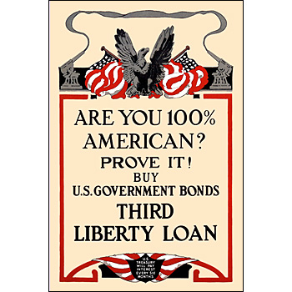
What cause is the poster designed to promote or publicize?
  Raise money for the war effort
What is the poster trying to get you to do?
  Buy war bonds - The main way that the government raised money for the war
Explain imagery used on the poster.
  Eagle, flags, smoking guns
Explain any text.
  Are you 100% American? Prove it!
Describe the ways in which the poster is biased or misleading
  Suggests that some people might be disloyal – targets those people of foreign born ancestry
  Loyalty doesn’t depend on buying war bonds
  Super patriotic

Slide 7
What cause is the poster designed to promote or publicize?
What is the poster trying to get you to do?
Explain imagery used on the poster.
Explain any text.
Describe the ways in which the poster is biased or misleading

Slide 8
Building an army

Slide 9
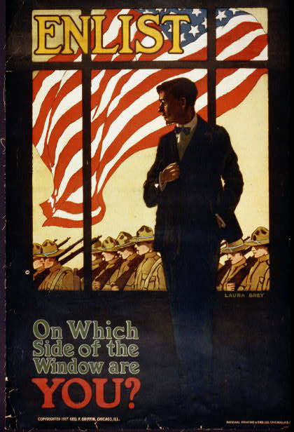
# 1

Slide 10
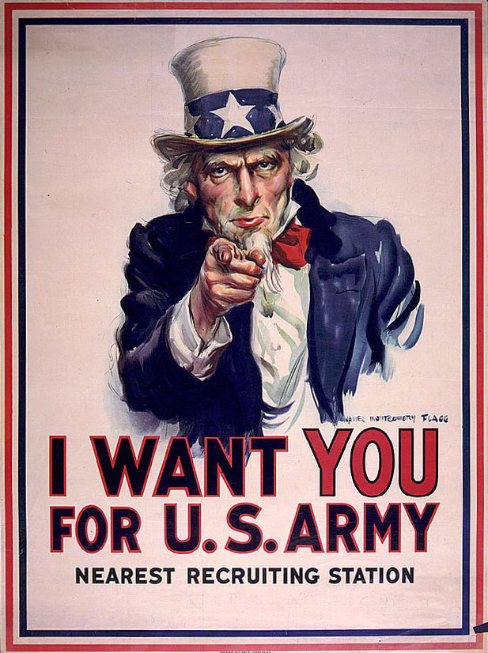
# 2

Slide 11

# 3

Slide 12

# 4

Slide 13
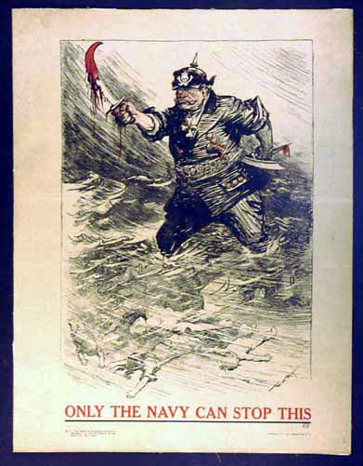
# 5

Slide 14
Constructing a war economy

Slide 15

# 6

Slide 16

# 7

Slide 17
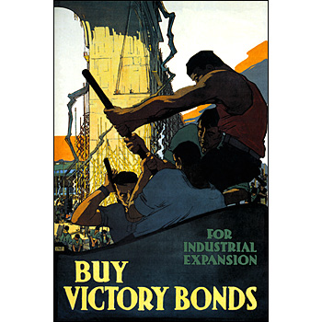
# 8

Slide 18
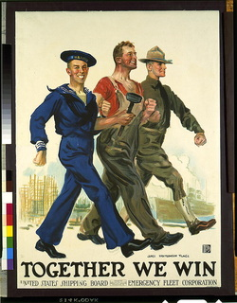
# 9

Slide 19
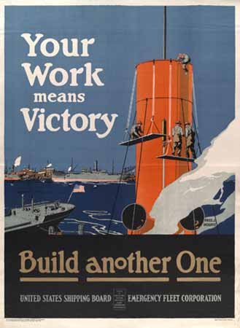
# 10

Slide 20
Shaping public opinion

Slide 21
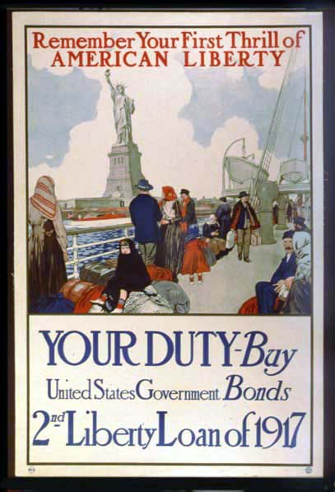
# 11

Slide 22
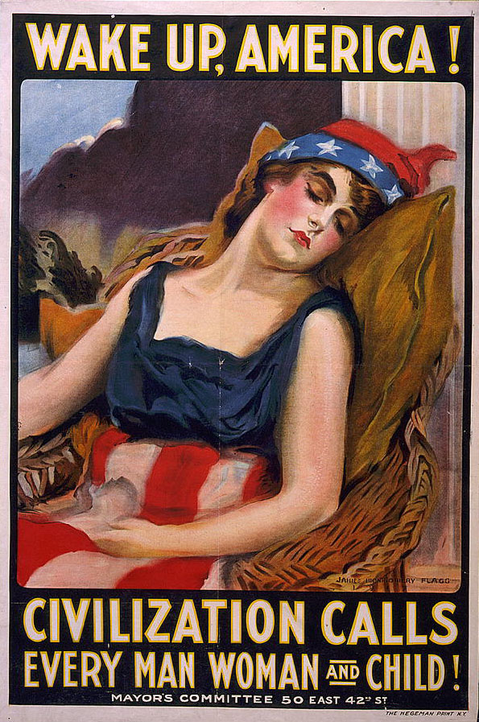
# 12

Slide 23
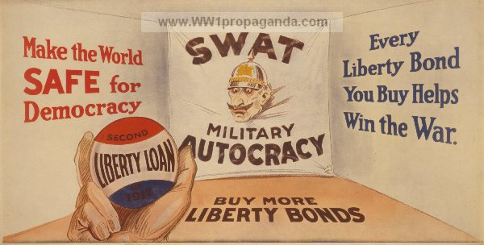
# 13

Slide 24

# 14

Slide 25
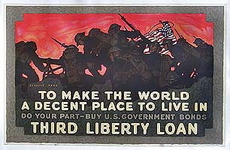
#15

