Slide 1

Modelling tomorrow’s energy
by team quAIntly, datathon 2025 ETH

Slide 2
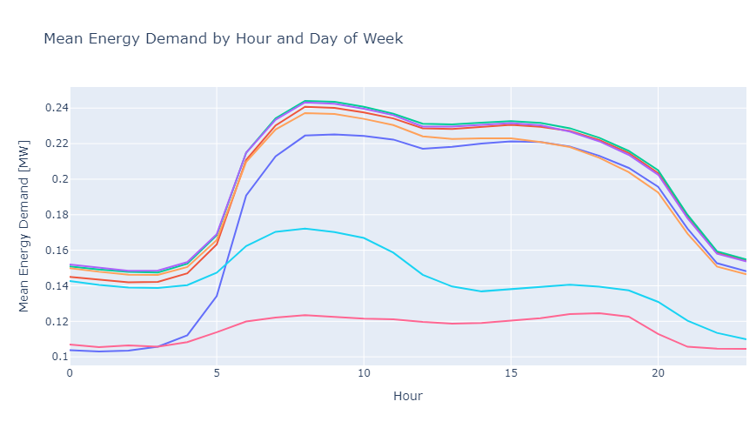
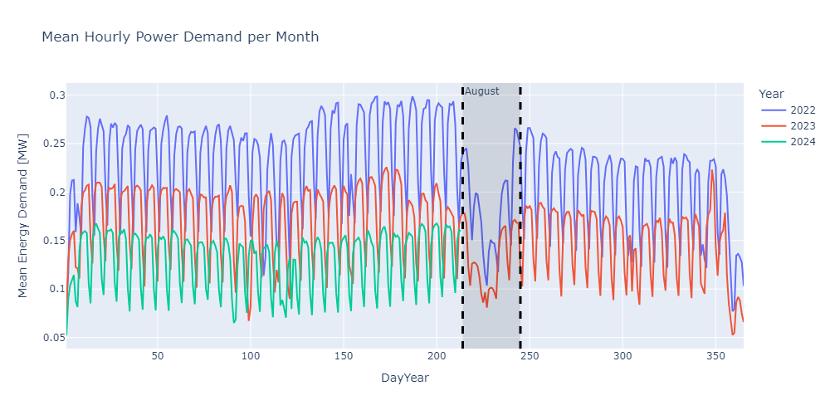
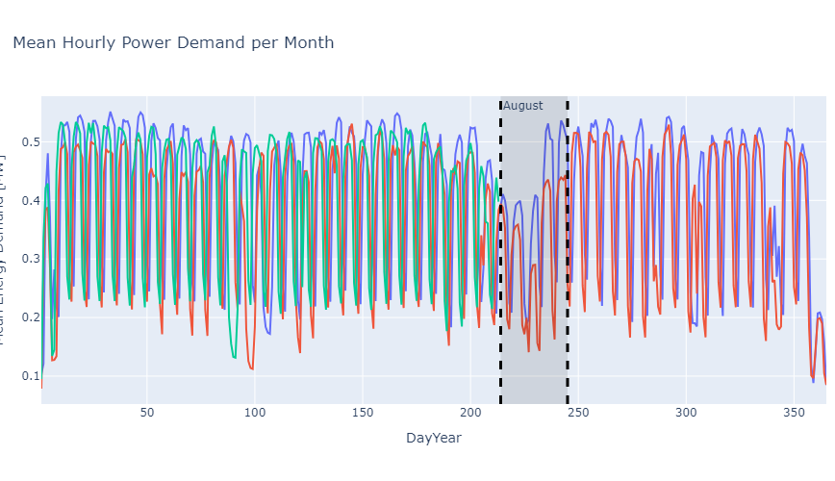
Understand customers needs
Daily behaviour: active between 5am and 8pm, lower on the weekend
Monthly behaviour: a major dip consumption in August

Slide 3
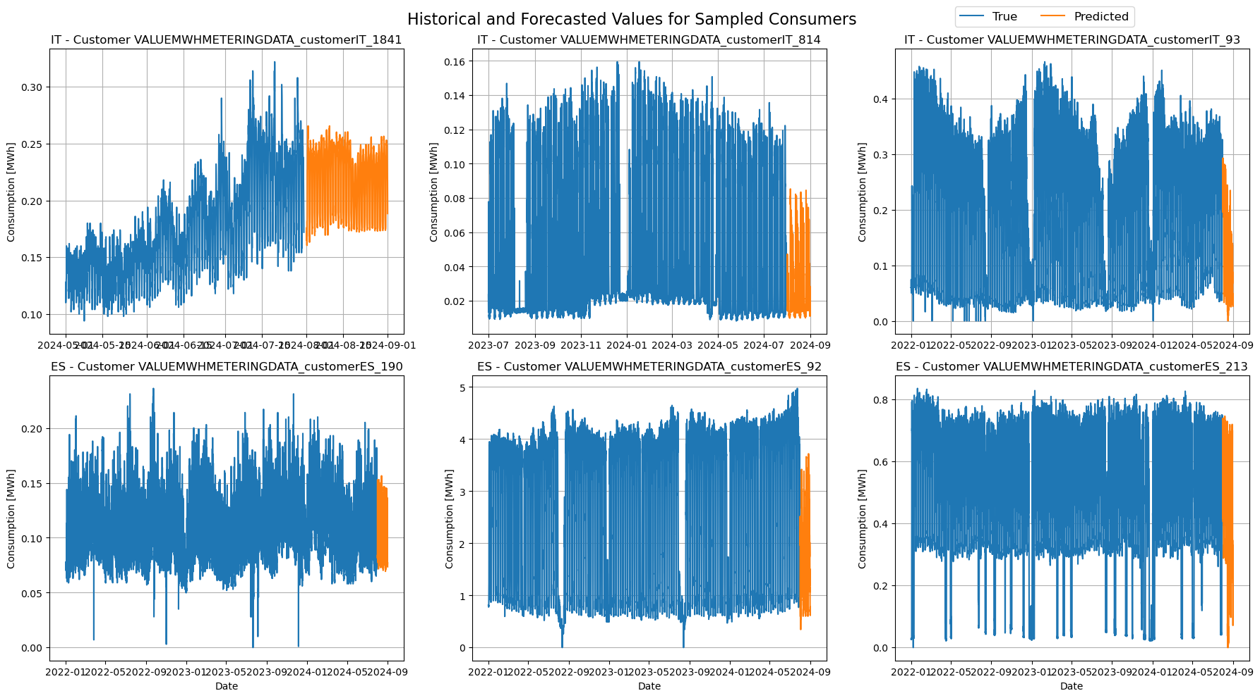
Crafting the gold of today
Data imputation: replicate behaviour for training set using a General LightGBM model
Selection of features: avoid redundancy

Slide 4
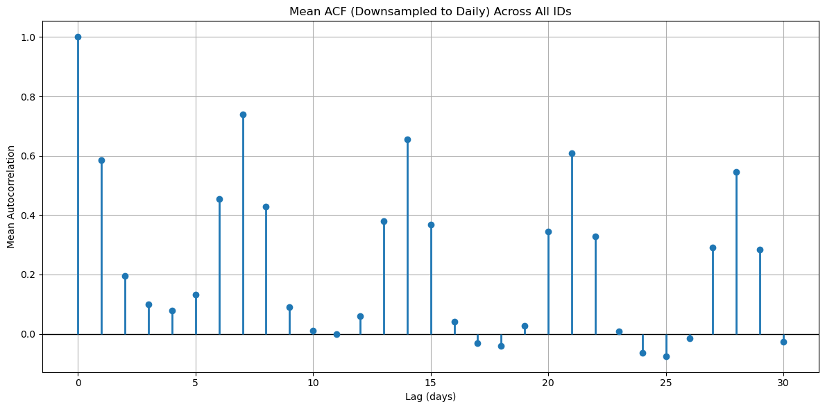
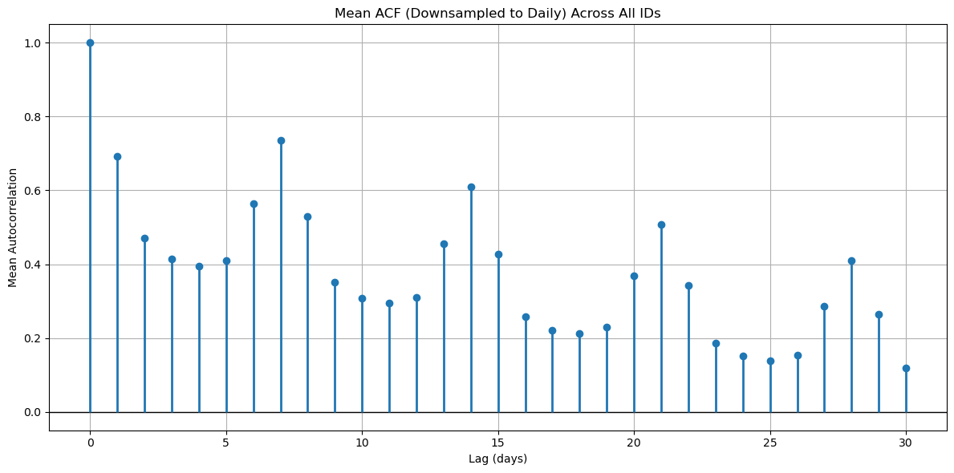
Seasonal and Cyclic Behaviours

Slide 5
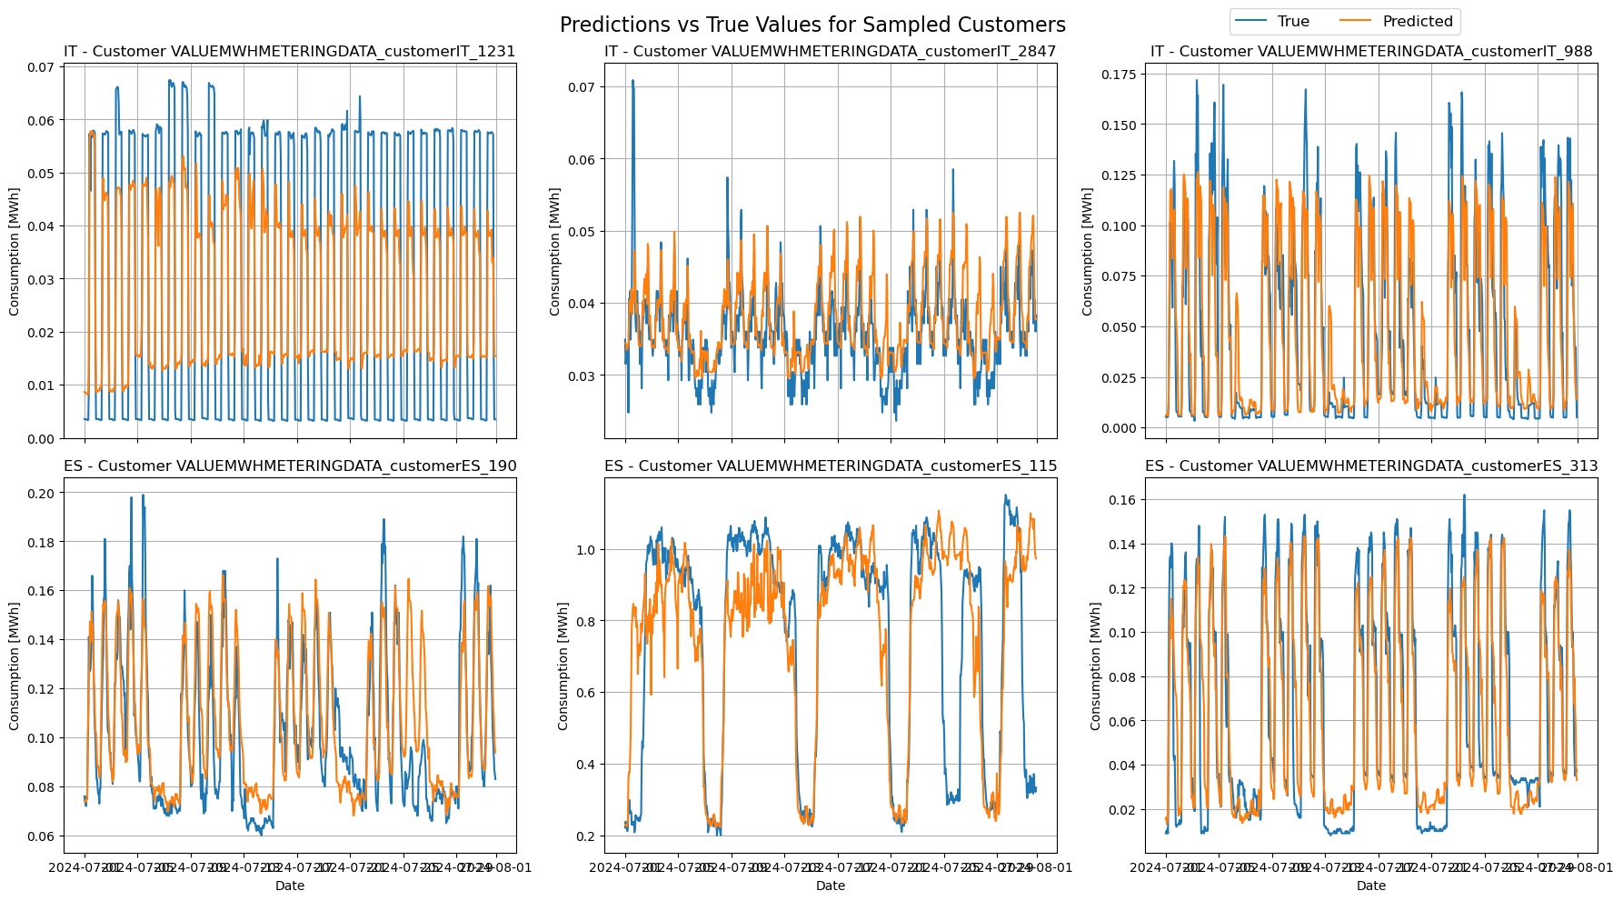
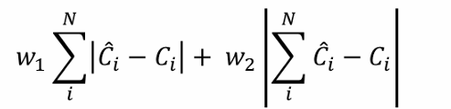
Models and validation
Baseline: ~320’000
Best model (LightGBM consumer level) : ~230’000
Reminder score:

Slide 6
Thank you ACE and Alpiq for this event!

