Slide 1

Halo 5: Guardians Improving Engagement and Retention Through Data Visualization and Machine Learning
Johnny Dryman

Slide 2
Goals
Propose strategies to improve player engagement through creative metrics and data visualization
What metrics can we calculate that demonstrate performance or improvement?
How can we show this to players in a way that’s easy to understand?
Evaluate matchmaking quality using machine learning models
Can we predict the victor of a match using in-house data?
If so, should we adjust matchmaking algorithms to bring players closer to 50/50 odds for each match?

Slide 3
Data
All data sourced from Halo Public API (Beta)
Visuals pulled from gamertag ‘Drymander’
Machine learning data pulled from ~850 gamertags
Features available in Appendix

Slide 4
APIs Used
Player Match History
Match ID’s and dates
Match Result – Arena
Player scores, gamertags, map, game type, playlist, and win / lose / tie information
Player Service Records – Arena
Historical aggregates of detailed player stats and actions per game type
Metadata
Necessary for decoding map name, game type, and playlist

Slide 5
Visualizations to Improve Engagement & Retention

Slide 6
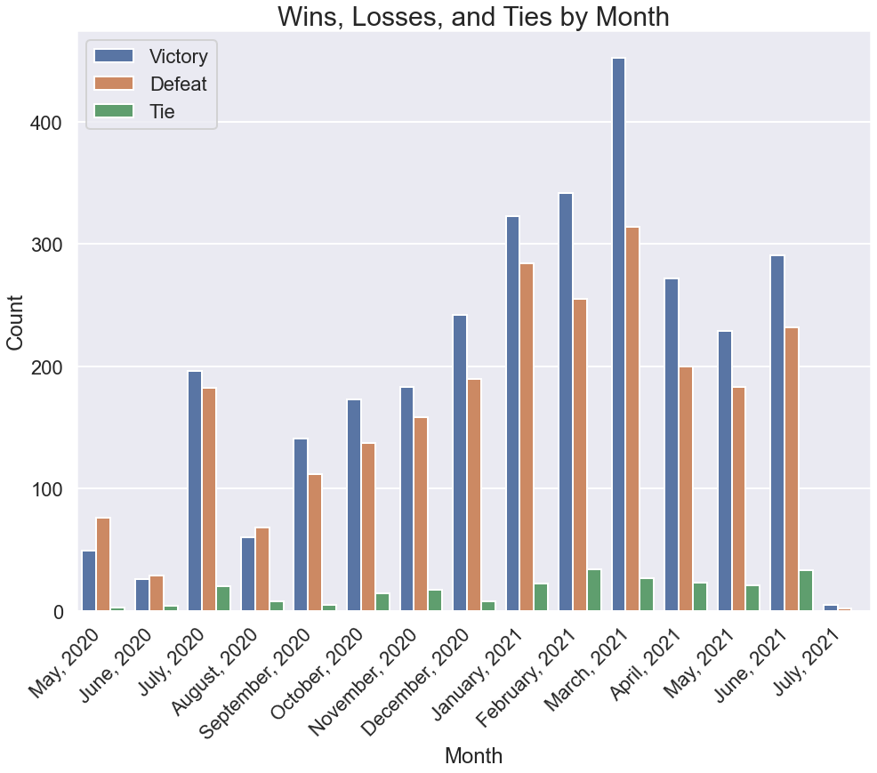
Wins, Losses, and Ties by Month
Display monthly win breakdown
Offer unique armor or achievement if first 50 games of the month beat a certain ratio
Example
May 2020 had low win rate
Steadily improved through September
Knowing improvement would have been encouraging

Slide 7
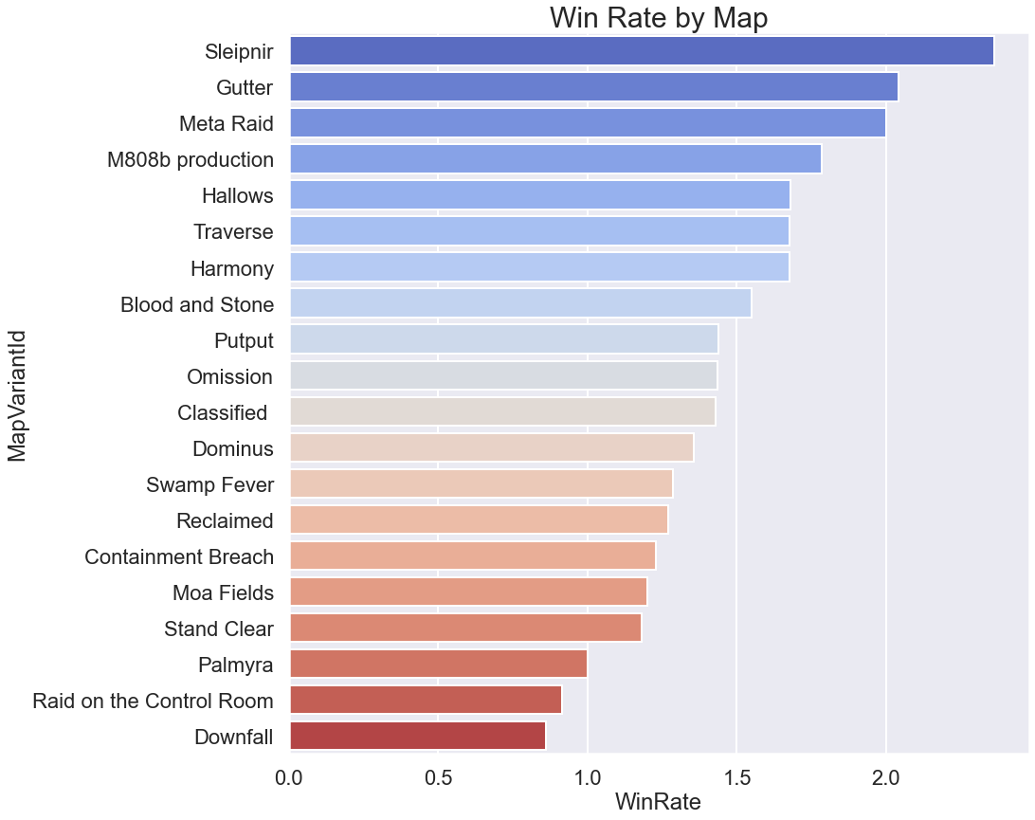
Win Rate by Map
Having a better understanding of map win rate reveals insight on strengths and weaknesses
Offer training scenarios for players on their weaker maps

Slide 8
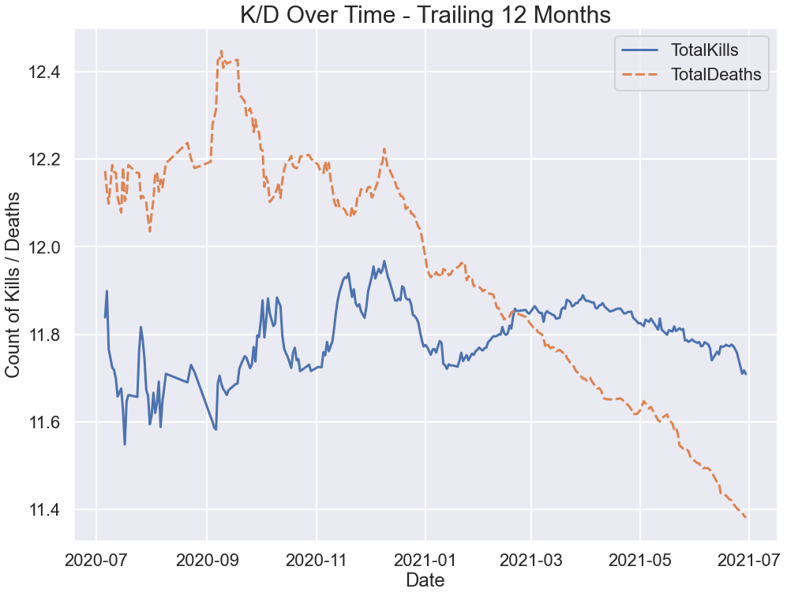
K/D Improvement Over Time
After match, tell player whether they beat their average kill / death spread
Give players sense of improvement even in the event of a loss or being the worst player on their team
Example
K/D ratio was below 1 until January 2021, but had slowly been increasing
Knowing it had been increasing would have been encouraging and rewarding

Slide 9
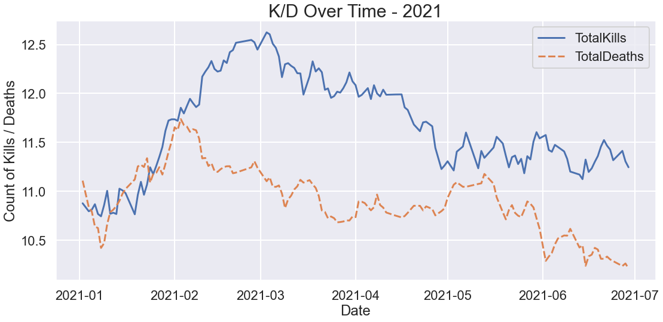
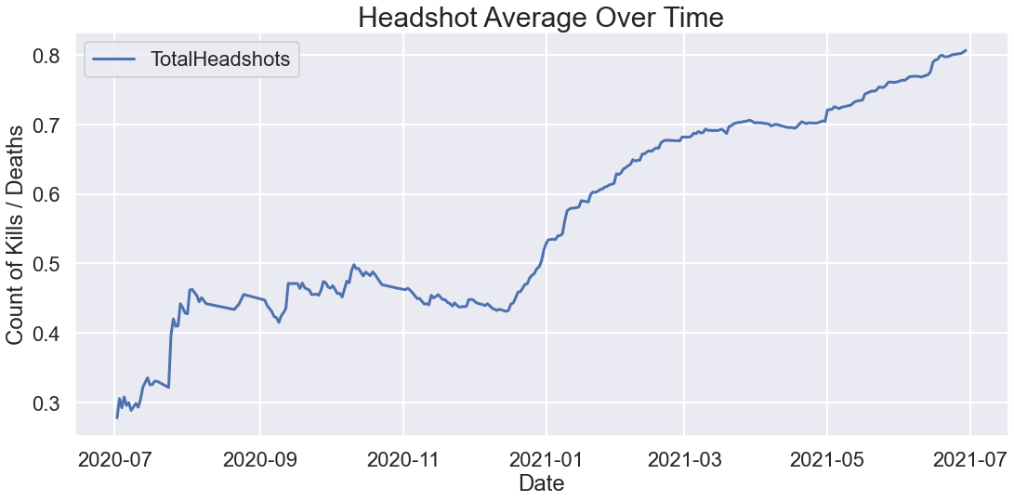
Controller Configuration Diagnostics
If a player wants to improve, make suggestions on best aiming sensitivity and controller configuration
KD Over Time – 2021
February: switched to paddle controls
May: paddle controller broke
Headshot Average Over Time
December: discovered headshots were not as difficult as previously believed
March – April: plateau
May: plateau broken thanks to sensitivity adjustment

Slide 10
Matchmaking Quality Evaluation Using Machine Learning

Slide 11
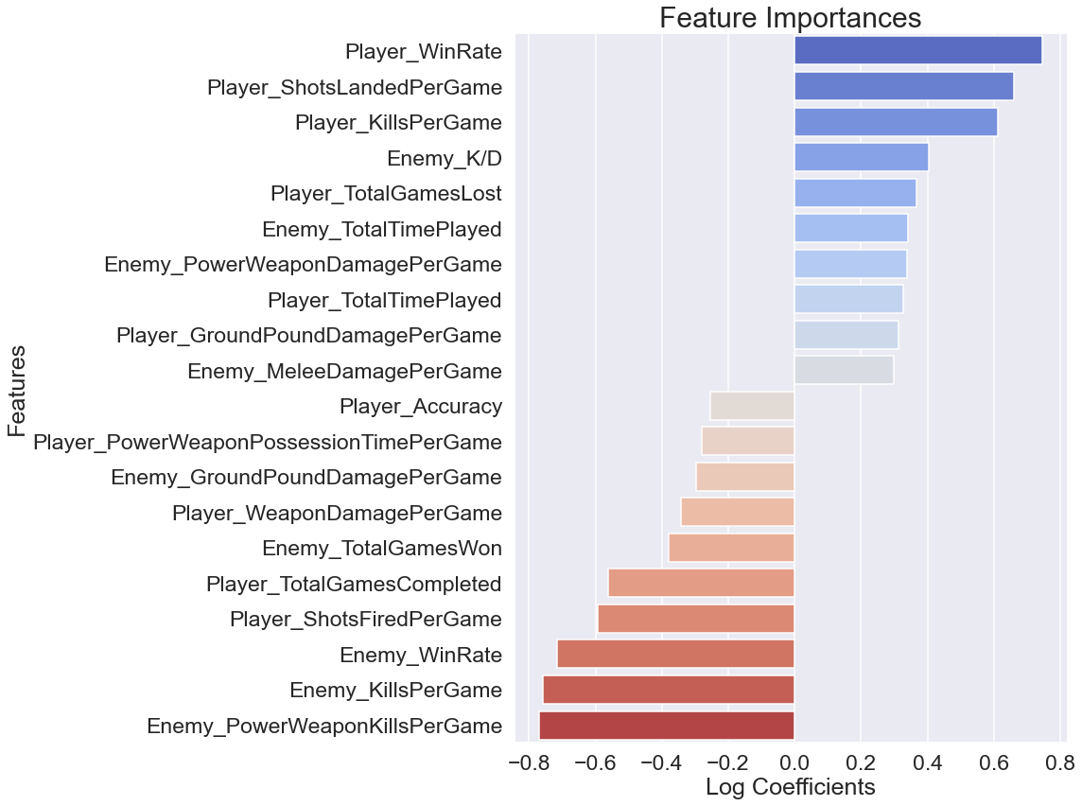
Best Model: Logistic Regression with Condensed Features
Test Accuracy: 72.73%
Many models were tested, many returned similar accuracy numbers but weighed features importances differently
Player_WinRate tends to dominate feature importances
Is 72.73% too high of a predictive quality before a match has even begun?
Can we implement efficient machine learning models that only match players in scenarios closer to 50/50?

Slide 12
Conclusions & Recommendations
Using in-house data to display visuals demonstrating player growth and improvement can be rewarding and instructive
Other ideas for graphs include:
2D / 3D heatmaps of action in each match
One-dimensional bar depicting timeline of which team was winning throughout the match
Use improvement metrics to encourage players to keep playing and as a basis for exclusive rewards
Certain game modes can be predicted using only gamertags and team assignments with up to 72.73% accuracy
Is this too high?
Can we use simple metrics like Player_WinRate to create matches that are consistently fair?
Experiment with implementing machine learning models in matchmaking algorithms to ensure 50/50 skill split between teams

Slide 13
Next Steps
Develop more creative data visualizations
Open conversation with online community
Source match data from players who play core competitive modes
Models will have different predictive quality based on game type

Slide 14
Thank you for your time!
Please feel free to ask any questions

Slide 15
Appendix

Slide 16
Features Used in Machine Learning Models
Win Rate
K/D
Accuracy
Total Games Completed
Total Games Won
Total Games Lost
Previous Total XP
Spartan Rank
Total Time Played
Kills Per Game
Headshots Per Game
Weapon Damage Per Game
Shots Fired Per Game
Shots Landed Per Game
Melee Kills Per Game
Melee Damage Per Game
Assassinations Per Game
Ground Pound Kills Per Game
Ground Pound Damage Per Game
Shoulder Bash Kills Per Game
Shoulder Bash Damage Per Game
Grenade Damage Per Game
Power Weapon Kills Per Game
Power Weapon Damage Per Game
Power Weapon Grabs Per Game
Power Weapon Possession Time Per Game
Deaths Per Game
Assists Per Game
Grenade Kills Per Game

