Slide 1
Presentation Title
Free PowerPoint Templates - prezentr.com

Slide 3
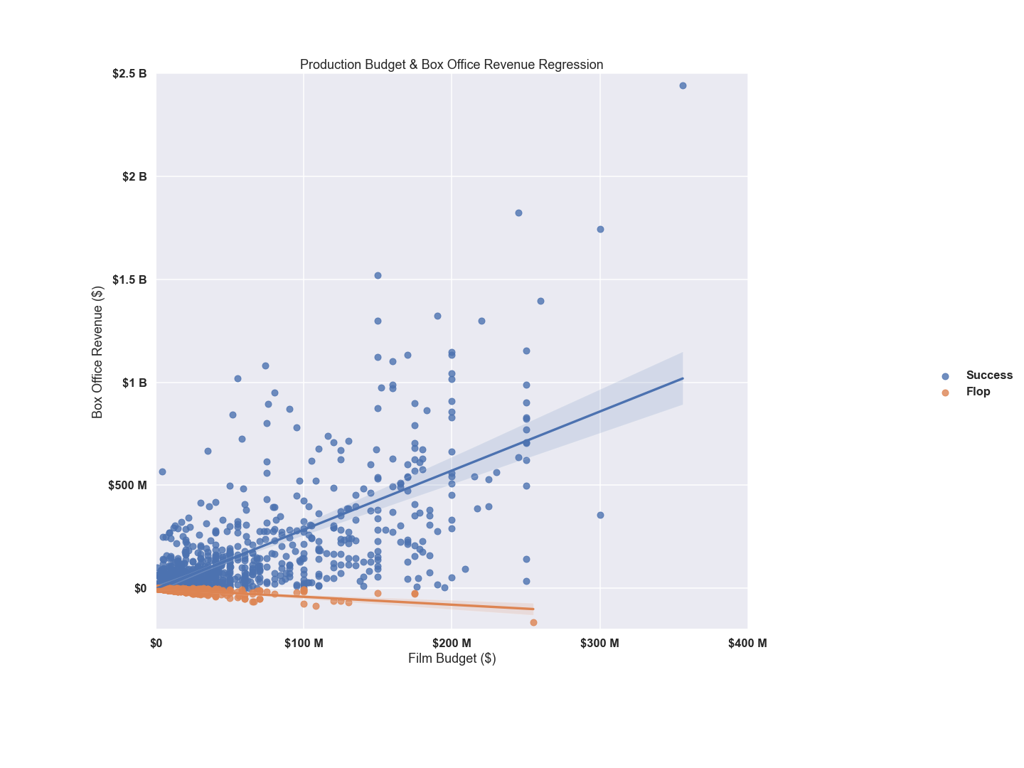

Slide 4
