Slide 1
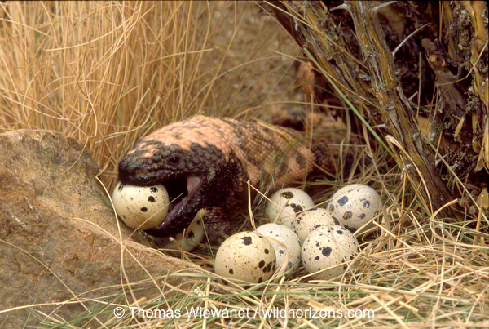
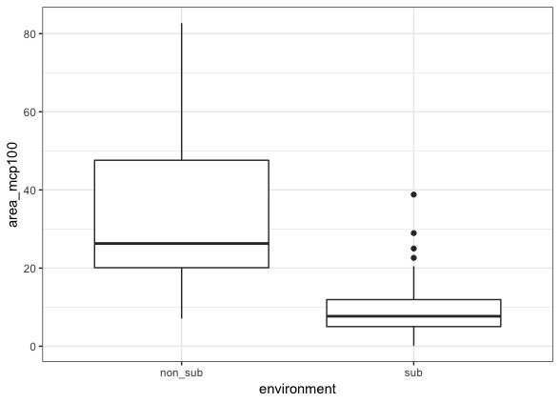
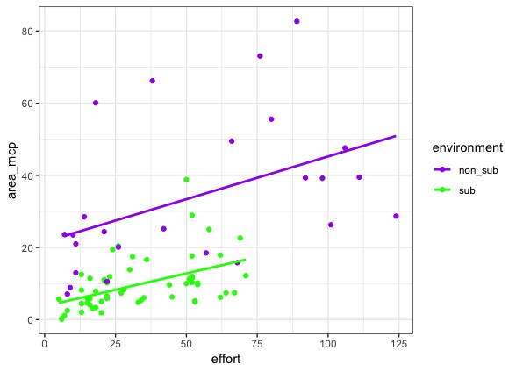
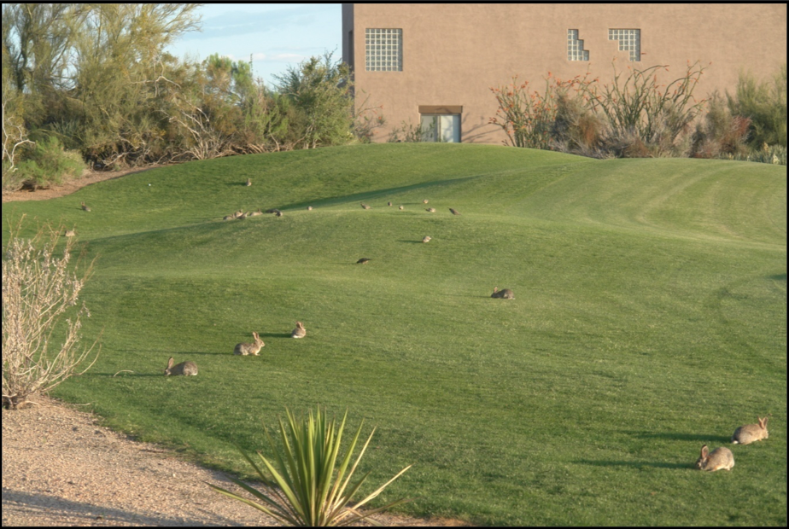
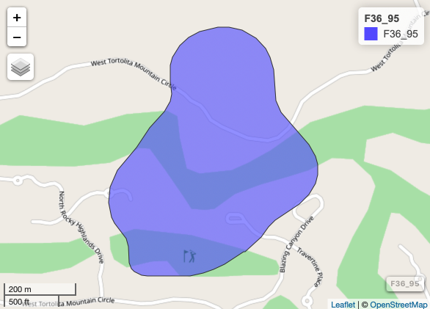
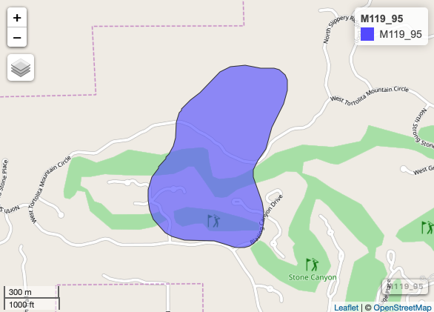
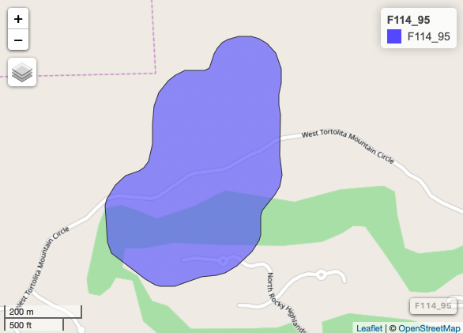
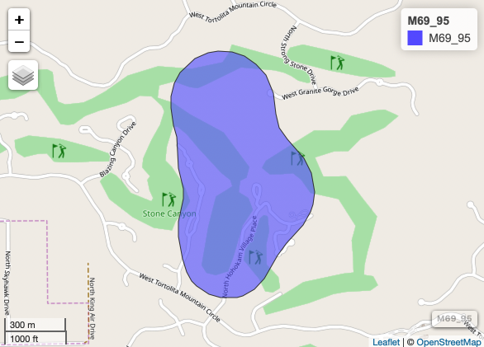
Spatial Ecology of Gila Monsters in a Subsidized Environment
Matt Pierson*, C. M. Gienger and Matt Goode
Department of Biology and Center of Excellence for Field Biology
Austin Peay State University, Clarksville, TN
Introduction
Animal movements are often defined using the home range concept as defined by William Burt in 1943. Consequently, home ranges are determined by temporal, spatial, and individual-level processes. One of the foundational questions in ecological studies is how an animal’s spatial distribution is determined by their environment and inter/intraspecific interactions within that environment. One of the key factors influencing an animal’s range and how it uses the environment is that of resources. Alterations to the environment that affect resource distribution and availability can have profound consequences on an animal’s spatial patterns. One of the best examples of this is that of golf courses. Historically, human-induced alterations to environments have been thought of as having negative consequences on local wildlife populations. This is due to the fact that alterations to the environment can change the landscape structure which in turn can cause shifts in resource availability. Some environmental modifications exhibited by some human altered environments can have positive effects on certain wildlife species by altering their movement patterns and foraging efforts.
Results
There is a significant difference in home range size among subsidized and non-subsidized populations (F=38.79, d.f.=76, p=0.004).
Year did not seem to have an impact on home range size (F=.153, p=0.696).
Sample size has a significant effect on home range size (F=24.47, p=<0.001).
a.
b.
Figure 1 | a. Boxplot showing the variation of home ranges sizes among the non-subsidized and subsidized population of Gila Monsters. b. Plot of home range sizes among the non-subsidized and subsidized populations with the effect of sampling effort.
Discussion
Our results show that the home range distribution of Gila Monsters is influenced by subsidies of the environment in which they inhabit. Gila Monsters are considered “widely foraging” animals due the their predatory preferences on the nesting young of vertebrates such as cottontail rabbits, and the eggs of quail and doves. Some human altered environments such as those of golf courses provide an increase in subsidies such as an increase in precipitation (artificial) that results in an increase in primary productivity further increases vertebrate species that feed on the primary productivity, ultimately creating prey rich environment for Gila Monsters without the need to forage as widely as those of natural unsubsidized populations. This is one example of how human altered environments can benefit certain species especially those species of concern while simultaneously providing recreational activities for people.
Methods
Study Populations:
Subsidized population located at the ~ 238 hectare Stone Canyon Club, Oro Valley, Tucson, AZ. This location serves as the “subsidized” population. 20 Gila Monsters (Heloderma suspectum) were tracked using radiotelemetry from 2007-2013.
Un-subsidized population at Owl Head Buttes, located in Pinal County, Arizona. An area of approximately 1,422 hectares located approximately 17 kilometers northwest of Tucson, Arizona. Sourced from radiotelemetry data that was collected from 2000-2002.
Home Range Analyses:
Minimum Convex Polygon
Kernel Density Estimation (KDE).
All mapping, spatial analyses and statistics were used using the open source statistical program R, version 1.1.463.
Statistical Analyses:
Multiple Regression
Repeated Measures ANOVA
25.21 ha.
49.61 ha.
19.58 ha.
60.09 ha.
Figure 2 | Home range map of two male and two females lizards at the Stone Canyon Golf Club. These home ranges were plotted using 95% kernel density estimation. F36 (female) overlaps with M119 (male), and F114 (female) overlaps with M69 (male). These were mapped to show the overlap of greens, among lizards and the contrast of male versus female home ranges.

