Slide 1
FINAL PROJECT INFO
2 Progress Interviews (10% each = 20% + 20% Final Presentation)
If you are a team of 2, both students must be present during the interview. If you have an emergency, that’s of course debatable.

Slide 2
ROADMAP
We can meet at practice hours (wednesdays) to talk about your final projects!
1st June 2022 - Progress Interviews #1
8th June 2022 - Progress Interviews #1/#2
15th June 2022 - Progress Interviews #2
22th June FINAL PRESENTATIONS (Awating approval…)

Slide 3
PROGRESS MEETINGS
As a team, come to the progress meetings during lab hours (Wednesdays) on your secion time.
Bring your laptop at the current state. (If you don’t have a laptop just upload the project files to the lab computer and make sure it’s running without a problem before the meeting starts.)
Make sure everything on Hack’n Plan is up to date and reflects the current state of the game.
I’ll check your Hack’n Plan.
Then you will demonstrate your progress on your laptop face-to-face. I’ll compare it with Hack’n Plan.
You will get graded based on your development progress.
Of course, we’ll talk, add new features and tasks to your current game. Development is a fully-dynamic process!
Good luck!

Slide 4
FINAL PROJECT REQUIREMENTS
Your game must have a main menu.
It should be available to be played from start to finish: No missing mechanics or features!
No game-breaking bugs!
Any player should be able to play it with the instructions displayed in the game. So any simple tutorial levels or visual representations are very welcome! (For instance, you can display inputs on the walls, screen ..etc)
You don’t need to add a lot of levels but enough levels to show your mechanics are working!
You are free to use store assets or your own ones! Implementation of mechanics based on your submission documents and presenting a reasonable gameplay with map elements are taken into account while grading.
It would be very time-saving to implement some cheat keys to showcase your game. Like skipping maps or teleporting into a next location...etc Because your team will going to have 5 mins for the presentation.

Slide 5
GRADING AND EVALUATION
*Midterm | You will be given 2 assignments which will have a common deadline to be announced later. Their average score will be counted as your midterm score. | 100 | 25
*Labworks | You will be asked to build 7 mini-game projects with the topics covered in the courses. | 100 | 35
*Final Project | You will be asked to build a complete game project with a team of maximum 2 people. (Solo teams are also accepted.) You are required to show weekly process of your project by coming to the practice sessions. And the whole project will be evaluated based on the items which will be explained later. | 100 | 40
TOTAL |  | 100 | 100

Slide 6
GRADE SCALE
Grade Range | Letter Equivalent
95-100 | A
90-94 | A-
85-89 | B+
80-84 | B
75-79 | B-
70-74 | C+
65-69 | C
60-64 | C-
55-59 | D+
50-54 | D
0-49 | F

Slide 7
LECTURE 11
How to create a Hack’n Plan Project!

Slide 8
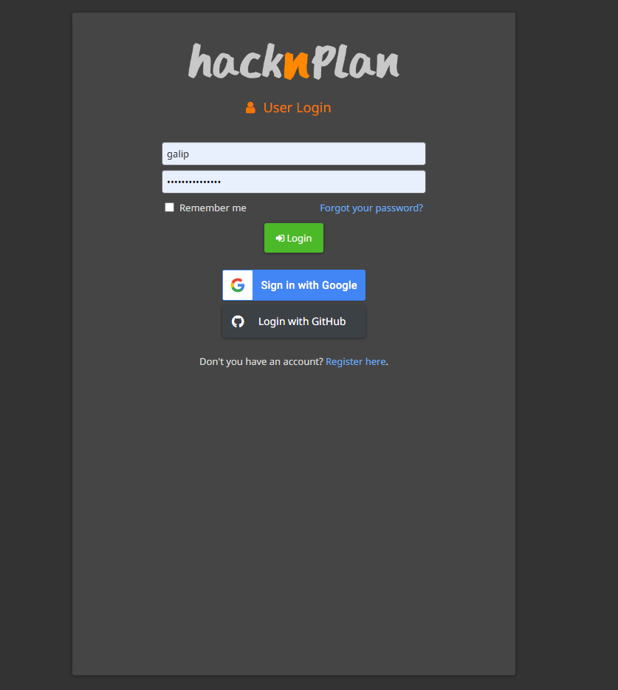
Create a new account
Goto
https://app.hacknplan.com/login
Create a new account!

Slide 9
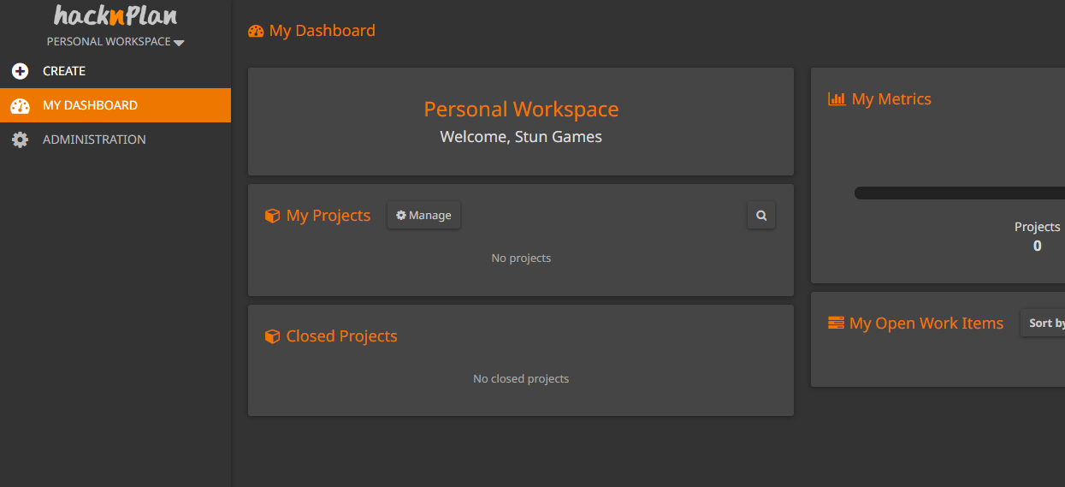
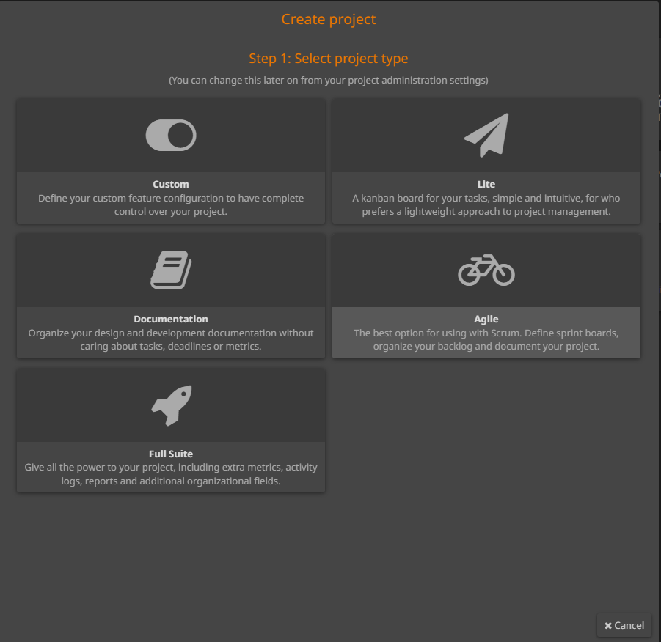
Create / Template
Select «Create»
Select «Agile» Template

Slide 10
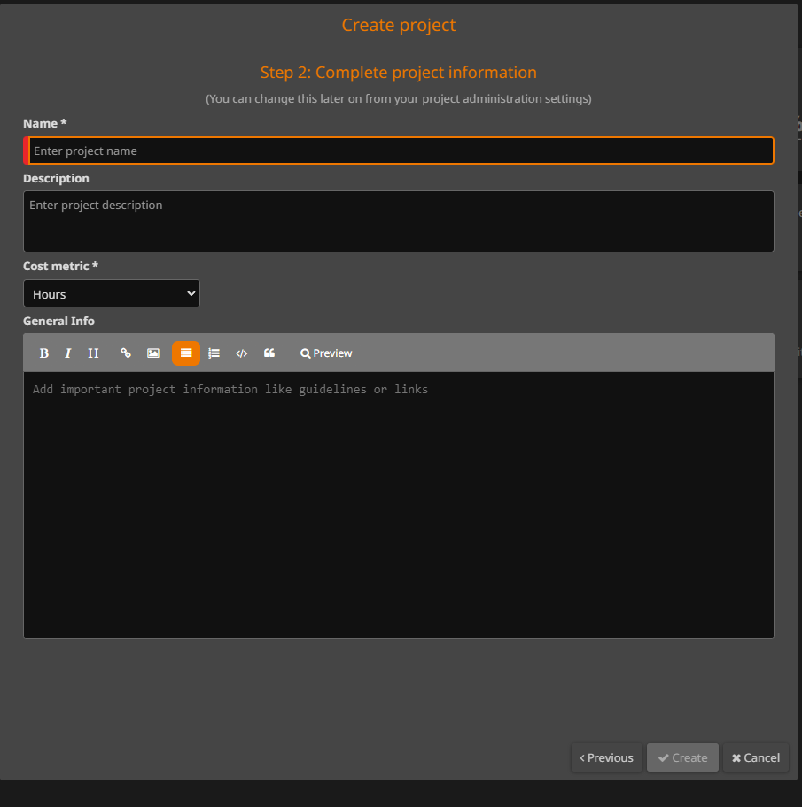
Final Project Details
Fill in your project details.
Name (Required!!!)
Description (Required)
General Info (Options)

Slide 11
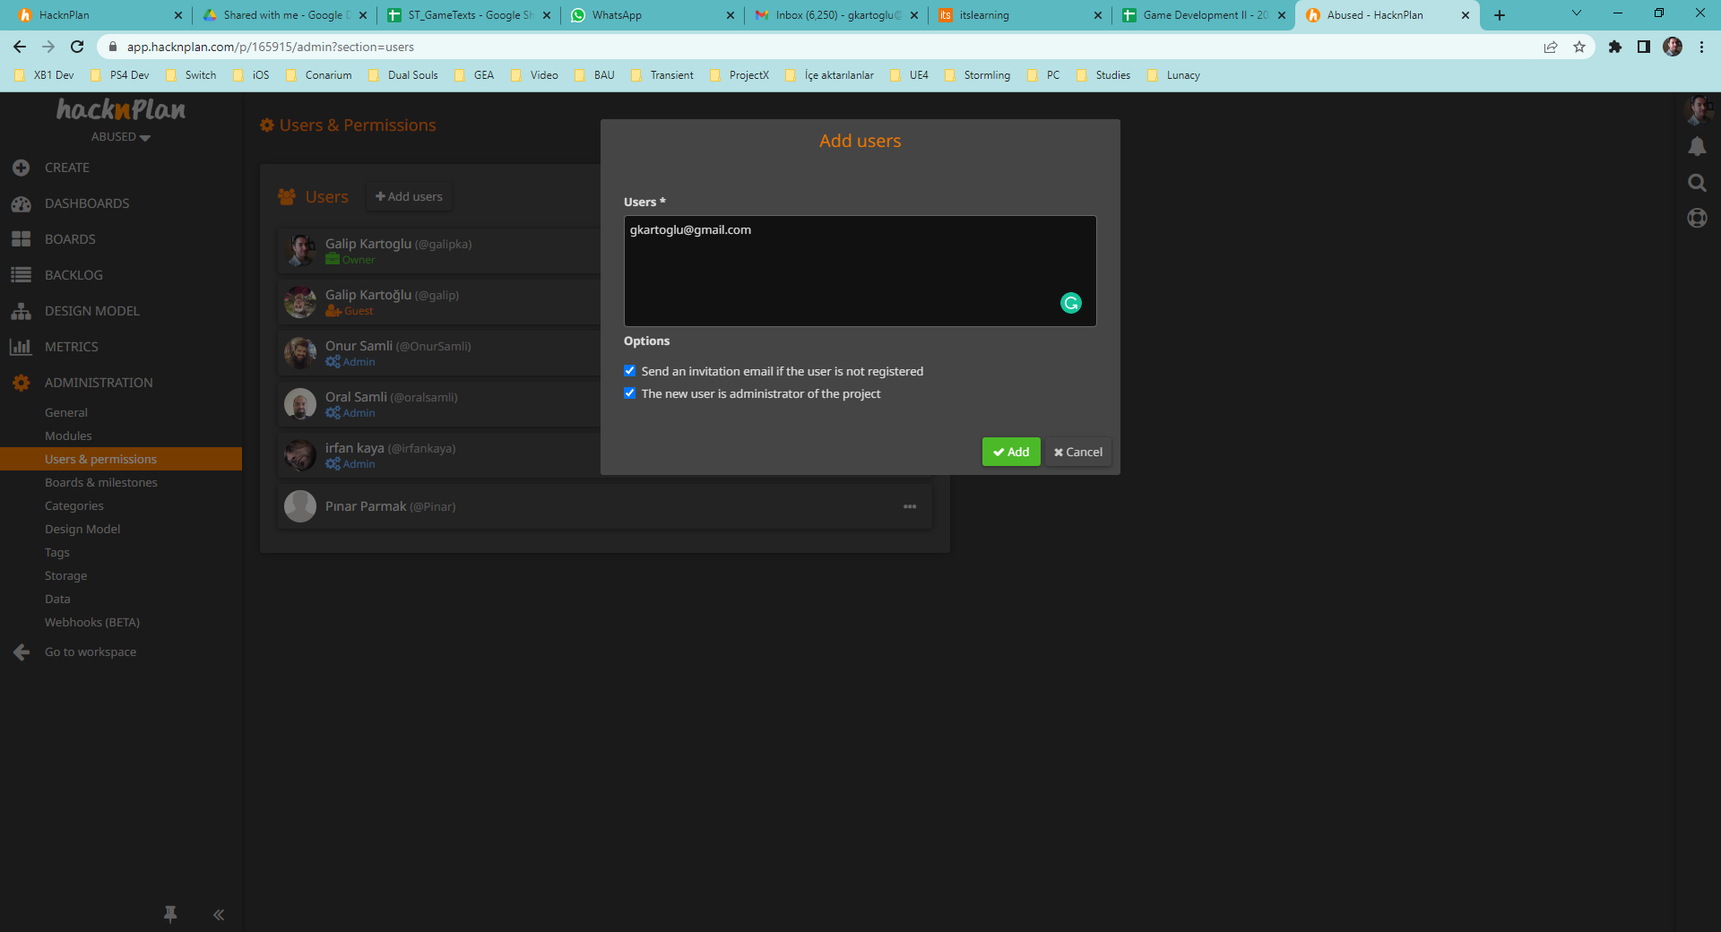
Adding Teams Members and Me!
Goto Administration => Users & Permissions.
Add users to invite your team members.
Invite me as an administrator of the project:
gkartoglu@gmail.com

Slide 12
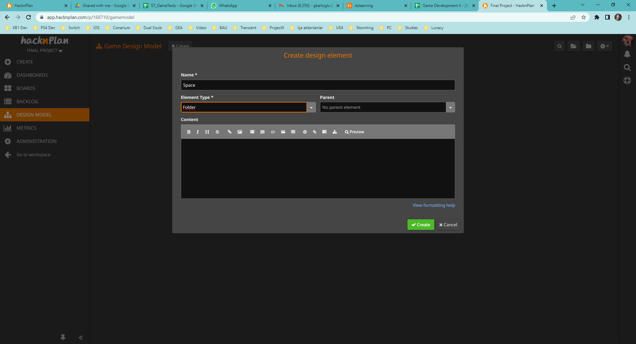
Design Model
Goto «Design Model»
Select Create and add these «Folder»s
Space
Goals
Actors
Mechanics
Rules

Slide 13
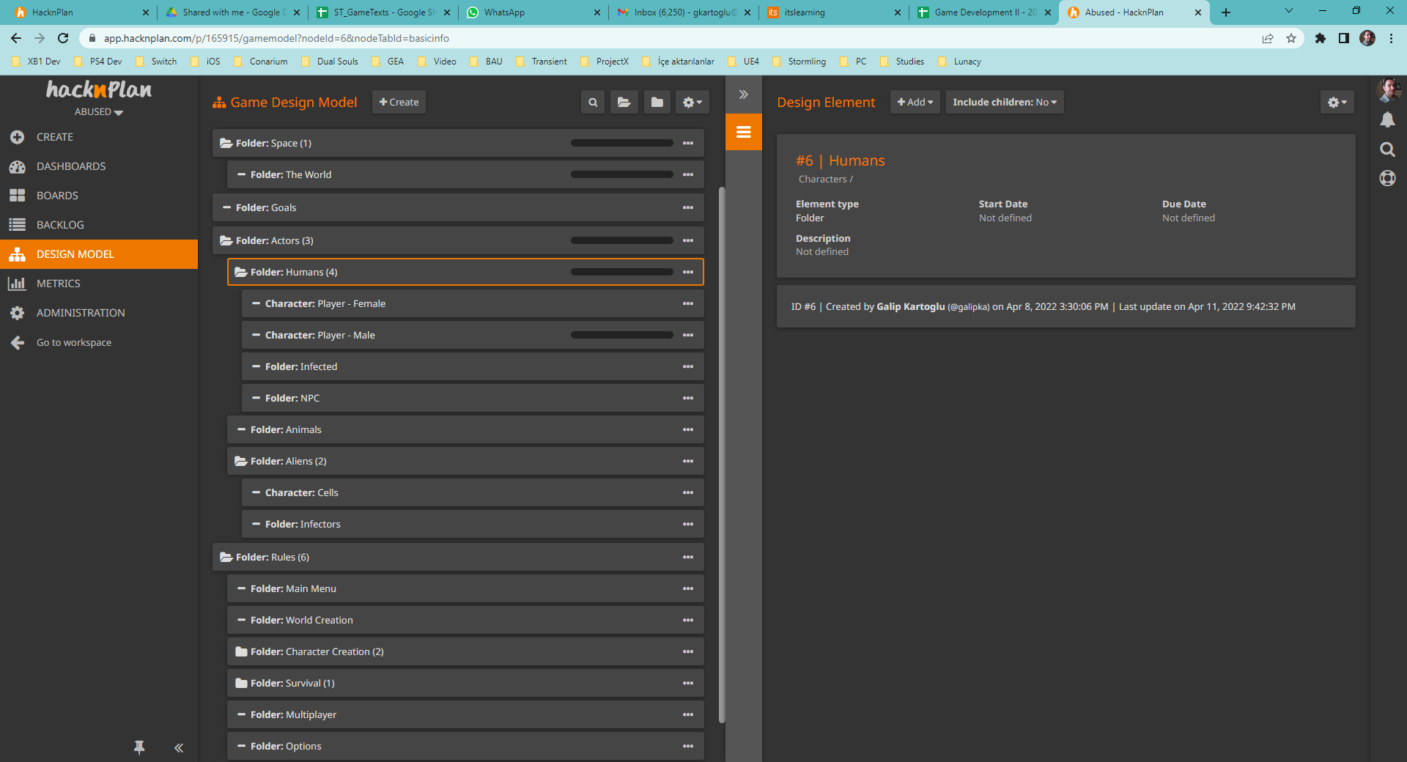
GDD
Add your sub-folders and description.
Maintain your GDD right here in Game Design Model.

Slide 14
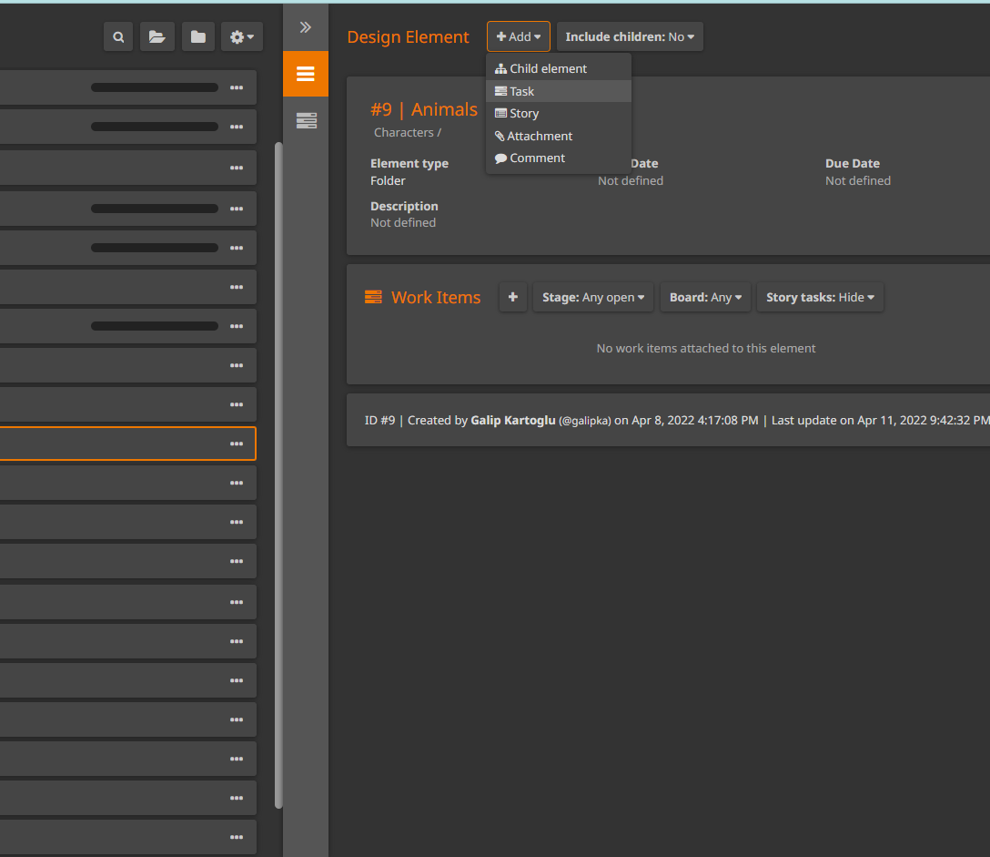
Tasks
- Using «Add Task» button, start adding tasks to team members and fill in «Sprint #1» board.

Slide 15
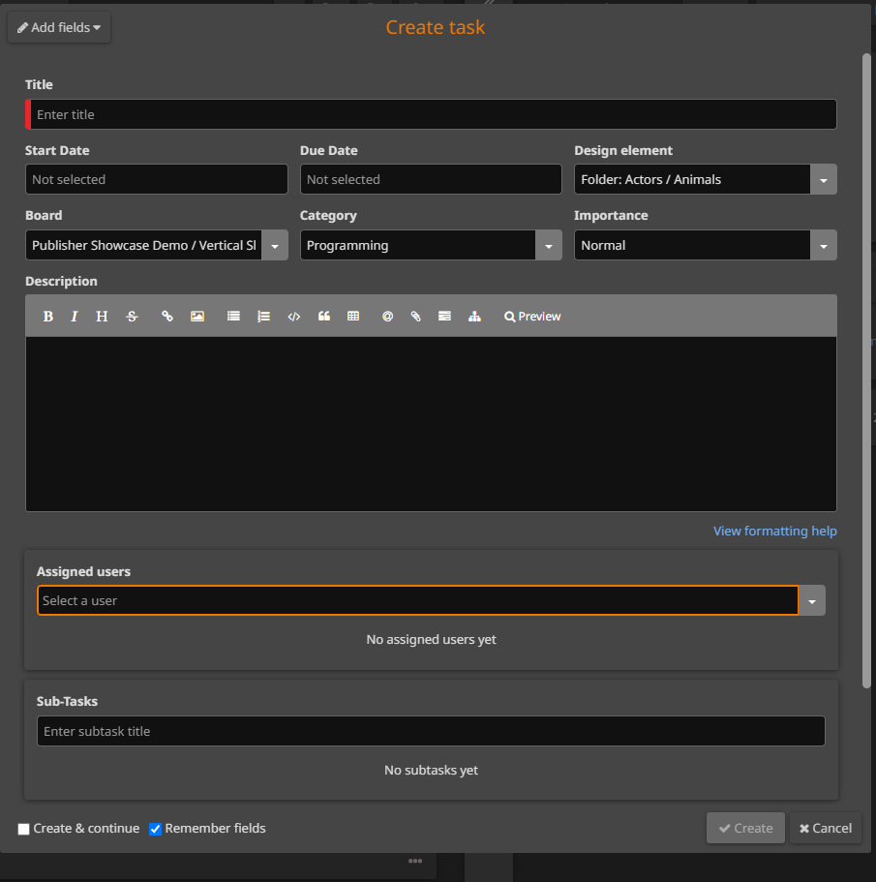
Creating Tasks
Add separate tasks for related «Categories» for each team member.
Set «Due Dates» if possible.
Create «Sub-Tasks» if necessary.

Slide 16
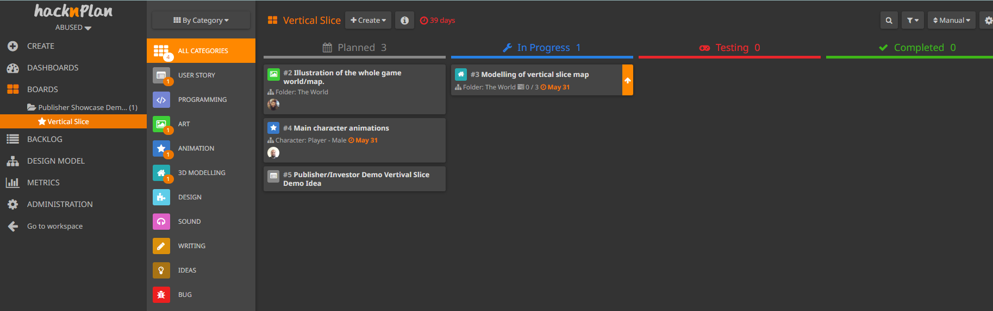
Plan, Code, Test, Complete!
You have one «Sprint»:
Finish the final project!
Every week during lab hours, we’ll meet and you will show me your project progress. Implementations will be checked and based on your progress you will get graded.
You start with planning things
Then decide to some of them
After implementation you start testing the features
When you think they are done, move them to Completed!
Easy stuff… huh?

Slide 17
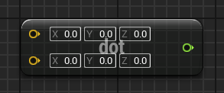
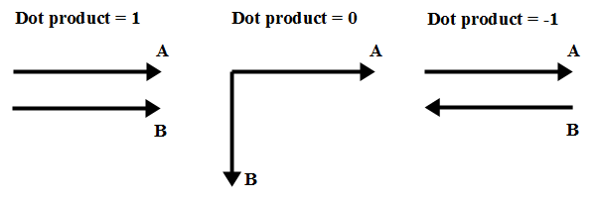
DOT PRODUCT
A dot product can be used to verify the relationship between two vectors, such as whether they are perpendicular or parallel.
If the two vectors are normalized, the dot product is equal to the cosine of the angle formed between the vectors and can range from –1 to 1.
The image on the right shows some examples of a dot product between two vectors.
You can make an entrance direction check (back/front) for level streaming with this!

