Slide 1
FINAL PROJECT INFO
Build a team of 2! (One person teams are also allowed.)
2 Milestone Interviews (10% each = 20% + 20% Final Presentation)
Fill the Final Project Concept Submission Form at itslearning.
Deadline is 31.05.2021 - 18:00

Slide 2
LECTURE 10
Blueprints in Action 3

Slide 3
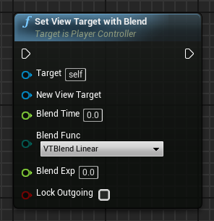
SET VIEW TARGET WITH BLEND
The Set View Target with Blend function from the Player Controller class is very useful for switching the game view between different cameras.
Input
Target: Reference to a Player Controller.
New View Target: Actor to set as view target. Usually a camera.
Blend Time: Time it takes to complete the blending.
Blend Func: Type of function to use for blending.
Blend Exp: Exponent value that controls the shape of the curve. It is used by some blend functions.
Lock Outgoing: Boolean variable. If the value is “true”, the outgoing view target will be locked to the last frame’s camera position.

Slide 4
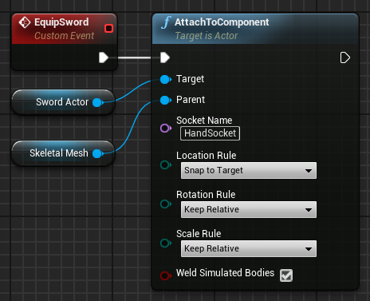
ATTACHING ACTOR TO COMPONENT
The AttachToComponent function attaches an Actor to the component referenced in the Parent input parameter. The Actor attached respects the transformations of the parent component.
Input
Target: Actor to be attached.
Parent: Component that receives the Actor.
Socket Name: Name of the socket where the Actor will be attached. Use of this parameter is optional.
Example
In the custom event on the right, the Skeletal Mesh of the player is equipped with a sword using a socket labeled “HandSocket” that indicates where the sword must stay in the Skeletal Mesh.

Slide 5
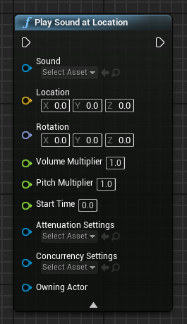
SOUNDS: PLAY SOUND AT LOCATION
There is a simple way to play a sound in Blueprints. Just use the Play Sound at Location function.
This function spawns an Ambient Sound Actor into your Level.
Use the combo box to define the Sound Cue or Sound Wave asset to play. The Location parameter is used to define the world position where the sound will play from.
Use of the others parameters is optional.
When the Actor finishes playing, it is destroyed.

Slide 6
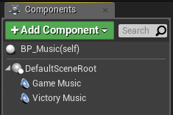
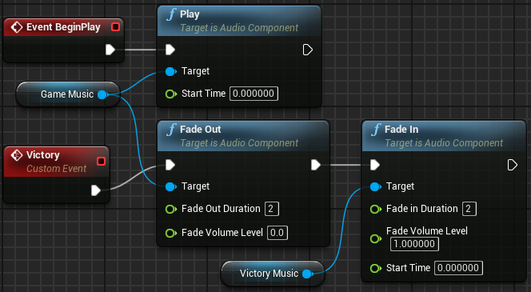
SOUNDS: AUDIO COMPONENT
A good way to have control over sounds in Blueprints is to use an Audio component.
To add an Audio component, click the Add Component button in the My Blueprint panel and choose “Audio”. In the Details panel, select in the Sound combo box the audio/song that will be used and uncheck the Auto Activate property so that the audio does not start playing automatically.
In the example on the right, there are two Audio components, one named “Game Music” and the other named “Victory Music”. The Fade Out and Fade In nodes are used to gradually change the music for two seconds.

Slide 7
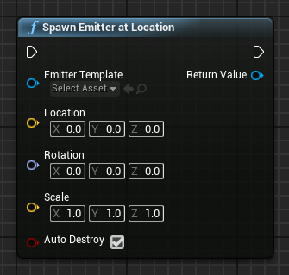
PARTICLES: SPAWN EMITTER AT LOCATION
The Spawn Emitter at Location function spawns and plays a Particle System component at the specified location.
Input
Emitter Template: Particle System template asset that will be used.
Location: Location where the Particle System will be placed.
Rotation: Rotation that will be applied to the Particle System.
Scale: Scale that will be applied to the Particle System.
Auto Destroy: Boolean variable. If the value is “true”, the Particle System will automatically be destroyed when execution is complete.
Output
Return Value: Reference to the Particle System component that was created.

Slide 8
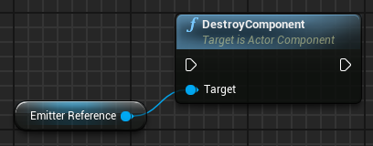
PARTICLES: DESTROYING
Particle Systems can stay in a loop or be deactivated and kept in memory to be reactivated later.
If it is necessary to destroy a Particle System, the DestroyComponent function can be used, since a reference to a Particle System is a Particle System component.

Slide 9
ANIMATIONS

Slide 10
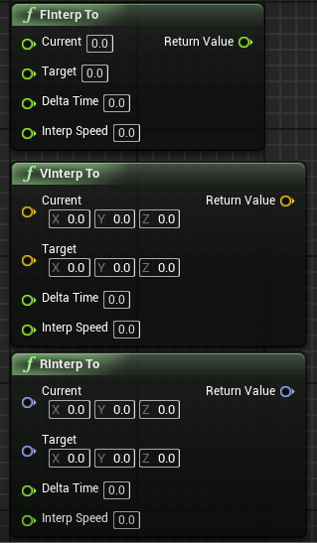
INTERP TO
Interp To functions are used to change a value smoothly until it reaches the specified target value. Some examples include the FInterp To function for float values, the VInterp To for vectors, and the RInterp To function for rotators.
Input
Current: Current value.
Target: Target value to be pursued.
Delta Time: The time interval that has elapsed since the last execution.
Interp Speed: Interpolation speed.
Output
Return Value: New value closer to the target value.

Slide 11
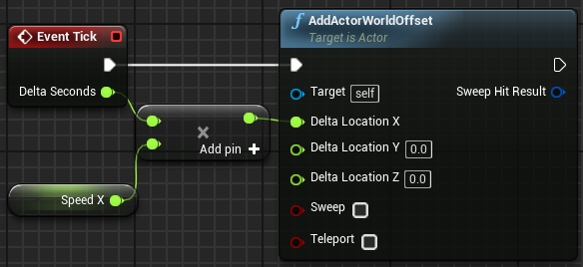
TICK EVENT AND DELTA TIME
There is an event named “Tick” that is called every frame of the game. For example, in a game that is running at 60 frames per second, the Tick event is called 60 times per second.
The Tick event has a parameter known as Delta Seconds, which contains the amount of time that has elapsed since the last frame.
In the Tick event illustrated on the right, the value of Delta Seconds is multiplied by the speed specified in the Speed X variable to determine the speed (in cm/s) at which the Actor needs to move along the X axis for each frame.
Tick actions can get very expensive, so alternatives should be considered if possible, such as Timelines or Timers.

Slide 12
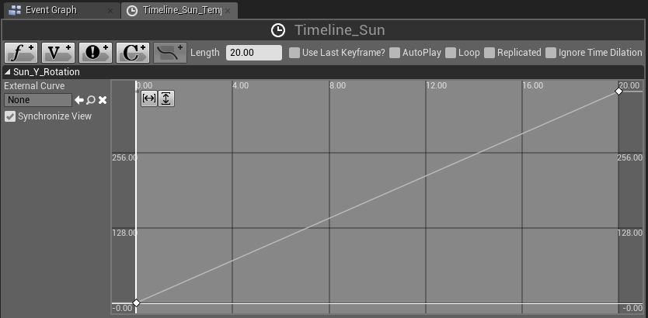
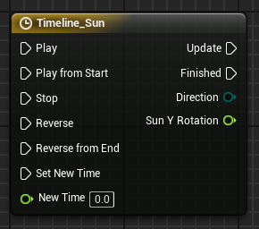
TIMELINES
Timelines allow for the creation of simple time-based animations inside Blueprints. After a Timeline has been added to the Event Graph, it can be edited in the Blueprint Editor by double-clicking it.
The variables that are added to the Timeline are shown as output parameters so that their values can be accessed. The top image on the right shows the Timeline Editor with a track named “Sun_Y_Rotation”.
The Update pin is called constantly while the Timeline is running.
A Timeline can be played forward or backward.

Slide 13
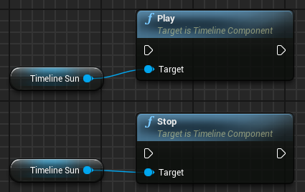
TIMELINES AS VARIABLES
Once created, Timelines can also be accessed as variables, so it is possible to call Timeline functions from anywhere in the graph.
A Get node of a Timeline can be obtained from the My Blueprint panel by going to Variables > Components.

Slide 14
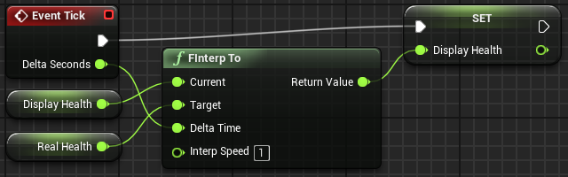
INTERP TO: EXAMPLE
The example on the right contains two variables. The Real Health variable stores the player’s current health. The Display Health variable is used to display a health bar on the screen.
When the player suffers damage, the value of Real Health is changed immediately, but the value of Display Health is modified using the FInterp To function so that the health bar smoothly decreases until the value of Display Health is equal to that of Real Health.

Slide 15
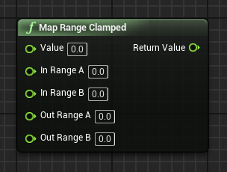
MAP RANGE CLAMPED
The Map Range Clamped function converts a value from one range of values to the corresponding value in another range of values. The end result will always be in the output value range.
Input
Value: Original value to be converted.
In Range A: Minimum value of the input value range.
In Range B: Maximum value of the input value range.
Out Range A: Minimum value of the output value range.
Out Range B: Maximum value of the output value range.
Output
Return Value: Converted value in the output value range.

Slide 16
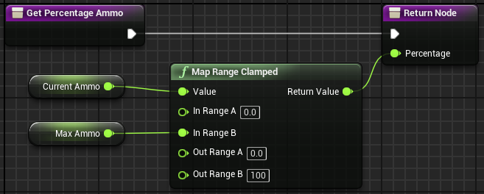
MAP RANGE CLAMPED: EXAMPLE
In the example on the right, the Get Percentage Ammo function converts the current amount of the player’s ammo into a percentage that is displayed on the screen.
The calculation is based on variables that hold the maximum ammunition that the player can have and the current amount of ammunition.

Slide 17
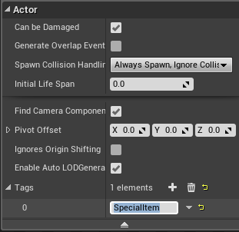
ACTOR HAS TAG
The Actor Has Tag function checks to see if a game Actor has a certain tag. The use of tags is a simple way to differentiate Actors in the Level. The image on the right shows that a tag called “SpecialItem” has been added to an Actor.
Input
Target: Actor reference that will be used in the tag verification.
Tag: Tag that will be used in the test.
Output
Return Value: Boolean value. If the value is “true”, the Actor has the specified tag.

Slide 18
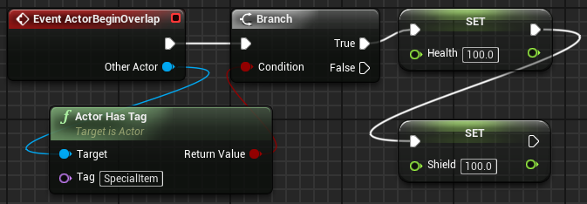
ACTOR HAS TAG: EXAMPLE
In the example on the right, the Actor Has Tag function is used to check if the Actor that was overlapped by the player has the SpecialItem tag.
If it does, then the health and shield of the player are restored by setting their values to “100.0”.

Slide 19
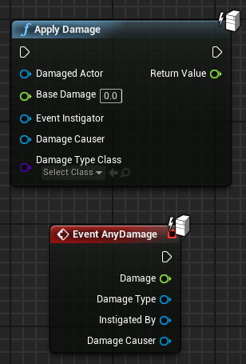
APPLY DAMAGE
The Apply Damage function is used to apply damage to an Actor. Information related to the damage can be passed through the function. The hit Actor responds to the damage using the AnyDamage event, but the event only fires if the value of the Apply Damage node’s Base Damage parameter is different from “0.0”.
Input
Damaged Actor: Reference to the Actor who will suffer the damage.
Base Damage: Float value that represents the damage.
Event Instigator: Reference to the Controller responsible for causing the damage. Use of this parameter is optional.
Damage Causer: Reference to the Actor that caused the damage. Use of this parameter is optional.
Damage Type Class: Class that represents the type of damage done. Use of this parameter is optional.

Slide 20
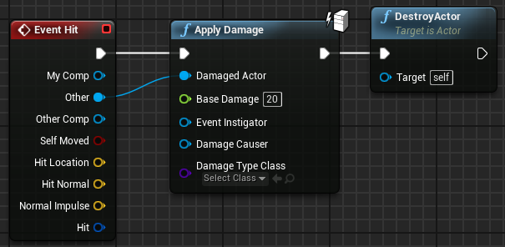
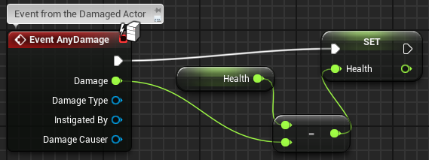
APPLY DAMAGE: EXAMPLE
The script seen in the top image on the right can be used in a Blueprint that represents a bullet.
When the bullet hits an Actor, the Apply Damage function is used to apply damage with a value of “20”. After that, the bullet is destroyed.
The bottom image shows the AnyDamage event for the damaged Actor. It will decrease the value of the Health variable by the Damage value.

Slide 21
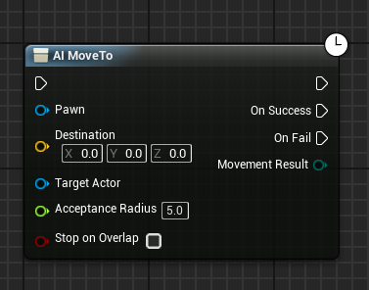
AI MOVE TO
The AI MoveTo node is used to move a Pawn. The destination can be a location or another Actor. The Level must have a Nav Mesh Bounds Volume to define the area that the AI MoveTo action can use. It is a latent action, so it runs in parallel to the normal flow of execution of the Blueprints.

Slide 22
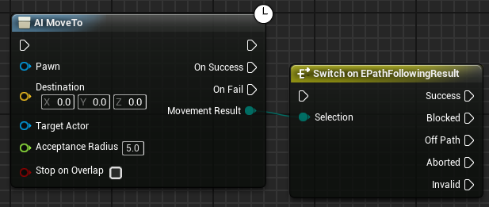
AI MOVE TO: INPUT AND OUTPUT
Input
Pawn: Reference to the Pawn that will be moved.
Destination: Vector indicating the destination.
Target Actor: Reference to an Actor that will be continuously tracked.
Acceptance Radius: Maximum destination distance to complete movement.
Stop on Overlap: Boolean value. If the value is “true”, the move will be complete as soon as the Pawn begins to overlap the acceptance radius.
Output
On Success: Exec pin that will be executed when the AI MoveTo function reaches its goal.
On Fail: Exec pin that will be executed if the AI MoveTo function cannot reach its goal.
Movement Result: Enumeration with the following possible result: “Success”, “Blocked”, “Off Path”, “Aborted”, or “Invalid”.

Slide 23
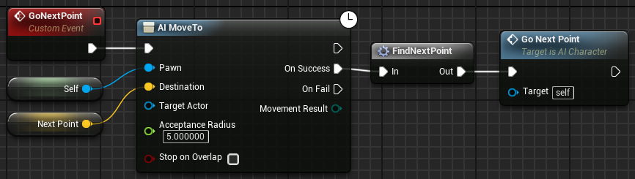
AI MOVE TO: EXAMPLE
In the example on the right, the AI MoveTo node is being used to direct a Pawn to follow a path represented by a set of predefined points in the Level. These points representing the path may be stored in an array. The FindNextPoint macro is responsible for picking the next point on the path and storing it in the Next Point variable.
The clock icon indicates that AI MoveTo is a latent action. The GoNextPoint event initiates the AI MoveTo action, but the actions connected to the On Success pin will be performed only when the Pawn reaches its destination. After the FindNextPoint macro updates the Next Point variable, the GoNextPoint event is called again.

Slide 24
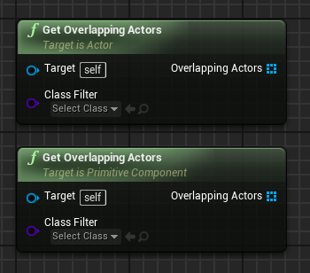
GET OVERLAPPING ACTORS
The Get Overlapping Actors function returns a list of Actors that are overlapping the Actor/component. There are two versions of this function, one that uses an Actor as the target and the other that uses a component as the target.
Input
Target: Reference to the Actor/component that will be used in the overlapping test.
Class Filter: Indicates which class or subclasses will be used in the test. Use of this parameter is optional.
Output
Overlapping Actors: Array containing the Actors that are overlapping the Actor/component.

Slide 25
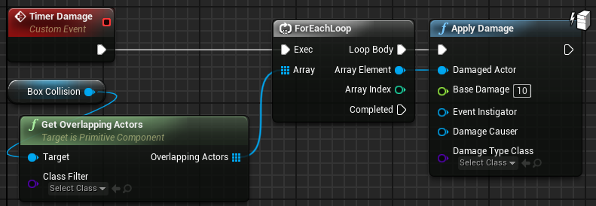
GET OVERLAPPING ACTORS: EXAMPLE
Imagine an area that deals damage to all the Actors in it.
In the example on the right, this area is represented by a Blueprint that has a Box Collision component that defines the location where the Actors suffer damage.
The Timer Damage event is periodically called to apply damage to all Actors who are overlapping the Box Collision.

Slide 26
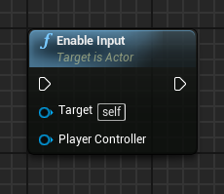
ENABLE INPUT
The Enable Input function is used to allow a Blueprint to respond to input events such as a keyboard, mouse, and gamepad.
Input
Target: Actor that will have its input enabled. The “self” value is used to target the Blueprint that contains the node.
Player Controller: A reference to the Player Controller in use.

Slide 27
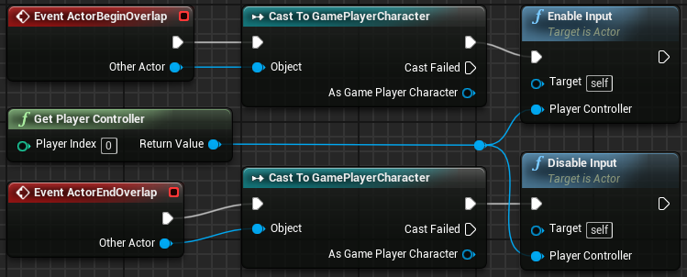
ENABLE INPUT:
EXAMPLE
In the example on the right, a Blueprint only responds to input events when the player is near it. The player is represented by a Blueprint named “GamePlayerCharacter”. When the player is within the Blueprint’s collision bounds, the Enable Input function is called.
When the player is out of the Blueprint’s collision bounds, the Disable Input function is called so that this Blueprint no longer responds to input events.

Slide 28
SUMMARY
This lecture presented more Blueprint functions. It showed how to spawn and destroy sounds and particles and how to create different types of animations using actions as well as moving AI characters with AI MoveTo function.

