Slide 1
Labwork #7
Chest Game!

Slide 2
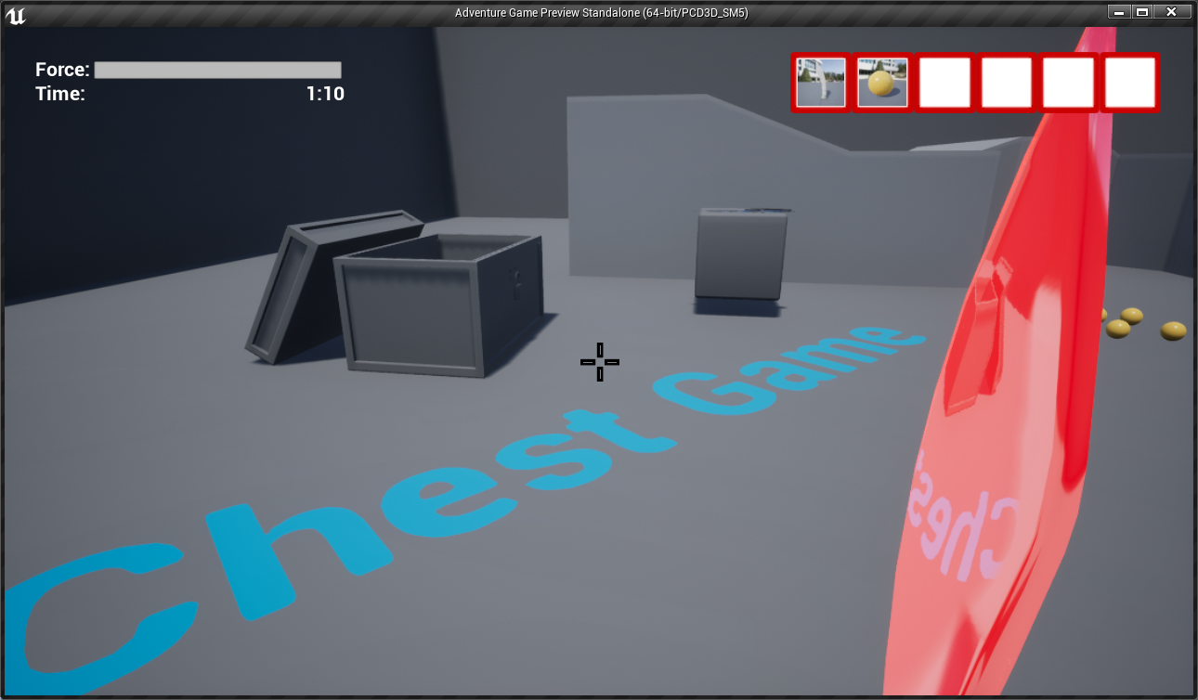
GAME CLASSES
ChestGameCharacter: A Pawn subclass that represents the player and is part of the First Person template.
BP_BasicItem: An Actor class to be used as a base for every pickable inventory item in this game.
ChestGameHUD: Draws the crosshair on the screen.
ChestGameMode: The game mode class of this game.
S_InventoryItem: Iventory item data structure to initialize a BP_BasicItem.
DT_ItemsRegistry: A Data-table asset Of S_IventoryItem type, which holds all the inventory item initial values..

Slide 3
GAME MECHANICS
TO BE IMPLEMENTED!
Items can be picked up with Left Mouse Button
Picked Items can be thrown by holding Right Mouse Button at a different force. Releasing the right Mouse button throws the item.
«Force» indicator displays the amount of force will be applied to the item.
If any item falls into the chest, added to the Inventory slots.
Picked-up items from the chest also removes them from the inventory slots.
Total elapsed time is also displayed on the UI.

Slide 4
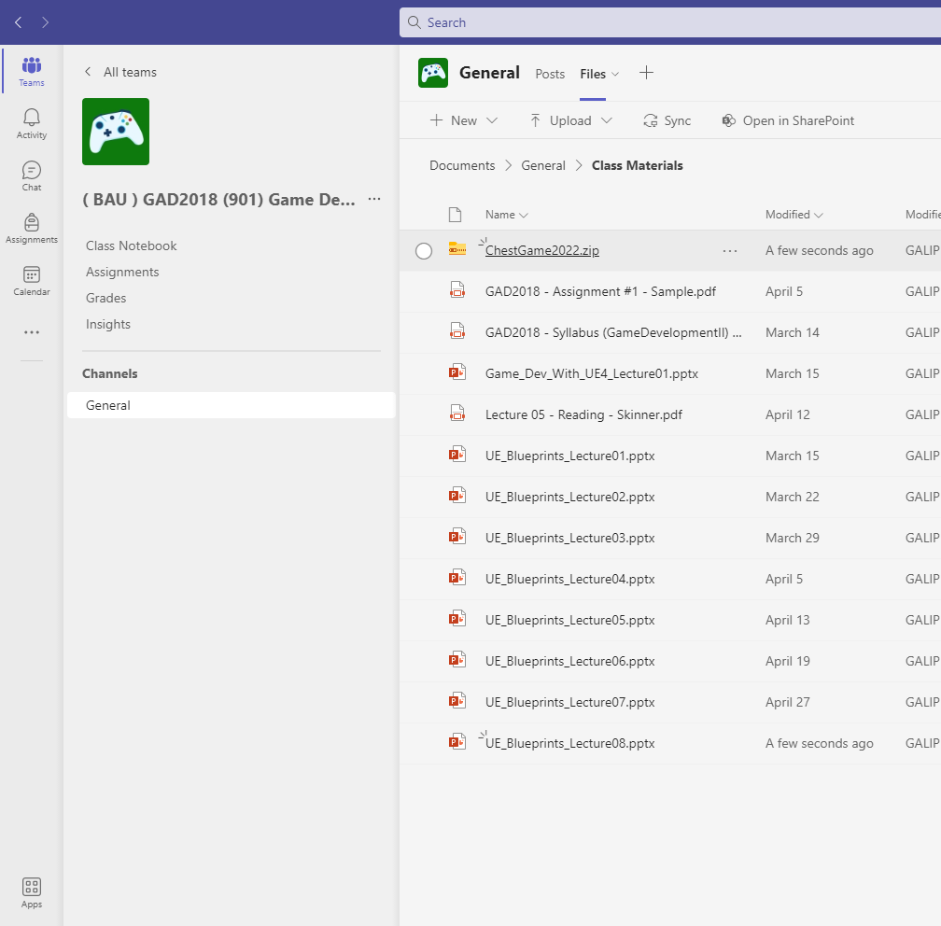
CREATING THE PROJECT
Download ChestGame2022.zip from Team’s Files Class Materials folder or itslearning Resources section.
Extract the contents and run ChestGame.uproject.

Slide 5
PHASE #1
Hints:
Use EventTick to adjust force on the fly.
Holding Right Click should only work while holding an item.
Add 2 more items types, adjust their properties and place them on the map.
Add functionality of holding right click to adjust the throwing force of equipped items.
Add these variables to your Character:
Bool ThrowButtonHolding
Float ThrowForce (between 0..1)

Slide 6
PHASE #2
Hints:
Put a Trigger Box in the chest.
Add a bool to check if the thrown item ended up inside the chest.
Use OnActorBeginOverlap and OnActorEndOverlap events together.
Find the code part where thrown item’s physics simulation is disabled. You may update the inventory and make sure the item is in the chest.
Make items added to inventory only if they are inside the chest.
Picking up the item from the chest should also remove it from the inventory.
Print out the contents of the inventory everytime an adding or removing happens.

Slide 7
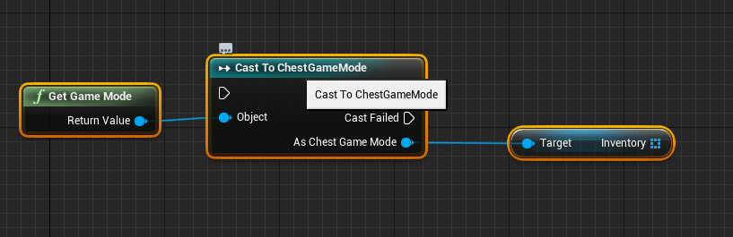
PHASE #3
Hints:
Inventory Slots Array in InventoryWidget
ForEachLoop
Add a function ‘UpdateInventory’ to refresh the UI with the contents of the inventory array.
IsValidIndex of Array
SetBrushFromTexture Image Objects
Add a ‘Icon’ property to your InventoryItem structure and use icon Texture2D images already given in ChestGame folder.
Add functionality of displaying Inventory contents.
For testing add all picked items into inventory.
Make your inventory array accessible from the ChestGameMode like this:

Slide 8
PHASE #4
Display the throw force on the progressbar of InventoryWidget by creating a bind.

Slide 9
PHASE #5 (OPTIONAL)
Hints:
DistanceTo
VectorLength
Complete this and gain extra points!
Design a scoring system where throwing an item into the chest from a far distance gives more points than throwing it very close to the chest.
Display the score on UI.

