Slide 1
Word2vec
박준형
데이터인텔리전스 연구실
irish07@korea.ac.kr

Slide 2
Class Lab - Schedule & Assignment
Neural Network Introduction (~3/31)
2. Skip-gram / CBOW (~4/14)
(Basic) Softmax
3. Hierarchical Softmax / Negative sampling (~4/28)
Subsampling

Slide 3
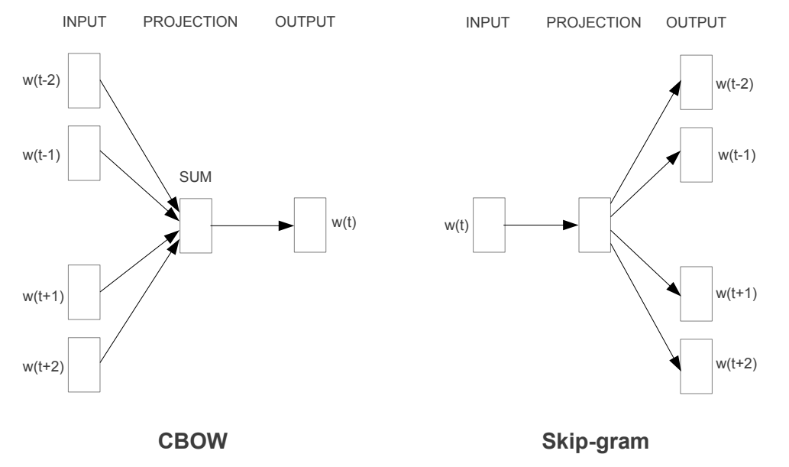
Class Lab - Schedule & Assignment
T. Mikolov, K. Chen, G. Corrado, J. Dean, “Efficient Estimation of Word Representations in Vector Space”, ICLR 2013

Slide 4
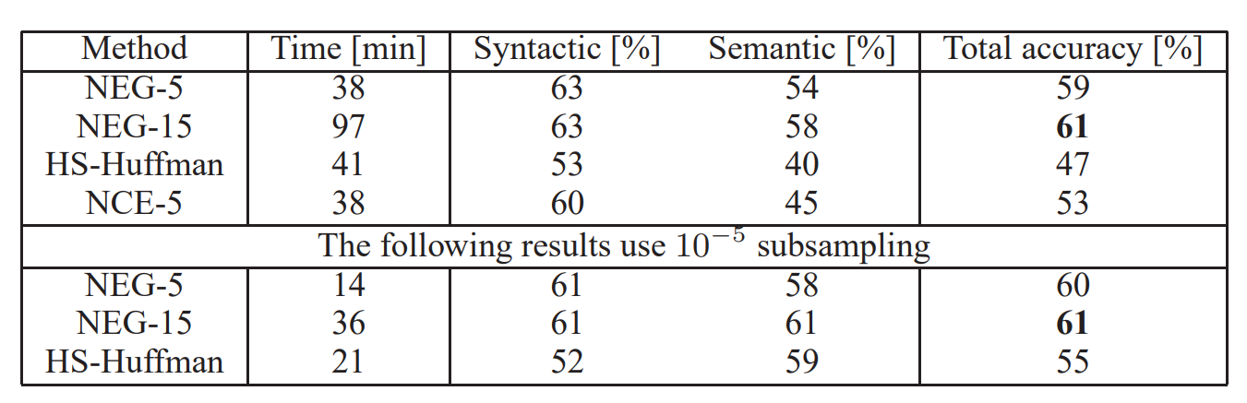
Class Lab - Schedule & Assignment
T. Mikolov, I. Sutskever, K. Chen, G. Corrado, J. Dean, “Distributed Representations of Words and Phrases and their Compositionality”, NIPS 2013

Slide 5
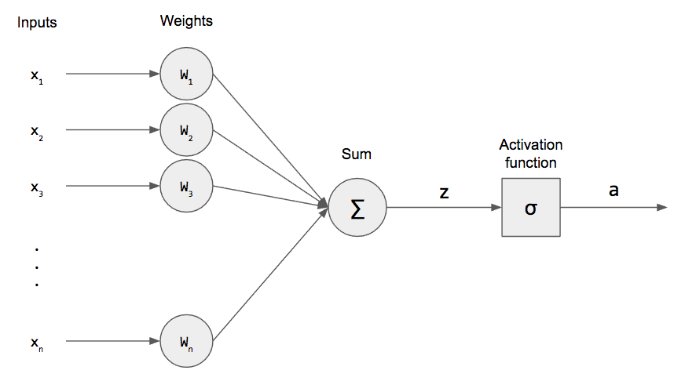
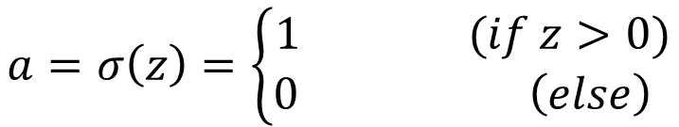

Perceptron
$$z=w_{1}x_{1}+w_{2}x_{2}+…+w_{n}x_{n}+b$$
$$z=WX+b$$
$$a=σ\left(z\right)=\left\{\begin{aligned}1 (if z>0) \\ 0 \left(else\right) \end{aligned}\right.$$

Slide 6
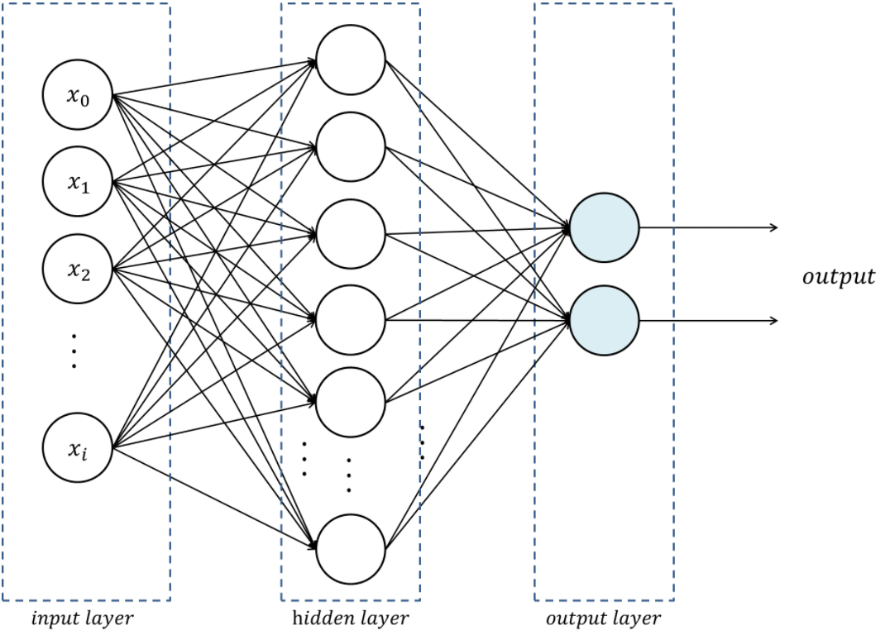

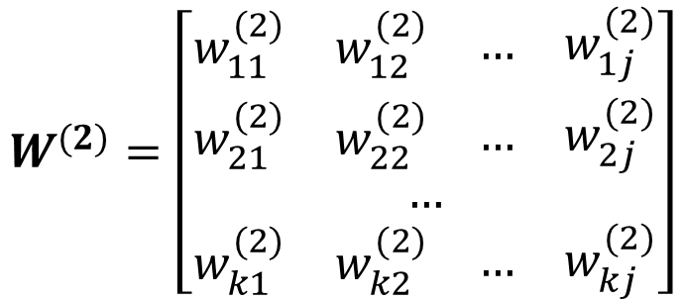
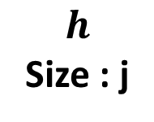
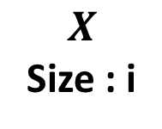
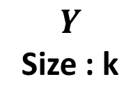

Multi-layer Perceptron
Stack of perceptron
$$h=σ\left(W^{(1)}X+b^{(1)}\right)$$
$$Y=σ\left(W^{(2)}h+b^{(2)}\right)$$
$$W^{(2)}=\left[\begin{aligned}\begin{matrix}\begin{matrix}w_{11}^{(2)} & w_{12}^{(2)}\end{matrix} & \begin{matrix}… & w_{1j}^{(2)}\end{matrix}\end{matrix} \\ \begin{matrix}\begin{matrix}w_{21}^{(2)} & w_{22}^{(2)}\end{matrix} & \begin{matrix}… & w_{2j}^{(2)}\end{matrix}\end{matrix} \\ … \\ \begin{matrix}\begin{matrix}w_{k1}^{(2)} & w_{k2}^{(2)}\end{matrix} & \begin{matrix}… & w_{kj}^{(2)}\end{matrix}\end{matrix}\end{aligned}\right]$$
$$X$$
Size : i
$$h$$
Size : j
$$Y$$
Size : k
( k x j ) matrix

Slide 7
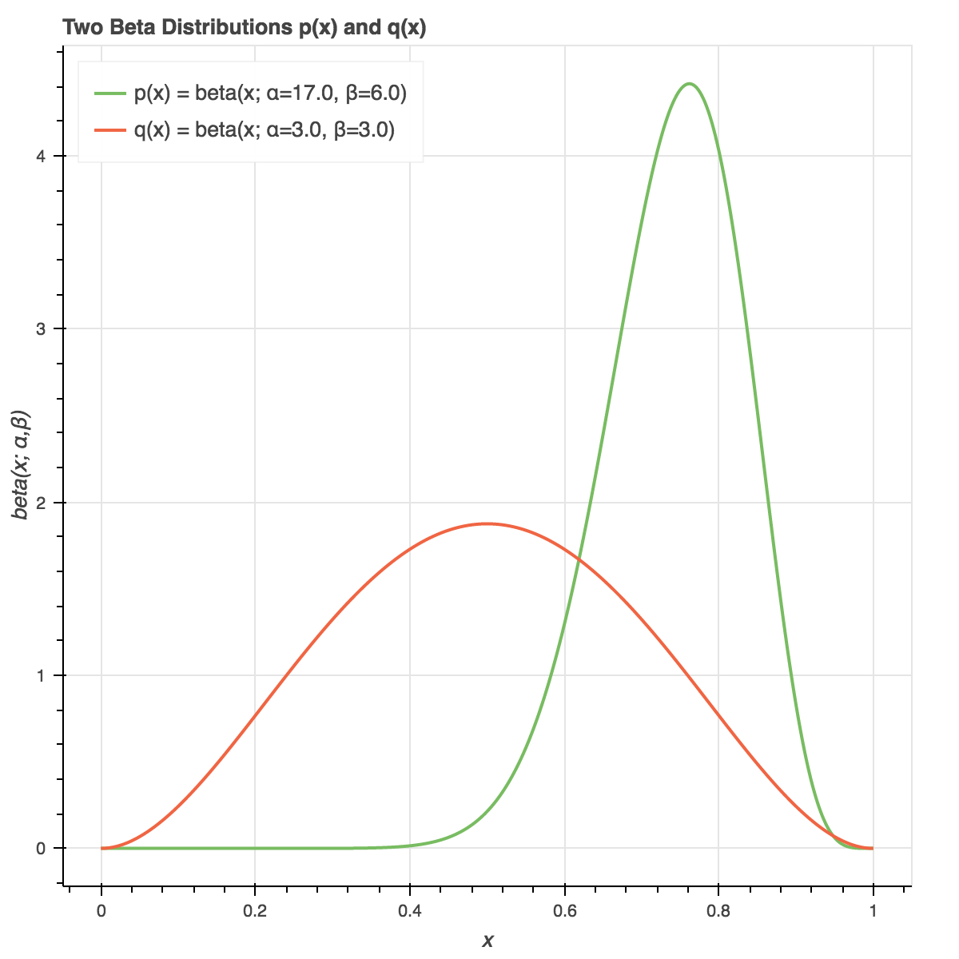
Backpropagation
Loss(=cost) : A real number that represents how wrong it is
Output: 3.4
Answer: 3.7
Loss : 4
Loss : 0.09
Loss : 1.7

Slide 8
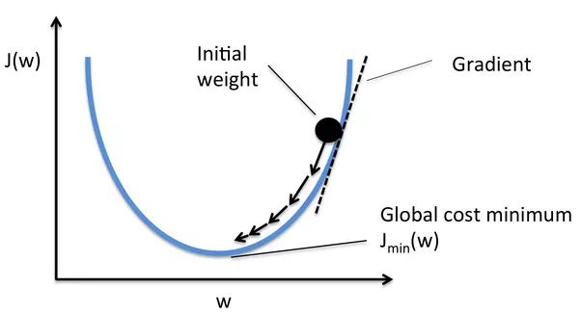
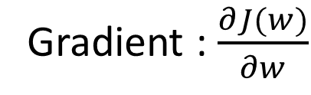
Backpropagation
We should minimize the loss function using differentiation
Gradient : $\frac{∂J(w)}{∂w}$

Slide 9






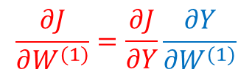










Backpropagation
Backpropagation: Using chain rule, calculate gradient step- by-step
$$\frac{∂J}{∂X}=\frac{∂J}{∂Y}\frac{∂Y}{∂X}$$
$$\frac{∂J}{∂Y}=0.105$$
$0.9$
$$Y=W^{(1)}X$$
$×$
$0.63$
$0.7$
$$\frac{∂Y}{∂X}=W^{(1)}$$
$$\frac{∂Z}{∂W^{(1)}}=X$$
$+$
$0.83$
$σ$
$0.70$
$$\frac{∂J}{∂W^{(1)}}=\frac{∂J}{∂Y}\frac{∂Y}{∂W^{(1)}}$$
$0.2$
$$\frac{∂J}{∂a}=0.5$$
$$\frac{∂J}{∂Z}=0.105$$
$$\frac{∂J}{∂b^{(1)}}=0.105$$

Slide 10
Gradient Descent
Take a small step proportional to the negative of the gradient at current point
Current Gradient
Step
Current Loss
Loss Surface
(We don’t know)
Current Point

Slide 11
Gradient Descent
Take a small step proportional to the negative of the gradient at current point
Current Gradient
Step
Loss Surface
(We don’t know)
Current Loss
Current Point

Slide 12


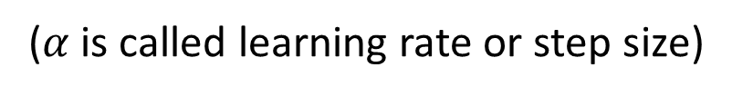
Gradient Descent
Gradient Descent
$$∇w=\frac{1}{N}\sum_{e}^{\begin{aligned}Training \\ examples\end{aligned}}{δ(e, w_{t})}$$
Calculating gradients of
all training examples is
expensive!
Iteration :
$$w_{t+1}=w_{t}−α∇w$$
($α$ is called learning rate or step size)

Slide 13
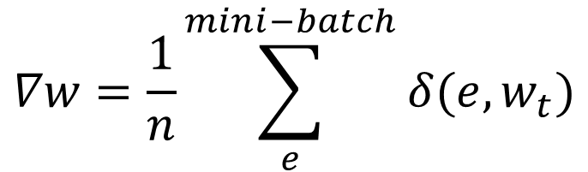
Gradient Descent
Stochastic Gradient Descent(SGD)
$$∇w=\frac{1}{n}\sum_{e}^{mini−batch}{δ(e, w_{t})}$$
Use mini-batch,
random sampled from
training examples
Iteration :
$$w_{t+1}=w_{t}−α∇w$$

Slide 14
How to represent words

Slide 15
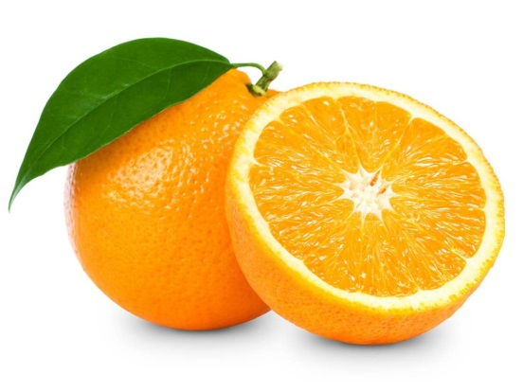
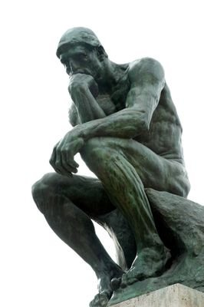
Word Representation
What is “Orange”?

Slide 16

Word Representation
? ? ?
What is “Orange”?

Slide 17
Word Representation
Orange
Representation

Slide 18
Word Representation
Atomic Word Representation
000000
100000
000100
apple
banana
One-hot encoding
grape
orange
strawberry
watermelon
vector
apple
orange

Slide 19
Word Representation
Atomic Word Representation
All vectors are independent
100000
000100
apple
orange

Slide 20
Word Representation
Atomic Word Representation
But words are dependent
100000
Semantic Relation
000100
Syntactic Relation
apple
orange

Slide 21
Word Representation
Atomic Word Representation
100000
Semantic Relation
000100
Syntactic Relation
apple
orange

Slide 22
Word Representation
Distributed Representation
Word
Continuous Feature Space

Slide 23
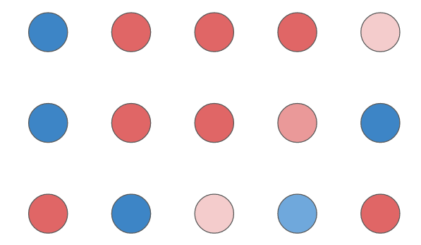

Word Representation
Distributed Representation
Word A
Word B
Word C

Slide 24
Word Representation
Distributed Representation
sweet
0.8
0.2
0.0
0.9
0.2
0.1
sweet
0.7
0.3
0.0
0.6
0.5
0.1
sour
Taste
sour
Taste
hot
hot
red
red
green
Color
green
Color
blue
blue
apple
orange

Slide 25
Word Representation
Distributed Representation
0.7
0.3
0.0
0.6
0.5
0.1
sweet
0.8
0.2
0.0
0.9
0.2
0.1
sweet
0.7
0.3
0.0
0.6
0.5
0.1
Similar taste
Different color
Taste
sour
Taste
sour
hot
hot
red
red
green
Color
green
Color
blue
blue
apple
orange

Slide 26
Word Representation
Distributed Representation
???
?
?
?
?
?
?
???
How to set features and values of them
???
???
???
???
Word

Slide 27
Word Representation
Distributed Representation
???
?
?
?
?
?
?
???
How to set features and values of them
???
???
???
Manually?
???
Word

Slide 28
Word Representation
Distributed Representation
???
?
?
?
?
?
?
???
How to set features and values of them
???
???
???
English words
More than 1 million
1 new word every 98 minutes
???
Word

Slide 29
Word Representation
Distributed Representation
???
?
?
?
?
?
?
???
How to set features and values of them
???
???
???
Manually? Impossible
???
Word

Slide 30
Word Representation
Distributed Representation
???
?
?
?
?
?
?
???
How to set features and values of them
???
???
???
With Neural Networks
???
Word

Slide 31
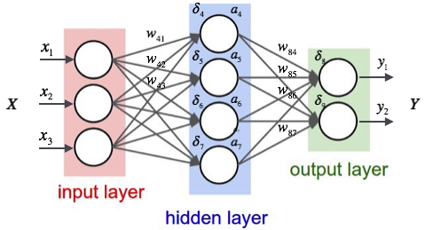
Neural Network
Automatically Detect Features

Slide 32
Neural Network
Automatically Detect Features

Slide 33

Neural Network
Automatically Detect Features
$$Y=F(X)$$

Slide 34

Neural Network
Automatically Detect Features
Loss
$L=J\left(F\left(X\right), Y^{′}\right)$
Adjust the parameters
to minimize the loss

Slide 35
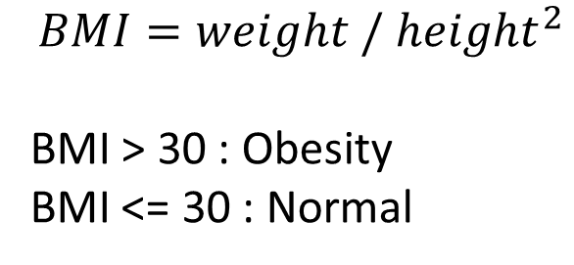
Neural Network
Ex) Obesity with height and weight
$$BMI=weight / {height}^{2}$$
BMI > 30 : Obesity
BMI <= 30 : Normal
Height(m) | Weight(kg) | Obesity
1.81 | 70 | False
1.63 | 68 | False
1.75 | 95 | True
1.55 | 46 | False
1.78 | 103 | True

Slide 36


Neural Network
Ex) Obesity with height and weight
Input : Height, Weight
Output : Probabilities of True or False
$$h= σ(W_{1}x+b_{1})$$
$$y= σ(W_{2}h+b_{2})$$
Neural network
with randomly initialized parameters

Slide 37
Neural Network
Ex) Obesity with height and weight
1.8
0.6
0.0
$$h= σ(W_{1}x+b_{1})$$
$$y= σ(W_{2}h+b_{2})$$
The first output will be very different
72
0.4
1.0
Answer

Slide 38
Neural Network
Ex) Obesity with height and weight
Update parameters with
Backpropagation and
Gradient descent
1.8
0.6
$$h= σ(W_{1}x+b_{1})$$
$$y= σ(W_{2}h+b_{2})$$
72
-0.6
Gradient

Slide 39
Neural Network
Ex) Obesity with height and weight
1.8
0.4
0.0
$$h= σ(W_{1}x+b_{1})$$
$$y= σ(W_{2}h+b_{2})$$
The second output will be
closer to the answer
72
0.6
1.0
Answer

Slide 40
Neural Network
Ex) Obesity with height and weight
1.8
0.1
0.0
After repeat of training,
the neural network will
approximate the obesity function
$$h= σ(W_{1}x+b_{1})$$
$$y= σ(W_{2}h+b_{2})$$
72
0.9
1.0
Answer

Slide 41


Neural Network
Ex) Obesity with height and weight
Output is inferred from the hidden layer
1.8
0.1
$$h= σ(W_{1}x+b_{1})$$
$$y= σ(W_{2}h+b_{2})$$
72
0.9
input
hidden
output

Slide 42
Neural Network
Ex) Obesity with height and weight
The important features will be represented
in the hidden layer
1.8
0.1
$$h= σ(W_{1}x+b_{1})$$
$$y= σ(W_{2}h+b_{2})$$
72
0.9
input
hidden
output

Slide 43
Neural Network
Determine forms of input and output
Define loss function
Training

Slide 44
Word2Vec
Determine forms of input and output
Define loss function
Training

Slide 45
Word2Vec
Input
Word Representation
Output
Automatically determined
Word
???

Slide 46
Word2Vec
I eat an apple every day (O)
I eat an orange every day (O)
I eat a car every day (X)

Slide 47
Word2Vec
I eat an apple every day (O)
I eat an orange every day (O)
I eat a car every day (X)

Slide 48
Word2Vec
I eat an apple every day (O)
I eat an orange every day (O)
I eat a car every day (X)
Co-occur frequently
Co-occur frequently
Co-occur rarely

Slide 49
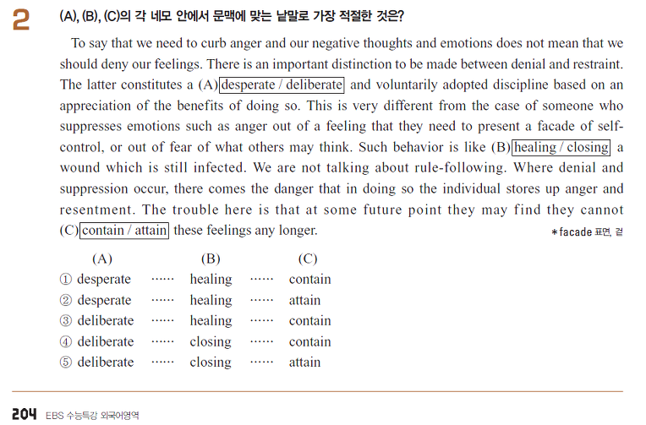
Word2Vec

Slide 50
Word2Vec
Co-occurrence probabilities have three important properties
Each word has its own unique distribution
Similar words have similar distributions
Different words have different distributions

Slide 51
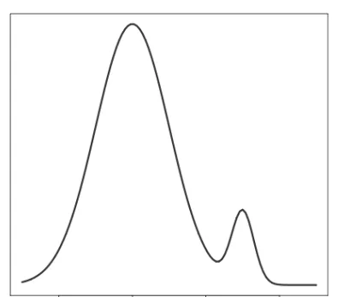
Word2Vec
Word2Vec uses co-occurrence probabilities as outputs
Input
Word Representation
Output
Automatically determined
Word

Slide 52
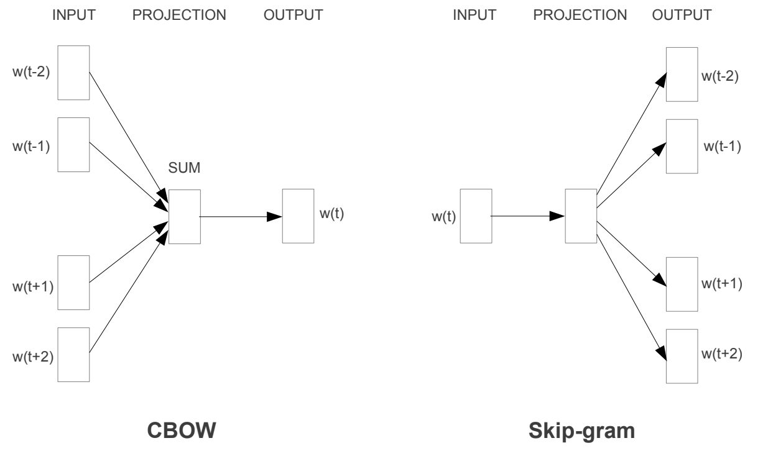
Word2Vec

Slide 53
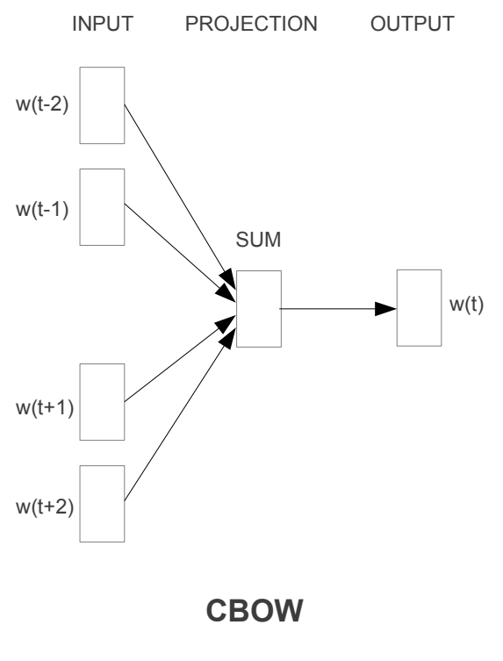
Word2Vec
Predict a target word using context words
I eat an orange every day.
eat
an
every
day
Prob.
SUM
Maximize
orange

Slide 54
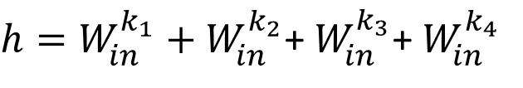
Word2Vec
eat
an
Prob.
SUM
Maximize
orange
every
day
$h=W_{in}^{k_{1}}+W_{in}^{k_{2}}$+ $W_{in}^{k_{3}}$+ $W_{in}^{k_{4}}$

Slide 55
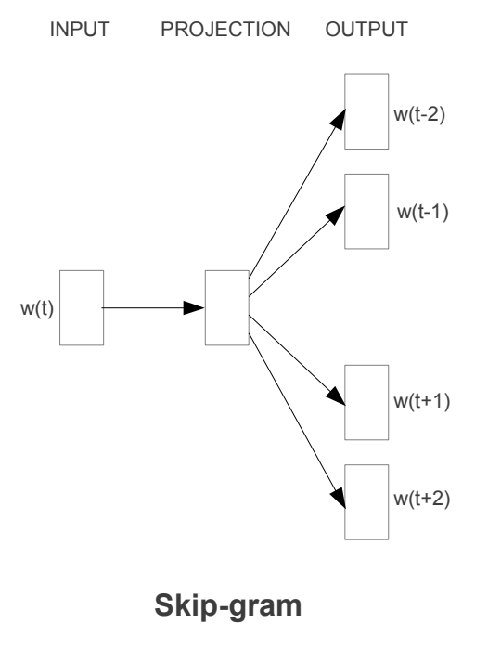
Word2Vec
Predict context words using a target word
I eat an orange every day.
orange
Prob.
PROJ
Maximize
eat

Slide 56
Word2Vec
Predict context words using a target word
I eat an orange every day.
orange
Prob.
PROJ
Maximize
an

Slide 57
Word2Vec
Predict context words using a target word
I eat an orange every day.
orange
Prob.
PROJ
Maximize
every

Slide 58
Word2Vec
Predict context words using a target word
I eat an orange every day.
orange
Prob.
PROJ
Maximize
day

Slide 59


Word2Vec
$$W_{in}$$
$$W_{out}$$
Embedding
Input word
Word probabilities

Slide 60




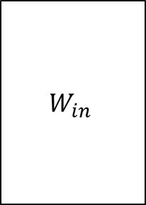
Word2Vec
$$h={W_{in}}^{T}x$$
$$W_{in}$$
0
0
0
0
1
0
$$h$$
$$W_{in}$$
$$=$$
Embedding
(D x 1)
(V x D)
(V x 1)
Input word

Slide 61


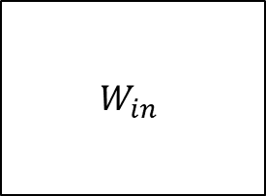
Word2Vec
$$h=W_{in}^{k} (k=index\left(x\right))$$
0
0
0
0
1
0
$$h$$
$$W_{in}$$
$$W_{in}$$
$$=$$
Embedding
(D x 1)
(D x V)
(V x 1)
Input word
We can use $W_{in}$as word embedding after training

Slide 62



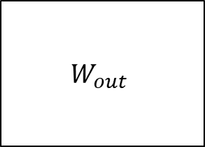
Word2Vec
$$y={softmax(W_{out}}^{T}h)$$
$$W_{out}$$
$$h$$
$$W_{out}$$
o
$$=$$
Embedding
(V x 1)
(D x V)
(D x 1)
Word probabilities

Slide 63

Word2Vec
$$y={softmax(W_{out}}^{T}h)$$
$$W_{out}$$
o
o’
y
exp
norm
Embedding
Word probabilities

Slide 64





Word2Vec
$$y={softmax(W_{out}}^{T}h)$$
$$h=W_{in}^{k}$$
$$W_{in}$$
$$W_{out}$$
$$y={softmax(W_{out}}^{T}W_{in}^{k})$$
Embedding
Input word
Word probabilities

Slide 65

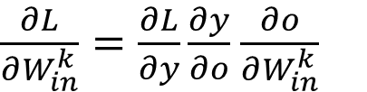
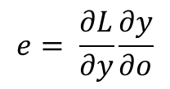
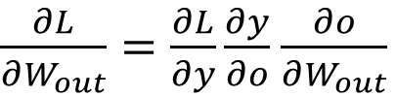

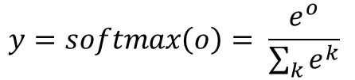
Word2Vec
$$o={W_{out}}^{T}W_{in}^{k}$$
$$y=softmax\left(o\right)= \frac{e^{o}}{\sum_{k}{e^{k}}}$$
$$L=CrossEntropy\left(y, t\right)=−t log\left(y\right)−\left(1−t\right)log(1−y)$$
$\frac{∂L}{∂W_{in}^{k}}=\frac{∂L}{∂y}\frac{∂y}{∂o}$ $\frac{∂o}{∂W_{in}^{k}}$
$$e= \frac{∂L}{∂y}\frac{∂y}{∂o}$$
$\frac{∂L}{∂W_{out}}=\frac{∂L}{∂y}\frac{∂y}{∂o}$ $\frac{∂o}{∂W_{out}}$
$$e_{j}= y_{j}− t_{j}$$

Slide 66


Word2Vec
$$o={W_{out}}^{T}W_{in}^{k}$$
$$y=softmax\left(o\right)= \frac{e^{o}}{\sum_{k}{e^{k}}}$$
$$L=CrossEntropy\left(y, t\right)=−t log\left(y\right)−\left(1−t\right)log(1−y)$$
$$\frac{∂L}{∂W_{in}^{k}}=W_{out} e$$
$$\frac{∂L}{∂W_{out}}=W_{in}^{k} e^{T}$$

Slide 67


Word2Vec
$$o={W_{out}}^{T}W_{in}^{k}$$
$$y=softmax\left(o\right)= \frac{e^{o}}{\sum_{k}{e^{k}}}$$
$$L=CrossEntropy\left(y, t\right)=−t log\left(y\right)−\left(1−t\right)log(1−y)$$
$$\frac{∂L}{∂W_{in}^{k}}=W_{out} e$$
$$W_{in}^{k}=W_{in}^{k}−η\frac{∂L}{∂W_{in}^{k}}$$
$$\frac{∂L}{∂W_{out}}=W_{in}^{k} e^{T}$$
$$W_{out}=W_{out}−η\frac{∂L}{∂W_{out}}$$

Slide 68
Word2Vec
$$o={W_{out}}^{T}W_{in}^{k}$$
*Xin Rong. word2vec Parameter Learning Explained
$$y=softmax\left(o\right)= \frac{e^{o}}{\sum_{k}{e^{k}}}$$
$$L=CrossEntropy\left(y, t\right)=−t log\left(y\right)−\left(1−t\right)log(1−y)$$
$$\frac{∂L}{∂W_{in}^{k}}=W_{out} e$$
$$W_{in}^{k}=W_{in}^{k}−η\frac{∂L}{∂W_{in}^{k}}$$
$$\frac{∂L}{∂W_{out}}=W_{in}^{k} e^{T}$$
$$W_{out}=W_{out}−η\frac{∂L}{∂W_{out}}$$

Slide 69
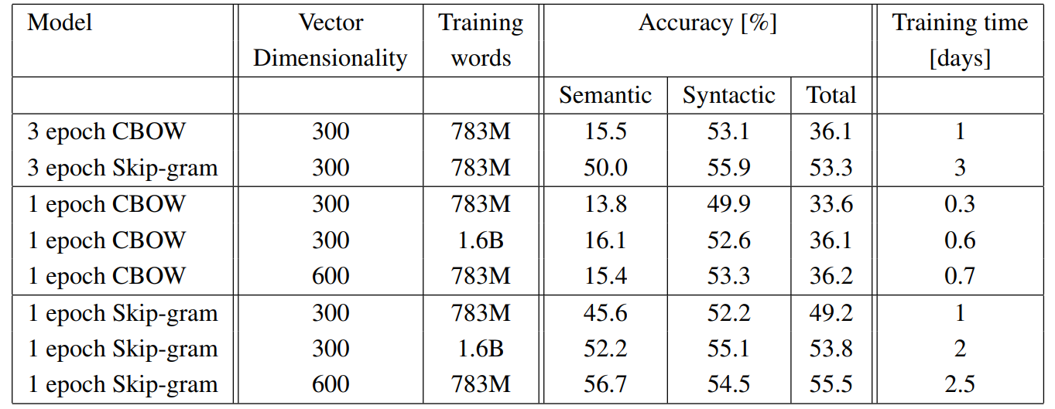
Word2Vec
CBOW vs Skip-gram

Slide 70
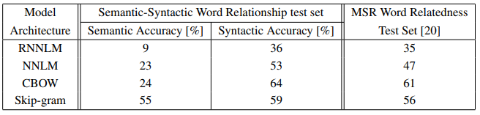
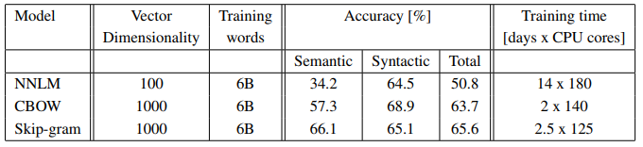
Word2Vec
Better and Faster

Slide 71
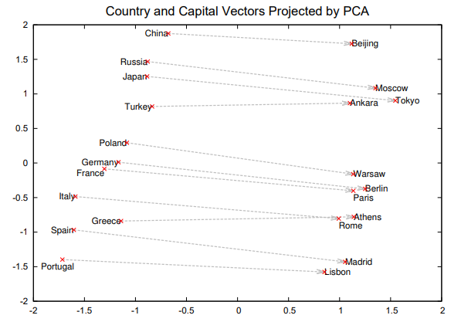
Word2Vec
Additive Compositionality
vec(“Paris”) - vec(“France”)
= vec(“Berlin”) - vec(“Germany”)

Slide 72
Word2Vec
Word2vec is very slow…
Why?

Slide 73


Word2Vec
No overhead
$$W_{in}$$
$$W_{out}$$

Slide 74
Word2Vec
Heavy overhead
$$W_{in}$$
$$W_{out}$$

Slide 75


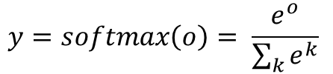
Word2Vec
Heavy overhead
The reason is…
Softmax function needs all values of the output vector
$$y=softmax\left(o\right)= \frac{e^{o}}{\sum_{k}{e^{k}}}$$
$$W_{in}$$
$$W_{out}$$

Slide 76
Word2Vec
Heavy overhead
The reason is…
Output dimension : V
Feature dimension : D
Complexity : O(V x D)
$$W_{in}$$
$$W_{out}$$

Slide 77
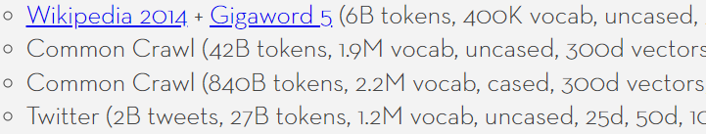
Word2Vec
Heavy overhead
The reason is…
Output dimension : V
Feature dimension : D
Complexity : O(V x D)
$$W_{in}$$
$$W_{out}$$

Slide 78
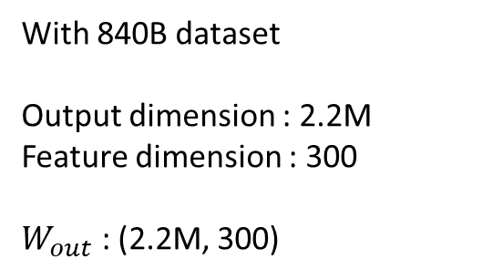
Word2Vec
Heavy overhead
With 840B dataset
Output dimension : 2.2M
Feature dimension : 300
$W_{out}$ : (2.2M, 300)
$$W_{in}$$
$$W_{out}$$

Slide 79
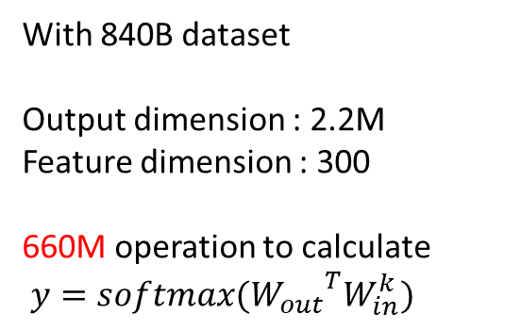
Word2Vec
Heavy overhead
With 840B dataset
Output dimension : 2.2M
Feature dimension : 300
660M operation to calculate
$y={softmax(W_{out}}^{T}W_{in}^{k})$
$$W_{in}$$
$$W_{out}$$

Slide 80
Word2Vec
Heavy overhead
With 840B dataset
Output dimension : 2.2M
Feature dimension : 300
840B tokens with window size 5
10 training pairs each word
660M x 8.4T operations an epoch
$$W_{in}$$
$$W_{out}$$

Slide 81
Word2Vec
Heavy overhead
The idea is…
Make use a portion of the output vector
$$W_{in}$$
$$W_{out}$$

Slide 82
Word2Vec
Hierarchical Softmax
1. Give every word a binary code (Huffman coding recommended)
ex) apple : 000
banana : 001
cherry : 010
…

Slide 83
Word2Vec
Hierarchical Softmax
2. Make a binary tree whose leaf nodes are the words
ex) apple : 000
banana : 001
cherry : 010
…
Suppose that 0 is the left and 1 is the right
0
1
2
3
4
5
6
apple
banana
cherry
…

Slide 84
Word2Vec
Hierarchical Softmax
3. Assign elements of the final layer of word2vec to the tree’s nodes
0
0
1
2
1
2
3
4
5
3
4
5
6
6
apple
banana
cherry
…

Slide 85

Word2Vec
Hierarchical Softmax
4. The elements are calculated in the same way of basic softmax, except for activation
0
0
1
Each node has sigmoid activation function
Instead of softmax
2
1
2
3
4
5
3
4
5
6
6
apple
banana
cherry
…

Slide 86







Word2Vec
Hierarchical Softmax
5. The probability of a word is a product of nodes on the way
0
0
1
$$σ(y_{0})$$
$$1−σ(y_{0})$$
2
$p\left(apple\right)= σ(y_{0})$ $σ(y_{1})$ $σ(y_{3})$
1
2
3
$$σ(y_{1})$$
$$1−σ(y_{1})$$
4
5
3
4
5
6
6
$$σ(y_{3})$$
apple

Slide 87






Word2Vec
Hierarchical Softmax
5. The probability of a word is a product of nodes on the way
0
0
1
$$σ(y_{0})$$
$$1−σ(y_{0})$$
2
1
2
$p\left(cherry\right)= σ(y_{0})$ $(1−σ\left(y_{1}\right))$ $σ(y_{3})$
3
$$σ(y_{1})$$
$$1−σ(y_{1})$$
4
5
3
4
5
6
6
$$σ(y_{4})$$
cherry

Slide 88
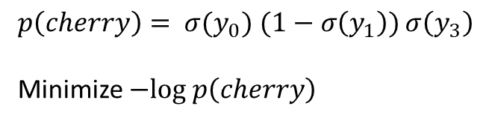
Word2Vec
Hierarchical Softmax
6. Maximize the probability by gradient descent on negative log likelihood
0
0
1
$$σ(y_{0})$$
$$1−σ(y_{0})$$
2
1
2
$p\left(cherry\right)= σ(y_{0})$ $(1−σ\left(y_{1}\right))$ $σ\left(y_{3}\right)$
Minimize $−log p\left(cherry\right)$
3
$$σ(y_{1})$$
$$1−σ(y_{1})$$
4
5
3
4
5
6
6
$$σ(y_{4})$$
cherry

Slide 89





Word2Vec
Hierarchical Softmax
Apple
Banana
Cherry
…
Watermelon
0
0
0
1
1
$$σ(y_{0})$$
$$1−σ(y_{0})$$
2
2
1
2
3
3
$$σ(y_{1})$$
$$1−σ(y_{1})$$
4
4
5
5
3
4
5
6
6
6
$$σ(y_{4})$$
cherry
Naïve Softmax
Vocabulary
Hierarchical Softmax
Hierarchical Tree

Slide 90


Word2Vec
Hierarchical Softmax
7. Weights connected to the activated nodes are updated
X
$$W_{in}$$
$$W_{out}$$

Slide 91







Word2Vec
Hierarchical Softmax
0
0
On average, only $\log\left(V\right)$ nodes are activated
1
$$σ(y_{0})$$
$$1−σ(y_{0})$$
With 840B dataset
Output dimension : 2.2M
Feature dimension : 300
Average activated nodes : 21
6.3k operation to calculate
$y={softmax(W_{out}}^{T}W_{in}^{k})$
Basic softmax : 660M
2
1
2
3
$$σ(y_{1})$$
$$1−σ(y_{1})$$
4
5
3
4
5
6
6
$$1−σ(y_{3})$$
banana

Slide 92
Word2Vec
Word2vec is still slow…

Slide 93
Word2Vec
Negative Sampling
0
1
2
1 of positive sample
V-1 of negative samples
Approximate the softmax function
only using k negative samples
3
4
5
6

Slide 94
Word2Vec
Negative Sampling
How many samples
1?
5-10?
Half of the negatives?
0
1
2
Sigmoid output
k negative samples
3
2
1
4
How to sample
Uniformly?
Linearly?
With some heuristic function?
4
5
6

Slide 95
Word2Vec
Negative Sampling
How many samples
5~15 samples recommended
3~5 samples enough on big corpus
0
1
2
Sigmoid output
k negative samples
3
2
1
4
How to sample
Frequency^(3/4)
4
5
6

Slide 96
Word2Vec
Negative Sampling
0
Design loss function to maximize the positive and to minimize the negatives
1
2
L = -log( ) - log((1- )(1- )(1- ))
5
1
2
4
3
4
Then the gradient descent algorithm optimizes the network
5
6

Slide 97

Word2Vec
Negative Sampling
With 840B dataset
Output dimension : 2.2M
Feature dimension : 300
Average activated nodes : 1 + 5
1.8k operation to calculate
$y={softmax(W_{out}}^{T}W_{in}^{k})$
Basic softmax : 660M
Hierarchical softmax : 6.3k
0
1
2
Only k nodes are activated
3
4
5
6

Slide 98

Word2Vec
Even faster but..
With 840B dataset
Window size : 5
Basic softmax : 660M x 8.4T
Hierarchical softmax : 6.3k x 8.4T
Negative Sampling : 1.8k x 8.4T

Slide 99
Word2Vec
Another idea is…
The orange is the fruit of the citrus species Citrus × sinensis in the family Rutaceae. It is also called sweet orange, to distinguish it from the related Citrus × aurantium, referred to as bitter orange. The sweet orange reproduces asexually varieties of sweet orange arise through mutations.
Highly frequent words are actually meaningful?

Slide 100

Word2Vec
Subsampling
The orange is the fruit of the citrus species Citrus × sinensis in the family Rutaceae. It is also called sweet orange, to distinguish it from the related Citrus × aurantium, referred to as bitter orange. The sweet orange reproduces asexually varieties of sweet orange arise through mutations.
Discard frequent words with probability

Slide 101

Word2Vec
Subsampling

Slide 102
Assignment 2
Word2Vec Implementation
CBOW and Skip-gram
Forward path
Backward path
Return : cost value and gradient of two word vectors

Slide 103


Assignment 2
$$y={softmax(W_{out}}^{T}W_{in}^{k})$$

Slide 104



Assignment 2
$h=W_{in}^{k_{1}}+W_{in}^{k_{2}}$+ $W_{in}^{k_{3}}$+ $W_{in}^{k_{4}}$
$$y={softmax(W_{out}}^{T}h)$$

Slide 105
Submission 2
Due date : ~4/14(일) 23:59
Submission : Online submission on blackboard
word2vec.py + 2 screenshots of results (Skip-gram / CBOW)
You must implement the components yourself!
File name : StudentID_Name.zip

Slide 106
Assignment 3
Word2Vec Implementation
Hierarchical Softmax
Assign binary code(Huffman coding)
Train with only weights connected to the activated nodes
Return : cost value and gradient of two word vectors
Negative Sampling
Frequency table
Random sampling during training
Return : cost value and gradient of two word vectors
Subsampling
Read(preprocess) corpus and make dictionary
Subsample corpus in every epoch

Slide 107
Assignment 3
Word2Vec Experiment
Analogical reasoning task[1][2]
“Germany” : “Berlin” :: “France” : ?
vec(x) =vec(“Berlin”) - vec(“Germany”) + vec(“France”)
Find the word x using cosine similarity
(Question words are zeroed)
[1] http://code.google.com/p/word2vec/source/browse/trunk/questions-words.txt
[2] Tomas Mikolov et al. Distributed Representations of Words and Phrases and their Compositionality, 2013

Slide 108

Assignment 3
Word2Vec Experiment
Analogical reasoning task[1]
“Germany” : “Berlin” :: “France” : ?
vec(x) =vec(“Berlin”) - vec(“Germany”) + vec(“France”)
Find the word x using cosine similarity
(Question words are zeroed)
[1] http://code.google.com/p/word2vec/source/browse/trunk/questions-words.txt
[2] Tomas Mikolov et al. Distributed Representations of Words and Phrases and their Compositionality, 2013

Slide 109
Assignment 3
Word2Vec 실험
Analogical reasoning task[1][2]
CBOW or Skip-gram
Hierarchical Softmax or Negative Sampling or Basic Softmax
Subsampling or not
Corpus : text8, 1B tokens corpus
[1] http://code.google.com/p/word2vec/source/browse/trunk/questions-words.txt
[2] Tomas Mikolov et al. Distributed Representations of Words and Phrases and their Compositionality, 2013

Slide 110
Submission 3
Due Date : ~4/28(일) 23:59
Submission : Submission : Online submission on blackboard
word2vec.py + Report with analysis of word analogy task(.docx / .hwp)
You must implement the components yourself!
File name : StudentID_Name.zip

Slide 111
Q&A
조교 박준형 : irish07@korea.ac.kr

