Slide 1

Analysis of Top Hits Spotify from 2000-2019
By team 12
team members:
Yuchen Li
Weiqi Hong

Slide 2

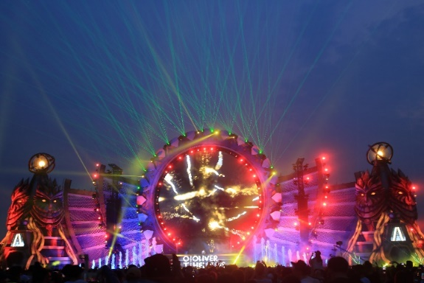
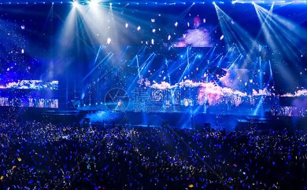
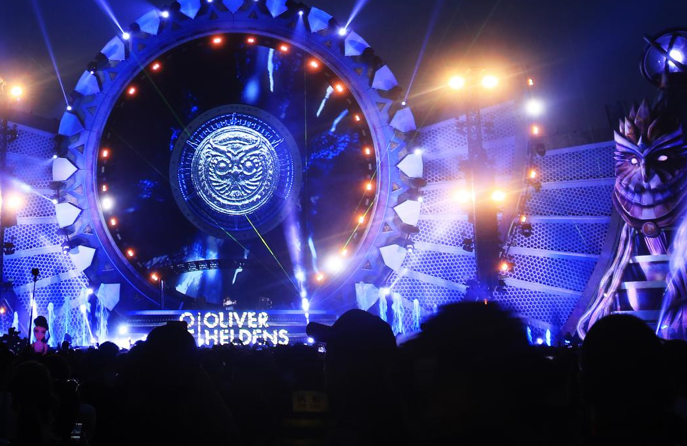
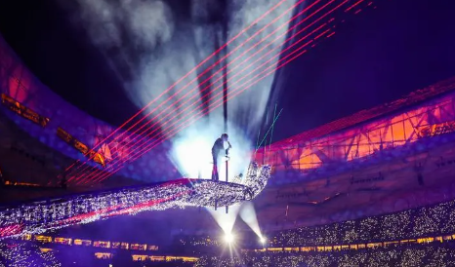
Introduction
1
CONTENTS目录
工作汇报概述
And I've waited longer for you than I've waited for any woman.
2
Production life has changed dramatically from 2000 to 2019. As an important force in the cultural field, how have people's preferences for music changed in these two decades?
成功项目展示
And I've waited longer for you than I've waited for any woman.
3
效益成果展示
And I've waited longer for you than I've waited for any woman.
4
明年工作计划
And I've waited longer for you than I've waited for any woman.

Slide 3
Dataset description
dataset: Top Hits Spotify from 2000-2019(from Kaggle)
Top Hits Spotify from 2000-2019 | Kaggle
1
工作汇报概述
CONTENTS目录
And I've waited longer for you than I've waited for any woman.
2
成功项目展示
This dataset contains audio statistics of the nearly top 2000 songs on Spotify from 2000-2019. The data contains about 18 columns each describing the song and it's qualities.
And I've waited longer for you than I've waited for any woman.
3
效益成果展示
Sample:
And I've waited longer for you than I've waited for any woman.
4
明年工作计划
And I've waited longer for you than I've waited for any woman.

Slide 4
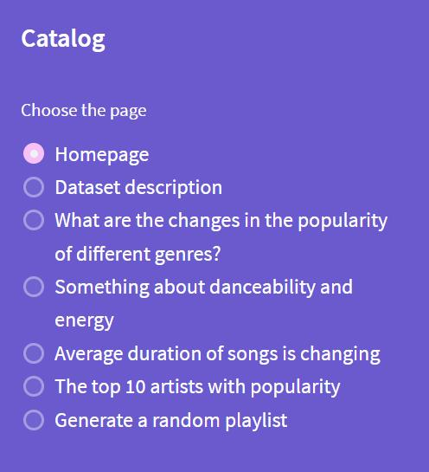
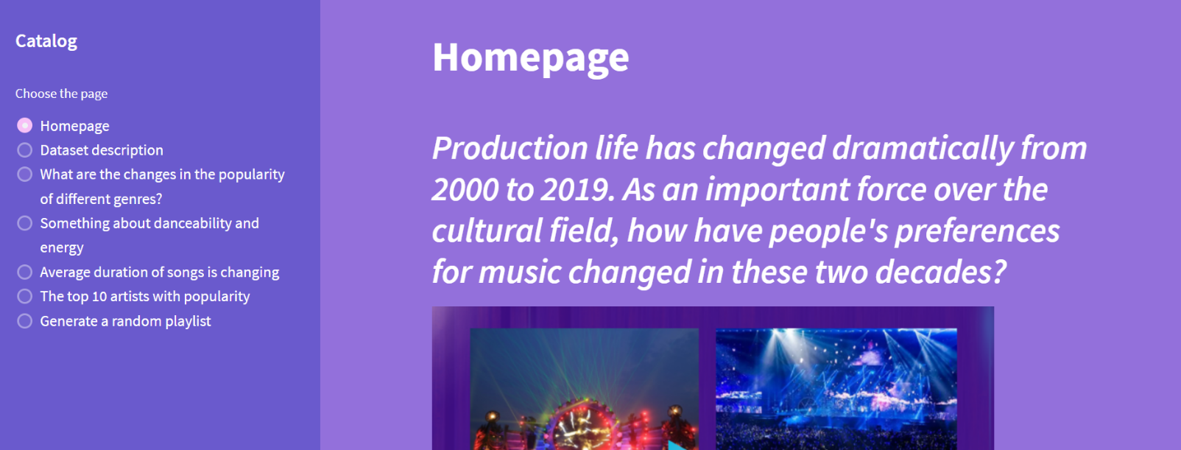
Project display
We present the five aspects of our project in an interactive way, flanked by selection boxes, and the corresponding research questions will appear when you tap on one.
1
工作汇报概述
CONTENTS目录
And I've waited longer for you than I've waited for any woman.
2
成功项目展示
And I've waited longer for you than I've waited for any woman.
3
效益成果展示
And I've waited longer for you than I've waited for any woman.
4
明年工作计划
And I've waited longer for you than I've waited for any woman.

Slide 5
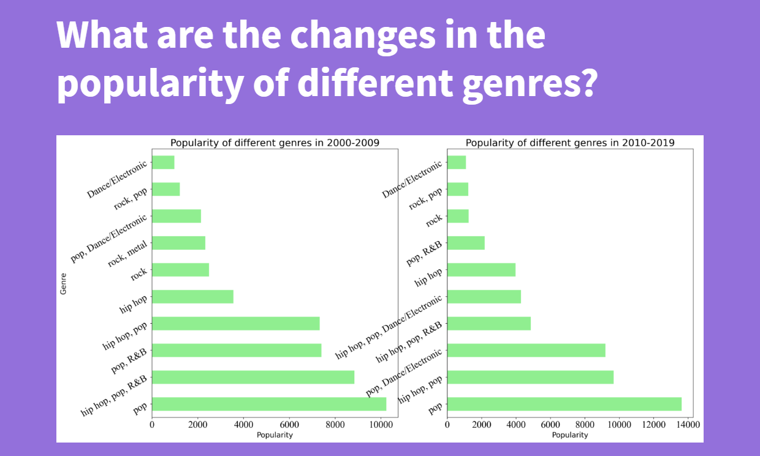
Changes in popularity of different genres
1
工作汇报概述
Pop music has the highest number of hits in both decades, while the ranking of popularity of the rest of the genres are constantly changing.
There are multiple style elements in one genre, the changes in the popularities of the genres are caused by changes in people's preferences for style elements.
（R&B ——Dance/Electronic）
CONTENTS目录
And I've waited longer for you than I've waited for any woman.
2
成功项目展示
And I've waited longer for you than I've waited for any woman.
3
效益成果展示
And I've waited longer for you than I've waited for any woman.
4
明年工作计划
And I've waited longer for you than I've waited for any woman.

Slide 6
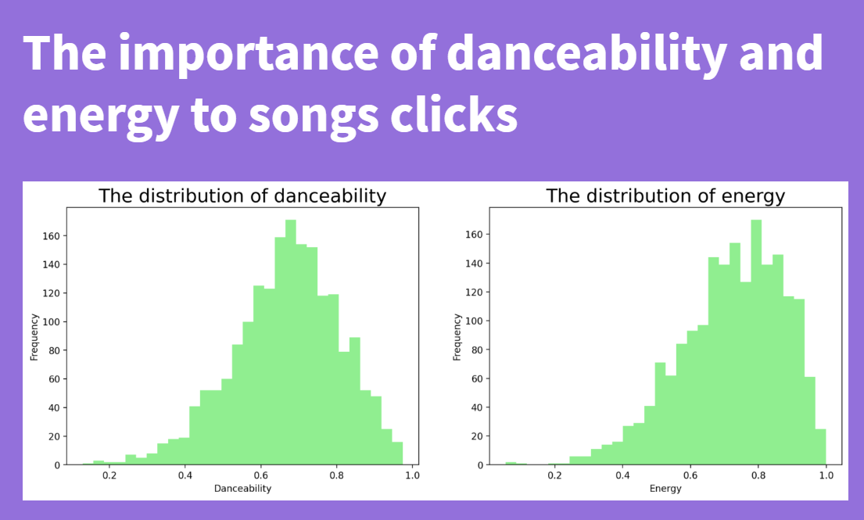
The distribution of danceability and energy
1
工作汇报概述
The danceability and energy of these songs are concentrated on high values.
We speculate that due to the emergence of various boy bands and girl groups now, people prefer songs that can be used as dance music.
CONTENTS目录
And I've waited longer for you than I've waited for any woman.
2
成功项目展示
And I've waited longer for you than I've waited for any woman.
3
效益成果展示
And I've waited longer for you than I've waited for any woman.
4
明年工作计划
And I've waited longer for you than I've waited for any woman.

Slide 7
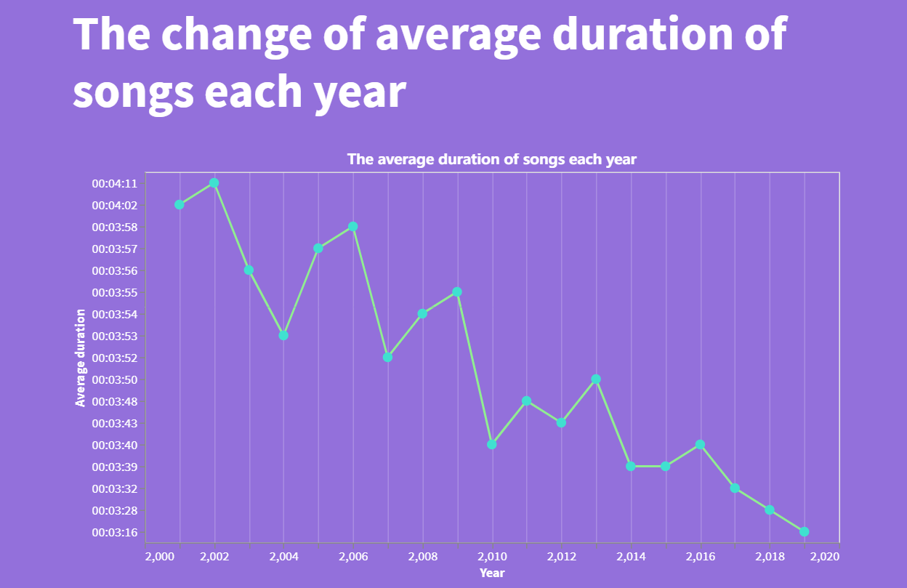
Change of average duration
1
工作汇报概述
CONTENTS目录
The analysis shows a shortening trend in song duration over these two decades.
-The era of fragmentation -Listen to songs at double speed -The listener's patience is worn out
……
And I've waited longer for you than I've waited for any woman.
2
成功项目展示
And I've waited longer for you than I've waited for any woman.
3
效益成果展示
And I've waited longer for you than I've waited for any woman.
4
明年工作计划
And I've waited longer for you than I've waited for any woman.

Slide 8
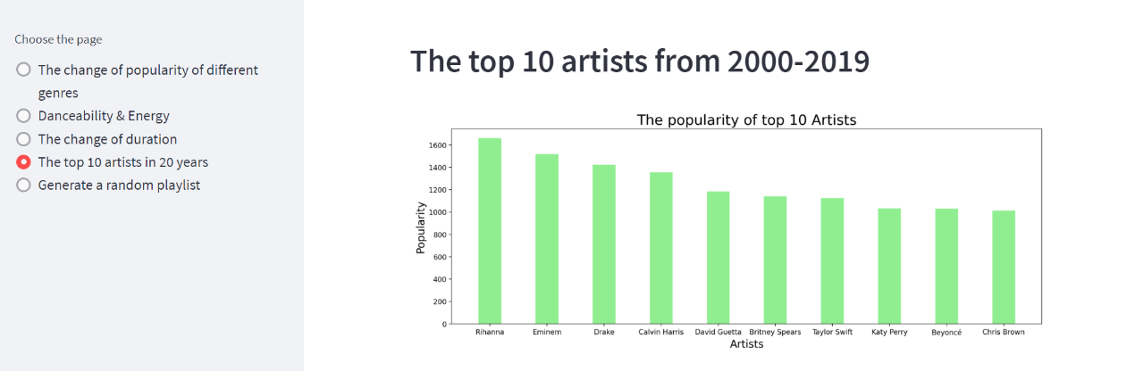
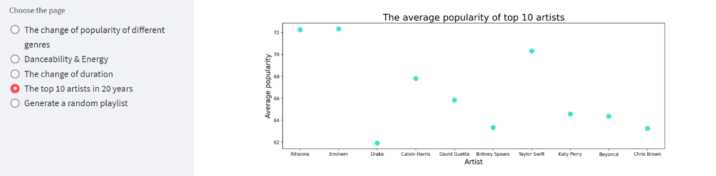
The top 10 artists
1
工作汇报概述
We have screened the top 10 most popular singers. We measured this by the sum of the popularity of all their songs.
CONTENTS目录
And I've waited longer for you than I've waited for any woman.
2
成功项目展示
And I've waited longer for you than I've waited for any woman.
We calculated the average number of hits for each of these ten artists' songs. It was found that there is no complete positive correlation between the average number of hits and their own popularity. (Taylor)
3
效益成果展示
And I've waited longer for you than I've waited for any woman.
4
明年工作计划
And I've waited longer for you than I've waited for any woman.

Slide 9
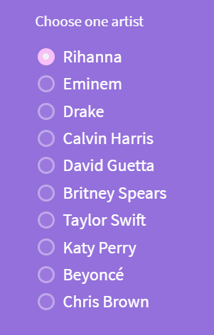
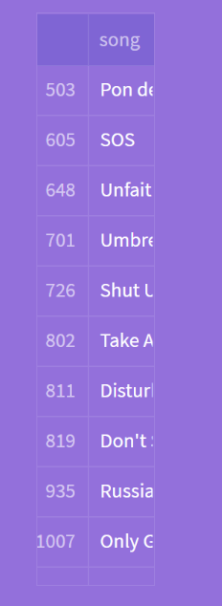
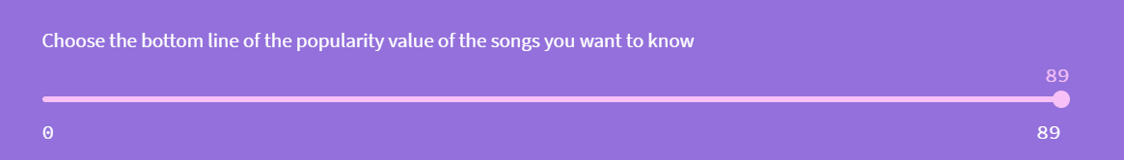
Function 1
1
工作汇报概述
CONTENTS目录
And I've waited longer for you than I've waited for any woman.
We list the top 10 artists with choice point.
2
成功项目展示
The user can choose his/her favorite artist.
And I've waited longer for you than I've waited for any woman.
Then he/she can select the bottom line of the popularity of the songs of that artist.
3
效益成果展示
And I've waited longer for you than I've waited for any woman.
We will return the list of songs.
4
明年工作计划
And I've waited longer for you than I've waited for any woman.

Slide 10
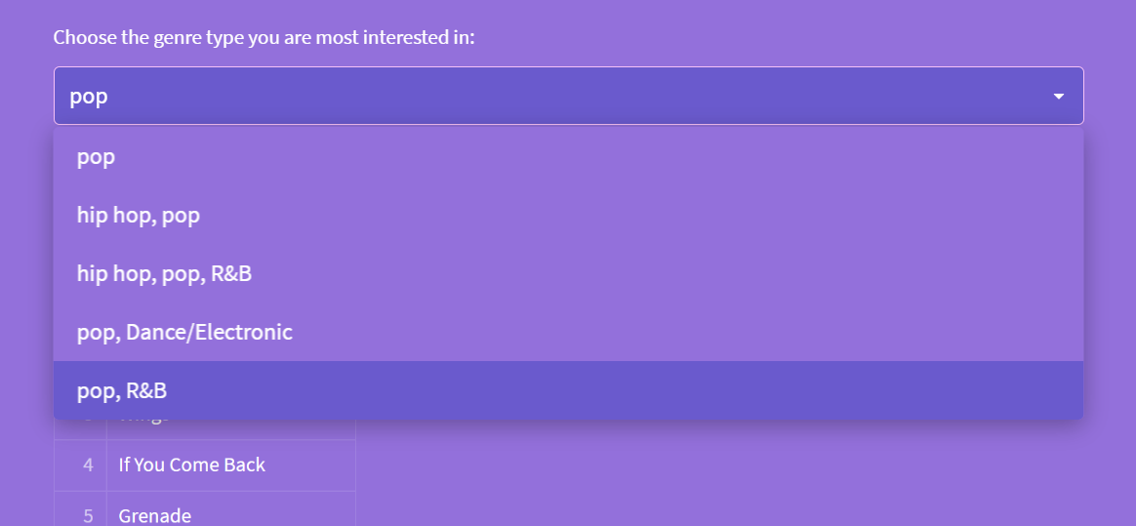
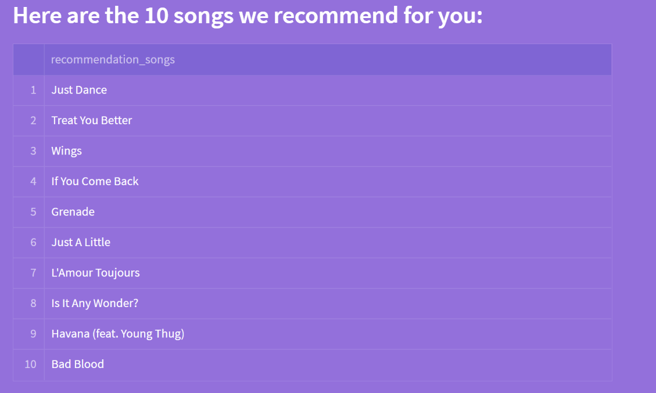
Function 2
1
工作汇报概述
We have selected the top 5 genres with the most popularity in 20 years.
CONTENTS目录
And I've waited longer for you than I've waited for any woman.
2
成功项目展示
Users can choose one of the 5 genres they are interested in.
And I've waited longer for you than I've waited for any woman.
3
效益成果展示
We will randomly generate a playlist of 10 songs for them.
And I've waited longer for you than I've waited for any woman.
4
明年工作计划
And I've waited longer for you than I've waited for any woman.

Slide 11
Thanks for listening

