Slide 1
Benchmarking Biomedical Image Classification Models
Charlie Ko, Lars Schimmelpfennig, Xuexuan Wang, Chaoyu Zhang

Slide 2
Motivation
1. Dataset Utilization: Evaluate the performance of deep learning models in classifying colorectal cancer histology images.
2. Accuracy Enhancement: Try to surpass the baseline accuracy reported in previous studies.
3. SENet Evaluation: Test the effectiveness of SENet in different CNN models and image resolutions.

Slide 3
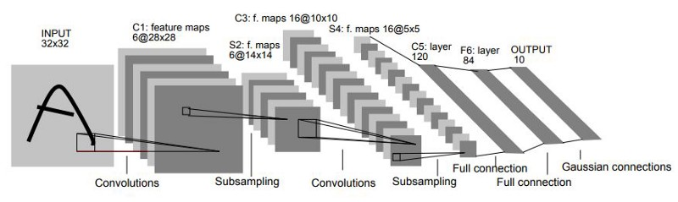
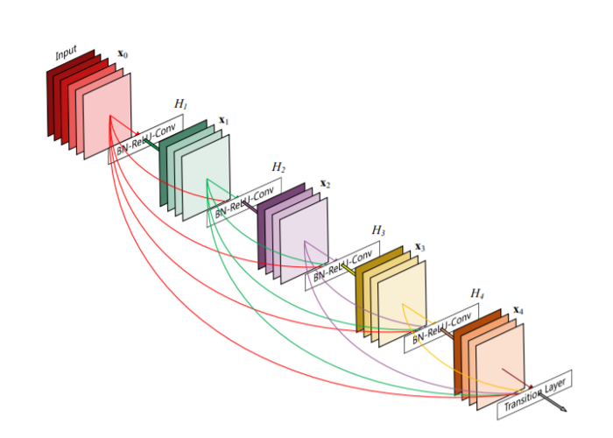
LeNet-5 – most simple model
ResNet – uses residual connections.

Slide 4
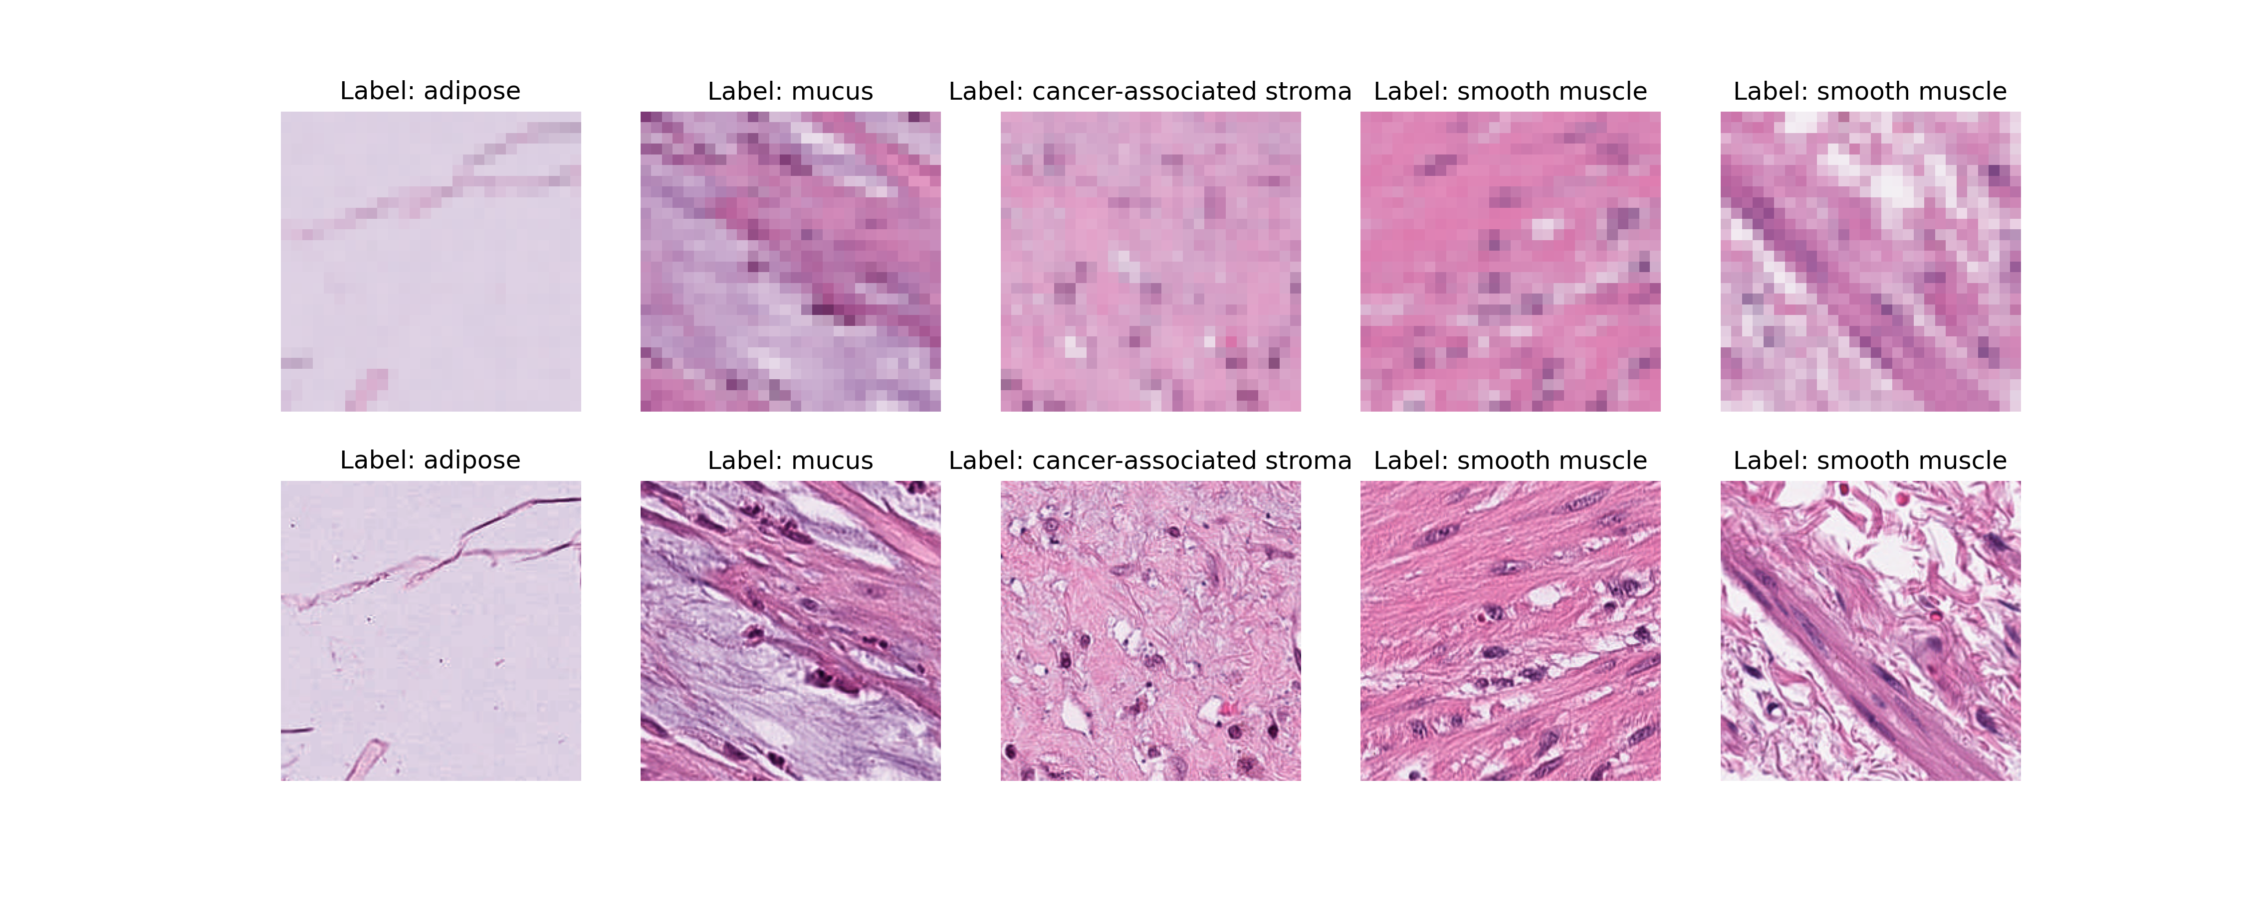
MedMNIST
28x28
224x224

Slide 5
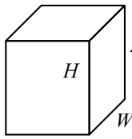
SENet finds attention values for each color channel of an image to reduce noise.
SENet
Learned attention weights: .5, 1, .5

Slide 6
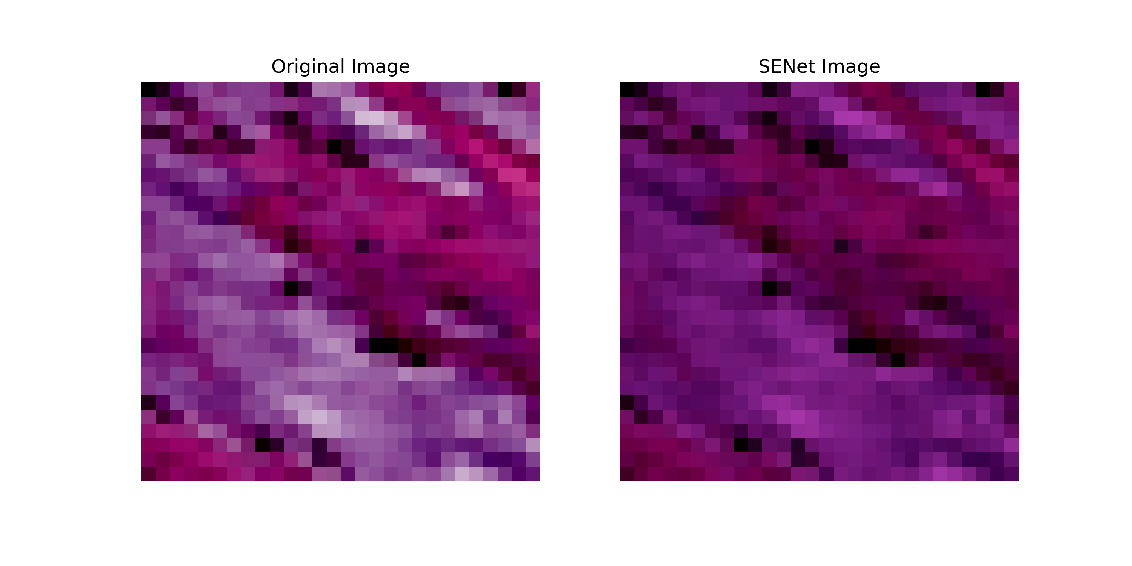
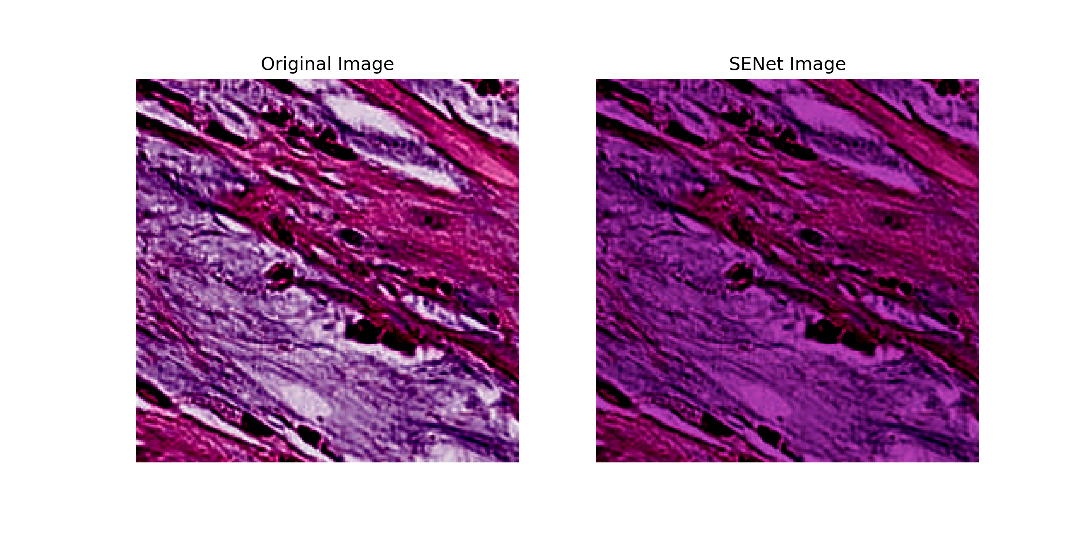
Impact of SENet on images
28x28
Example Learned RGB Weights:
0.8, 0.3, 0.8
224x224

Slide 7
Parallel Job Information
2 GPUs used for each job, example names: NVIDIA A100-SXM4-80GB, NVIDIA GeForce RTX 2080 Ti, NVIDIA L40.
Each job uses ~33.8 GB Disk, ~18.4 GB Memory
model_list.txt
--model LeNet --image_size 28 --use_se
--model LeNet --image_size 28
--model LeNet --image_size 224 --use_se
--model LeNet --image_size 224
--model ResNet --image_size 28 --use_se
--model ResNet --image_size 28
--model ResNet --image_size 224 --use_se
--model ResNet --image_size 224
queue model from model_list.txt
CHTC

Slide 8
Requesting GPU Resources
+WantGPULab = true
Clearly communicates to the job scheduler that our task requires GPU resources.
+GPUJobLength = "medium”
Informs the scheduler that our job has a medium length, helping it allocate resources efficiently.

Slide 9
Setting Up the Python Environment
run_python.sub
run_python.sh
…
executable = ./run_python.sh
arguments ="$(model)"
should_transfer_files = YES
when_to_transfer_output = ON_EXIT
transfer_input_files = http://proxy.chtc.wisc.edu/SQUID/chtc/python39.tar.gz, packages.tar.gz,data.tar, model_train.py, model.py,model_list.txt
+WantGPULab = true
+GPUJobLength = "medium"
…
queue model from model_list.txt
#!/bin/bash
tar -xzf python39.tar.gz
tar -xzf packages.tar.gz
tar -xvf data.tar
export PATH=$PWD/python/bin:$PATH
export PYTHONPATH=$PWD/packages
export HOME=$PWD
# run your script
python3 model_train.py $@
Running model_train.py with our Python setup

Slide 10
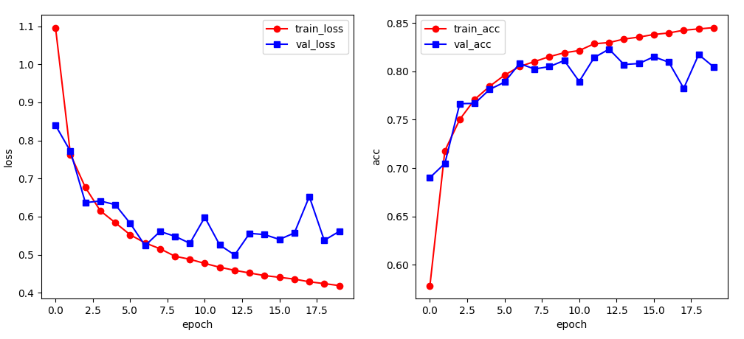
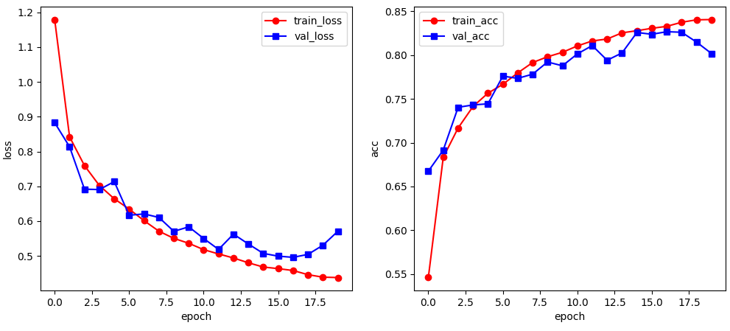
Training Results – LeNet 28x28
LeNet 28x28 without SENet
LeNet 28x28 with SENet
SENet did not have significant effect on performance
LeNet had significant overfitting with 224x224

Slide 11
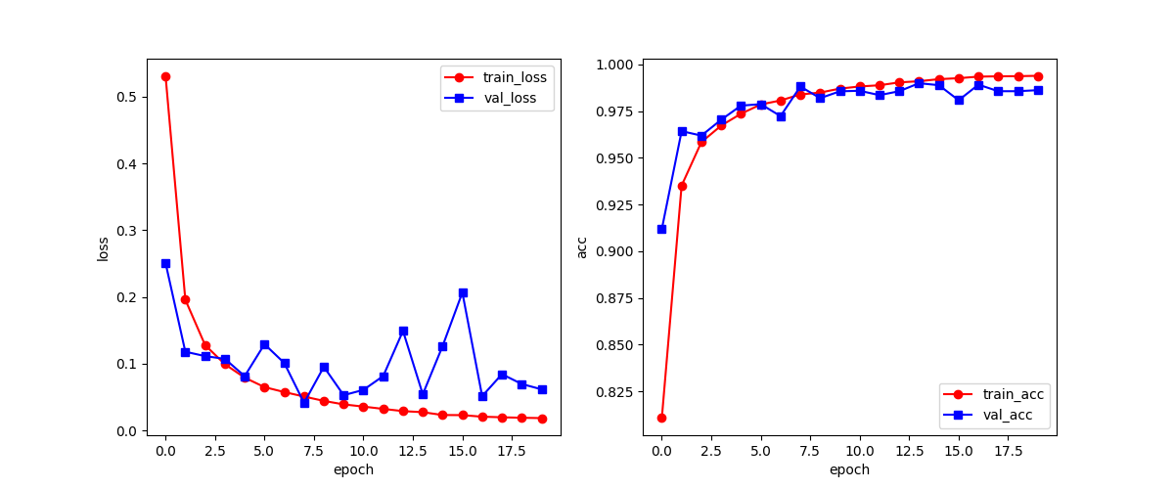
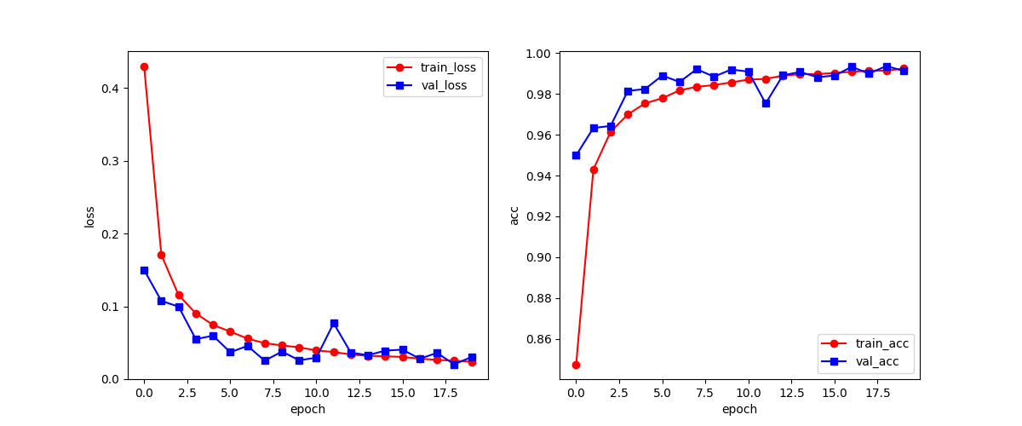
Training Results – ResNet 224x224
224x224 without SENet
224x224 with SENet
SENet provides improvements with ResNet

Slide 12
Benchmarking Results
Model | Image Size | SENet | PathMNIST Test Accuracy | Training Time (minutes)
LeNet | 28x28 | ☑ | 0.754 | 27
 |  | ⮽ | 0.770 | 14
 | 224x224 | ☑ | 0.769 | 49
 |  | ⮽ | 0.829 | 41.5
ResNet | 28x28 | ☑ | 0.842 | 137
 |  | ⮽ | 0.855 | 110
 | 224x224 | ☑ | 0.920 | 464.3
 |  | ⮽ | 0.850 | 206
Baseline: ResNet-50 | 28x28 | ⮽ | 0.911 | ~
 | 224x224 | ⮽ | 0.892 | ~

Slide 13
Conclusions and Future directions
SENet provided significant benefit to the test accuracy of ResNet with the large image size.
LeNet is an old model: we would be very interested to see if SENet improves performance for other models and image types.

Slide 14
References
https://medium.com/codex/kernels-filters-in-convolutional-neural-network-cnn-lets-talk-about-them-ee4e94f3319
Squeeze-and-Excitation Networks https://doi.org/10.48550/arXiv.1709.01507
https://www.datasciencecentral.com/lenet-5-a-classic-cnn-architecture/
https://datagen.tech/guides/computer-vision/resnet/

