Slide 2
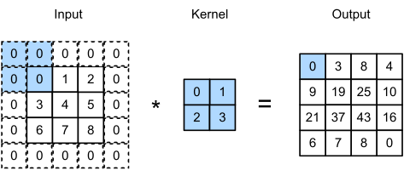
Overview of Convolutional Neural Networks

Slide 3
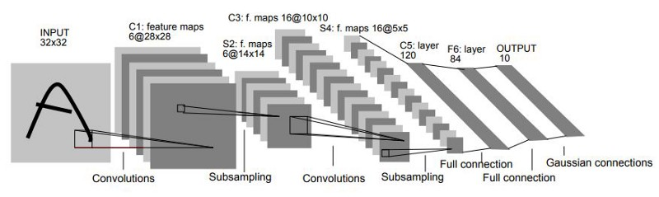
LeNet-5

Slide 4
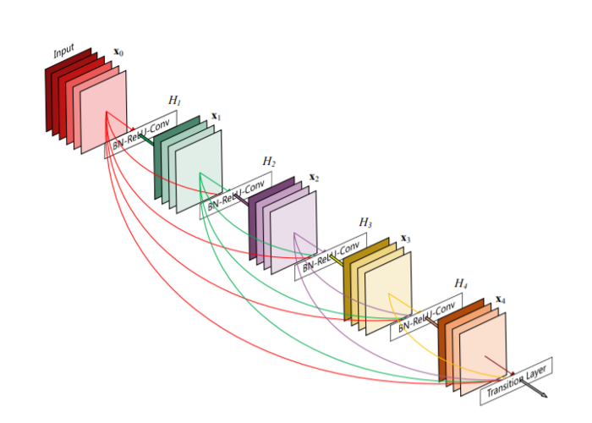
ResNet – uses residual connections. Output of earlier layers are used as input of future layers.

Slide 5
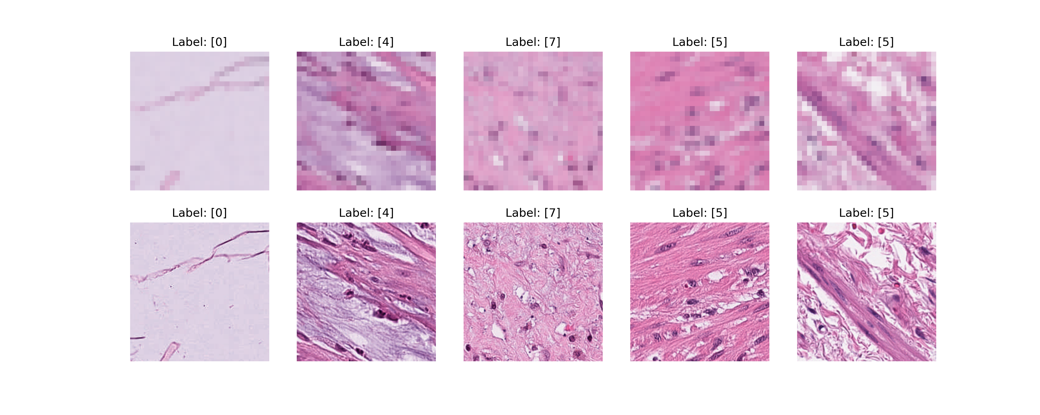
MedMNIST
28x28
224x224

Slide 6
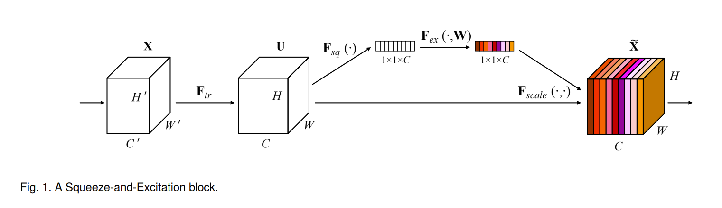
SENet finds attention values for each color channel of an image to reduce noise.

Slide 7
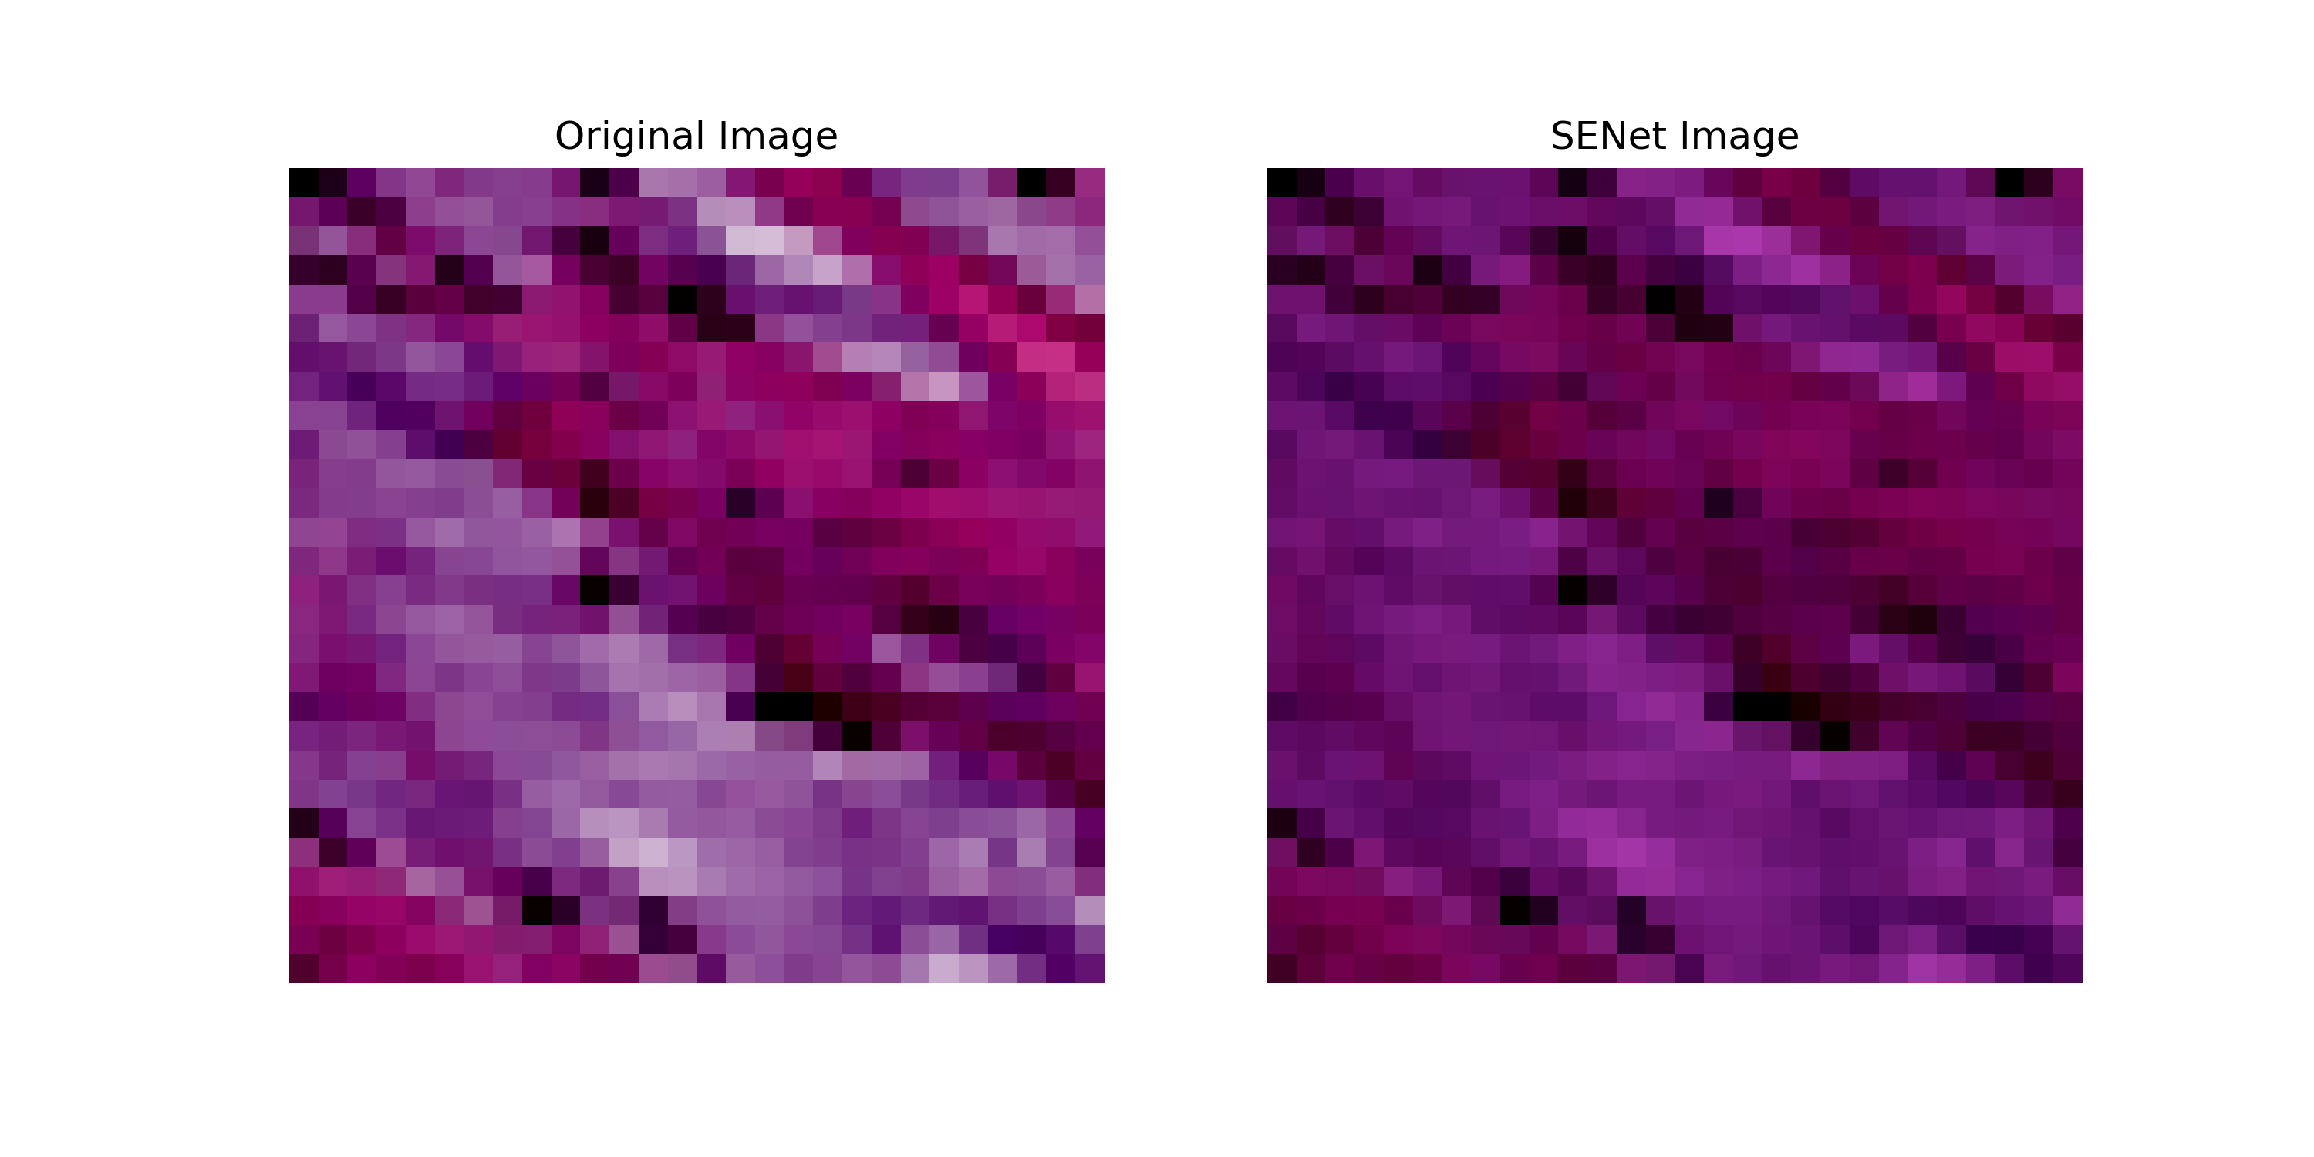
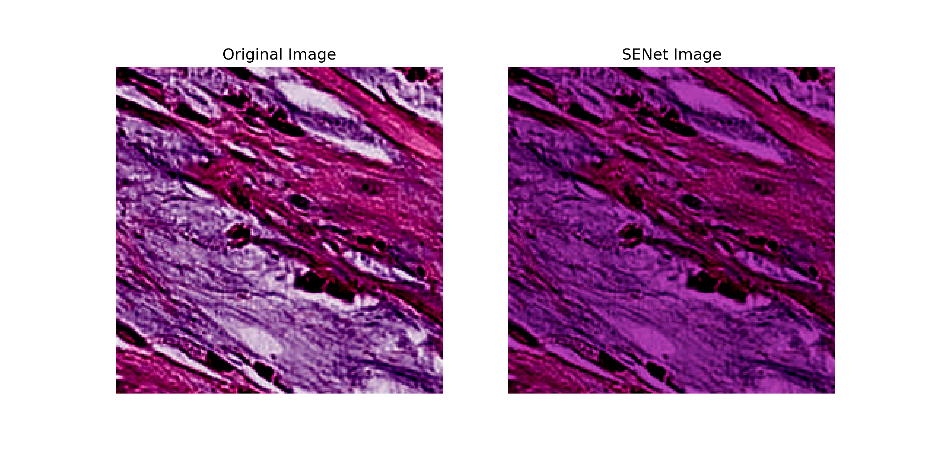
Impact of SENet on images
28x28
Example Learned RGB Weights:
0.8, 0.3, 0.8
224x224

Slide 8
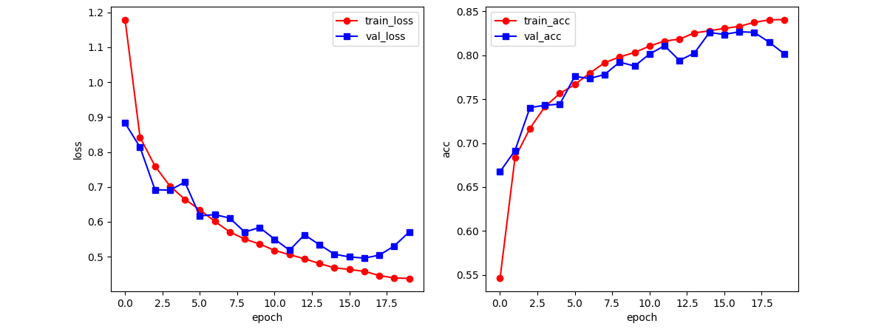
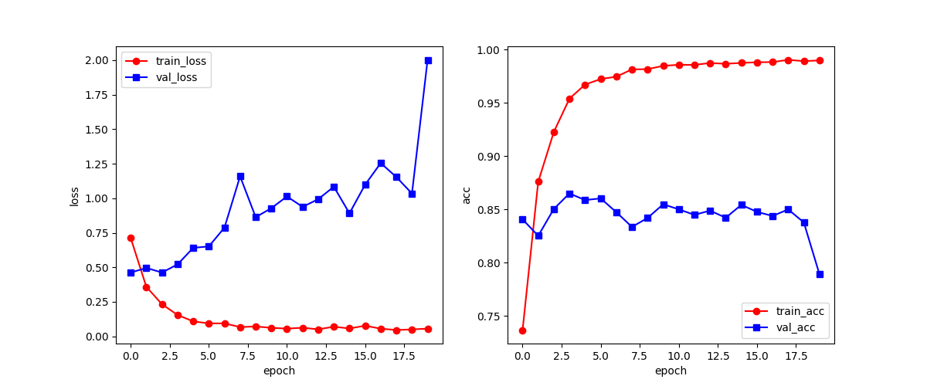
Training Results - LeNet
LeNet 28x28 without SENet
SENet did not have significant effect on performance
LeNet 224x224 SENet
LeNet has significant overfitting with and without SENet

Slide 9
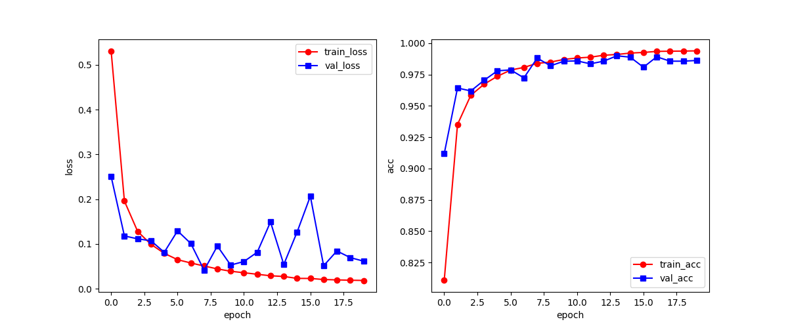
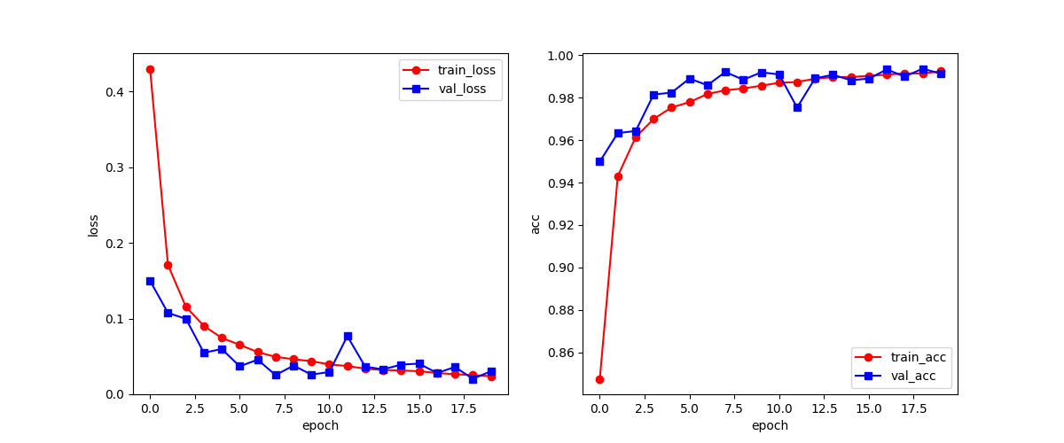
Training Results - ResNet
224x224 without SENet
224x224 with SENet
SENet provides improvements with ResNet

Slide 10
Benchmarking Results
Model | Image Size | SENet | PathMNIST Test Accuracy
LeNet | 28x28 | ☑ | 0.754
 |  | ⮽ | 0.770
 | 224x224 | ☑ | 0.769
 |  | ⮽ | 0.829
ResNet | 28x28 | ☑ | 0.842
 |  | ⮽ | 0.855
 | 224x224 | ☑ | 0.920
 |  | ⮽ | 0.850
Baseline: ResNet-50 | 28x28 | ⮽ | 0.911
 | 224x224 | ⮽ | 0.892

Slide 11
References
https://medium.com/codex/kernels-filters-in-convolutional-neural-network-cnn-lets-talk-about-them-ee4e94f3319
Squeeze-and-Excitation Networks https://doi.org/10.48550/arXiv.1709.01507
https://www.datasciencecentral.com/lenet-5-a-classic-cnn-architecture/
https://datagen.tech/guides/computer-vision/resnet/

