Slide 1
Benchmarking Biomedical Image Classification Models
Charlie Ko, Lars Schimmelpfennig, Xuexuan Wang, Chaoyu Zhang

Slide 2
Motivation
1. Dataset Utilization: Evaluate the performance of deep learning models in classifying colorectal cancer histology images.
2. Accuracy Enhancement: Try to surpass the baseline accuracy reported in previous studies.
3. SENet Evaluation: Test the effectiveness of SENet in different CNN models and image resolutions.

Slide 3
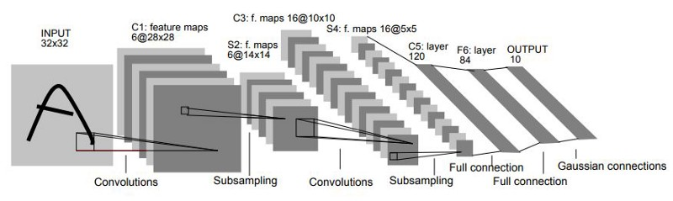
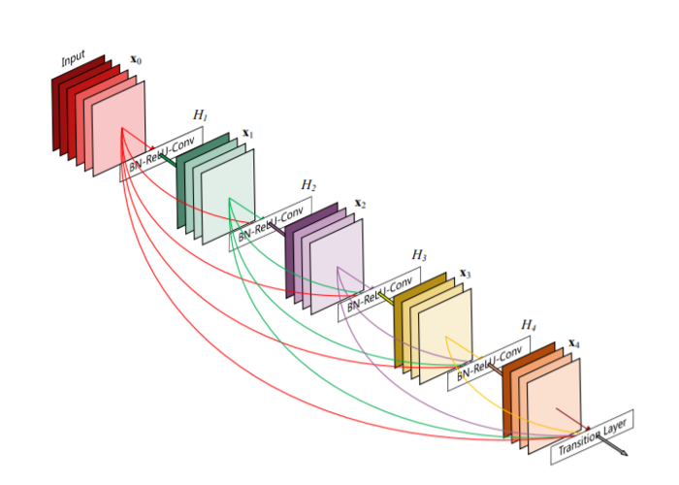
LeNet-5 – most simple model
ResNet – uses residual connections.

Slide 4
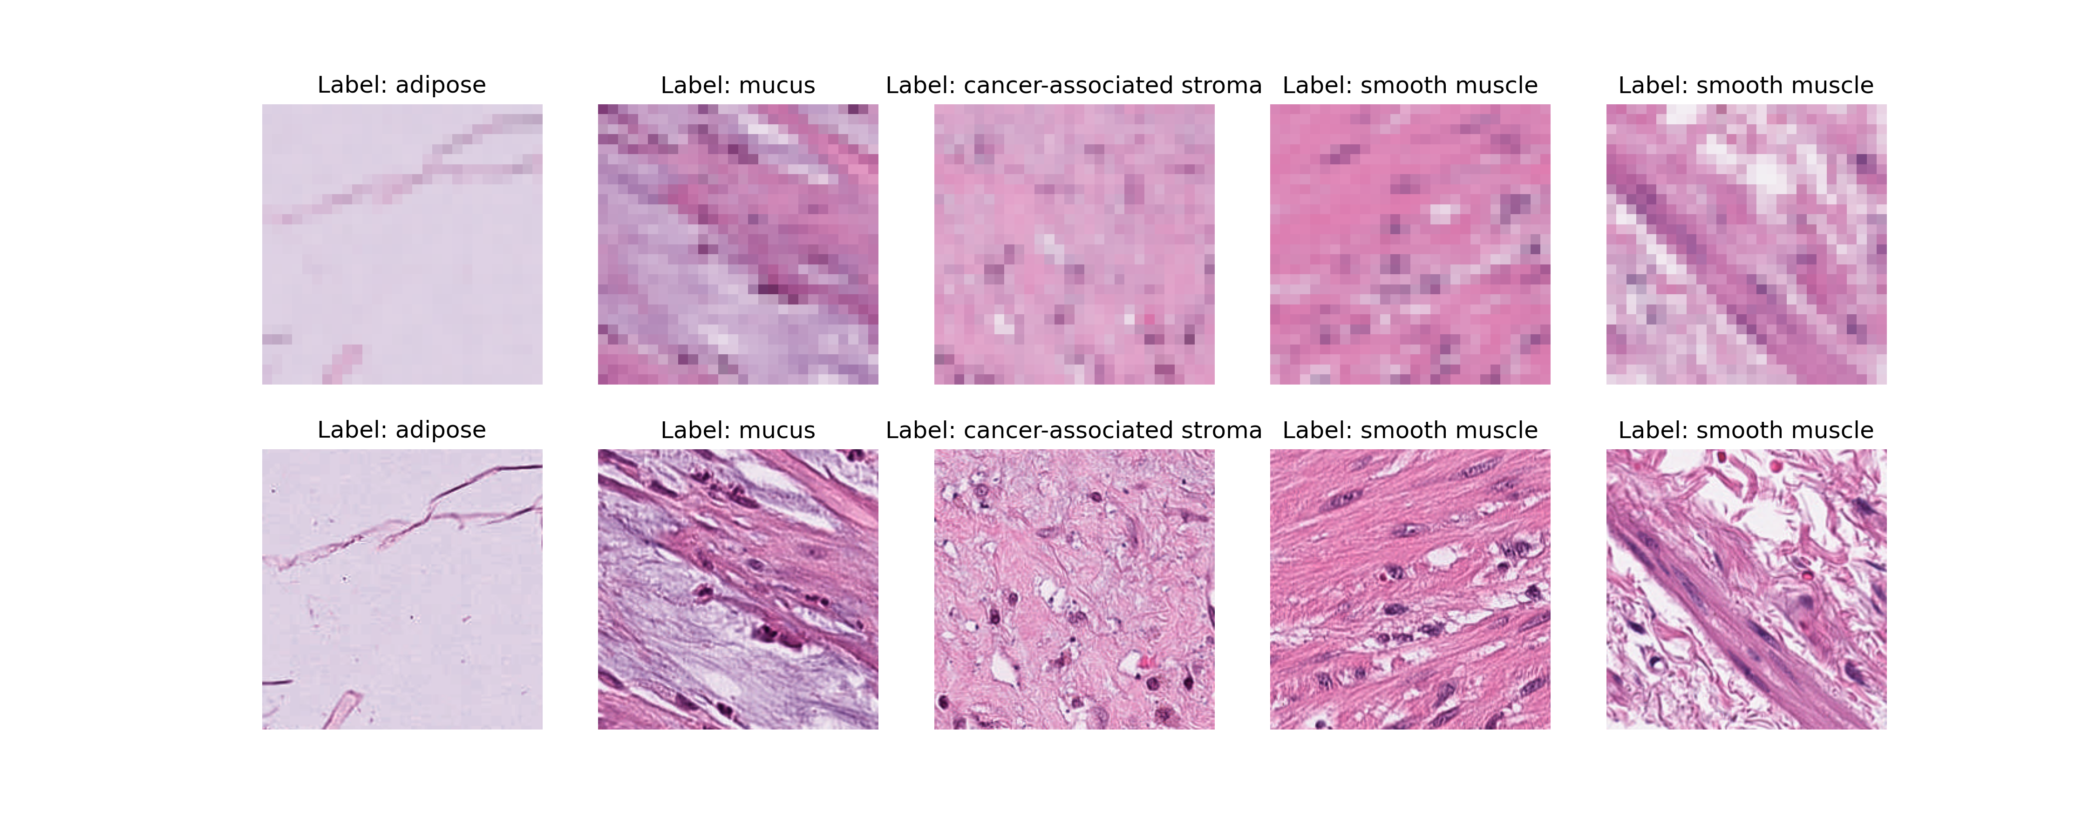
MedMNIST
28x28
224x224

Slide 5
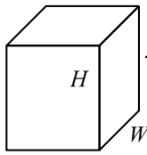
SENet finds attention values for each color channel of an image to reduce noise.
SENet
Learned attention weights: .5, 1, .5

Slide 6
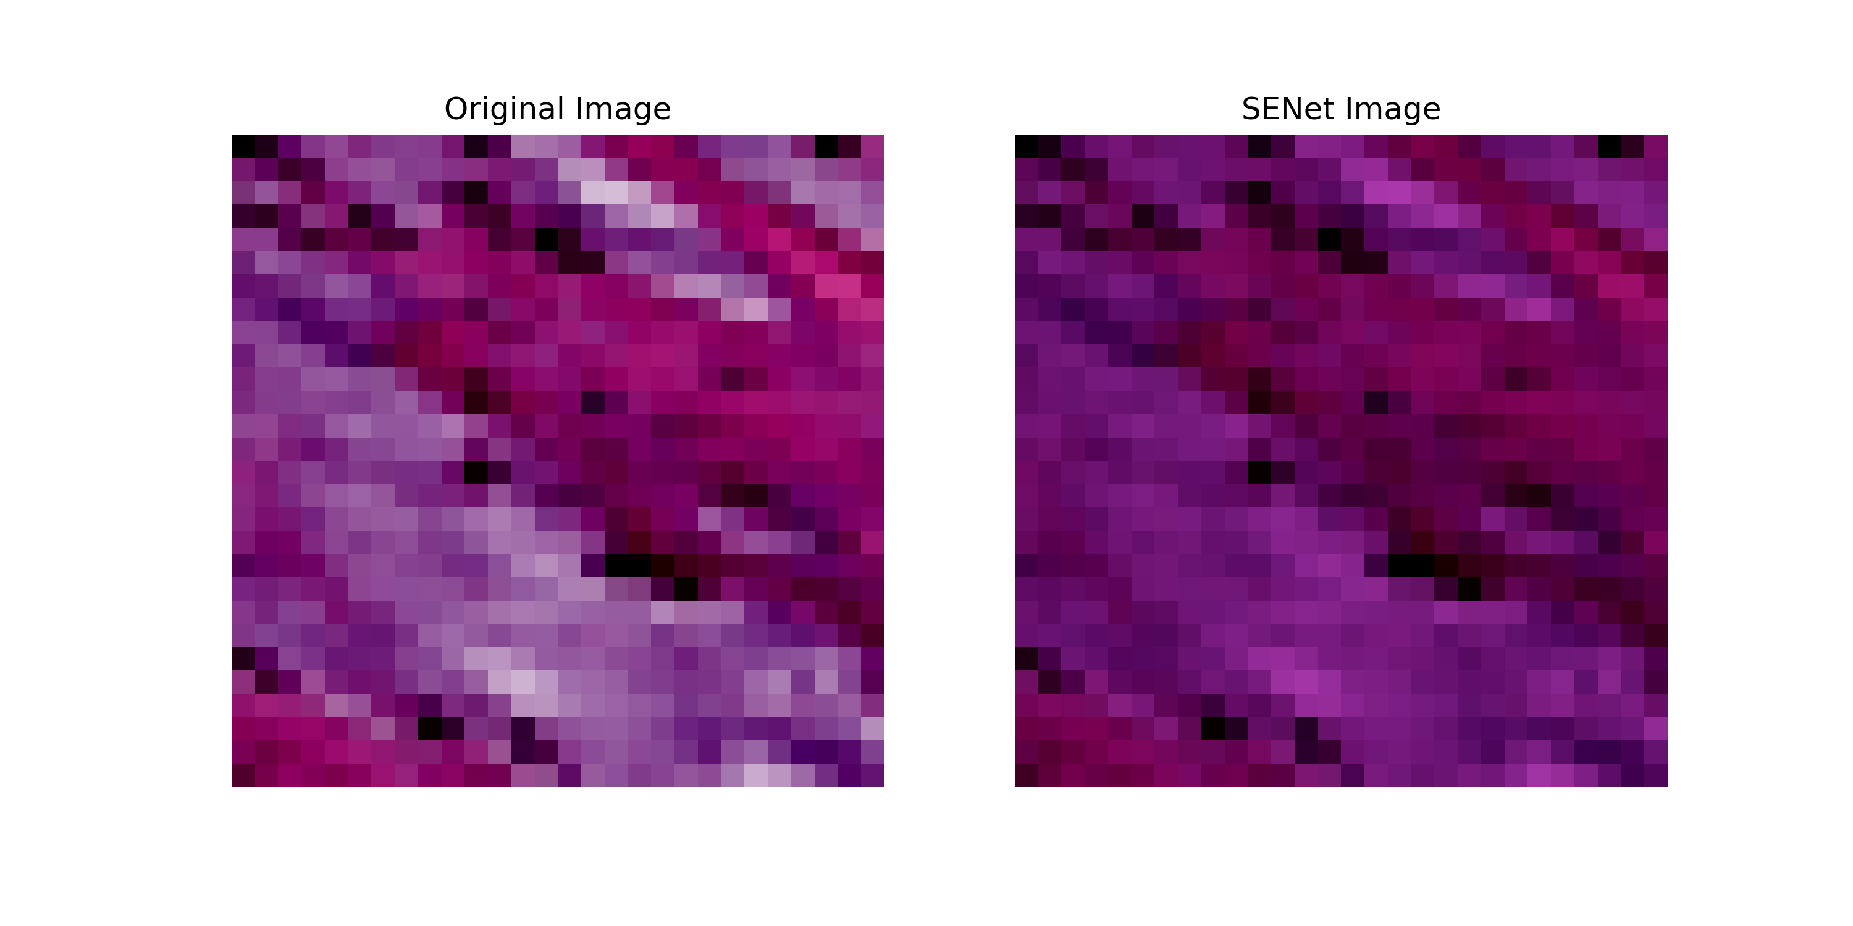
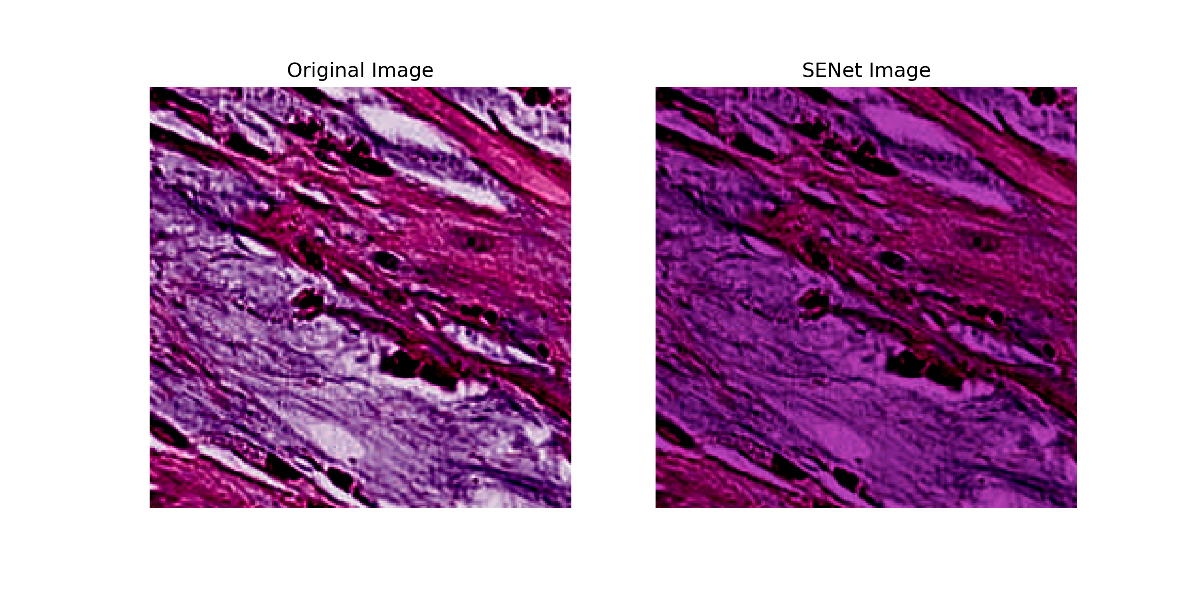
Impact of SENet on images
28x28
Example Learned RGB Weights:
0.8, 0.3, 0.8
224x224

Slide 7
Parallel Job Information
2 GPUs used for each job, example names: NVIDIA A100-SXM4-80GB, NVIDIA GeForce RTX 2080 Ti, NVIDIA L40.
Each job uses ~33.8 GB Disk, ~18.4 GB Memory
model_list.txt
--model LeNet --image_size 28 --use_se
--model LeNet --image_size 28
--model LeNet --image_size 224 --use_se
--model LeNet --image_size 224
--model ResNet --image_size 28 --use_se
--model ResNet --image_size 28
--model ResNet --image_size 224 --use_se
--model ResNet --image_size 224
queue model from model_list.txt
CHTC

Slide 8
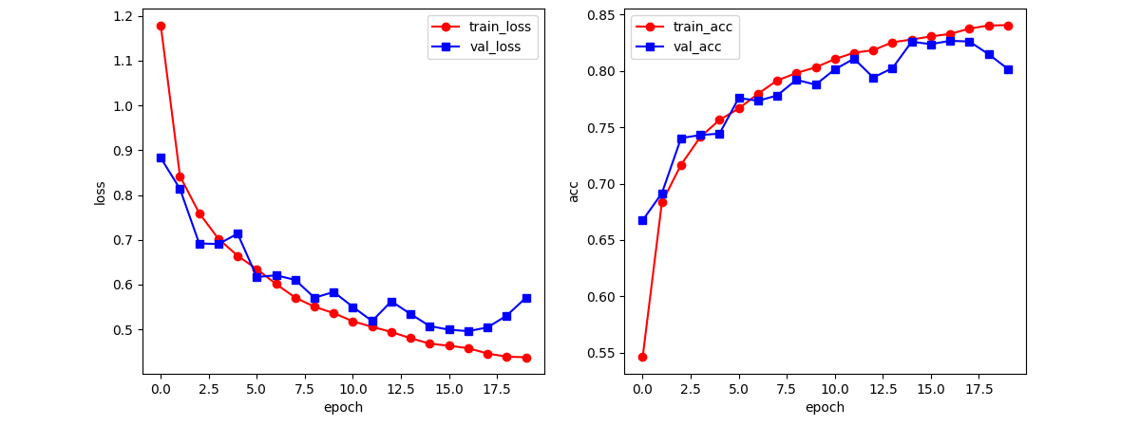
Training Results - LeNet
LeNet 28x28 without SENet
SENet did not have significant effect on performance

Slide 9
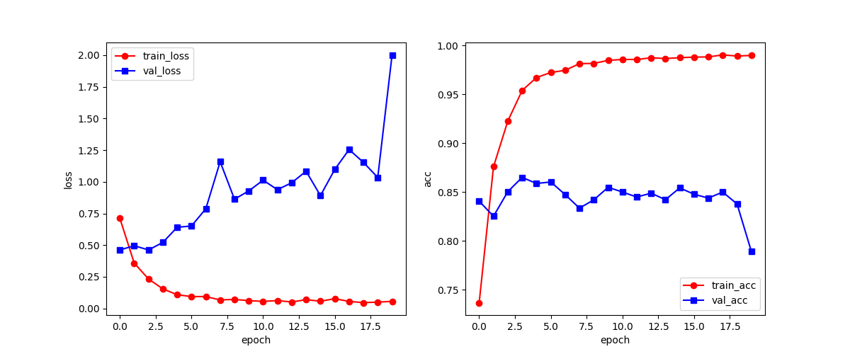
LeNet 224x224 SENet
LeNet has significant overfitting with and without SENet

Slide 10
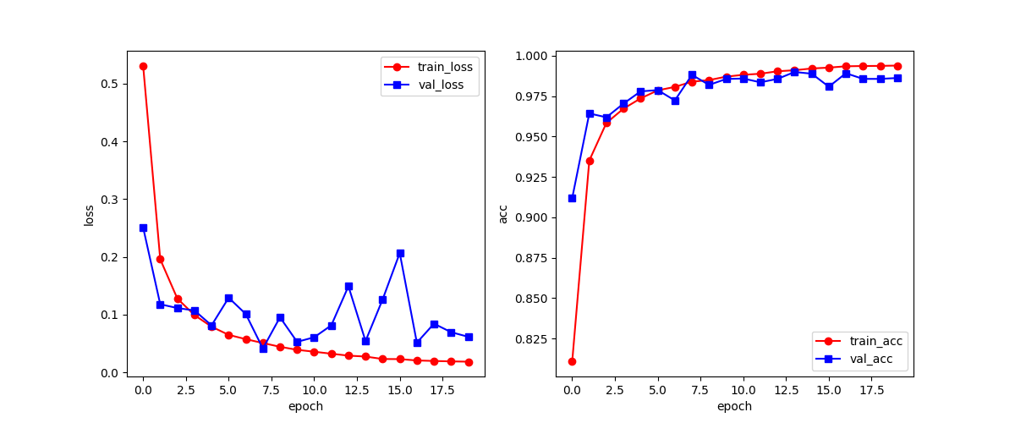
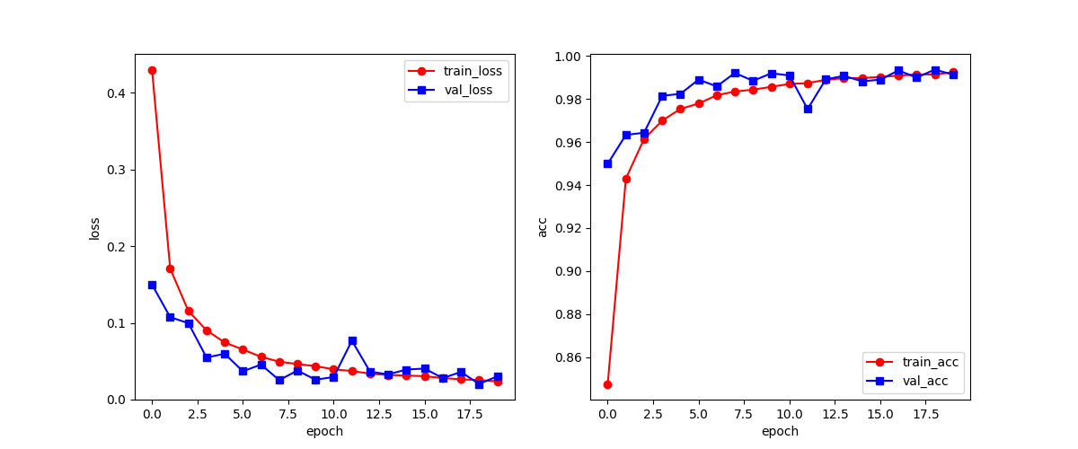
Training Results - ResNet
224x224 without SENet
224x224 with SENet
SENet provides improvements with ResNet

Slide 11
Benchmarking Results
Model | Image Size | SENet | PathMNIST Test Accuracy | Training Time (minutes)
LeNet | 28x28 | ☑ | 0.754 | 27
 |  | ⮽ | 0.770 | 14
 | 224x224 | ☑ | 0.769 | 49
 |  | ⮽ | 0.829 | 41.5
ResNet | 28x28 | ☑ | 0.842 | 137
 |  | ⮽ | 0.855 | 110
 | 224x224 | ☑ | 0.920 | 464.3
 |  | ⮽ | 0.850 | 206
Baseline: ResNet-50 | 28x28 | ⮽ | 0.911 | ~
 | 224x224 | ⮽ | 0.892 | ~

Slide 12
Conclusions and Future directions
SENet provided significant benefit to the test accuracy of ResNet with the large image size.
We would be very interested to see if SENet improves performance for other models and image types.
LeNet is an old model.

Slide 13
References
https://medium.com/codex/kernels-filters-in-convolutional-neural-network-cnn-lets-talk-about-them-ee4e94f3319
Squeeze-and-Excitation Networks https://doi.org/10.48550/arXiv.1709.01507
https://www.datasciencecentral.com/lenet-5-a-classic-cnn-architecture/
https://datagen.tech/guides/computer-vision/resnet/

