Slide 1
ARM AMBA
13103518 - Cesar Eduardo Correa
16200639 - Daniel de souza baulé
16100751 - Vinícius Schwinden Berkenbrock

Slide 2
ARM AMBA (Advanced Microcontroller Bus Architecture)
An open standard, on-chip interconnect specification for the connection and management of functional blocks in a System-on-Chip (SoC).
Facilitates right-first-time development of multi-processor designs with large numbers of controllers and peripherals.
Promotes design re-use by defining common interface standards for SoC modules
ARM.com

Slide 3
ARM AMBA (Advanced Microcontroller Bus Architecture)
An architecture that is widely used in system-on-chip designs, which are found on chip buses.
The AMBA specification standard is used for designing high-level embedded microcontrollers.
AMBA’s major objective is to provide technology independence and to encourage modular system design.
It strongly encourages the development of reusable peripheral devices while minimizing silicon infrastructure.
techopedia.com

Slide 4
ARM AMBA (Advanced Microcontroller Bus Architecture)
It’s the interface(s) everyone uses to bolt blocks together in their chip.
Ben Walshe
Advanced System Bus | ASB | Now obsolete, so don’t worry about this one!
Advanced Peripheral Bus | APB | Simple, easy, for your peripherals
Advanced High-Performance Bus | AHB | Now used a lot in Cortex-M designs
Advanced eXtensible Interface | AXI | The most widespread, now up to AXI4
Advanced Trace Bus | ATB | For moving trace data around the chip, see CoreSight
AXI Coherency Extensions | ACE | Used in big.LITTLE systems for smartphones, tablets, etc.
Coherent Hub Interface | CHI | The highest performance, used in networks and servers

Slide 5
ARM AMBA (Advanced Microcontroller Bus Architecture)
It’s the interface(s) everyone uses to bolt blocks together in their chip.
Ben Walshe
Advanced System Bus | ASB | Now obsolete, so don’t worry about this one!
Advanced Peripheral Bus | APB | Simple, easy, for your peripherals
Advanced High-Performance Bus | AHB | Now used a lot in Cortex-M designs
Advanced eXtensible Interface | AXI | The most widespread, now up to AXI4
Advanced Trace Bus | ATB | For moving trace data around the chip, see CoreSight
AXI Coherency Extensions | ACE | Used in big.LITTLE systems for smartphones, tablets, etc.
Coherent Hub Interface | CHI | The highest performance, used in networks and servers

Slide 6
ARM AMBA (Advanced Microcontroller Bus Architecture)
It’s the interface(s) everyone uses to bolt blocks together in their chip.
Ben Walshe
Advanced Peripheral Bus | APB | Simple, easy, for your peripherals
Advanced High-Performance Bus | AHB | Now used a lot in Cortex-M designs
Advanced Trace Bus | ATB | For moving trace data around the chip, see CoreSight

Slide 7
ARM AMBA
A brief history

Slide 8
ARM AMBA
1995 – ARM received EU funding;
1996 – ARM introduces the Advanced Microcontroller Bus Architecture as an open architecture;
It facilitates development of multiprocessor designs with large numbers of controllers and peripherals
Since its inception, the scope of AMBA has, despite its name, gone far beyond microcontroller devices.
Today, AMBA is widely used on a range of ASIC and SoC parts including applications processors which are typically found in modern portable mobile devices like smartphones.

Slide 9
ARM AMBA
An important aspect of a SoC is not only which components or blocks it houses, but also how they interconnect.
AMBA served as a solution for how the blocks would interface with each other.
It soon became the 'de facto' standard interface for anyone which to bring a controller or a peripheral IP block to market.

Slide 10
ARM AMBA
AMBA
ASB - Advanced System Bus;
APB - Advanced Peripheral Bus;
AMBA 2
AHB - High-performance Bus;
AMBA 3 (2003)
AXI - Advanced eXtensible Interface;
ATB - Advanced Trace Bus

Slide 11
ARM AMBA
AMBA 4 (2010)
AXI4;
ACE - AXI Coherency Extensions;
AMBA 5 (2013)
CHI - Coherent Hub Interface

Slide 12
AMBA 3 APB
Advanced Peripheral Bus

Slide 13
AMBA3 APB
It provides a low-cost interface that is optimized for minimal power consumption and reduced interface complexity.
The APB interfaces to any peripherals that are low-bandwidth and do not require the high performance of a pipelined bus interface.
All signal transitions are only related to the rising edge of the clock to enable the integration of APB peripherals easily into any design flow.
Every transfer takes at least two cycles.

Slide 14
AMBA3 APB
The APB can interface with:
AMBA Advanced High-performance Bus Lite (AHB-Lite);
AMBA Advanced Extensible Interface (AXI);
You can use it to provide access to the programmable control registers of peripheral devices.

Slide 15
AMBA3 APB – Changes from previous specification
A ready signal, PREADY, to extend an APB transfer.
An error signal, PSLVERR, to indicate the failure of a transfer.

Slide 16
AMBA 3 APB signals
Signal | Source | Description
PCLK | Clock source | Clock. The rising edge of PCLK times all transfers on the APB.
PRESETn | System bus equivalent | Reset. The APB reset signal is active LOW. This signal is normally connected directly to the system bus reset signal.

Slide 17
AMBA 3 APB signals
Signal | Source | Description
PADDR | APB bridge | Address. This is the APB address bus. It can be up to 32 bits wide and is driven by the peripheral bus bridge unit.
PSELx | APB bridge | Select. The APB bridge unit generates this signal to each peripheral bus slave. It indicates that the slave device is selected and that a data transfer is required. There is a PSELx signal for each slave.
PENABLE | APB bridge | Enable. This signal indicates the second and subsequent cycles of an APB transfer.
PWRITE | APB bridge | Direction. This signal indicates an APB write access when HIGH and an APB read access when LOW.
PWDATA | APB bridge | Write data. This bus is driven by the peripheral bus bridge unit during write cycles when PWRITE is HIGH. This bus can be up to 32 bits wide.

Slide 18
AMBA 3 APB signals
Signal | Source | Description
PREADY | Slave interface | Ready. The slave uses this signal to extend an APB transfer.
PRDATA | Slave interface | Read Data. The selected slave drives this bus during read cycles when PWRITE is LOW. This bus can be up to 32-bits wide.
PSLVERR | Slave interface | This signal indicates a transfer failure. APB peripherals are not required to support the PSLVERR pin. This is true for both existing and new APB peripheral designs. Where a peripheral does not include this pin then the appropriate input to the APB bridge is tied LOW.

Slide 19
AMBA3 APB – Write Transfer
With no wait states.
With wait states.

Slide 20
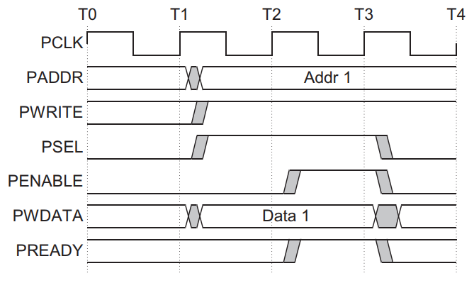
AMBA3 APB – Write Transfer with no wait states
Signals:
PCLK
PADDR
PWRITE
PSEL
PENABLE
PWDATA
PREADY

Slide 21
AMBA3 APB – Write Transfer with no wait states
Setup Phase:
The write transfer starts with the address, write data, write signal and select signal all changing after the rising edge of the clock.

Slide 22
AMBA3 APB – Write Transfer with no wait states
Access phase:
After the following clock edge the enable signal is asserted, PENABLE, and this indicates that the Access phase is taking place.
The address, data and control signals all remain valid throughout the Access phase.
The transfer completes at the end of this cycle.

Slide 23
AMBA3 APB – Write Transfer with no wait states
Final phase:
The enable signal, PENABLE, is deasserted at the end of the transfer.
The select signal, PSELx, also goes LOW unless the transfer is to be followed immediately by another transfer to the same peripheral.

Slide 24
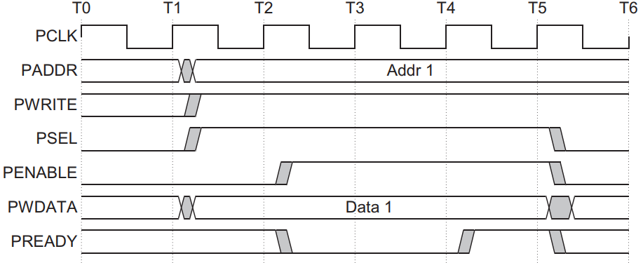
AMBA3 APB – Write Transfer with wait states
Registers:
PCLK
PADDR
PWRITE
PSEL
PENABLE
PWDATA
PREADY

Slide 25
AMBA3 APB – Write Transfer with wait states
Setup Phase:
The write transfer starts with the address, write data, write signal and select signal all changing after the rising edge of the clock.
Same as with no wait states.

Slide 26
AMBA3 APB – Write Transfer with wait states
Access phase:
During an Access phase, when PENABLE is HIGH, the transfer can be extended by driving PREADY LOW.
Remain unchanged:
PADDR
PWRITE
PSEL
PENABLE
PWDATA
2 additional cycles

Slide 27
AMBA3 APB – Write Transfer with wait states
Final phase:
The enable signal, PENABLE, is deasserted at the end of the transfer.
The select signal, PSELx, also goes LOW unless the transfer is to be followed immediately by another transfer to the same peripheral.

Slide 28
AMBA3 APB – Read Transfer
With no wait states.
With wait states.

Slide 29
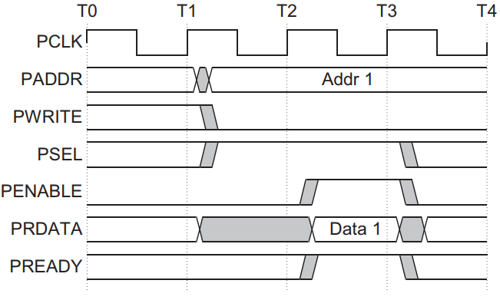
AMBA3 APB – Read Transfer with no wait states
Setup Phase:
The read transfer starts the same as the write transfer: with the address, write signal and select signal all changing after the rising edge of the clock.
PWRITE set to LOW.

Slide 30
AMBA3 APB – Read Transfer with no wait states
Access phase:
After the following clock edge the enable signal is asserted, PENABLE, and this indicates that the Access phase is taking place.
The slave must provide the data before the end of the read transfer.

Slide 31
AMBA3 APB – Read Transfer with no wait states
Final phase:
The enable signal, PENABLE, is deasserted at the end of the transfer.
The select signal, PSELx, also goes LOW unless the transfer is to be followed immediately by another transfer to the same peripheral.

Slide 32
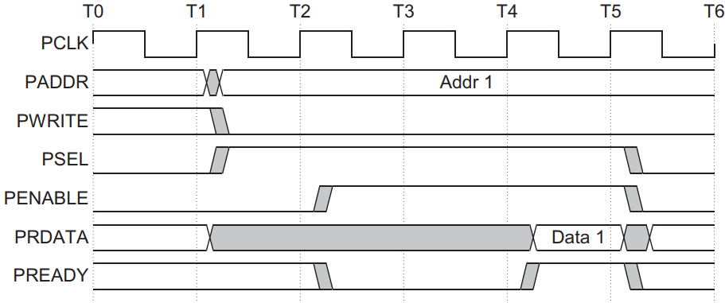
AMBA3 APB – Read Transfer with wait states
Setup Phase:
The write transfer starts with the address, write data, write signal and select signal all changing after the rising edge of the clock.
Same as with no wait states.

Slide 33
AMBA3 APB – Read Transfer with wait states
Access phase:
During an Access phase, when PENABLE is HIGH, the transfer can be extended by driving PREADY LOW.
Remain unchanged:
PADDR
PWRITE
PSEL
PENABLE
2 additional cycles

Slide 34
AMBA3 APB – Read Transfer with wait states
Final phase:
The enable signal, PENABLE, is deasserted at the end of the transfer.
The select signal, PSELx, also goes LOW unless the transfer is to be followed immediately by another transfer to the same peripheral.

Slide 35
AMBA3 APB – Error Response
You can use PSLVERR to indicate an error condition on an APB transfer.
Error conditions can occur on both:
Read transactions.
Write transactions.
PSLVERR is only considered valid during the last cycle of an APB transfer, when PSEL, PENABLE, and PREADY are all HIGH.

Slide 36
AMBA3 APB – Error Response
When an error occurs:
Peripheral might or might not have changed state.
The register within the peripheral might or might not have been written to.
Data read might be invalid.
Support for PSLVERR signal is not required in APB peripherals.
Where a peripheral does not include this pin then the appropriate input to the APB bridge is tied LOW.

Slide 37
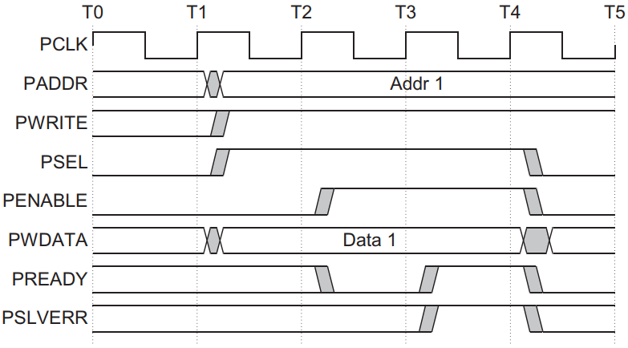
AMBA3 APB – Error Response on Write Transfer

Slide 38
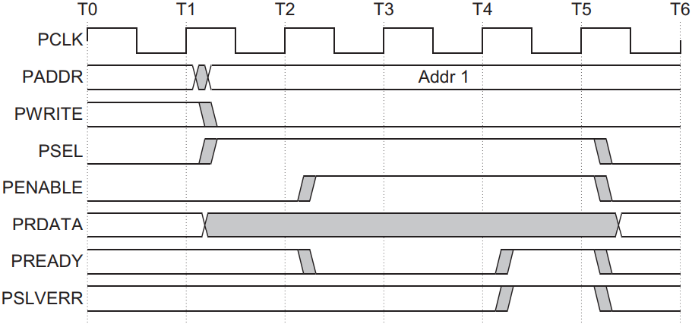
AMBA3 APB – Error Response on Read Transfer

Slide 39
AMBA3 APB – Error Response on AXI/AHB
From AXI to APB:
An APB error is mapped back to RRESP/BRESP = SLVERR. This is achieved by mapping PSLVERR to the AXI signals RRESP[1] for reads and BRESP[1] for writes.
From AHB to APB:
PSLVERR is mapped back to HRESP = ERROR for both reads and writes. This is achieved by mapping PSLVERR to the AHB signal HRESP[0].

Slide 40

AMBA3 APB – Operating States
IDLE:
Default state of the APB
When a transfer is required the bus moves into the SETUP

Slide 41
AMBA3 APB – Operating States
SETUP:
The appropriate select signal, PSELx, is asserted.
The bus only remains in the SETUP state for one clock cycle and always moves to the ACCESS state on the next rising edge of the clock.
The address, write, select, and write data signals must remain stable during the transition from the SETUP to ACCESS state.

Slide 42
AMBA3 APB – Operating States
ACCESS:
The enable signal, PENABLE, is asserted.
Exit from the ACCESS state is controlled by the PREADY signal from the slave:
If PREADY is held LOW by the slave then the peripheral bus remains in the ACCESS state.
If PREADY is driven HIGH by the slave then the ACCESS state is exited and the bus returns to the IDLE state if no more transfers are required. Alternatively, the bus moves directly to the SETUP state if another transfer follows.

Slide 43
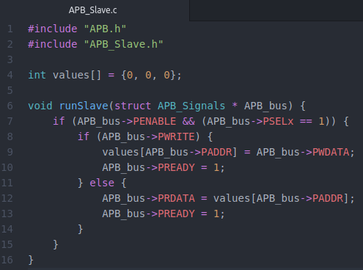
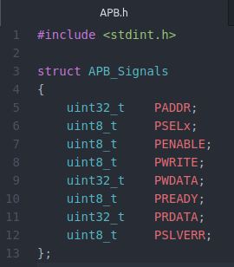
AMBA3 APB – Implementation

Slide 44
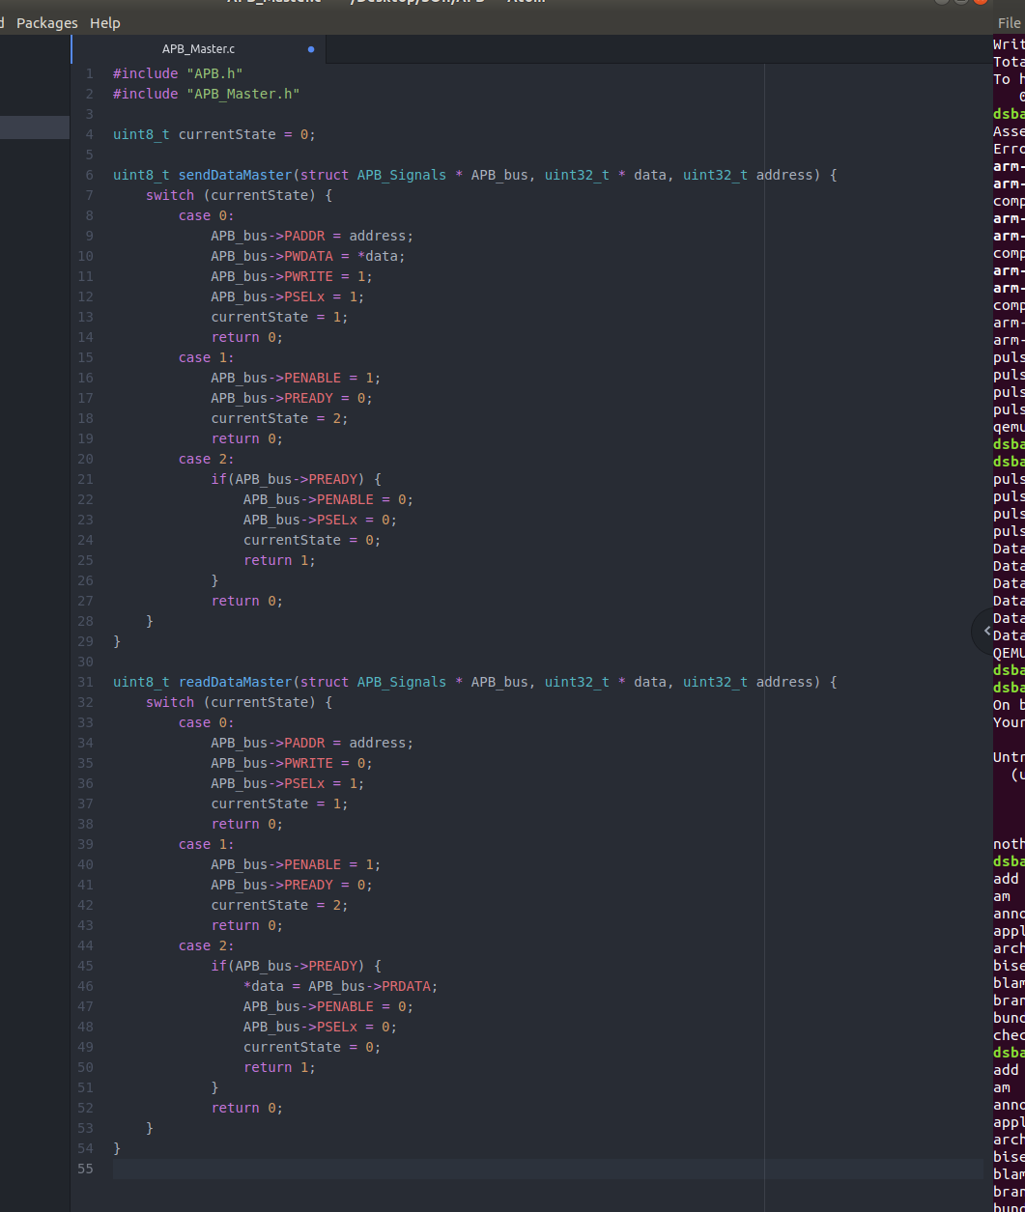
AMBA3 APB – Implementation

Slide 45
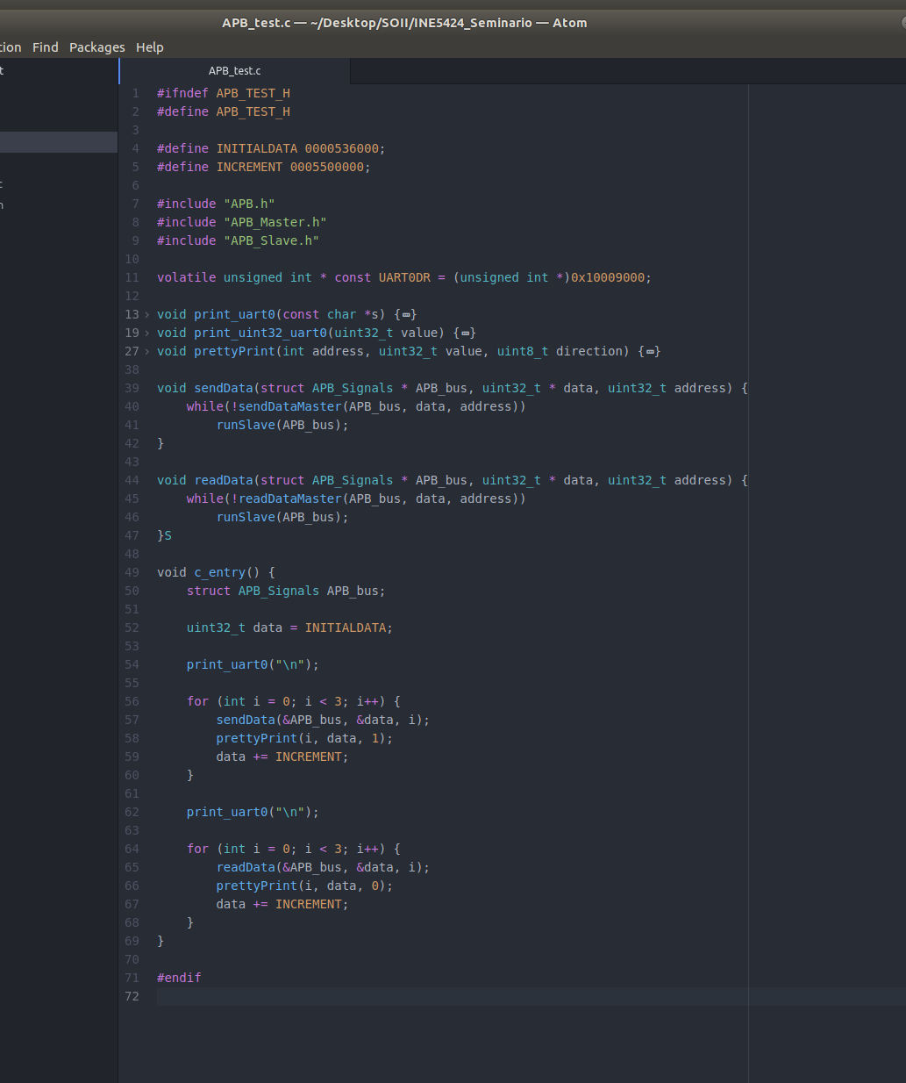
AMBA3 APB – Implementation

Slide 46
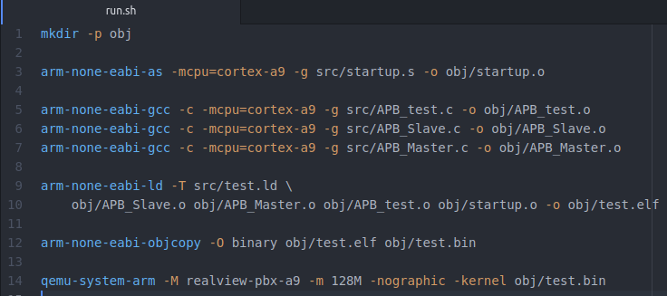
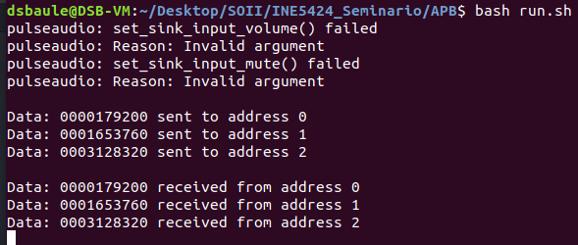
AMBA3 APB – Implementation

Slide 47
AMBA ATB

Slide 48
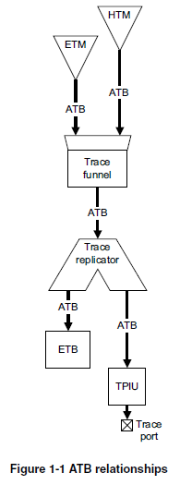
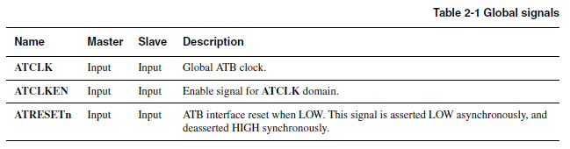
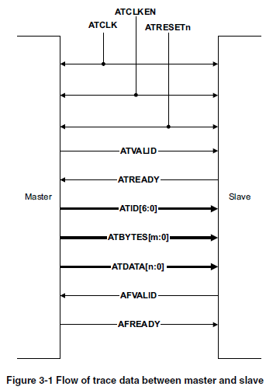
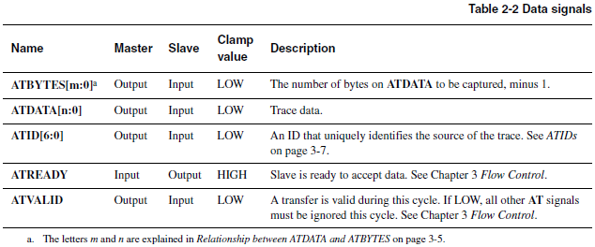
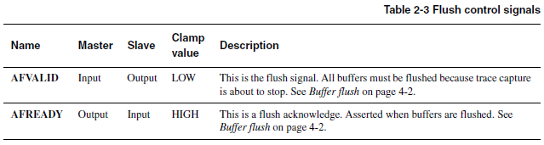

Slide 49
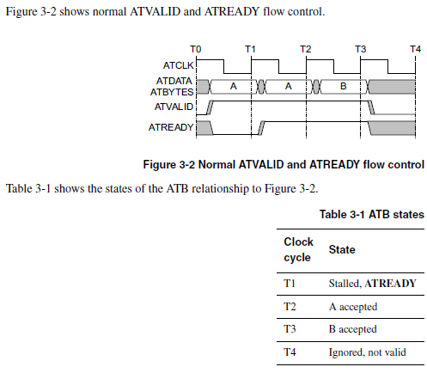
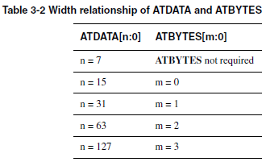
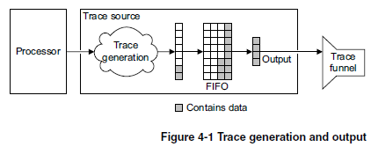

Slide 50
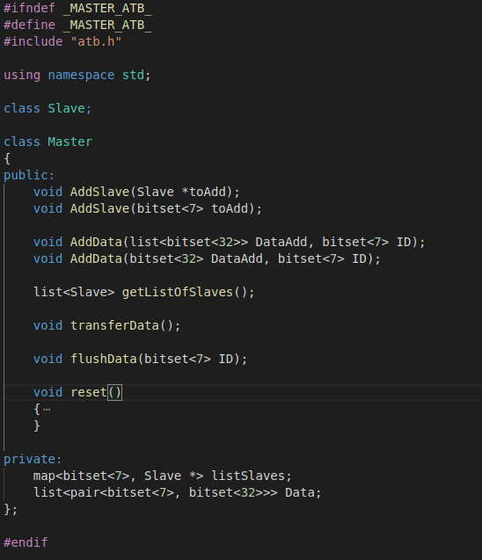
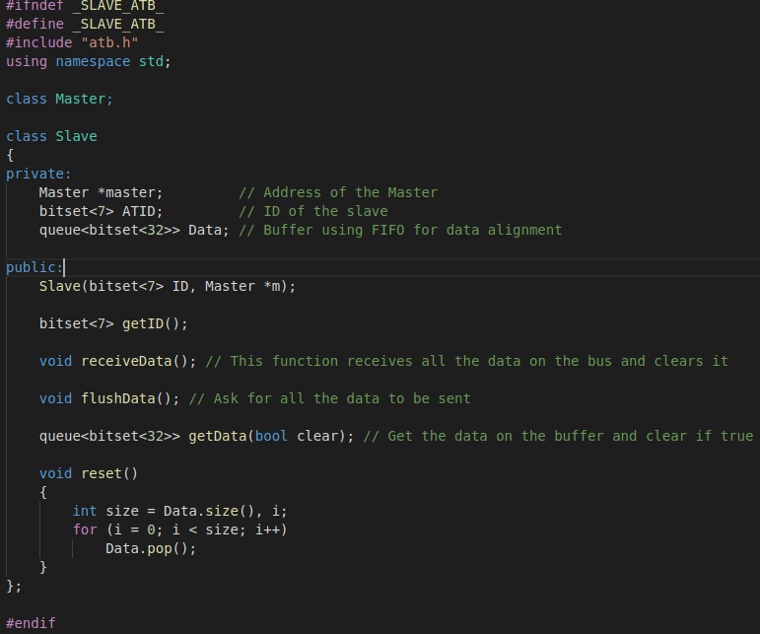
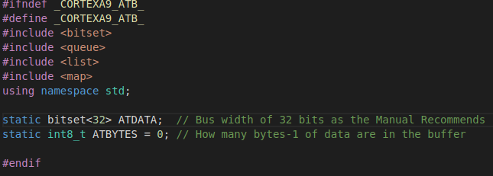
Files.h

Slide 51
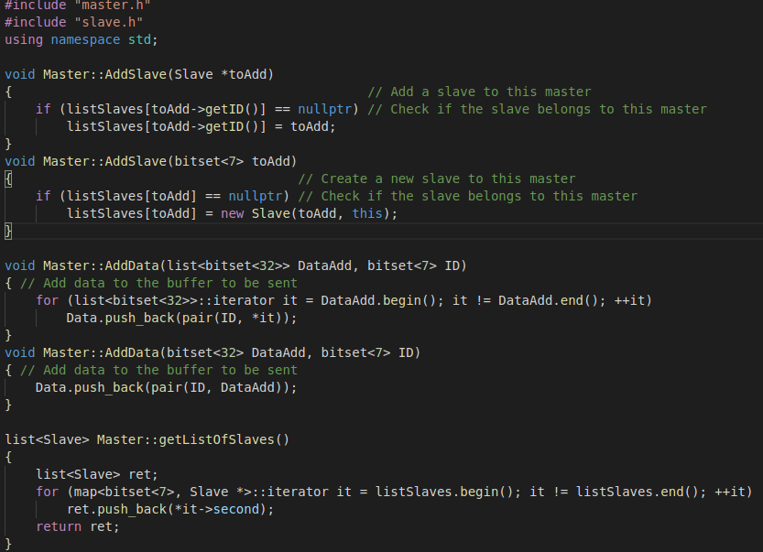
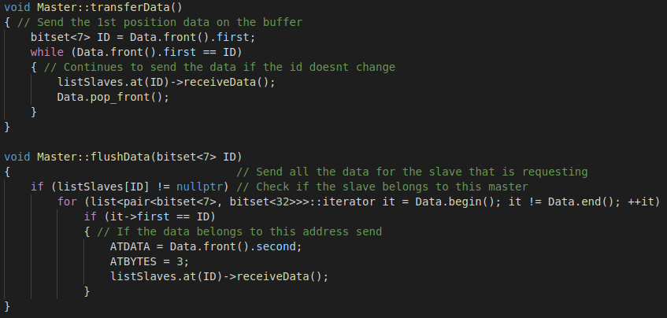
Master.cpp

Slide 52
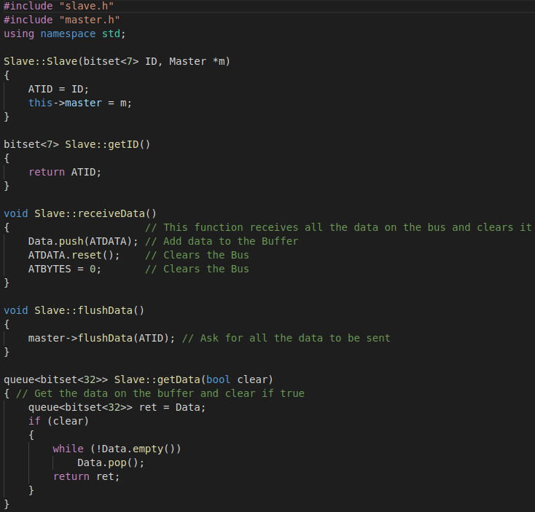
Slave.cpp

Slide 53
AMBA AHB

