Slide 1
Python Programming
Premkumar Chandra Shegaran

Slide 2
Advantages of Python
Developers can learn it quickly
Typically involves less code
Syntax is easier to read
Utilized by every major tech companies
Huge amount of open source libraries

Slide 3
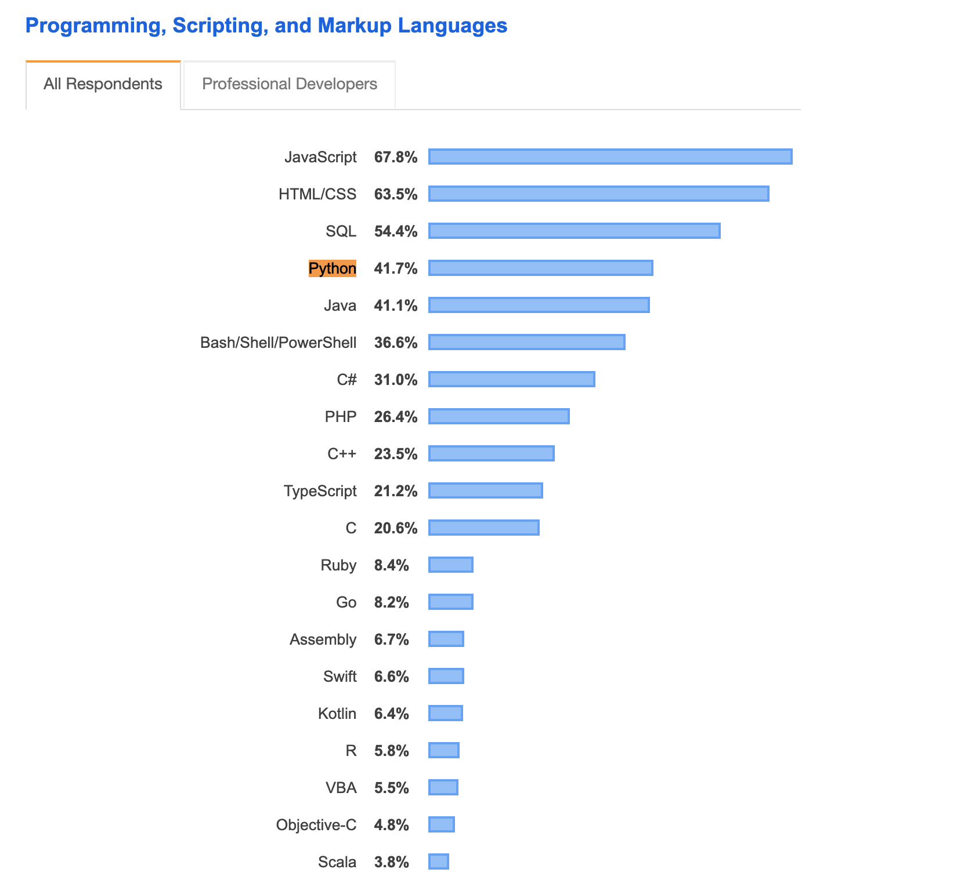
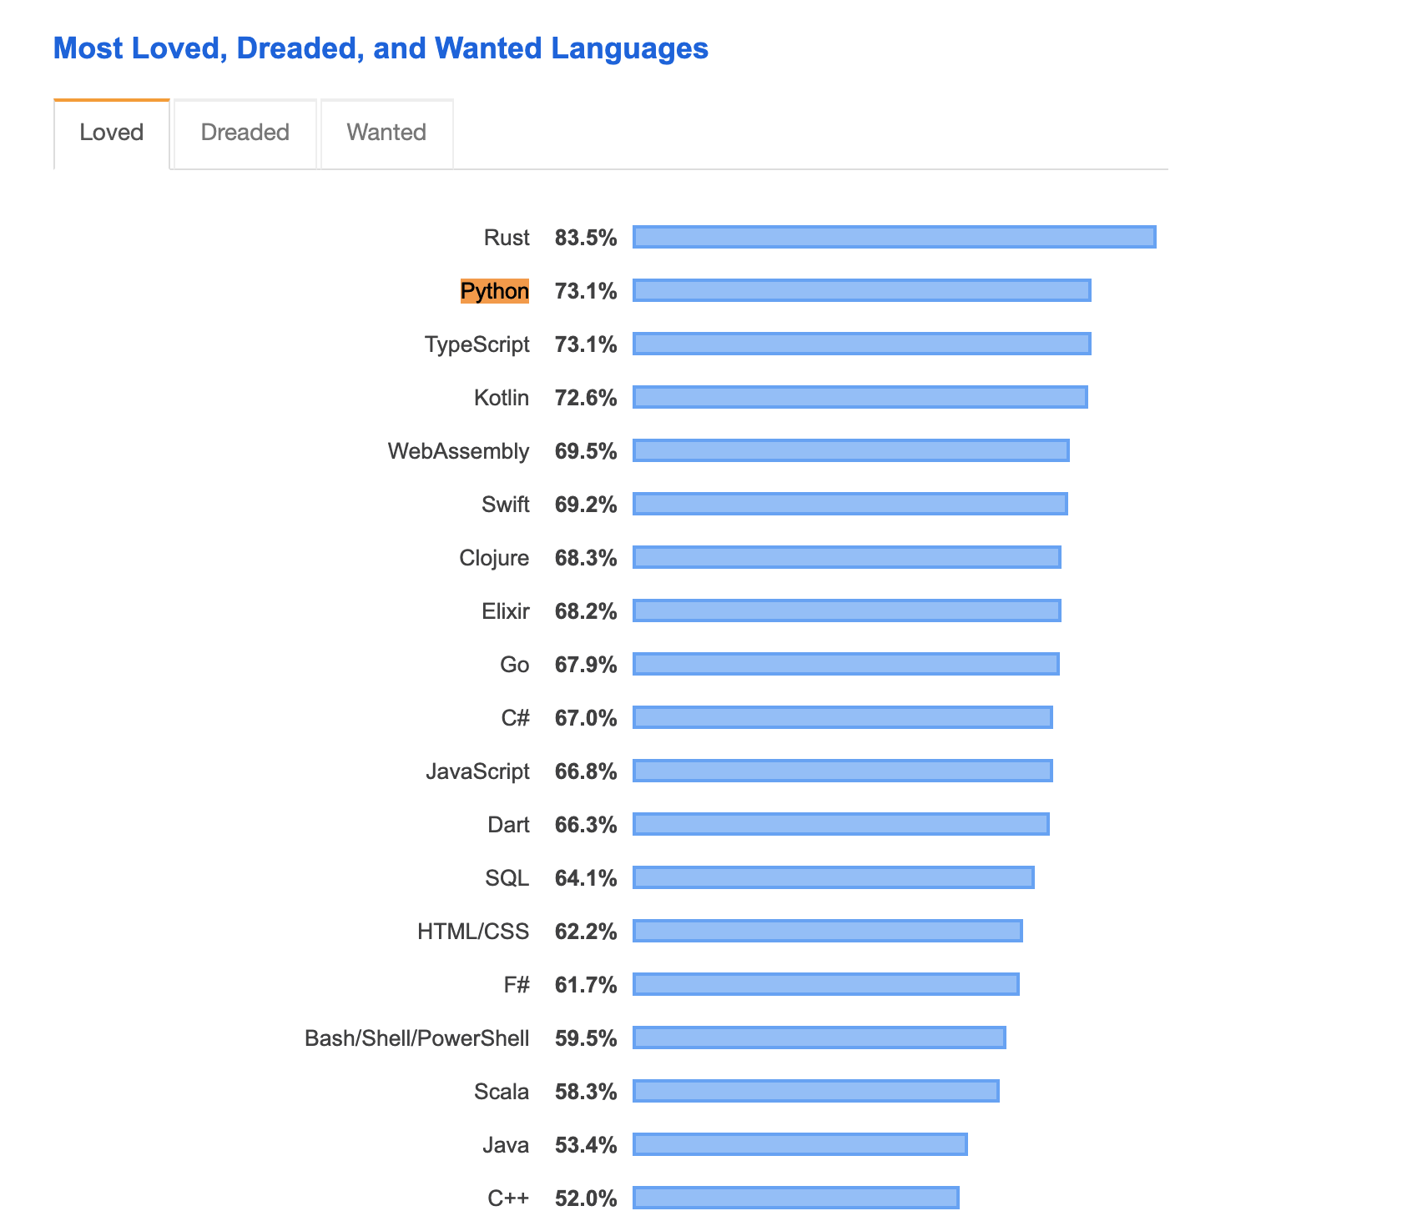

Slide 4
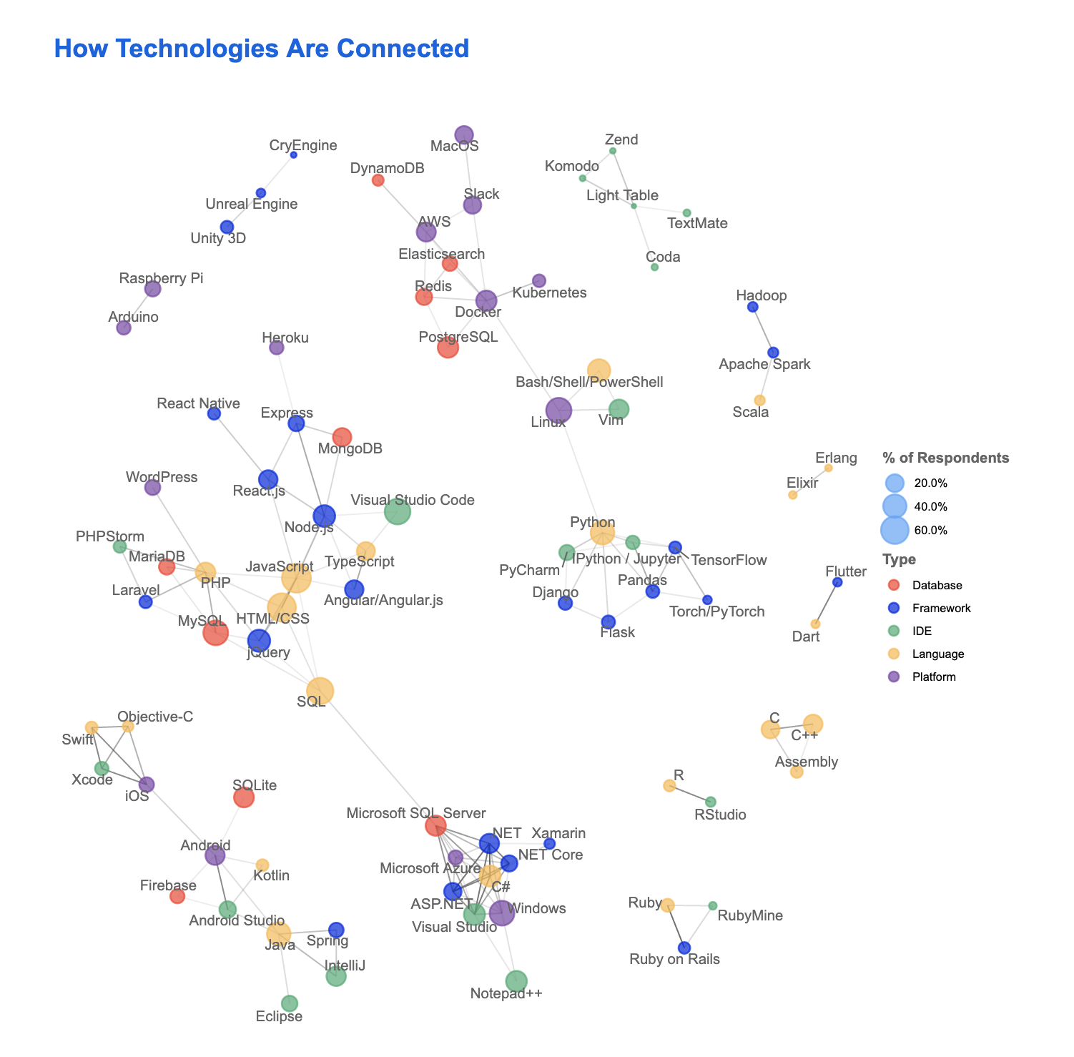

Slide 5
Python Installation

Slide 6
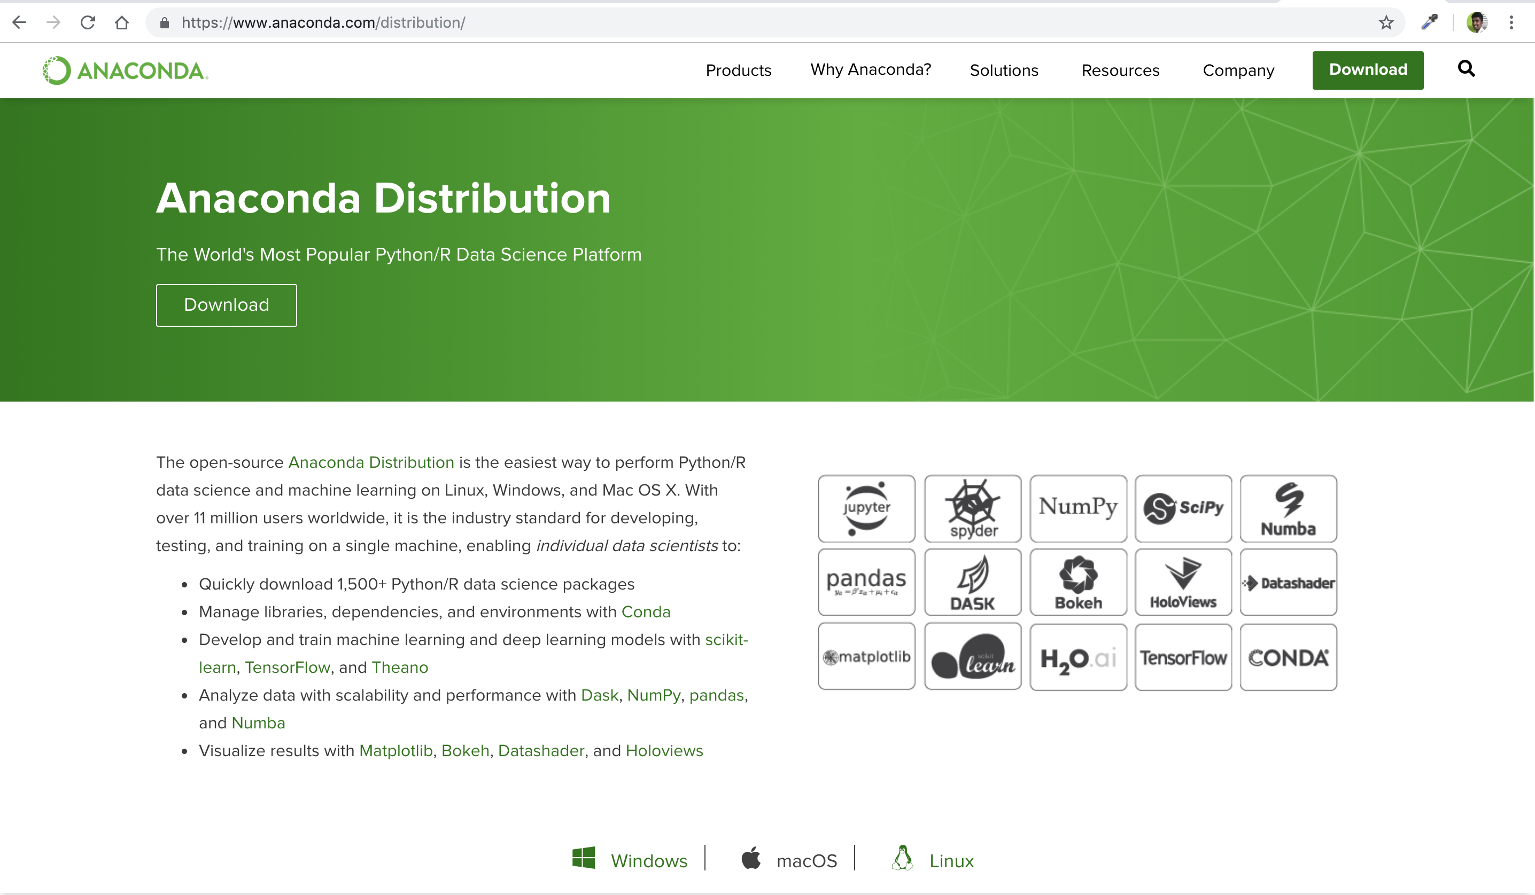
Install Python & Jupyter

Slide 7
Development Environments
Text Editors - Atom, Sublime, TextWrangler, Notepad++
Full IDEs - Pycharm, Spyder, Visual Studio Code
Notebook Environments - Jupyter Notebooks, IPython environments
Command Line Interface/Terminal - Bash Shell

Slide 8
Development Environments
Text Editors - Atom, Sublime, TextWrangler, Notepad++
Full IDEs - Pycharm, Spyder, Visual Studio Code
Notebook Environments - Jupyter Notebooks, IPython environments
Command Line Interface/Terminal - Bash Shell

Slide 9
Python Crash Course – 1.5 hours
Data Types
If, elif, else
For loops, enumeration, list comprehensions
Functions
Map, reduce, filter, zip and Lambda Expressions
Python Regex

Slide 10
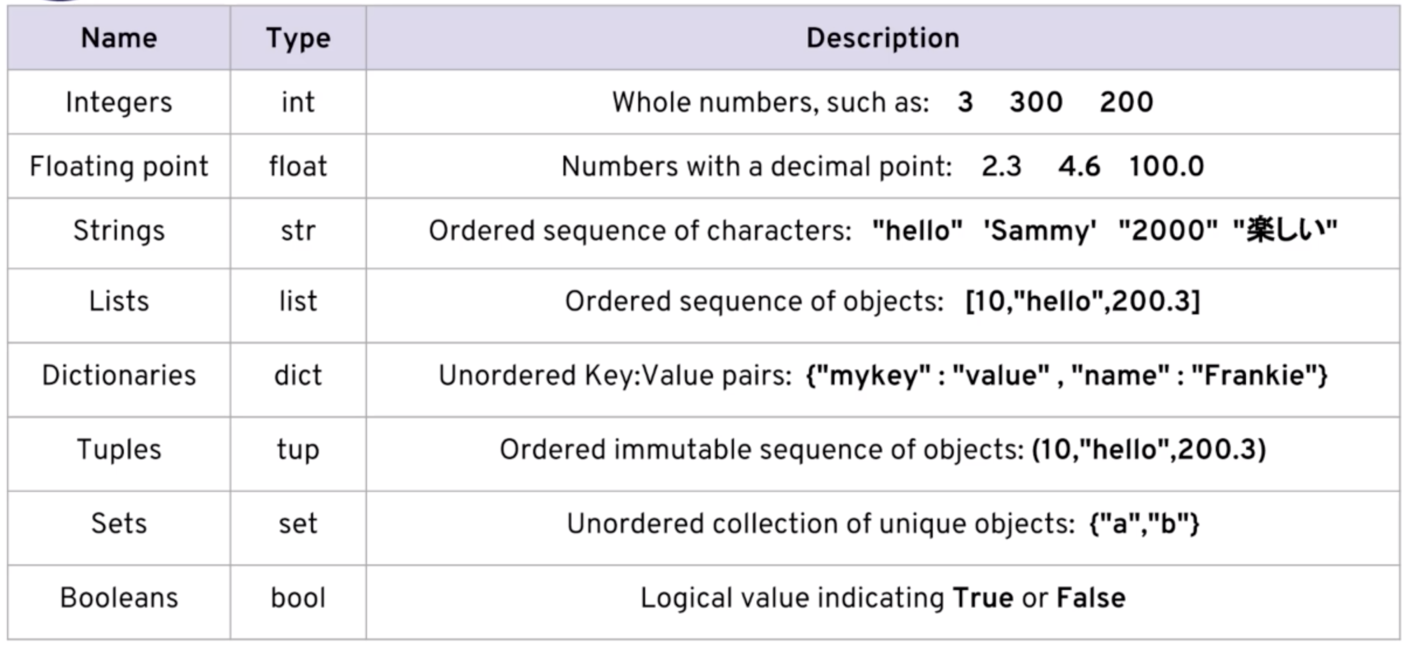
Python Data Types

Slide 11
Python Data Science
Numpy
Pandas
Matplotlib and Seaborn

