Slide 1



Blinkit
View in Power BI
Last data refresh:
11/25/2024 8:35:26 AM UTC
Downloaded at:
11/25/2024 8:40:23 AM UTC

Slide 2
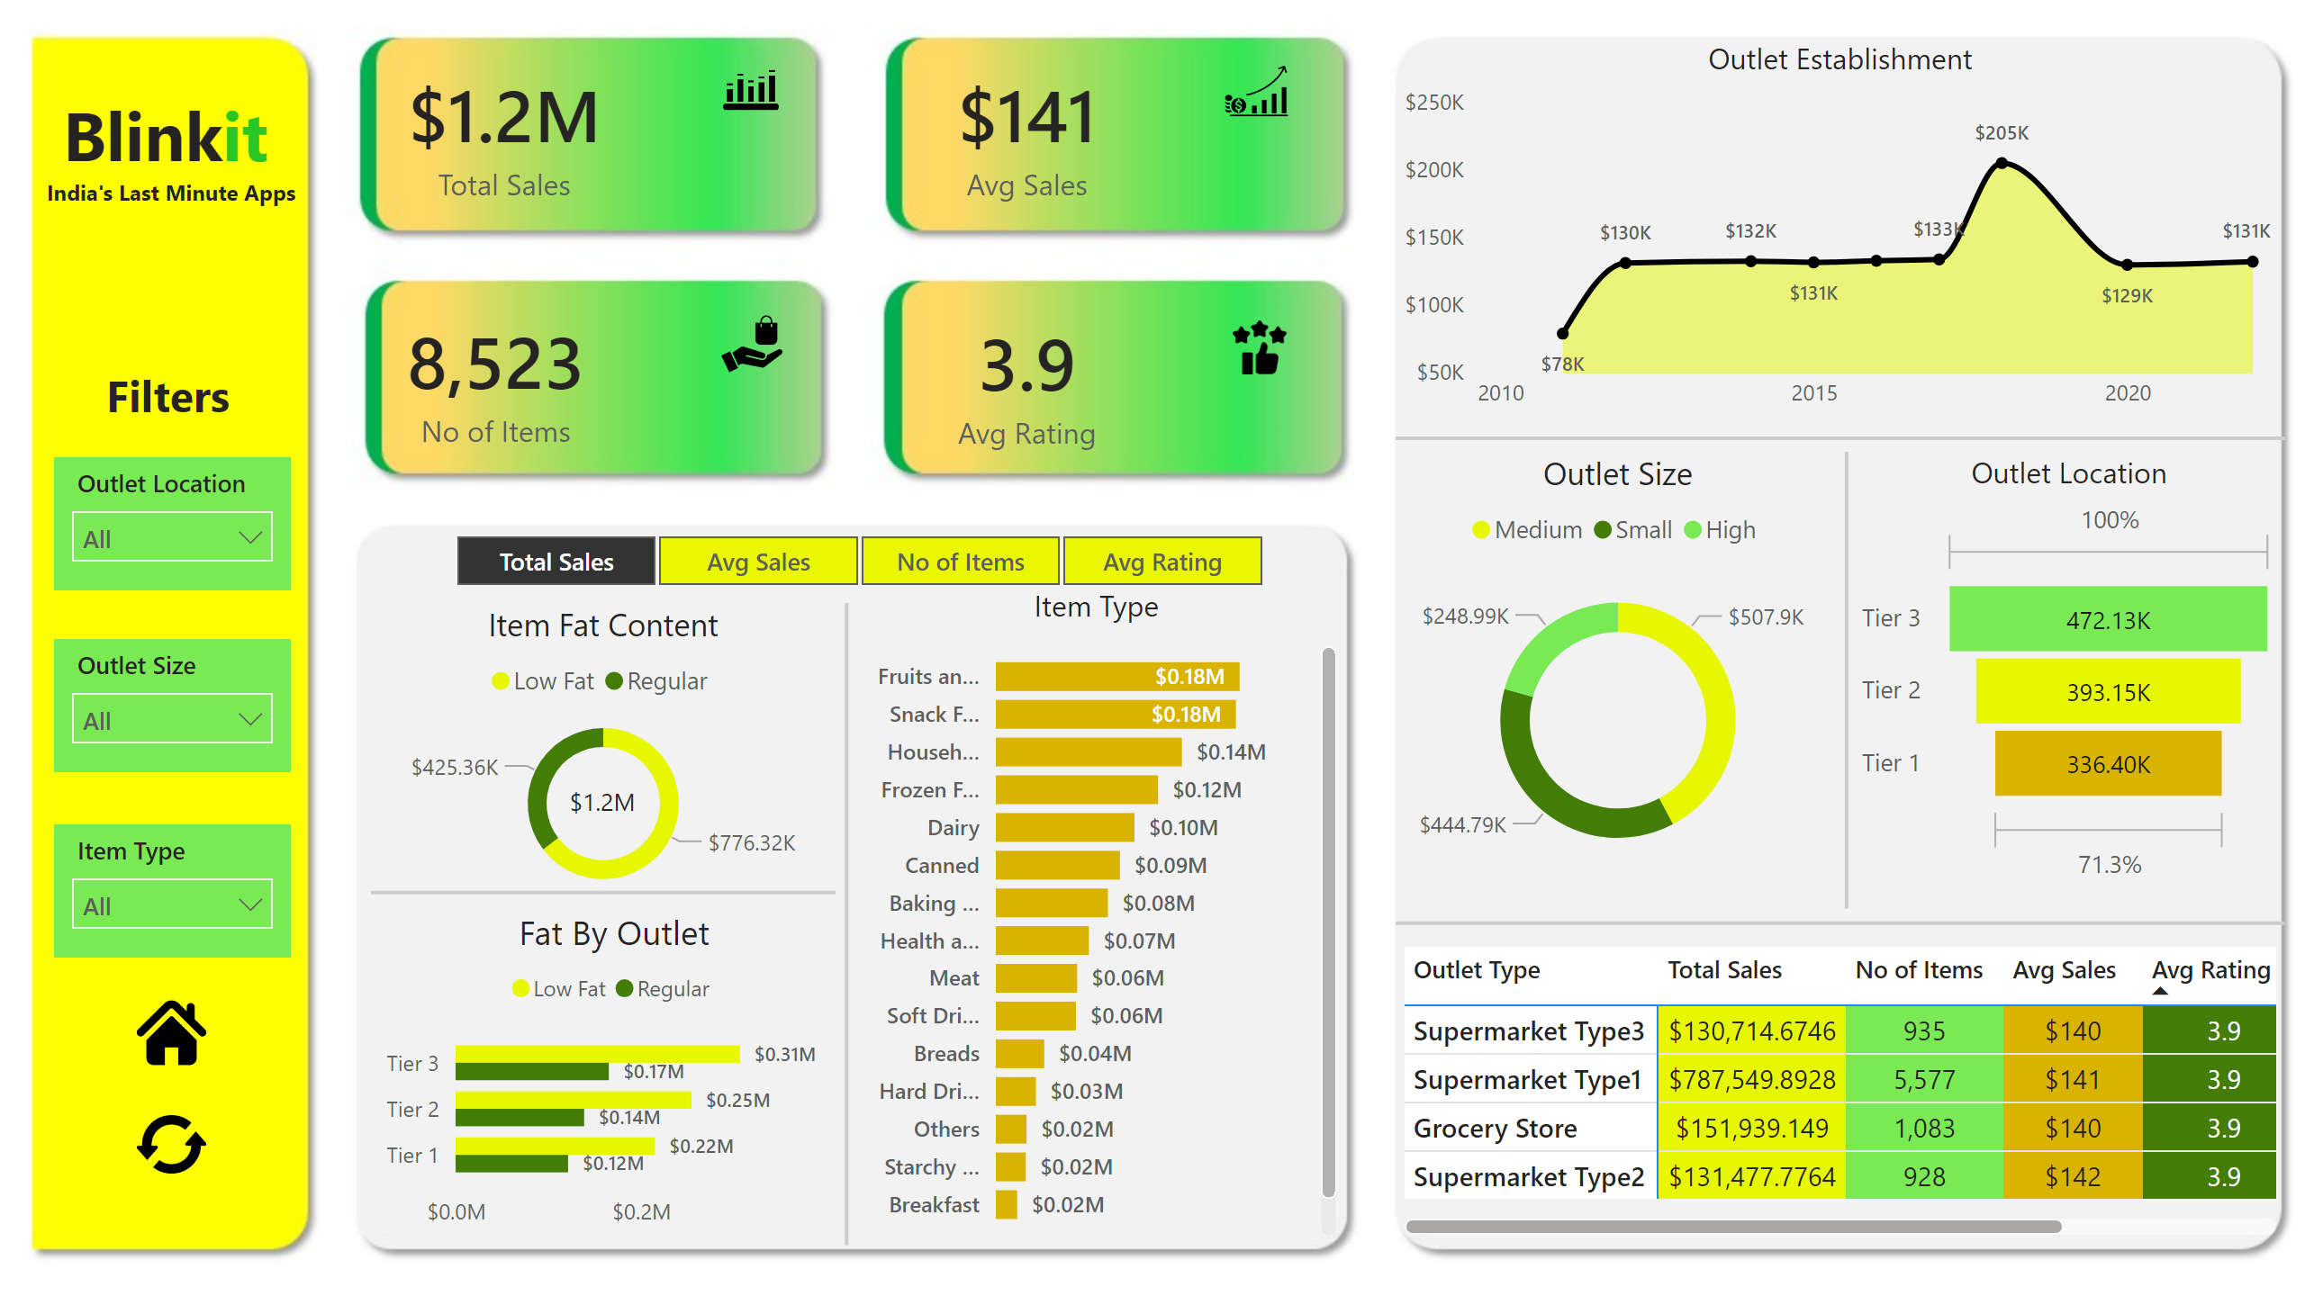
Page 1
Notes:
card
No alt text provided
textbox
No alt text provided
textbox
No alt text provided
card
No alt text provided
card
No alt text provided
card
No alt text provided
image
No alt text provided
image
No alt text provided
image
No alt text provided
image
No alt text provided
Item Fat Content
No alt text provided
slicer
No alt text provided
card
No alt text provided
Fat By Outlet
No alt text provided
shape
No alt text provided
shape
No alt text provided
Item Type
No alt text provided
Outlet Establishment
No alt text provided
shape
No alt text provided
Outlet Size
No alt text provided
Outlet Location
No alt text provided
shape
No alt text provided
pivotTable
No alt text provided
shape
No alt text provided
slicer
No alt text provided
slicer
No alt text provided
slicer
No alt text provided
textbox
No alt text provided
image
No alt text provided
image
No alt text provided

