Slide 1

Peer to Peer Science
Dsensor.org
Introduction to idea

Slide 2
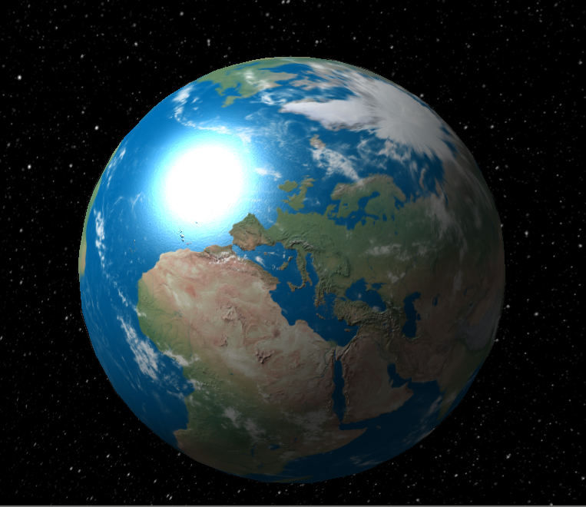

Slide 3

N
T
I
M
P

Slide 4
Science
Peer
review
Experiment
+ Results
Hypothesis
Theory
Law

Slide 5
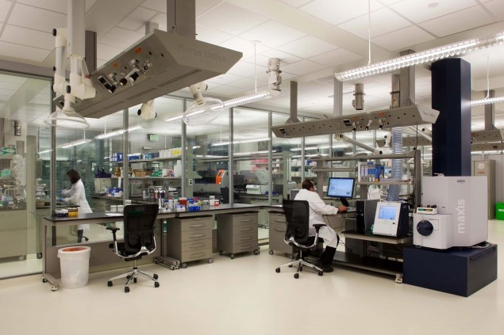
'too clean'

Slide 6

Future of Science?
MESSY
Computationally active 24/7

Slide 7
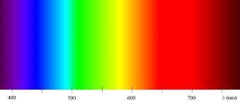
Human
Guess
Peer review
Journal
Open Science
Citizen
Dsensor
Human + Machine
Clean context –-> Myriad context
Peer review –-> Computational consensus
Clinical Trials –-> Computationally active

Slide 8
Blockchain +
DISCOVERY SPACE
Vast uncertainty & complexity
Proof of work Complexity
BLOCKCHAIN

Slide 9
Problem to solve
Make it (near) impossible to validate or cheery pick data sets that support a science theory regardless of having enough money or compute resources to flood the network with data.

Slide 10
Peer to Peer Science
Compute
Consensus
DMAPS
Decentralized Sensor Mapping Protocol
BLOCKCHAIN

Slide 11
Decentralised Sensor Mapping Protocol
Best science available to all
'Scoring' Protocol -prediction complexity context
Decentralized Sampling Protocol
Anyone free to put forward Dmaps (scientific computations-how world works)
Blockchain 'Science Accounting'

Slide 12
Dsampling
Two different DHTs to 'random' walk over
Estimate network size from structure
Samples representative of 'reality'
Auto record – proof of evidence trail

Slide 13
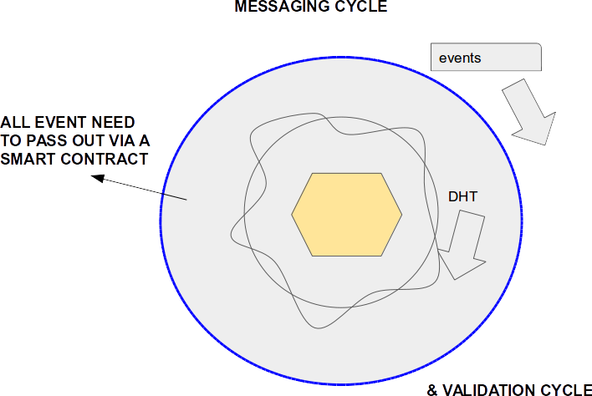
Network View

Slide 14
Peer view
IF (CHOSEN)
Start COMPUTE
Select A or B
Random select peer
DHT A
DHT B

Slide 15
Dscoring
Blind Oracle on scientific truth
Score – predictions, complexity, context
Learn:
  Same context – segment 'accuracy'
  Across different context
  Aggregate 'network' view 'priors'

Slide 16
Process
Dmap – computational (knowledge) theory
Samples across network and computes
Returns a prediction path that is locked into blockchain
Reality
Prediction

Slide 17
Learning
Smart contract aggregates 'training'
MCMC scale up 'scoring'

Slide 18
Quotes
New post monetary currency
A unit of computationally active knowledge

Slide 19
Thank you
www.dsensor.org
@aboynejames
james@dsensor.org
07521580938

