Slide 1
Attendance per Game vs CSA Population
Is there a strong correlation between population and attendance per game?

Slide 2
Considerations
We chose to use the Combined Statistical Areas defined by the Census Bureau because they tend to represent wider geographical areas than the Metropolitan Statistical Areas.
Four teams (MIA,TBR,ARI,SD) are not located with Combined Statistical Areas and Toronto is not located within the United States so we dropped these five teams from this analysis.

Slide 3
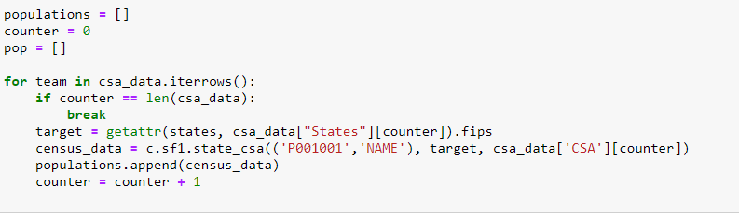
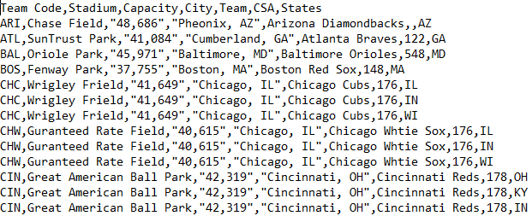
Using the Census Wrapper
The census frequently groups CSAs across state lines.
To collect the data for each state in each CSA we created a csv file to grab the data for each state and then used pandas to sum the population data for each team.

Slide 4
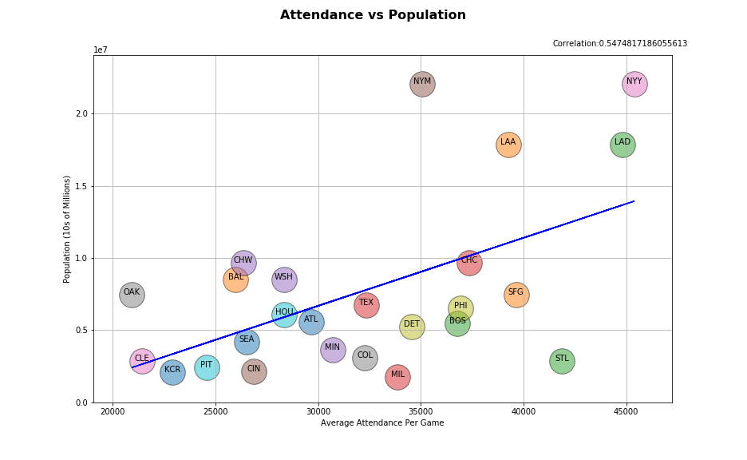

Slide 5
Conclusion
There is a moderate correlation (.547) between population and average team attendance however there are significant differences in attendance per game between the pairs of teams that exist within the same CSA.

