Slide 1
Attendance vs. Record Analysis
by: Howard G. Mitchell III

Slide 2
The Process
Clean and combine the yearly attendance data with the stats data in order to create a uniform master DF to perform my visualizations.
Organize the cleaned data in an appropriate fashion to extract the story of Attendance vs. Record.
2a. Start with the overall set to get my correlations and a team agnostic scatter plot.
2b. Group the data be team to see the outliers.

Slide 3
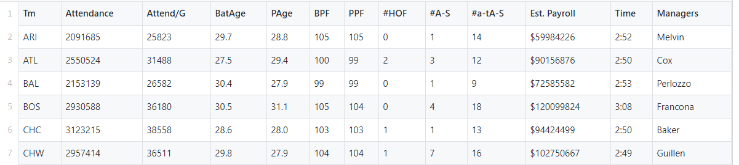
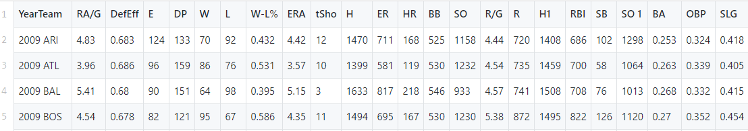
The Data

Slide 4
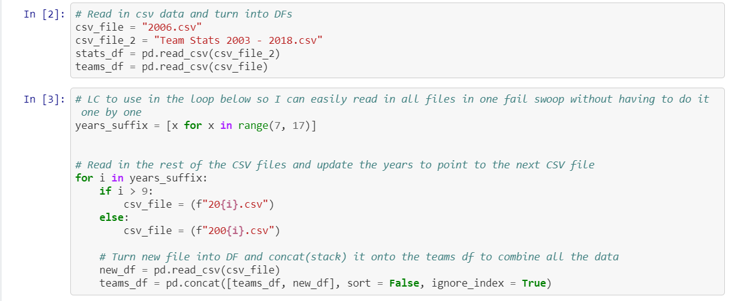
-Read in the data and stack my yearly attendance data into one DF with for loop.

Slide 5

-Create new list to match the column formatting needed to properly merge the attendance and stats data sets together.

Slide 6
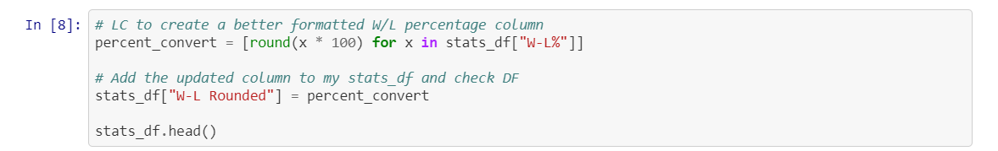
-Add the derivative list to the full teams(attendance) DF.
-Augment the win/ loss percentage column in my stats DF
to make it more aesthetic for the visualizations.

Slide 7
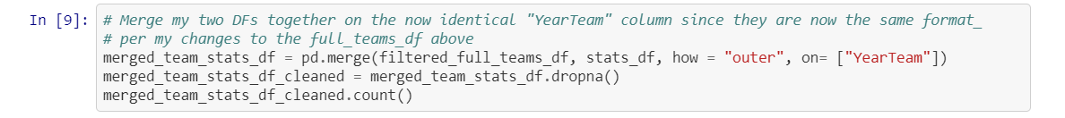
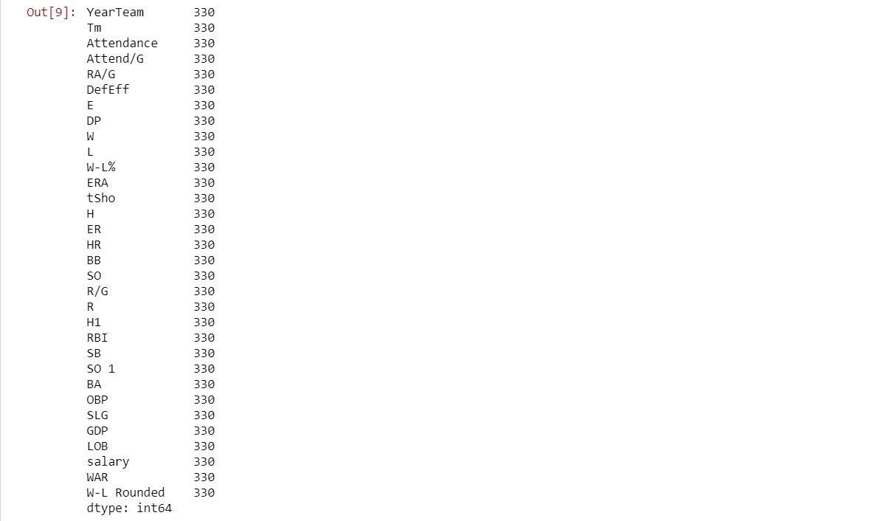
-Merge DFs on the homogenized “YearTeam” columns and drop all of the NA columns to fully clean. -Check counts to make sure everything was done correctly.

Slide 8
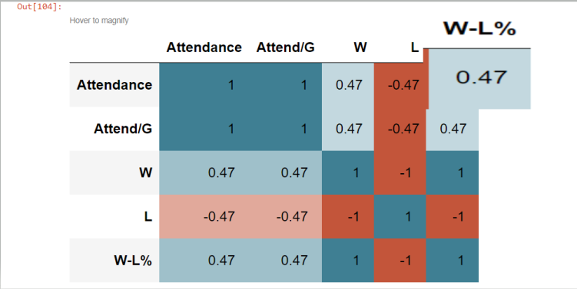
Correlation Matrix

Slide 9
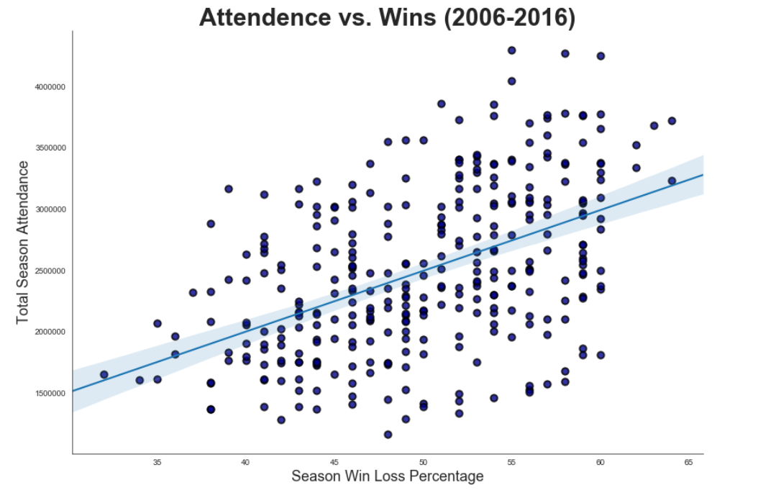

Slide 10
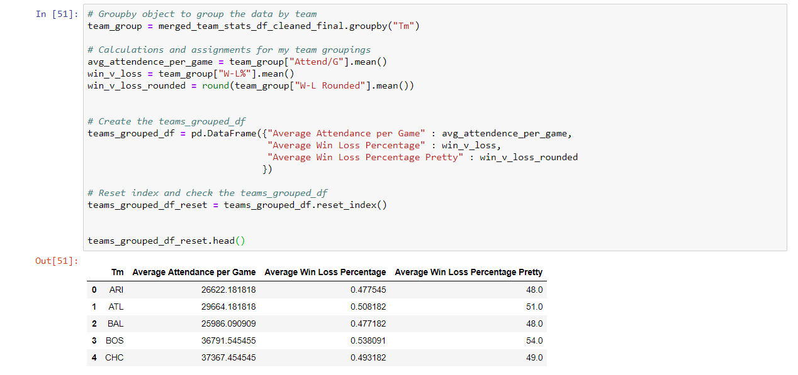
-Group data by team for team level visualizations.

Slide 11
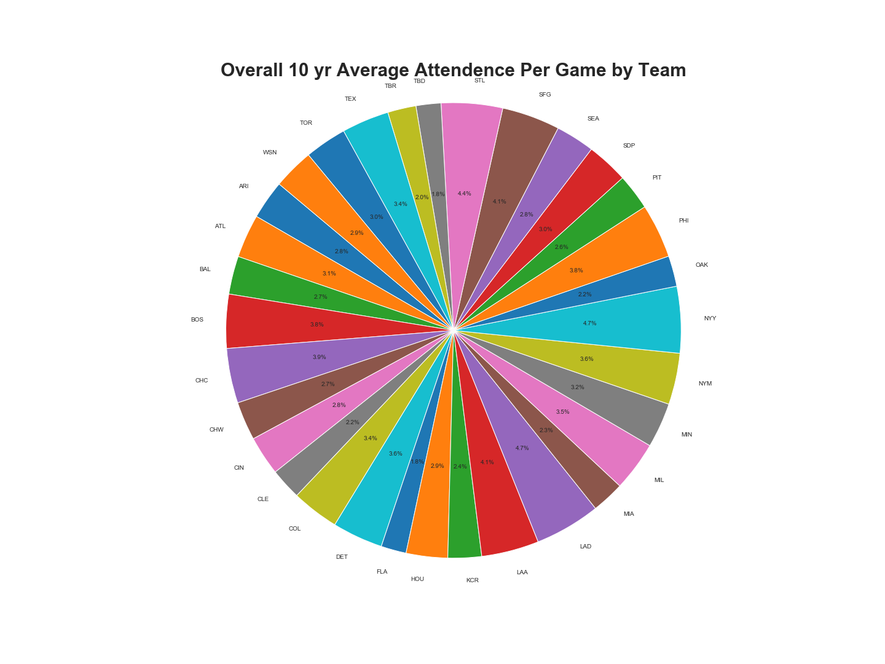

Slide 12
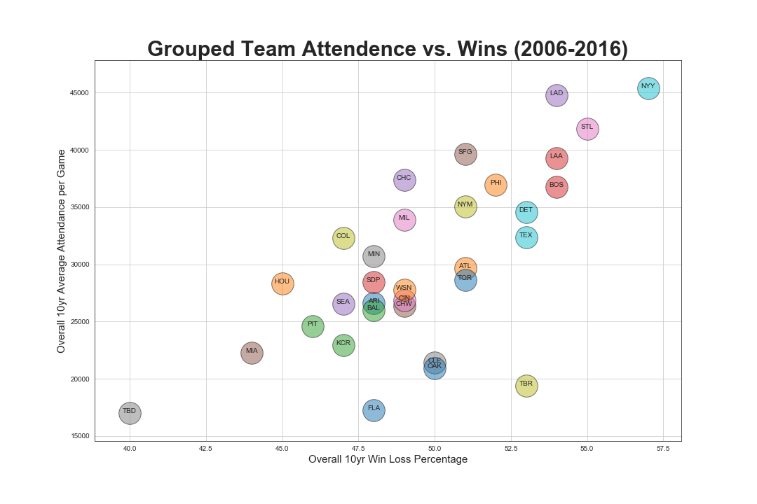

Slide 13
Conclusions
At a correlation of 0.47, there appears to be only a moderate correlation between win/ loss percentage and attendance.
With that said, the biggest outliers as far as highest winning percentages tend to have the highest number of attendees per game.
The New York Yankees have the highest average attendance per game at circa 45,384 attendees per game and the highest win percentage at circa 57% over the course of the 10 year period.

Slide 14
Considerations
Overall, even though we exhibit a moderate correlation of 0.47 for attendance vs. record, the data does not necessarily covey a overly strong and/ or causal relationship between the two.
One has to also account for the “bandwagon effect” where the better a team does over the course of the season, the more people might be interested in buying tickets and attending games.
There are teams with “any weather” fans, such as the Chicago Cubs, that do have an overall win percentage of less than 50% but still rank higher overall in the attendance metrics in comparison to the overall data set.

