Slide 1
Unreal Insight
The Renderer in brief
alexqzhou
dsotsen@gmail.com
Notes:
前两次分享了虚幻4的材质模型和动态全局光照技术，本次主要分享渲染器的实现以及光影表现实现
Morton code, Tiled Lighting, deferred and forward, parallel command buffer build, HDR, Dof

Slide 2
Intro
Modern GPU
Tiled vs Immediate
Renderer
Multi-Thread Rendering
Render Passes
Lighting
Post Process
Render Hardware Interface

Slide 3
Modern GPU
Tile Based Mobile GPU
Vs
Immediate Mode Desktop GPU

Slide 4
Tile-Based GPU
ARM Mali GPU (Pixel Local Storage)
Img Tech PVR Series (High Speed Tile Mem Cache)
Qualcomm Adreno

Slide 5

Tile-based GPU
Split the screen into tiles
E.g. 32x32 (PVR) pixels or 300x300 (Qualcomm)
The whole tile fits with GPU, on chip
Process all drawcalls for one tile
Write out final tile results to RAM
Repeat for each tile to fill the image in RAM

Slide 6
Tile-based GPU: Qualcomm
Cmd Buffer
(RAM)
Vertex Processing
(Position only)
Binning Data
(RAM)
Game
Per Tile:
Tile Memory
Frame Buffer
(RAM)
Vertex Processing
Pixel Processing

Slide 7
Tile-based GPU: Qualcomm
Traditional handing of overdraw (via depth test)
Cull as much as you can on CPU, to avoid both CPU and GPU cost
Sort on distance (front to back) to maximize early z-rejection

Slide 8
Tiled Framebuffer Resolve/Restore Tips
Expensive to switch Frame Buffer Object
Saves the current FBO to RAM
Reloads the new FBO from RAM
Clear all FBO attachments after new frame/render target
Avoids reloading FBO from RAM
Discard unused attachments before new frame/render target
Avoids saving unused FBO attachments to RAM

Slide 9
Immediate Mode GPU
NVIDIA, AMD, Intel Desktop GPUS
Cmd Buffer
(RAM)
Vertex
Processing
Depth
Test
Pixel
Shading
Frame Buffer
(GDDR)
Game
Z Buffer
(GDDR)

Slide 10
Renderer
Multi-Thread Rendering
Render Passes
Tile-based Lighting

Slide 11
The Big Picture
Renderer
Engine
Scene Renderer
Scene Management
Game Framework
Scene
SceneProxy
World
Render
Init View
Mesh Collector
Level
Render PrePass
Mesh Batch
Render Occlusion
Actor
ComputeLightGrid
Base Pass
Render Lights
PrimComponent
Translucency
Mesh Element
Post Processing
Renderer Hardware Interface
Gpu Resources
Render States
Graphics API Implement
Notes:
From the bottom up

Slide 12
Multi-Thread Rendering
Isolate rendering thread to issue render commands
Render Command
Task Pool
Task Execution
Get Task/Wait
Render Thread
Enqueue_Render_Command Macros

Slide 13

Multi-Thread Rendering
From game thread to render thread
Game World
Render Scene
Scene Components
Scene Proxies

Slide 14
From Component to Scene Proxy
Game Thread
Scene Component
CreateSceneProxy
Scene Proxy
GatherDynamicElements
Render
Thread
Scene Renderer
Mesh Elements

Slide 15
Multi-thread Rendering
From render thread to RHI thread
RHI Command
RHI Command
GPU Driver
RHI Command List

Slide 16
Render Path
UE4 has three different renderers:
Deferred Renderer
Default for the editor, PC and Console
Feature Levels “SM4”, “SM5”
Forward VR Renderer
Used mainly for desktop VR and to support MSAA
Similar feature set to the deferred renderer with a few exceptions
Feature levels “SM5”
Mobile Renderer
Used for mobile devices
Forward renderer
Reduced feature set especially for lighting, shadowing
Feature levels “ES2”,”ES3_1”

Slide 17
Forward vs Deferred
Forward
Computes shading in the same pass as geometry/materials
More flexible pipeline
Good at translucent surface rendering
Faster for simple scene
Dynamic Lighting has a big performance impact
Deferred
Shading happens in deferred passes
Works compositing based using Gbuffer
Good at rendering dynamic lighting
Good at stable predictable high end performance
Less flexible rendering pipeline

Slide 18
Before Rendering
Calculate all logic and transforms
Animation
Positions of Models and Objects
Physics
AI
Spawn and Destroy
Notes:
Mostly CPU Bound

Slide 19
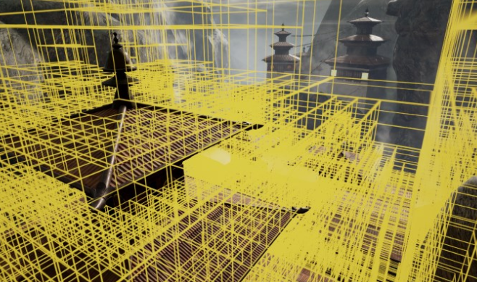
Scene Management
Uses octree to manage lights and primitives
Octree was able to accelerate gathering shadow projected primitives

Slide 20
Before Rendering
Occlusion process – Builds up a list of all visible models/objects
Happens per object – not per polygon
4 Stage process – in order of execution
Distance Culling
Frustum Culling
Precomputed Visibility
Occlusion Culling

Slide 21
Before Rendering
Precomputed visibility divides the scene into a grid, each grid cell remembers what is visible at the location

Slide 22
Before Rendering
Occlusion Performance Implications
Setup distance culling
More than 10-15k objects can have an impact
Mostly CPU bound, but some GPU impact
Large open environments dont occlude well
Large models will rarely occlude and thus increase GPU
But combining models to large models will lower the CPU

Slide 23
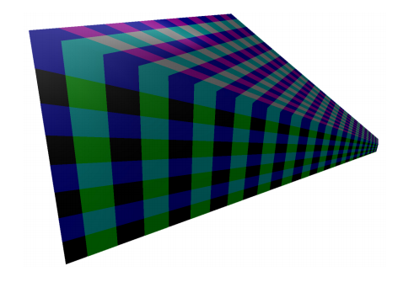
Before Rendering
Build light grid (64px)
Cull lights on the view grid
Save light infos in the light grid
Light Type, radius, color and falloff exponent
When in forward renderer, basspass pixel shader will look up light grid data by pixel position (also with scene depth), and calculate the final color.

Slide 24
Geometry Rendering
Pre Pass / Early-Z
The GPU now has a list of models and transforms but if we’d just render this info out we could cause a lot of redundant pixel rendering.
Thus we need to figure out which models will be displayed where in advance.

Slide 25
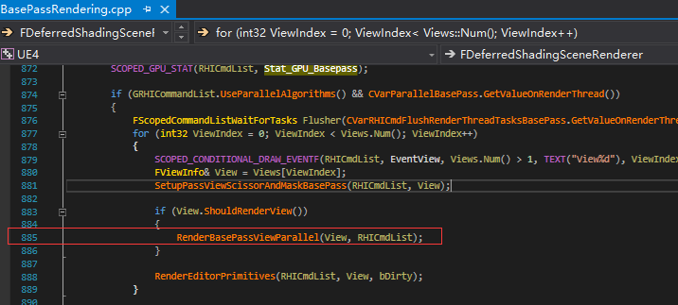
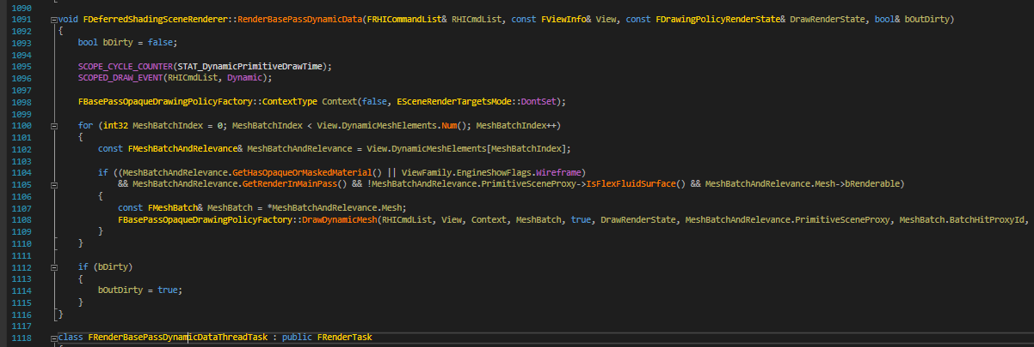
Geometry Rendering
Reorder meshes front to back across each all lists
Minimizes overdraw
Render dynamic primitives in parallel (build command lists)

Slide 26
Geometry Rendering
Draw Calls
Measure with “Stat RHI”
2000-3000 is reasonable
More than 5000 is getting high
More than 10000 is probably a problem
On mobile this number is far lower (few hundred max)

Slide 27
Rasterizing and GBuffer
Rasterization and Overshading Performance Implications
Polygons are more expensive to render in great density
When seen at a distance the density increases
Thus reduce polygon count at a distance (lodding/culling) is critical
The more complex the initial pixel shader pass it, the more expensive overshading is. Thus forward rendering receives a bigger hit on performance from this than deferred.

Slide 28
Composite Lighting
Custom light function

Slide 29
Post Process
HDR & Bloom
Depth of Field
SSSS
Tone Mapping / Color Grading
AO

Slide 30
Renderer Hardware Interface
A Low Level Wrapper for Different Graphics APIs

Slide 31
Aggregation of Graphics Device Objects
Device
Command List
Buffer
Uniform buffer, index buffer, vertex buffer, structed buffer…
Texture
1D, 2D, 3D, cube textures…
Pipeline State Object
Render Target
Resource Views
SRV, UAV…

Slide 32
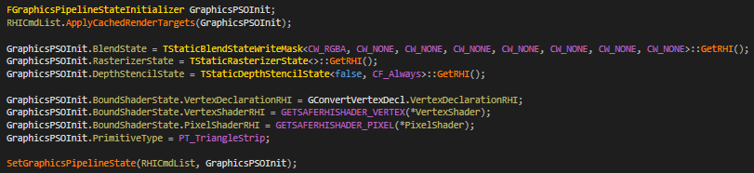
RHI Update
More compliant with modern style APIs
Renderer tells more information upfront to the RHI
Explicit transitions
Pipeline states are now first-class citizens of the Renderer and RHIs

Slide 33
#Todo-next
Render Passes as first-class citizen of the RHI
Will allow the RHI to stop guessing what the Renderer wants to do
Less tracking
Also helps with transitions
Cooked/Offline PSOs
Conservative shader compilation
Side gain: Reduces total # of shaders compiled!
Helps with hitches creating PSOs at runtime
Vertex Inputs
Shaders
RT Formats
Material States

Slide 34
One More Thing…
Render Pass Oriented Renderer Design

Slide 35
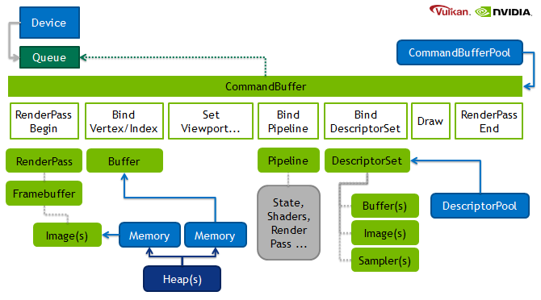
Render Pass
Pass
Sequence of draw calls
Sharing same targets

Slide 36
Frostbite: Frame-Graph
High-level representation of render passes and resources
Full knowledge of the frame

Slide 37
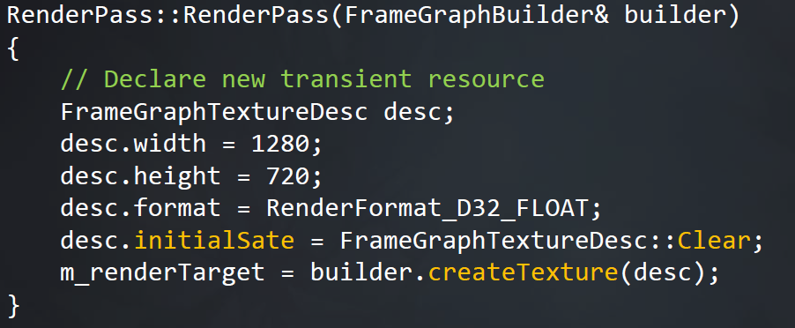
Frame Graph: Setup
Moving away from immediate mode rendering
Rendering code split into passes
Setup
Compile
Execute

Slide 38
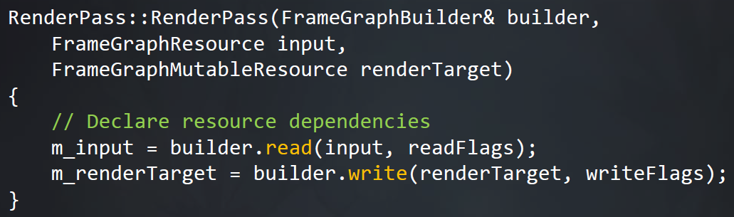
Frame Graph: Setup
Moving away from immediate mode rendering
Rendering code split into passes
Setup
Input
RenderPass
RenderTarget
Ver2
Compile
Render Target
Ver1
Execute

Slide 39
Frame Graph: Compile
Cull unreferenced resources and phases
Calculate resource lifetimes
Allocate concrete GPU resources based on usage
Simple greedy allocation algorithm
Extend lifetimes for async compute
Derive resource bind flags based on usage
Setup
Compile
Execute

Slide 40
Frame Graph: Execute
Execute callback functions for each render pass
Immediate mode rendering code
Draw, dispatch
Get real GPU resources from handles generated in setup phase
Setup
Compile
Execute

Slide 41
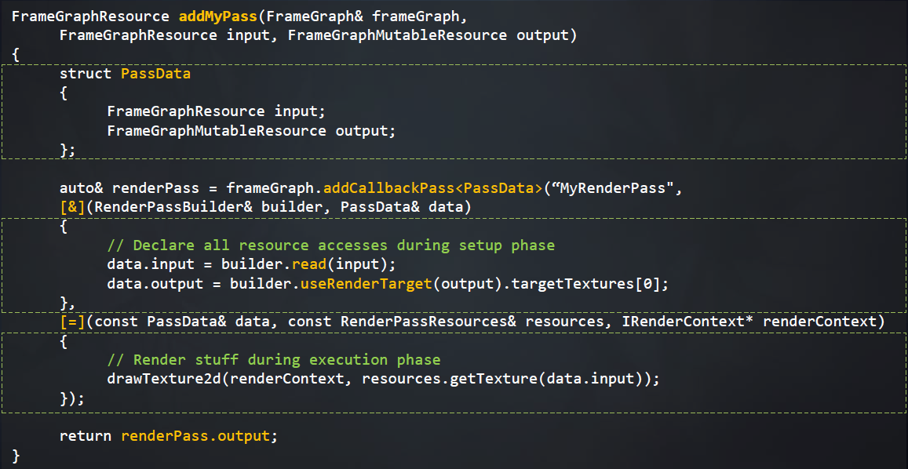
Declare a Render Pass
Resources
Setup
Execute

Slide 42
Frame Graph
Async Compute Example
Sync Point
Graphics Queue
Depth Pass
Shadows
Lighting
Compute Queue
SSAO
SSAO Filter
Depth Buffer
Raw AO
Filtered AO

Slide 43
Frame Graph
Many benefits from full frame knowledge
Huge memory savings from resource aliasing
Semi-automatic async compute
Simplified rendering pipeline configuration
Allow to barrier resources more efficiently
Graphs are an attractive representation of rendering pipelines
Similar to CPU job graphs or shader graphs
Modern C++ features ease the pain of retained mode API

Slide 44
References
SIGGRAPH 2012: The Technology Behind the “Unreal Engine 4 Elemental demo”
Tiled and Clustered Forward Shading
Unreal Open Day 2017 UE4 for Mobile: The Future of HQ Mobile Games
SIGGRAPH 2017 Live
GDC 2017: FrameGraph: Extensible Rendering Architecture in Frostbite

