Slide 1
Job Market Analysis

Slide 2
Project Overview:-
Analyze job market trends using a dataset of 742 job postings, focusing on 42 key features including job title, salary estimate, company rating, location, required skills, and educational requirements.
Utilize data from various sources to identify in-demand skills and qualifications for data-related roles.
Explore job responsibilities, salary trends, and industry demands. Provide insights to help job seekers align their skills with market needs and assist employers in understanding hiring trends.
Support data-driven decision-making through visualizations and analysis.

Slide 3
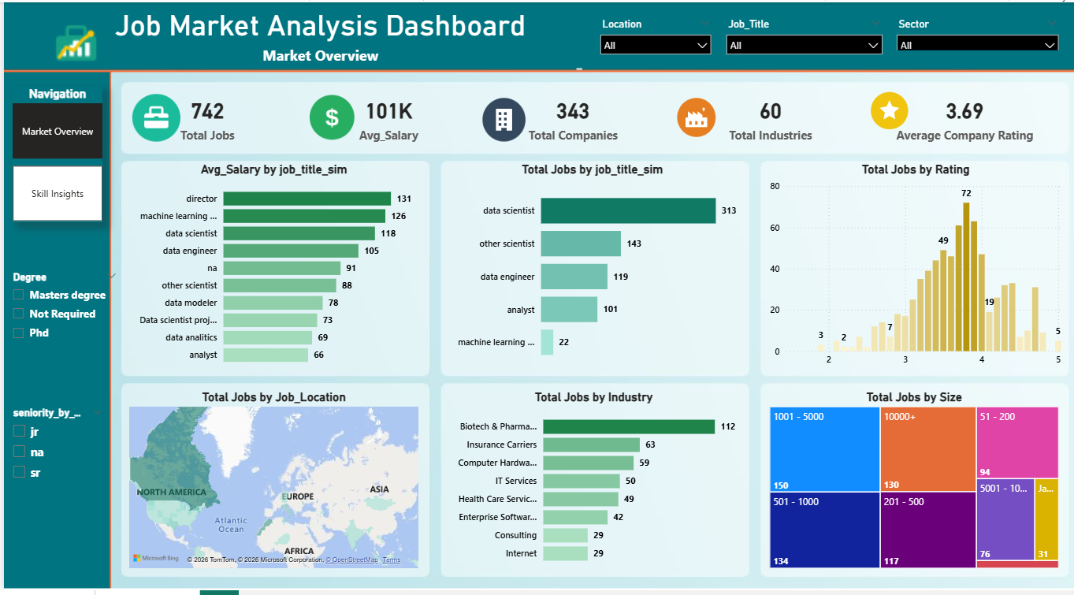
MARKET OVERVIEW

Slide 4

Total Jobs
Insight: The dataset contains 742 job postings, indicating strong demand for data professionals across multiple industries and locations.
Recommendation: Job seekers should focus on developing in-demand analytical and technical skills.

Slide 5

Average Salary
Insight: The average salary across all job postings is approximately $101K.
Recommendation: Continuously improve technical and analytical skills to qualify for higher-paying positions.

Slide 6

Total Companies
Insight: 343 companies are actively hiring data professionals.
Recommendation: Explore opportunities across various industries.

Slide 7

Total Industries
Insight: Data professionals are required across 60 industries.
Recommendation: Develop transferable skills applicable across sectors.

Slide 8

Average Company Rating
Insight: Average rating is 3.69.
Recommendation: Evaluate company culture alongside salary.

Slide 9
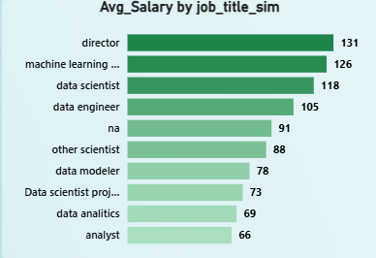
Avg Salary by Job Title
Insight: Director and Machine Learning roles receive the highest salaries.
Recommendation: Focus on advanced technical and leadership skills.

Slide 10
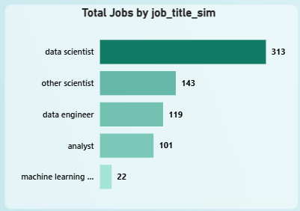
Total Jobs by Job Title
Insight: Data Scientist is the most advertised role.
Recommendation: Prioritize Python, SQL, and ML skills.

Slide 11
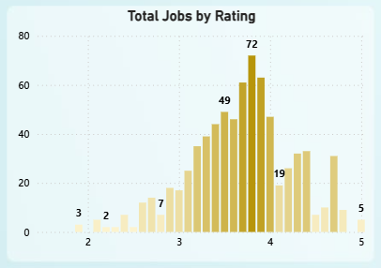
Total Jobs by Rating
Insight: Most jobs come from companies rated 3.5–4.0.
Recommendation: Target highly rated employers.

Slide 12
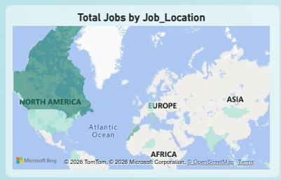
Total Jobs by Location
Insight: Opportunities are concentrated in major economic hubs.
Recommendation: Consider relocation for broader opportunities.

Slide 13
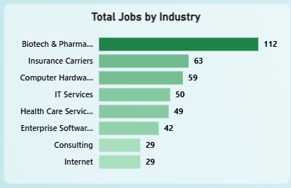
Total Jobs by Industry
Insight: Biotech & Pharmaceuticals lead hiring demand.
Recommendation: Explore healthcare and biotech sectors.

Slide 14
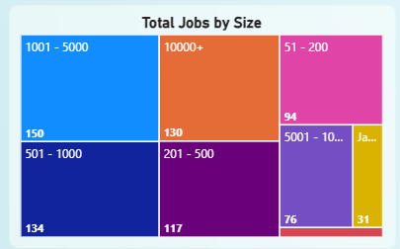
Total Jobs by Company Size
Insight: Most jobs are from medium and large organizations.
Recommendation: Target organizations with strong growth potential.

Slide 15
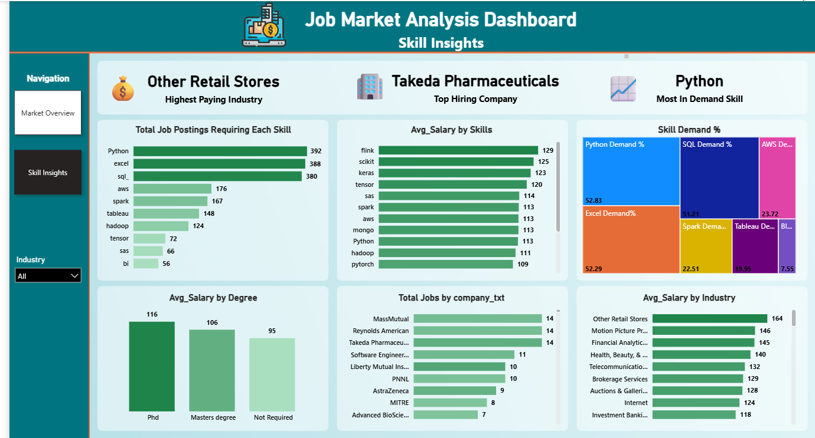
SKILL ANALYSIS

Slide 16

Highest Paying Industry
Insight: Other retail stores offer the highest average salary.
Recommendation: Consider retail analytics opportunities.

Slide 17

Top Hiring Company
Insight: Takeda Pharmaceuticals is among the top recruiters.
Recommendation: Follow major hiring organizations.

Slide 18

Most In-Demand Skill
Insight: Python is the most requested skill.
Recommendation: Master Python as a core skill.

Slide 19
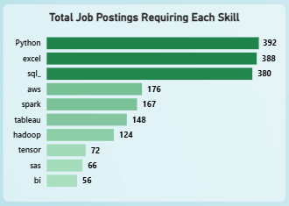
Job Postings Requiring Each Skill
Insight: Python, Excel, and SQL are the top three skills.
Recommendation: Build strong foundations in these technologies.

Slide 20
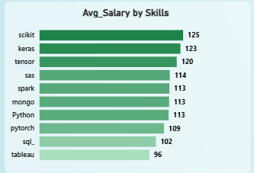
Average Salary by Skills
Insight: Flink, Scikit-Learn, and Keras command the highest salaries.
Recommendation: Learn advanced ML and big-data technologies.

Slide 21
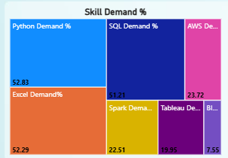
Skill Demand Percentage
Insight: Python, SQL, and Excel show the highest demand percentages.
Recommendation: Make these skills part of your learning roadmap.

Slide 22
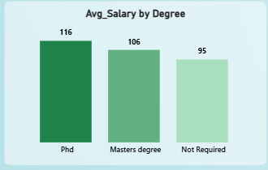
Average Salary by Degree
Insight: PhD holders earn the highest average salary.
Recommendation: Higher education can improve earning potential.

Slide 23
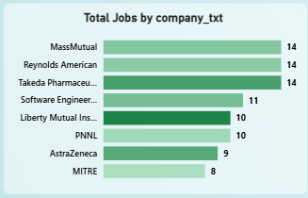
Total Jobs by Company
Insight: A small number of companies account for significant hiring activity.
Recommendation: Target companies with consistent demand.

Slide 24
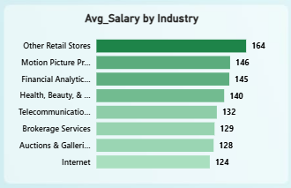
Average Salary by Industry
Insight: Retail, Finance, Healthcare, and Telecom offer high salaries.
Recommendation: Consider these sectors for long-term growth.

Slide 25
Conclusion:-
Analyzed 742 job postings to identify key job market trends and hiring patterns.
Found strong demand for data professionals across multiple industries and locations.
Identified Python, SQL, and Excel as the most in-demand skills.
Advanced machine learning and big data technologies are linked to higher-salary opportunities.
Industries such as Healthcare, Finance, Retail, and Technology offer significant career prospects.
Continuous skill development and practical experience are essential for long-term career growth

