Slide 1




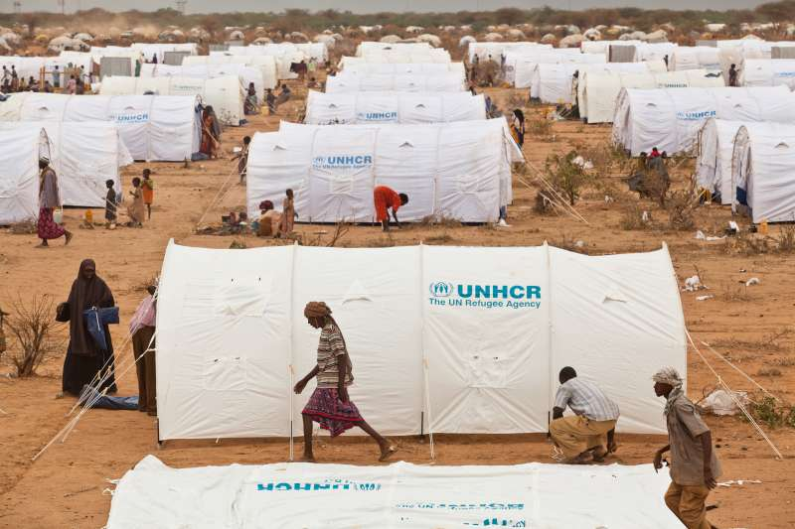
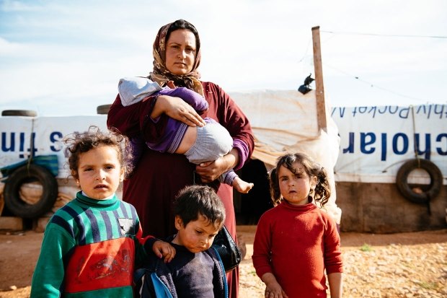











World Bank
United Nations
European Commission
Other NGOs
List goes to UNHCR
Register with Ministry
Family arrives to Greece
Family is assigned to a refugee camp
Family is given a list of services:
Legal
Mental
Education
Physical
Upon completion they receive aid
Refugee avails of each service
Notes:
Point of slide 1 is to say that different agencies keep different records that don’t speak to each other.
The UNHCR has the master record (Green – Funder ledgers, Blue – Refugee manifesto, Dark Blue --- Refugee + disbursement)
Funders (different shades of green) also have their own ledgers but they have no direct and real time access to the dark blue ledger. They have to go through the UNHCR to check their disbursement progress.
Other colors imply other records that would be good to track but they are just disparate / disconnected from the rest of the systems.

Slide 2
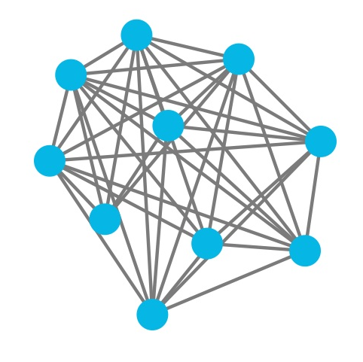
Notes:
Proposal: blockchain technology
Unified, distributed, decentralized.
All systems in one color.

