Slide 1


West Midlands Rural Affairs Forum,
16th March 2010
Ian Binks, Regional Manager, BT, West Midlands
Ian.binks@bt.com
0121 230 2950
Openreach makes every effort to ensure the information in this report is accurate at the time of compilation, however, Openreach does not represent that it is complete and recipients should check with Openreach for the latest available information. Openreach reserves the right to modify delivery criteria and delivery dates. and/or a copyright statement (or message that reproduction only on BT’s permission).

Slide 2
Agenda
About Openreach
Network coverage
  Rural broadband: the challenge
The Digital Britain Review
Technical solutions
  Broadband Enabling Technology
Working together to fill the gaps

Slide 3
About Openreach
Openreach installs, services, supports and maintains the wiring, fibres and connections which link tens of millions of homes and businesses in Britain to their Communications Providers' networks.
Openreach is part of the BT Group, but a separate division with separate:
  Headquarters
  Identity (Brand)
  Financial reporting
  Commercial operating principles
Notes:
Openreach exists to provide fair and equal access to the access network to all CPs eg Carphone Warehouse and Sky to individual or niche providers for particular vertical markets or areas of the country.
Here are a couple of areas in which we are very independent of our parent company. Also worth mentioning that all of us are financially incentivised not on the performance of BT, but on that of Openreach, underlining our neutral position in the market.
Over 30,000 employees, the large majority of which are in the field, helping homes and businesses every day
If we were a standalone company we would be of a FTSE 250 size.
Openreach is also the main deployment arm of BT’s Next Generation fibre access programme, and is committed to making this new network available at a wholesale level (or ‘open access’) to all other Communications Providers on an Equivalent basis.

Slide 4
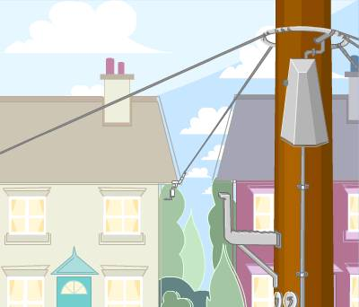
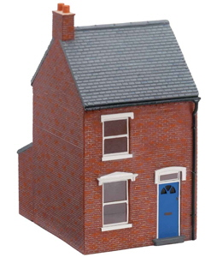
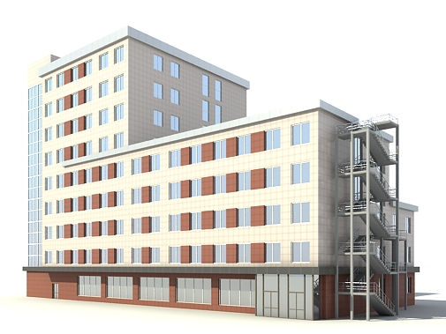
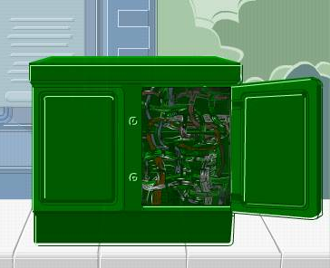
A reminder of Openreach’s responsibility:
Home or office
Primary Cross Connection Point (green cabinet)
Telephone exchange
Distribution point
Main distribution frame
Socket
The access network
Notes:
And so to the network:
We are the proud custodians of what is known as the access network or ‘first mile’.
Everything from the exchange to your home or business, including the green boxes and poles you see around you every day.
Openreach’s creation and sole focus on the network has revolutionised the service it is capable of delivering today.
Our people proactively, as well as reactively, fix the network, replacing worn or outdated components, of those that may hinder broadband speeds like DACS technology and line concentrators
Our efforts have broken the link between weather and performance
On average a line will fault only once every 13 years.
And perhaps most crucially, what we deliver is a COMPETITION-READY NETWORK. You may have heard the term open access used a lot lately – this really started with the creation of Openreach and our commitment to ensure that all CPs have the chance to buy the same network products from us in the same way at the same price in the same timescales.
We have built an industrial-grade business platform to allow this to happen called the EMP (Equivalence Management Platform) Through this CPs can see engineer appointments, order, bill and track, to help them deliver the most competitive services to you.
EXTRAS:
Our evolution:
Year 1: Delivering a better network
Year 2: Delivering a better network to help our customers grow
Year 3: Delivering tomorrow’s network of choice together

Slide 5
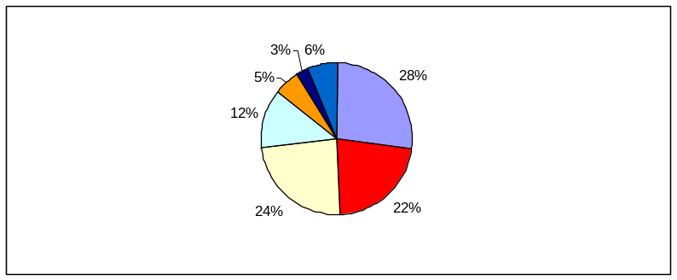


















UK broadband market is competitive at all layers from end user services through to infrastructure
O2/Be
Orange
Sky
BT
Talk Talk
Inc Tiscali
Virgin
Broadband for Home & Businesses
UK market share Q2 09
Enders Analysis
Front end customer interface
Service providers
BT Retail
Global Services
O2
Integrated business processes / systems
Wholesale providers
BT Local Loop Unbundling
From the Carphone Warehouse
Integrated business processes / systems
Infrastructure providers
EMP
Systems and operational interfaces
Wholesale Operational system
EMP
Equivalence Management Platform

Slide 6
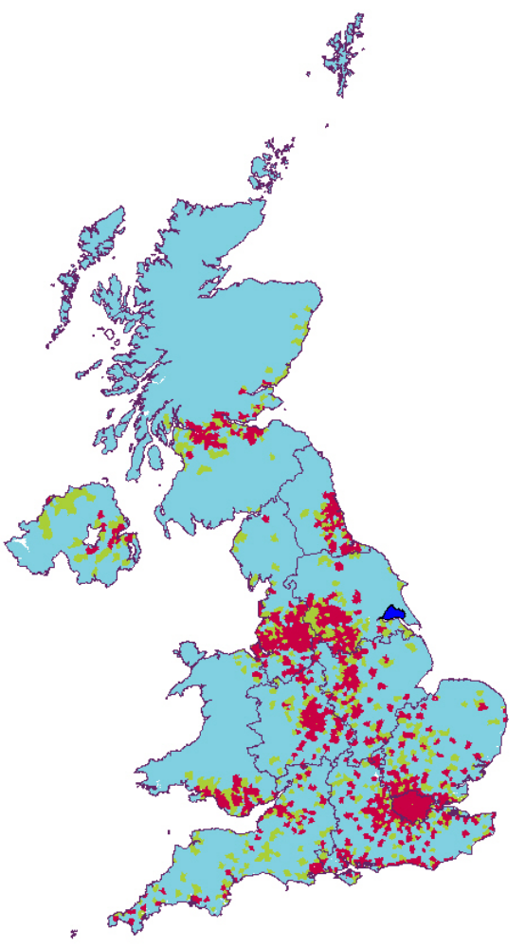
Competition is greatest in urban areas with BT providing wholesale services for communication providers in the more remote locations
This map shows the current footprint of where Communication Providers offer direct LLU service or where they resell wholesale broadband from BT Wholesale.
It illustrates that the greatest extent of competition is available within dense urban areas
Colour Coding & % of population
4 or more operators – 69%
2 to 3 operators – 14%
BT only – 16%
KCOM only – 1%
Source; Ofcom

Slide 7
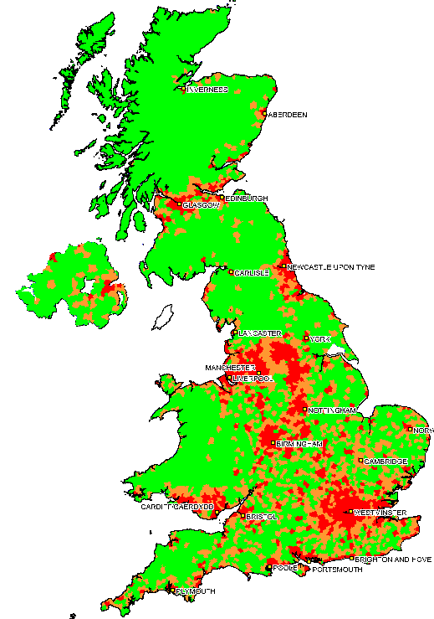
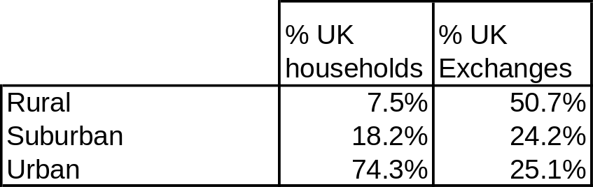
How rural communities are connected
Average size of Exchange
Urban = 14.2k
Suburban = 3.6k
Rural = 0.7k
Urban
Suburban
Rural
Notes:
So how do you define rural:
Eurostat definition
Urban > 500 inhabitants/Km²
Suburban >100 inhabitants/Km² < 500 inhabitants/Km²
Rural < 100 inhabitants/Km²
At Openreach we can apply this definition to our exchange areas…..
Of Openreach’s 5.5k exchanges, around 50% cover urban and suburban areas of high population density as per the Eurostat definition. These 50% of exchanges also cover off as a result over 90% of the UK population.
It takes the same number of exchanges again to reach the remaining 7.5% of the population. This gives an idea of the challenging business case for both Communications Providers and operators when it comes to delivering broadband.
A little more on the practicalities of delivering broadband and then let’s look at the real options on the table to address some of these challenges…

Slide 8
UK Broadband: Status update
Over 99% of BT exchange lines are capable of delivering a 256Kbit service (Ofcom definition of broadband)
Availability is greater than other G8 countries
85% of BT exchange lines are capable of delivering 2 Mbit/s
BT Group will make Next Generation Access available to 40% of UK homes by 2012 (Virgin has similar plans)
…but this doesn’t feel true for everyone- particularly rural communities
Notes:
All good news:
iPlayer to the PC – 0.5 Meg
Xbox, Bebo, Youtube – 1 Meg
BT Vision – 1.5 Meg
HDTV - 6Mb/s downstream
HD 3D TV - 12Mb/s downstream
However, these advances throw into sharp relief the difference in experience between those that have and don’t have broadband
This and comparisons with initiatives elsewhere in the world are driving expectation and public pressure – hence the timeliness of the DBR
You’ll see based on challenges that without funding to support the business case, the opportunity to close the gap between commercially viable and unviable areas will be limited.
There is no single rural broadband experience – why not? How are rural communities currently served and what challenges are there to connecting everyone under the terms of the USC.

Slide 9
The challenge of rural broadband
Long lines >5.5km
Multiple individual dwellings
Geographical obstacles
Legacy topology
Home wiring/interference
Planning, conservation and environmental factors
Notes:
Long lines: due to the simple laws of physics, the longer the line, the less able it is to support high or stable broadband speeds.
Multiple individual dwellings: clearly delivering high speed services to apartment blocks is more cost effective
Geographical obstacles: hills, valleys, other features
Legacy topology : DACs, line splitters, line concentrators, lines following old roads or connected to exchanges further away
AONBs or Conservation areas: These are critical to preserving the beauty of the UK, but can cause issues for us with civil engineering works and forcing work underground can quadruple or more the cost of providing service.
Home wiring/interference: Electric fences commonly found in rural areas can cause dramatic interference to broadband lines – we have no powers to mandate removal.
Planning: The topography typical of rural areas and the requirements to circumnavigate obstacles can significantly impact our ability to invest. Local auths can really help us in working collaboratively with us to identify sensitive areas and arrive at alternative solutions to ensure services can still be provided
(Note on costs)
Really horses for courses depending on topology/geography. 60-70% costs can be down to civils, particularly in rural areas.
So what are the technical options currently available to address this?

Slide 10
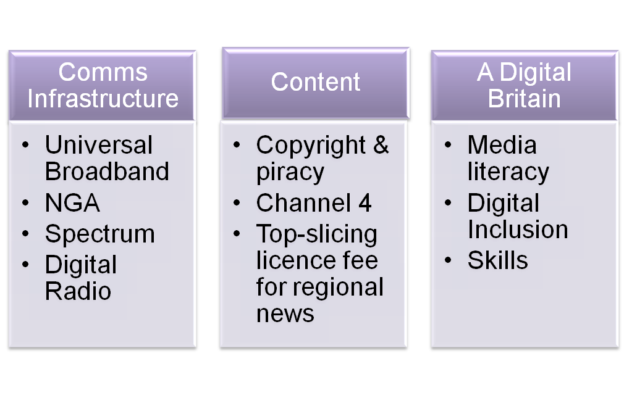
How do these issues fit with the Digital Britain Review?
Stephen Carter:
  “an action plan to secure the UK’s place at the forefront of innovation, investment and quality in the digital and communications industries”
Broadest scope of any UK Govt review of our industries
Can the outcomes deliver in line with the demands of rural communities?
Notes:
DBR seeks to address some of these challenges
Wide ranging report with a number of particular areas of focus for us: USC and NGA (Click now to highlight these areas)
We are talking to the relevant government departments regularly to input into the debate on how the aims set out in the report can be achieved.
And whilst the USC focuses on delivering broadband to everyone, Stephen Timms has recently acknowledged in the press that even so, rural communities may well have to pay more to gain broadband connectivity, not least because CPs need to be convinced of their returns to invest in an area – a much easier case to make in urban areas reaching many more people per exchange.
USC
Broadband USC at 2Mb/s by 2012 to ‘virtually every household’ in UK – including current notspots
Mix of technologies
£200m from public funding – Digital Switchover Help Scheme underspend & Strategic Investment Fund - competitive tenders
NGA – plans now in question
Final Third Project’ to deliver 90% NGA coverage by 2017
Partially funded by 50p levy per month (£6 per year) on all copper lines (including cable) from April 2010 – expected to raise £150m -£175m a year.
Network Design and Procurement Group to run the procurement process – CPs bidding on a reverse auction basis
Commercial roll-out expected to increase from 50% to two-thirds)
Relate to Commission latest policy statement/manifesto
These programmes however, in combination with other support/subsidy from public bodies could help us hep you to deliver on your key policy goals as we head to the next election. Adequate connectivity can help in the realisation of your goals for rural community cohesion and prosperity, and provide support in the face of declining availability of public services via traditional means. The information highway can be an important additional transport route to those you focus on in the manifesto. Communications capability can play an important and complementary role to these goals and supporting promoting rural economies and communities into the future. We too experience significant cost challenges in delivering services to some rural parts of Britain and the support (both financial and other) of local authorities and government will be key to delivery.

Slide 11
Recent Developments
NGA Fund consultation – closes end of March 2010.
Business Innovations and Skills Committee – published a report on Digital Britain
Broadband Delivery UK has been announced
  USC by 2012 using under spend from the Digital Switchover fund
  Deliver NGA by 2017 using the NGA fund

Slide 12
Many considerations…
Timescales to deliver
Sustainability
Reliability
Customer experience
Price
Choice
Notes:
So, initiatives coming out of the DBR create opportunities for rural communities to receive connectivity where not previously available. Of course local authorities, parishes and other organisations have also indicated to us that they are seeking solutions independently of this government funding. A few things to bear in mind if procuring/deciding on solutions:
Decide what matters to you – we’d suggest certainty, dependability and affordability should be your watch words.
Keeping costs competitive in rural areas relies on competition – look for true open access with a ready choice of CPs who will bring competitive packages. Captive audiences bring no incentive for a single CP to keep costs down
Solutions claiming an instant fix may not be futureproof – numerous wireless examples now bust and State Aid money cannot be re-spent to rectify it
Beware unreliable headline speeds that could be compromised by weather or environmental factors.

Slide 13
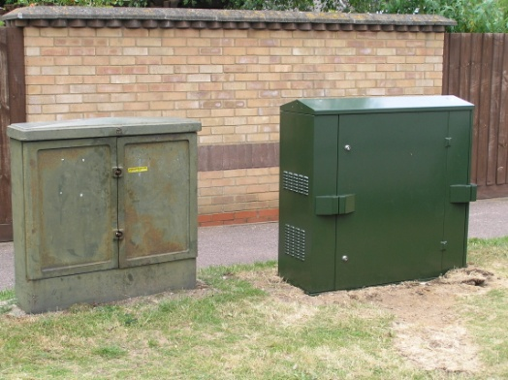







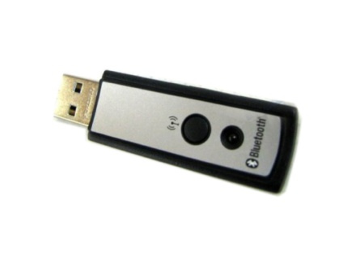
What are the options?
Fixed
Wireless
Satellite
Notes:
Some of these solutions are more suited than others to delivering broadband to rural areas in our view.
Fixed:
Common misperception that replicating the fixed line network is easy, cheap, straightforward.
Requires ubiquity yet locality, expertise, maintenance infrastructure, industrial grade platforms, complex service wraps to support open access
Practicalities make it almost impossible to replicate – and certainly not at an attractive price
BET (Broadband Enablement Technology)
Ongoing technical trials in Scotland
Proven robust 1 Meg capability
Testing 2 Meg – initial results encouraging
A real and cost-effective option for rural communities and individual premises with long lines
Excited about its potential to help deliver the USC
Will be delivered adhering to all our principles of open access.
FTTC
Shortlist of 1m homes announced 9th July-delivered by Summer 2010
Further consultation to reach 10m homes by 2012 due later this year
Based on numerous factors: technology, network topology, social, economic, demand, tangible commitment from local areas
Programme acceleration recently announced
Again being delivered on an open wholesale basis – we have six CP trialists including BT, Sky and TalkTalk.
Could be suitable for areas of proven or significant demand, with clustered premises near to one or more cabinets
Again could be used to address USC
Two rural pilots of FTTC announced – Calder Valley in Yorkshire and Taffs Well in Wales – will help us test practicalities of delivering to rural areas.
Wireless
Wireless is great for roaming and continuing to be in touch when on the move, mainly with non-mission-critical data.
Expensive
Variable performance
Often tied in to one provider.
Satellite
Defined data rate into a specific area e.g. the mobile base station area or the satellite footprint area (which would be typically the size of a country or a large region).
Have to share the available capacity with all other active users

Slide 14
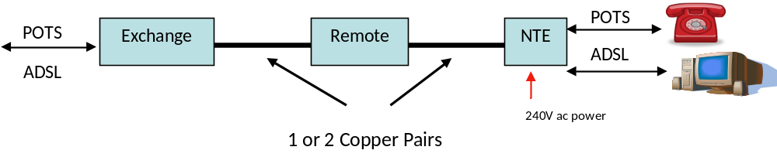
Broadband Enabling Technology (BET)
An ‘equivalent’ reach extension to broadband services
1 Mb/s or 2 Mb/s downstream
Up to 1 Mb/s upstream
A dedicated access link
Stable services for 7-12km lines
Trials have proven a robust and reliable service for long lines
Notes:
Trials in Moray in the north of Scotland have shown lines of between 7 and 12 km running stable 1Mb/s services, and where a second line is available, we can now bond them together to provide an enhanced 2Mb/s service.
Comparable to existing broadband technologies
Crucially this technology will reach the areas – reliably - that other technologies may not be able to
Should enable CPs to actively want to provide service – combined this is a sizeable market
But the commercials are difficult
A level of public or private subsidy will be required to make the case
THIS WILL BE SUBJECT TO ANY NECESSARY REGULATORY REQUIREMENTS

Slide 15


