Slide 1
DARSHAN B
Final Project
NM ID: 6B1C0C27509E1EB8BBB4A6BF51353C11
Course: Generative AI for Engineering (E2324)
Campus: Zone IV : MIT – Chromepet
3/21/2024 Annual Review

Slide 2
PROJECT TITLE
EmoNet: Real-time Emotion Detector using Convolutional Neural Networks with Keras
3/21/2024 Annual Review

Slide 3


AGENDA
Introduction
Problem Statement
Project Overview
End Users
Solution and Value Proposition
Wow in our Solution
Modelling Approach
Results
3/21/2024 Annual Review

Slide 4

PROBLEM STATEMENT
Emotion recognition is crucial for human-computer interaction but often presents challenges due to varying facial expressions and contexts.
Existing methods may struggle with accuracy, especially in real-time scenarios.
The need is for a robust and efficient emotion detection system that can accurately classify emotions from images or video frames.
3/21/2024 Annual Review

Slide 5

PROJECT OVERVIEW
Objective:
Develop a system capable of real-time emotion recognition from live video feeds, facilitating instantaneous feedback on human emotional states in dynamic environments.
Implementation:
Utilizes Convolutional Neural Networks (CNNs) integrated with the Keras framework to efficiently extract features and classify emotions from facial expressions captured in live video streams.
3/21/2024 Annual Review

Slide 6
PROJECT OVERVIEW
Key Features:
Incorporates face detection algorithms to locate and isolate facial regions within live video frames, ensuring accurate analysis of emotional cues.
Employs CNNs to infer emotions from facial features, enabling the system to recognize and classify various emotional states in real-time.
Adapts to changing lighting conditions, facial poses, and environmental factors, ensuring robust performance across diverse real-world scenarios.
3/21/2024 Annual Review

Slide 7

WHO ARE THE END USERS?
Target Audience:
Human-Computer Interaction Researchers
Interface Designers
Market Researchers
Mental Health Professionals
End Users Benefit from:
Real-time feedback on user emotions
Enhanced user experience in interactive systems
Insights into market sentiment and consumer behavior
Support for mental health diagnostics and interventions
3/21/2024 Annual Review

Slide 8

YOUR SOLUTION AND ITS VALUE PROPOSITION
Solution:
Real-time Emotion Detector leveraging CNNs with Keras
Integration with live video capture and face detection using OpenCV
Value Proposition:
Instantaneous emotion recognition in dynamic environments
Enhanced user engagement and satisfaction in interactive systems
Real-time feedback for market research and sentiment analysis
Support for mental health diagnostics and interventions in clinical settings
3/21/2024 Annual Review

Slide 9

THE WOW IN OUR SOLUTION
Wow Factor:
Real-time processing of live video feeds for instant emotion recognition
Seamless integration of CNN-based emotion inference with face detection
Robust performance in diverse lighting conditions and facial poses
Practical applications in human-computer interaction, market research, and mental health diagnostics
3/21/2024 Annual Review

Slide 10
MODELLING
Model Architecture:
CNN architecture designed with multiple convolutional and pooling layers.
Feature extraction and classification using Keras framework.
Training:
Data preprocessing including resizing, grayscale conversion, and partitioning
Training the CNN model on emotion-labeled facial images
Early stopping and model checkpointing for preventing overfitting and saving best-performing model
3/21/2024 Annual Review

Slide 11
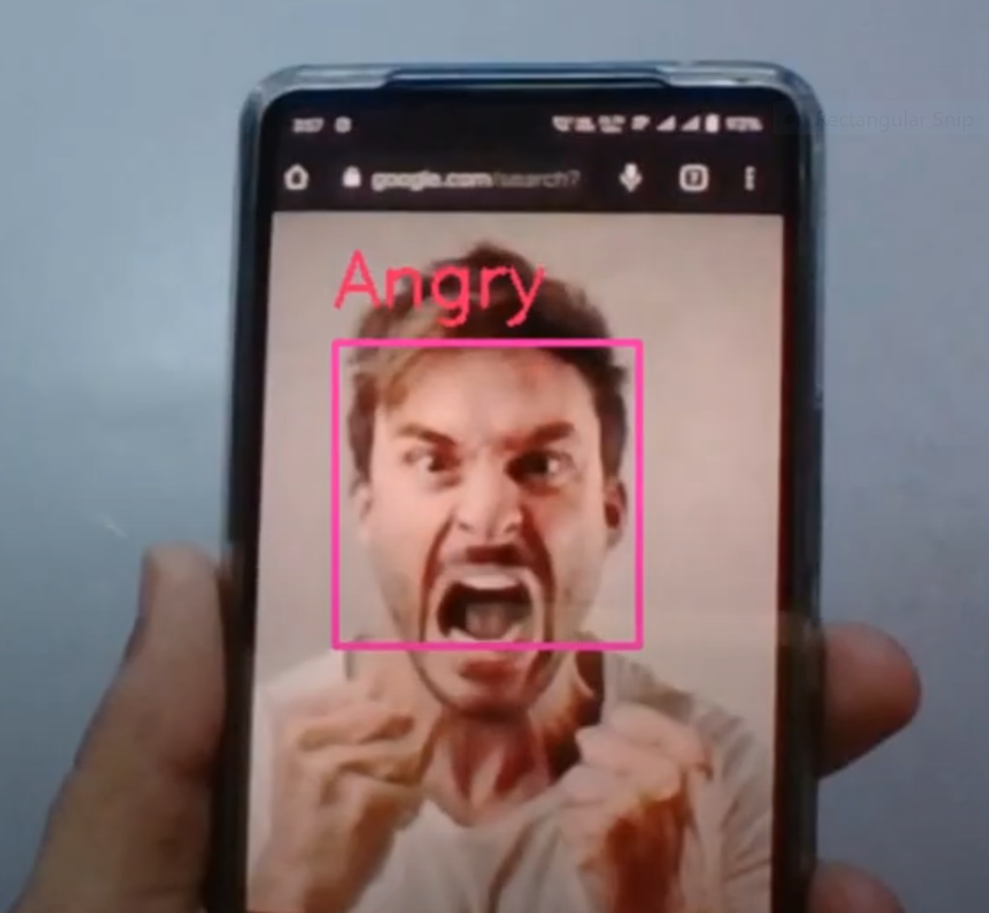
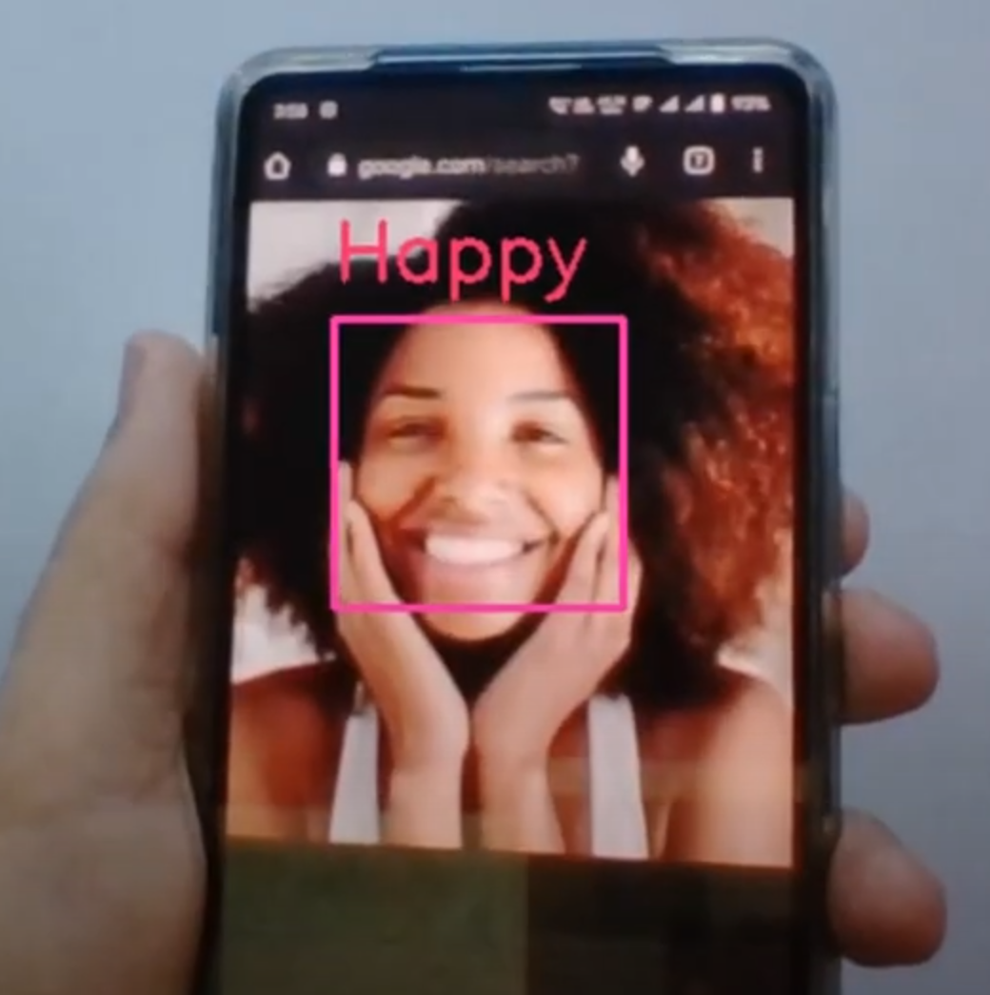
RESULTS
Demo Link
3/21/2024 Annual Review

Slide 12
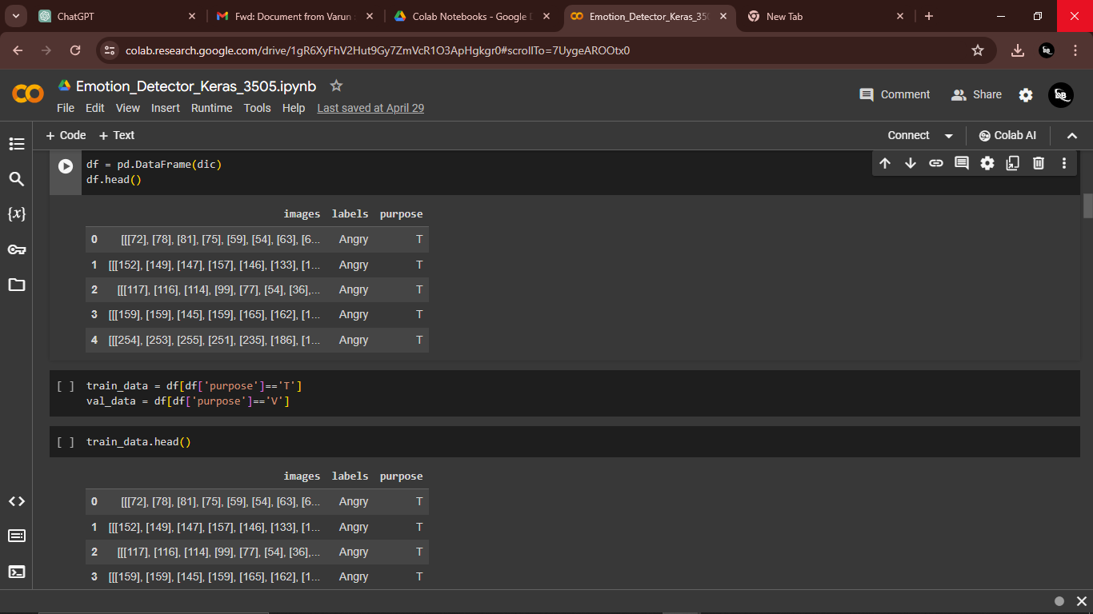
RESULTS
Demo Link
3/21/2024 Annual Review

Slide 13
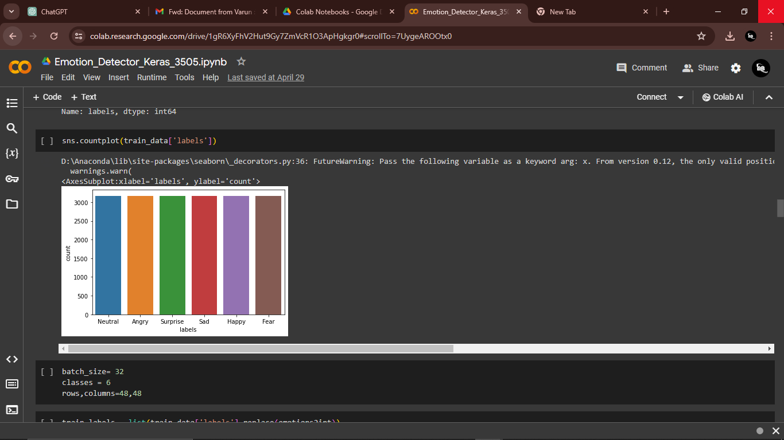
RESULTS
Demo Link
3/21/2024 Annual Review

Slide 14

RESULTS
Accuracy Measures:
Accuracy = 99.6%
Demo Link
3/21/2024 Annual Review

Slide 15
Thank You

