Slide 1
Component Interactions & Routing
David Karolyi
Nyíregyháza – 2024/04/09

Slide 2
Agenda
01
Component interactions
02
Exercises – part I
03
History API
04
React Router
05
Exercises – part II

Slide 3
Component interactions
Do only one thing but do it well

Slide 4
Where are my results?
Component interactions
Example: Search
<Page> Hey, SearchBox – let me know when the users want something
Pass a callback method which will change the page’s query when called
<SearchBox> They are looking for a Batman movie
calls the callback with the search query
<Page> Then I’ll ask the big guy
the callback sets the internal state with query
It triggers a useEffect – start the search
<Page> ok, we got the results after an eternity
Changes the internal state with the results
<MovieList> Oh, 6 movies – let’s show them
The page just passed the list
<Orderlist> Hey, Page – the users changed the ordering, they want to see the fresh movies first
Another callback triggers a similar effect
<Page> Ok, then I’ll ask the boss again
Retrieves the paginated content
Props: for input parameters and initial state values
State: model what is on the screen within the component
Output: here’s the thing
Then how?
One component – one job; do the thing
The output is an input -> define a callback
Handle the necessary things within
Call the callback method when everything is ready
The task is ready and I’m happy to know
Imaginary conversation:
Please do this thing for me and I don’t care what kind of black magic you do
I’ll call you when it’s ready
Thanks, fine by me

Slide 5
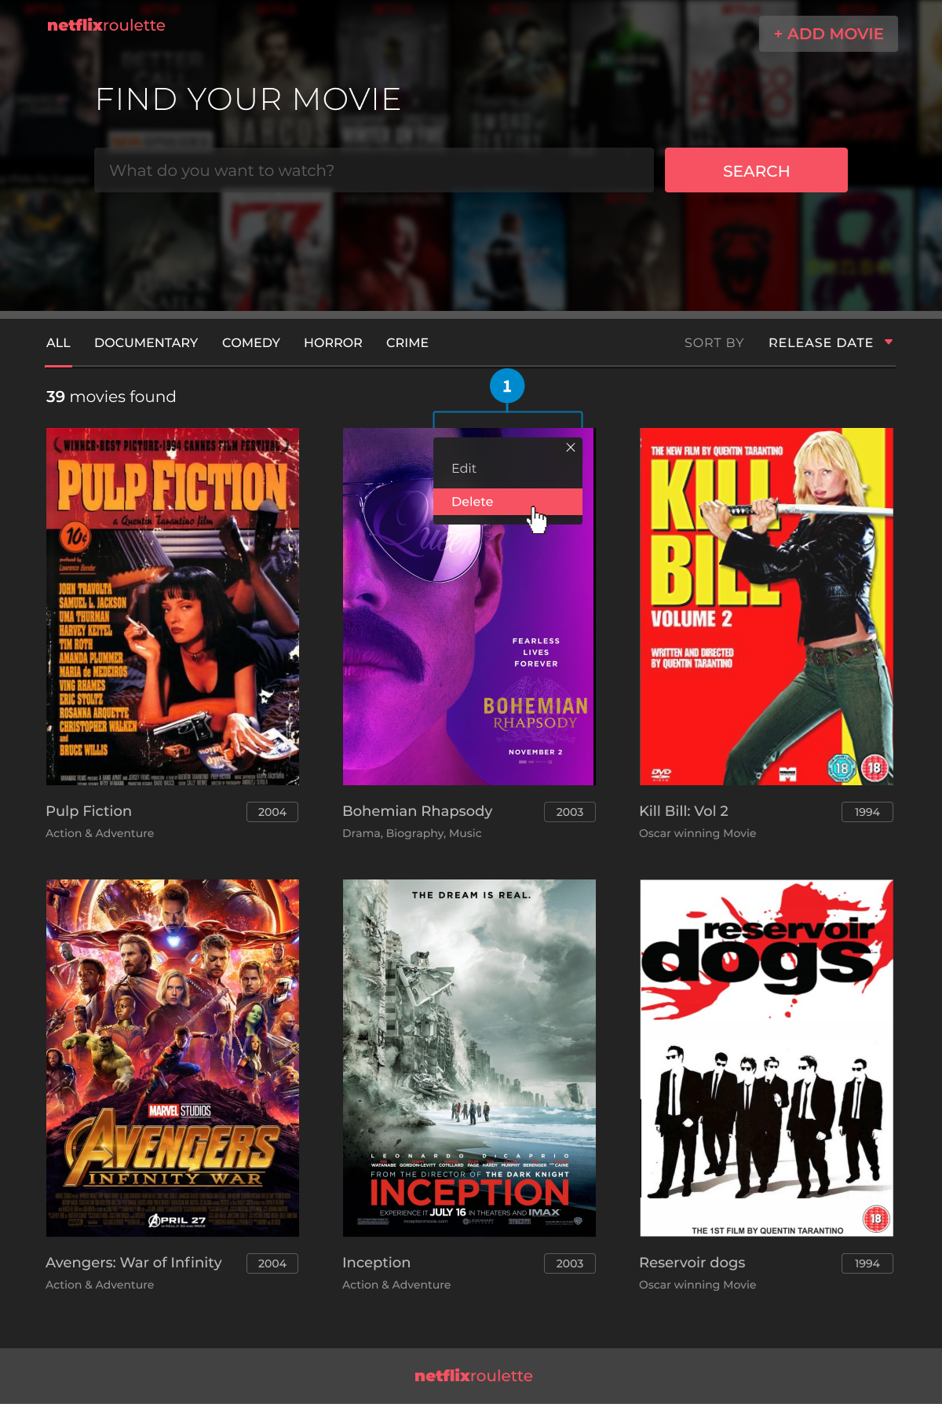
Let’s do it
Component interactions
We need the following items:
The Page itself
Works as a controller
Knows everything, but not a micromanager
We basically got this already
SearchBox component
Handle the search query itself
Only disturbs the Page when the user submitted the search
The Ordering list
Has a default value defined by the Page
Notifies the Page when the user changed this item
Total values
Result list and items
We have already done this before
Got a list to display, pass the items to down to handle the details
Pagination…?
somewhere here

Slide 6
Exercise – Part I
Let’s make those items sing

Slide 7
Let’s update our page
Component interactions
const [movies, setMovies] = useState<Movie[] | null>(null);
const [orderBy, setOrderBy] = useState<MovieSortType>(MovieSortType.RATING_DESC);
const [search, setSearch] = useState('');
const [total, setTotal] = useState(0);
useEffect(() => {
(async () => {
const response = await fetch('http://localhost:5000/movies');
const { data, total } = await response.json();
setMovies(data.map((movie: RawMovie) => ({
...movie,
release_date: new Date(movie.release_date),
})));
setTotal(total);
})()
}, [setTotal, setMovies]);
return (
<Box width="full" backgroundColor="background.dark">
{movies && <MovieList movies={movies} />}
</Box>
);
Continue where we finished last time
Pull the repository from https://epa.ms/nye-webapp
Go to lessons/week-08/start/netflixroulette
Install the dependencies (yarn or npm)
Open in code editor
Start the Movies-API as well to have a backend
Open src/components/movie-list/movie-list-page.tsx
What state items will we need?
The results (-> we already have that - movies)
Search query (with default empty string)
Current ordering (with one default value)
Number of total items (comes with the results)
-> The setters will be the callbacks

Slide 8
We need an input field
Component interactions
export interface SearchBoxProps {
query: string;
onSearch: (query: string) => void;
}
export const SearchBox: FC<SearchBoxProps> = ({ query, onSearch }) => {
const [searchQuery, setSearchQuery] = useState(query);
const onSubmit = useCallback(
(event: FormEvent<HTMLDivElement>) => {
event.preventDefault();
preventDefault(searchQuery);
},
[searchQuery, onSearch]
);
const onChange = useCallback(
(event: FormEvent<HTMLDivElement>) => {
setSearchQuery(event.target.value);
},
[setSearchQuery]
);
return (
<Flex as="form" gap={4} onSubmit={onSubmit}>
<Input
placeholder="What do you want to watch?"
size="lg"
value={movies}
onChange={onChange}
/>
<Input
type="submit"
size="lg"
/>
</Flex>
);
};
Create new folder under src/components: search
Add new compontent: search-box.tsx
Input parameters:
query – string; the default value
onSearch callback
Inner state - the actual search query
Two internal functions:
Handling the submit event (onSubmit)
Handling the input field value changes (onChange)
What the …? useCallback…? Why? How?
Chakra UI components:
Input field
Button
Flex
React imports:
ChangeEvent, FC, FormEVent, useCallback, useState

Slide 9
Update the search effect
Component interactions
useEffect(() => {
(async () => {
const queryParams = URLSearchParams({ search })
const response = await fetch(
`http://localhost:5000/movies?${queryParams}`
);
const { data, total } = await response.json();
setMovies(data.map((movie: RawMovie) => ({
...movie,
release_date: new Date(movie.release_date),
})));
setTotal(total);
})()
}, [search, setTotal, setMovies]);
return (
<Box width="full" backgroundColor="background.dark">
<SearchBox query={search} onSearch={setSearch} />
{movies && <MovieList movies={movies} />}
</Box>
);
We have the query, so pass it as argument
Visit http://localhost:5000/api-doc (Movies API Swagger)
We will need: GET /movies
And search param in query string
Import the newly created component and use it
The query param will be our search value
And the onSearch will be the setSearch
Pass these to the fetch request:
URLSearchParams to the rescue
Pass the search value
Update the URL
Enjoy the results

Slide 10
Style time – if you want
Component interactions
App.tsx:
return (
<ChakraProvider theme={theme}>
<Container maxWidth="7xl">
<NetfilxRouletteLogo />
<MovieListPage />
</Container>
</ChakraProvider>
);
movie-list-page.tsx:
return (
<Box width="full" backgroundColor="background.dark">
<Container maxWidth="4xl" paddingY="10">
<Heading as="h3" textTransform="uppercase" marginBottom="9">
Find your movie
</Heading>
<SearchBox query={search} onSearch={setSearch} />
</Container>
<Container maxWidth="6xl" paddingY="5">
{movies && <MovieList movies={movies} />}
</Container>
</Box>
);
The page is pretty out of shape – make it ready
Create a container to have the content centered in App.tsx
Update the MovieListPage to have sections:
One for the search part
One for the results
At least it’s somewhat similar ☺

Slide 11
Let’s sort these things
Component interactions
export const SortMovies: FC<SortMoviesProps> = ({ sortType, onChange }) => {
const menuItemStyle = {
backgroundColor: 'background.dark',
_focus: { backgroundColor: 'background.default' },
};
const { isOpen, onClose, onOpen } = useDisclosure();
return (
<Flex alignItems="center" gap="8" marginBottom="6">
<Text as="label" fontSize="md" opacity={0.6}>Sort by</Text>
<Menu onClose={onClose} onOpen={onOpen} isOpen={isOpen}>
<MenuButton>
</MenuButton>
<MenuList bgColor="background.dark">
<MenuItem
onClick={() => onChange(MovieSortType.RELEASE_DATE_DESC)}
sx={menuItemStyle}
>
Release date
</MenuItem>
<MenuItem
onClick={() => onChange(MovieSortType.TITLE_ASC)}
sx={menuItemStyle}
>
Title
</MenuItem>
</MenuList>
</Menu>
</Flex>
);
};

Slide 12
Finish this up
Component interactions
Your turn
Add SortMovies component to the page
Set initial value and callback
Create Total component and add to the page

Slide 13
History API
Clientside navigation without page reload

Slide 14
Clientside navigation without reload
History API
History object – session history
Let’s you navigate back and forth the user’s history
Manipulate the contents of the history stack
history.length
history.back()
history.go(-1)
history.forward()
history.go(1)
Let’s you insert a new entry to the browser’s session history stack
state: JS object associated with the new history entry (has to be serializable, at max 2MB)
unused: exists for historical reasons, cannot be ommitted
url: the new entry’s URL
window.onpopstate = (event: PopStateEvent) => {
console.log(
`location: ${document.location}`,
`state: `, event.state
)
}
const state = {
pageId: 1,
userId: 5
}
const url = 'hello-world.html’
history.pushState(state, '', url)
https://developer.mozilla.org/en-US/docs/Web/API/History_API

Slide 15

React Router
History API usage within React

Slide 16
Usage
React Router
Fully featured client and server-side routing library for React (and React Native)
Think on web page as a single component:
Page defines the layout
Content is defined by routing parameters
Paths can be organized into single level or tree
Requires:
Routes – provider to access navigational items
Route paths – assigns a component to a path
Links – instead of anchors access pages via React Router Links
<Routes>
<Route path="/" element={<PageHeader />} />
<Route path="/movie/:movieId" element={<MoviePage />} />
</Routes>

Slide 17
Exercise – Part II
Apply routing to our application

Slide 18
Add provider and routes for app
React router
Add a new dependency:
react-router-dom (version: 6.22.3)
Add BrowserRouter to index.tsx
Insert Routes to App.tsx
Create routes for:
Home page: "/"
Movie pages: "/movies/:movieId"
Replace chakra’s link to react routers link items
>: yarn install
>: yarn add react-router-dom@6.22.3
<Routes>
<Route path="/" element={<PageHeader />} />
<Route path="/movie/:movieId" element={<></>} />
</Routes>
import { Link as NavLink } from "react-router-dom";
import { Link, LinkOverlay } from "@chakra-ui/react";
<Link
as={NavLink}
to="/"
_hover={{
textDecoration: "none"
}}
>
...
<LinkOverlay as={NavLink} to={`movie/${movie.id}`}>

Slide 19
Create a new page
React router
export const MoviePage: FC = () => {
const { movieId } = useParams<"movieId">()
const [movie, setMovie] = useState<Movie | null>(null);
useEffect(() => {
(async () => {
const response = await fetch(`${BASE_URL}/movies/${movieId}`);
if (!response.ok) {
return;
}
const movieData = await response.json();
setMovie({
...movieData,
release_date: new Date(movie.release_date),
});
})()
}, [movieId, setMovie]);
if (!movie) {
return null;
}
return (
<MovieDescription movie={movie}/>
);
};
Purpose: display the movie details
What we need:
The movie id from the url -> useParams
Retrieve movie data from server -> again
Pass the data to a component to display it

Slide 20
Display the item
React router
export const MovieDescription: FC<MovieDescriptionProps> = ({ movie }) => {
return (
<Box as="article" bgColor="background.dark" pb="7" pt="9" px="16">
<Flex justifyContent="space-between" gap={10}>
<AspectRatio ratio={323 / 486} flexBasis="30%" flexShrink={0}>
<Image src={movie.poster_path} />
</AspectRatio>
<Box flexGrow={1}>
<Box as="header" marginBottom={8}>
<HStack spacing={6}>
<Heading
fontSize="4xl“
textTransform="uppercase“
>{movie.title}</Heading>
<Rating rate={movie.vote_average} />
</HStack>
{movie.tagline && <Text>{movie.tagline}</Text>}
</Box>
<HStack as="time" spacing={12} color="text.highlighted" fontSize="2xl" mb="7">
<Text as="span">{movie.release_date.getFullYear()}</Text>
<Text as="span">{formatRuntime(movie.runtime)}</Text>
</HStack>
<Text fontSize="xl" opacity={0.5}>{movie.overview}</Text>
</Box>
</Flex>
</Box>
);
};
export interface RatingProps {
rate?: number;
}
const RatingStyle = {
border: "solid 1px",
borderRadius: "50%",
borderColor: "white",
flexShrink: 0,
fontSize: "xl",
fontWeight: 300,
lineHeight: "3em",
height: "3em",
textAlign: "center",
width: "3em",
};
export const Rating: FC<RatingProps> = ({ rate }) => (
<Box sx={RatingStyle}>
{rate || "?"}
</Box>
);

Slide 21
Thank you!
For more information, contact
Jozsef Gal
Senior Software Engineer
jozsef_gal@epam.com
EPAM Debrecen
Tüzér street 4.
HU-4028 Debrecen

