Slide 1
Chakra UI
David Karolyi
Nyíregyháza – 2024/04/02

Slide 2
Agenda
01
Template analysis
02
Chakra UI
03
Exercises

Slide 3
Template analysis
What do we need and for what?

Slide 4
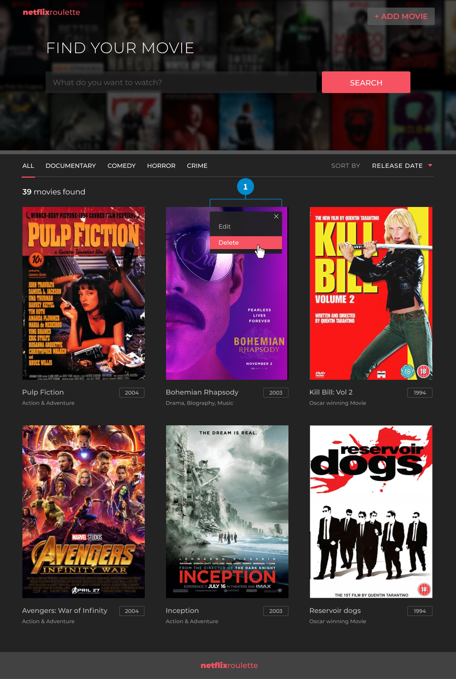
We need a plan
Template analysis
Design plans helps a lot to see what is really expected
You have to see the whole picture:
What is common in all pages?
How to build the page layout?
What are the major elements?
Small things could make big differences:
Identify the possible components
Think on how they could communicate
What are the specific attributes?
Is there any issue with the actual plans?
Colors, font families and sizes (specific)
https://epa.ms/nye-webapp-template

Slide 5
Components
Template Analysis
A list of possible components:
Logo -> possibly works as a link should lead you to homepage
Add movie button -> pops up a form
Search box
Input field
Search button -> should change result list
Genre selector -> should change result list
Order results -> dropdown; should change result list
Item counter -> based on actual results
Movie list -> grid layout?
Movie list items -> movie property?
Dropdown menu to update / remove a movie
Basic movie information
Possible navigational item -> should lead you to movie description page

Slide 6

Chakra UI
Accessible React apps with speed

Slide 7
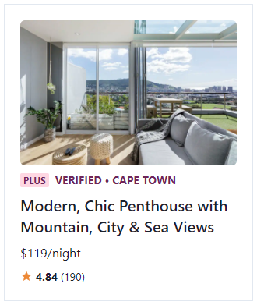
What is Chakra UI?
Chakra UI
Simple, modular and accessible component library
Building blocks to build React applications
Contains most of the possible items you need in a web application
Accessible – WAI-ARIA standards for all components
Themable – customization
Composable – composition instead of inheritance
Supports dark/light mode
import React from "react";
import { Box, Center, Image, Flex, Badge, Text } from "@chakra-ui/react";
import { MdStar } from "react-icons/md";
export const Example = () => (
<Center h="100vh">
<Box p="5" maxW="320px" borderWidth="1px">
<Image borderRadius="md" src="https://bit.ly/2k1H1t6" />
<Flex align="baseline" mt={2}>
<Badge colorScheme="pink">Plus</Badge>
<Text
ml={2}
textTransform="uppercase"
fontSize="sm"
fontWeight="bold"
color="pink.800"
>
Verified &bull; Cape Town
</Text>
</Flex>
<Text mt={2} fontSize="xl" fontWeight="semibold" lineHeight="short">
Modern, Chic Penthouse with Mountain, City & Sea Views
</Text>
<Text mt={2}>$119/night</Text>
<Flex mt={2} align="center">
<Box as={MdStar} color="orange.400" />
<Text ml={1} fontSize="sm">
<b>4.84</b> (190)
</Text>
</Flex>
</Box>
</Center>
);

Slide 8
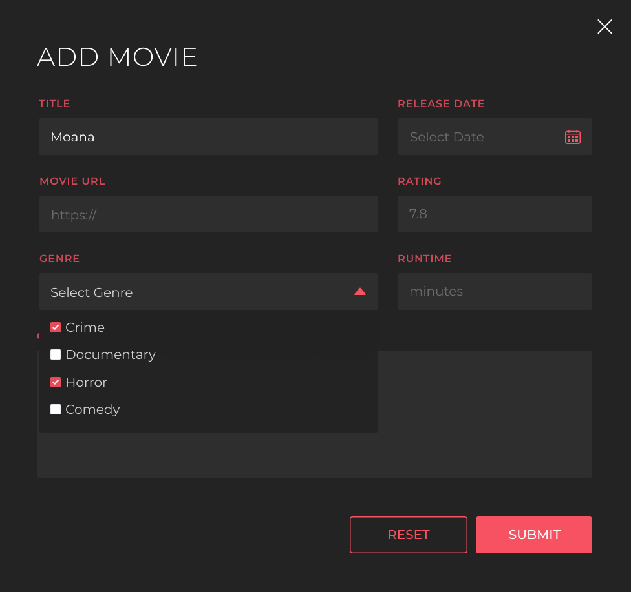
How we can use this to our own benefits?
Chakra UI
There’s already created components with a common look and feel
We can modify the base theme to match with the requirements
No additional CSS is needed
Modify items inline without the consequences
CSS-style or attribute style
Conditional styling
Do not reinvent the wheel – just use it
Dropdown menus
Lists
Layout specific items
Input fields: text, checkbox, select
Modal windows (pop-ups)
Drawer
Icons: built-in and extended

Slide 9
Exercises

Slide 10
Warm up
Exercises
Checkout main repository (and update if needed):
https://epa.ms/nye-webapp
Create a React application with Yarn or NPM
Use chakra-ui template with TypeScript
Suggested app name: netflixroulette
Start application
Cleanup App.tsx – only ChakraProvider is needed
Add Montserrat font family:
@fontsource/montserrat (current version: 5.0.17)
Apply theme from resources:
Copy the theme and models
Include theme into App.tsx
Start movie-api in the background
yarn create react-app netflixroulette --template @chakra-ui/typescript
OR
npx create-react-app netflixroulette --template @chakra-ui/typescript
yarn add @fontsource/montserrat@5.0.17
import { theme } from "./theme";
…
<ChakraProvider theme={theme}>

Slide 11
Create logo
Exercies
File: netflix-roulette-logo.tsx
Component name: NetflixRouletteLogo
Should lead to home page (/)
Chakra components:
Link
Heading
Text
Use tokens
import React, { FC } from "react";
import { Heading, Link, Text } from "@chakra-ui/react";
export const NetflixRoulletteLogo: FC = () => (
<Link
href="/"
_hover={{
textDecoration: "none",
}}
>
<Heading fontSize="xl" color="text.highlighted">
<Text as="span" fontWeight="black">netflix</Text>
<Text as="span" fontWeight="medium">roulette</Text>
</Heading>
</Link>
);

Slide 12
Create movie list item
Exercises
<LinkBox>
<AspectRatio ratio={322 / 455} marginBottom={7}>
<Image src={movie.poster_path} />
</AspectRatio>
<Flex justifyContent="space-between" opacity={0.5}>
<LinkOverlay href={`/movie/${movie.id}`}>
<Heading
as="header"
flexGrow={1}
gap={2}
display="flex"
flexDirection="column"
>
<Text as="h4" fontSize="lg" fontWeight="medium"> {movie.title}
</Text>
{movie.tagLine && <Text fontSize="sm">{movie.tagLine}</Text>}
</Heading>
</LinkOverlay>
<Text sx={{
border: "solid 1px",
borderColor: "border.default",
borderRadius: 4,
fontSize: "sm",
height: 8,
paddingX: 2,
paddingY: 1,
}}>
{movie.release_date.getFullYear()}
</Text>
</Flex>
</LinkBox>
Responsibility: display one list item
File: movie-list-item.tsx
Component name: MovieListItem
Property:
movie: Movie
Image (poster_path):
Can differ item per item – but the layout is fix
Aspect ratio: 322 / 455 (~70%)
Conditional rendering: tagline
Inline styling – override for local changes

Slide 13
Create list
Exercises
Responsibility: display all passed items
File: movie-list.tsx
Component name: MovieList
Property:
movies: Movie[]
Use grid layout
Template columns: repeat(3, 1fr)
Gap: 12
<Grid
sx={{
gridTemplateColumns: "repeat(3, 1fr)",
gap: 12,
}}
>
{movies.map((movie) => (
<GridItem key={movie.id}>
<MovieListItem movie={movie} />
</GridItem>
))}
</Grid>

Slide 14
Load data and pass it:
Exercises
Responsibility: access list, organize and sort items
File: movie-list-page.tsx
Tip: create own hook to handle this
Component name: MovieListPage
State items:
Movies, sorting
Raw data list should be transformed to Movie items (string date to date)
Use hooks: useState
const [movies, setMovies] = useState<Movie[] | null>(null);
const [sorting, setSorting] = useState<MovieSortType>(MovieSortType.RATING_DESC);
useEffect(() => {
(async () => {
const searchParams = new URLSearchParams();
sorting && searchParams.set('orderBy', sorting);
const response = await fetch(
`http://localhost:5000/movies?${searchParams}`
);
const { data } = await response.json();
setMovies(data.map((movie: RawMovie) => ({
...movie,
release_date: new Date(movie.release_date),
})));
})()
}, []);
return (
<Box width="full" backgroundColor="background.dark">
{movies && <MovieList movies={movies} />}
</Box>
);

Slide 15
Create sorting component
Exercises
<Flex alignItems="center" gap="8">
<Text
as="label"
sx={{
fontSize: "md",
letterSpacing: "0.888889px",
textTransform: "uppercase",
opacity: 0.6,
}}
onClick={openMenu}
>
Sort by
</Text>
<Menu
placement="bottom-end"
onClose={closeMenu}
onOpen={openMenu}
isOpen={isOpened}
>
<MenuButton>
{SORT[sortType]}
<UpDownIcon color="text.highlighted" marginLeft={3} />
</MenuButton>
<MenuList bgColor="background.dark">
<MenuItem onClick={}>Release date</MenuItem>
<MenuItem onClick={}>Title</MenuItem>
<MenuItem onClick={}>Best first</MenuItem>
</MenuList>
</Menu>
</Flex>
Responsibility: display available sorting options, show actual sorting state
File: sort-movies.tsx
Component name: SortMovies
Properties:
sortType: MovieSortType
onChange: (sortType: MovieSortType) => void;
When user selects a sorting the onChange should be called
Additional dependency required: @chakra-ui/icons
Note: the menu items has to be restyled (coloring)

Slide 16
Update page item
Exercises
Add sorting component to the page
Pass properties
Try it out
<Box width="full" backgroundColor="background.dark">
<Flex as="nav">
<SortMovies onChange={setSorting} sortType={sorting} />
</Flex>
{movies && <MovieList movies={movies} />}
</Box>

Slide 17
Thank you!
For more information, contact
Jozsef Gal
Senior Software Engineer
jozsef_gal@epam.com
EPAM Debrecen
Tüzér street 4.
HU-4028 Debrecen

