Slide 1
Stateful communication
Jozsef Gal
Nyíregyháza – 2022/04/23

Slide 2
Agenda
01
HTTP Communication
02
Cookies
03
Web Storage API
04
IndexedDB
05
Authorization
06
Exercises

Slide 3
HTTP Communication
Stateless vs Stateful

Slide 4
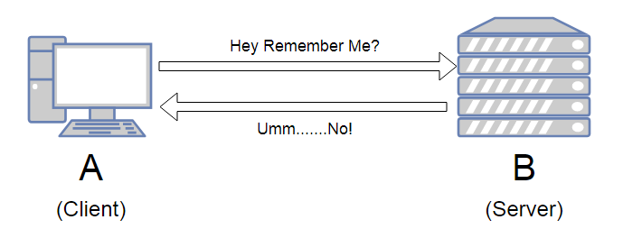
Stateless protocol
HTTP Communication
The receiver must not retain session state from previous requests
Each request is expected to be independent from the other
The request should contain all the necessary information
Typical problems: identificiation, remember data

Slide 5
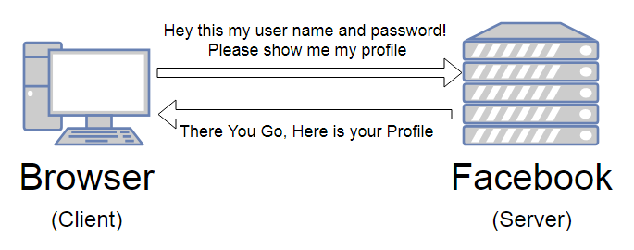
Authentication and authorization over HTTP
HTTP Communication
Authentication: the process of determining whether someone or something is who or what it says it is
Authorization: giving someone permission to do or have something
Attach an identifier to the request
Cookie
Specific header (Authorization)

Slide 6
Session
HTTP Communication
Sequence of HTTP request and response transactions with the same client
Has a unique ID (session id / session token)
Expected to be finished after a defined time or when the connection is „closed”
Problem: how to organize independent requests into a session?
Possible solution: store the ID on client side somehow

Slide 7
Cookies

Slide 8
What are cookies?
Cookies
A small piece of data that a server sends to a user’s web browser
The browser may store the cookie and send it back to the same server with later requests
Used to tell if two requests come from the same browser
Remember stateful information
Key-value pairs
Limited to a specific size
Usages:
Session management
Login, shopping carts, game scores, etc
Personalization
User preferences, themes or other settings to access immediatelly
Tracking
Recording and analyzing user behavior
GDPR

Slide 9
Set-Cookie and Cookie headers
Cookies
Set-Cookie
HTTP response header
Sends cookies from server to the user agent
Tells the client to store a pair of cookies
Cookie
HTTP request header
Sends stored cookies back to the server
Session cookie:
Deleted when the current session ends
End is defined by browser – can last indefinitely
Permanent cookie:
Expires attribute – end date of the cookie
Max-Age attribute – removed after period of time
Set-Cookie: <cookie-name>=<cookie-value>
Host: www.example.org
Cookie: yummy_cookie=choco; tasty_cookie=strawberry

Slide 10
Restrictions attributes and security
Cookies
Domain
Specifies which hosts can receive a cookie
Defaults to the same host that set the cookie excluding subdomains
If specified subdomains are included
Path
Indicates a URL path that must exist in the requested URL in order to send the Cookie header
Directory separator: „/” (%2F)
Valid for subdirectories as well
SameSite
Lets servers specify when cookies are sent with cross-site requests
Minimal protection agains cross-site request forgery attacks (CSRF)
Values
Lax: when the user navigates to the cookie’s origin site (default)
Strict: only where it was originated
None: both originating and cross-site requests, but only when Secure attribute is also set
https://developer.mozilla.org/en-US/docs/Web/HTTP/Cookies

Slide 11
Web Storage API

Slide 12
Concepts and usage
Web Storage API
Useful for storing smaller amounts of data
Maintains a seperate storage area for each given origin
Data is never transfered to the server
sessionStorage
Available for the duration of the page session (while browser is open, including reloads and restores)
Stores data only for a session
Storage limit is larger than a cookie (at most 5MB)
localStorage
Stores data with no expiration date
Gets cleared only through JavaScript or clearing brower cache / locally stored data
Greater storage limit
https://developer.mozilla.org/en-US/docs/Web/API/Web_Storage_API

Slide 13
Storage
Web Storage API
Both sessionStorage and localStorage implements Storage interface
Stores key-value pairs
where both are handled as strings (DOMString object)
Store objects: JSON.stringify & JSON.parse (apply manually)
Allows:
Retrieval (getItem)
Addition (setItem)
Removal (removeItem)
Wipe-out (clear)

Slide 14
IndexedDB

Slide 15
IndexedDB API
IndexDB
Low-level API for client-side storage of significant amounts of structured data (e.g. files)
JavaScript-based object-oriented transactional database system
Operations are done asynchronously
Follows same-origin policy
Usage:
Specify database schema
Open a connection to the database
Retrieve and update data within a series of transactions
https://developer.mozilla.org/en-US/docs/Web/API/IndexedDB_API

Slide 16
Authorization with JWT
JSON Web Token

Slide 17
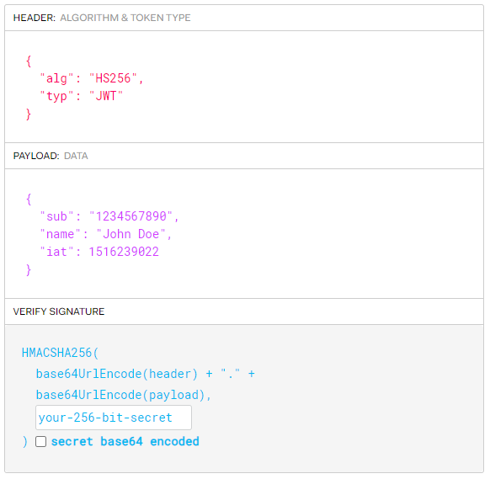
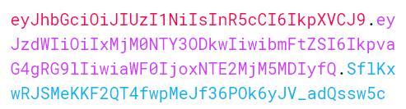
What is JWT?
Authorization with JWT
JSON Web Token (RFC 7519)
Defines a compact and self-contained way for securely transmitting information in a JSON object
Simple structure with base64 encoded parts:
Header
Contains token type and the signing algorithm being used
Payload
Typically claims
Statements about an entity and additional data
Public: can be regained on client side
Signature
Verify content integrity and authenticity of sender
More information: https://jwt.io/introduction

Slide 18
Power of Authorization header
Authorization with JWT
(async() => {
const res = await fetch("/user/login", {
method: "POST",
headers: {
"Content-Type": "application/json",
"accept": "application/json“
},
body: JSON.stringify({
username: "admin@local.com",
password: "admin123456“
})
});
const { authToken } = await res.json();
console.log(authToken);
})();
(async() => {
const res = await fetch("/user", {
headers: {
"Authorization": `Bearer ${token}`
},
});
if (!res.ok) {
throw new Error('Unauthorized’);
}
const userData = await res.json();
console.log(userData);
})();
Standard HTTP header
You don’t have to deal with the restrictions come with cookies
Works in CORS requests as well
Drawbacks:
Must be manually attached to every request
Storage on client side

Slide 19
Exercises
Create login with protected pages with JavaScript

Slide 20
Let’s start with configuration
Exercises
Clone repository from:
https://epa.ms/nye-webapp
Open directory with editor:
movies-api – backend server
lessons/week-10/start/netflixroulette
Build the server environment:
Minimal support for login and request profile
Default user: admin@local.com / admin123
Open browser: http://localhost:5000/api-doc
Check the OpenAPI documentation for
POST /user/login – for login
GET /user – get user profile
POST /user – registration
interface User {
userId: string;
email: string;
firstName: string;
lastName: string;
}
interface AuthContext {
user: User | null;
inProgress: boolean;
login: (username: string, password: string) =>
Promise<string | void>;
logout: () => void;
};

Slide 21
Start with login page
Exercise
Create a new component: LoginForm
Input params:
onLogin – method to call to do the login
errorMessage – optional string; if something goes wrong
Internal state – for basic form handling
Username
Password
IsEnabled
Error
Methods:
Handle changes in username and password
Submit handling
Create a page that covers this in one and handles the additional logic (will be added later)
return (
<Box as="form" bgColor="background.dark" py="9" px="16" onSubmit={onSubmit}>
<VStack maxW="lg" spacing={5} marginX="auto">
<Text color={ error ? 'text.hightlighted' : 'text.default’ }>
{error || 'Kérjük adja meg felhasználónevét és jelszavát’}
</Text>
<FormControl>
<FormLabel>Felhasználónév:</FormLabel>
<Input value={username} onChange={onChangeUsername} />
</FormControl>
<FormControl>
<FormLabel>Jelszó:</FormLabel>
<Input type="password" value={password} onChange={onChangePassword} />
</FormControl>
<ButtonGroup>
<Button type="reset" onClick={reset} variant="transparent">
Mégsem
</Button>
<Button type="submit" isDisabled={!isEnabled} variant="primary">
Belépés
</Button>
</ButtonGroup>
</VStack>
</Box>
);

Slide 22
Continue with profile page
Exercise
New component: ProfilePage
No external properties – not yet inner state either
Simple layout:
Welcome User (just create a fake for now)
Display email address
Add a button to logout (and a fake method will do as well)
See the problems:
This is not supposed to be reachable without a valid session
The data should be reachable somehow
return (
<Vstack
bgColor="background.dark"
paddingY="9"
paddingX="16"
spacing={4}
alignItems="flex-start"
>
<Heading as="h2">
Welcome, {user.firstName} {user.lastName}
</Heading>
<Text>Email cím: {user.email}</Text>
<Button variant="primary" onClick={logout}>Kilépés</Button>
</VStack>
);

Slide 23
Put together a context
Exercise
What we need:
User data
Login method
Logout method
and one more you would not think on: inProgress
Utility functions may be handy in this case:
createLoginToken – to login with username and password
getUserProfile – to retrieve user’s profile using the token
export const createAuthContext = () => {
const context = createContext<AuthContext | null>(null);
const useAuthContext = () => {
const ctx = useContext<AuthContext | null>(
//@ts-ignore
context as AuthContext
);
if (!ctx) {
throw new Error(
'must be within a AuthContextProvider component'
);
}
return ctx;
};
return [useAuthContext, context.Provider] as const;
};
export const [useAuthContext, AuthContextProvider] =
createAuthContext();

Slide 24
The provider
Exercises
Additional package: react-use@17.5.0
Common hooks in one package
Save the auth token in local storage
Internal state for user and inProgress
Callback definitions for login and logout
On logout we should go redirect the user back to home page (or a public place)
On login we should go to profile page
Effects to handle these things
Memoize everything what is needed
Add this provider element all above others
Every component is can reach it
export const AuthProvider: FC<PropsWithChildren> = ({ children }) => {
const [authToken, setAuthToken] = useLocalStorage(AUTH_KEY, ‘’);
const [user, setUser] = useState<User | null>(null);
const [inProgress, setInprogress] = useState(!!authToken);
const navigate = useNavigate();
...
return (
<AuthContextProvider value={state}>
{children}
</AuthContextProvider>
);
};

Slide 25
Navigation
Exercises
Login: peace of cake – just a new Route element
Profile: well, things are a bit more complicated
Protected route – should not be accessed only if the user is logged in
We need a generic solution
Would be repetitive: do the same things multiple times easily leads to broken code
Not only this page will require this
export const ProtectedRoute: FC<PropsWithChildren> = ({ children }) => {
const { user, inProgress } = useAuthContext();
const navigate = useNavigate();
useEffect(() => {
if (!user && !inProgress) {
navigate('/login’);
}
}, [navigate, user, inProgress]);
if (!user) {
return null;
}
return <>{children}</>;
};
<Route
path="/profile“
element={<ProtectedRoute><ProfilePage /></ProtectedRoute>}
/>

Slide 26
Update the pages
Exercises
Login: utilize login function and navigate to profile when login is ok
Profile page: use inProgress, user and logout methods respectively
Display a spinner while waiting to get the data
export const LoginPage = () => {
const { login } = useAuthContext();
const [error, setError] = useState<string>();
const navigate = useNavigate();
const onLogin = useCallback(
async (username: string, password: string) => {
const error = await login(username, password);
if (error) {
setError(error);
} else {
navigate('/profile’);
}
},
[setError, navigate, login]
);
return <LoginForm onLogin={onLogin} errorMessage={error} />;
};

Slide 27
One last thing
Exercise
We should somehow reach these pages:
Create a component: ProfileButton
Depending on logged in or out it shows:
A short welcome message with a logout option
Or a link to login page
export const ProfileButton: FC = () => {
const { user, logout } = useAuthContext();
if (!user) {
return (
<Button as={NavLink} to="/login" variant="primary" size="sm">
Belépés
</Button>
);
}
return (
<Box>
<Link as={NavLink} to="/profile">Üdv, {user.lastName}</Link>
<IconButton
onClick={logout}
icon={<ExternalLinkIcon />}
aria-label="Kilépés"
variant="transparent"
size="sm"
marginLeft="2"
/>
</Box>
);
};

Slide 28
Thank you!
For more information, contact
Jozsef Gal
Senior Software Engineer
jozsef_gal@epam.com
EPAM Debrecen
Tüzér street 4.
HU-4028 Debrecen

