Slide 1
React
David Karolyi
Nyíregyháza – 2024/03/26

Slide 2
Agenda
01
Single-page applications
02
React
03
Exercises

Slide 3
Single-page applications
Thick clients

Slide 4
What is an SPA?
Single Page Application
SPA: Single-page application web app implementation that loads only a single HTML document and then updates the body content via JavaScript
Allow users to use websites without loading whole new pages from the server
Thick (heavy/fat/rich) client
The loaded application contains every necessary template and styling (can be also cached)
The server does not have to render HTML, can focus on data only (REST API)
Stateful client, stateless server
Client-side navigation (or routing):
Uses JS History API
Different URL for different pages – same look and feel as a generic website
Requirements:
Usage of modern browsers (the newer the better)
Service Oriented Architecture on server side (properly defined API with endpoints supporting JSON)
Tip: use a JS library or framework to avoid code duplication

Slide 5

React

Slide 6
What is React?
React
AKA: React.JS or ReactJS
Declarative, component-based JavaScript library to build interactive UIs
Seamlessly connects HTML with JavaScript via JSX (syntax extension to JS)
Rendering logic is inherently coupled with other UI logic (event handling, state changes, data-preparation)
Easy templating
Unlike other frameworks (e.g. Angular) requires additional tools to build a whole application
Maintained by Facebook (Meta)
<Box width="full" backgroundColor="background.dark">
<Flex as="nav">
<SortMovies sortType={sorting} onChange={setSorting}/>
</Flex>
<MovieList movies={movies} />
</Box>

Slide 7
Component & Props
React
Components create the UI of an application
Class or functional components
Main purpose: encapsulation and reusability
Modular coding
Separation of concerns:
Each component should focus on one purpose
Easy unit testing
Props (or properties)
Read-only parameters
Static resources for a component
Defines how a component should be rendered
Callbacks: communicate with other components
interface WelcomeProps {
name?: string;
}
class Welcome extends React.Component<WelcomeProps> {
constructor(props: WelcomeProps) {
super({
...props,
name: props.name ?? "World",
});
}
render() {
return <h1>Hello, {this.props.name}</h1>;
}
}
const Welcome: React.VFC<WelcomeProps> = ({ name = "World" }) => (
<h1>Hello, {name}</h1>
);

Slide 8
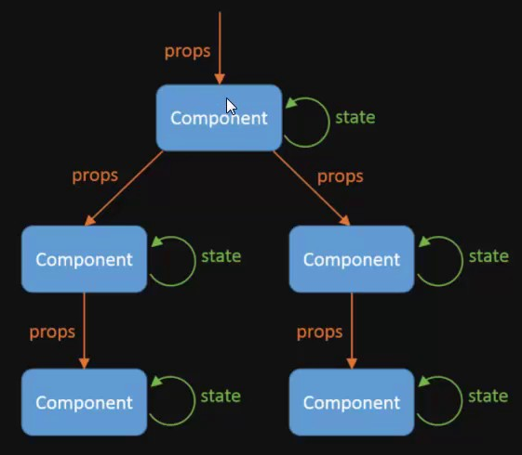
State
React
State represents the current state of a component
Data in the State control what you see in the View
Private and fully controlled by the component
When the state changes (e.g. on an event) the UI is rerendered with only the changed parts
Updating a state is asynchronous

Slide 9
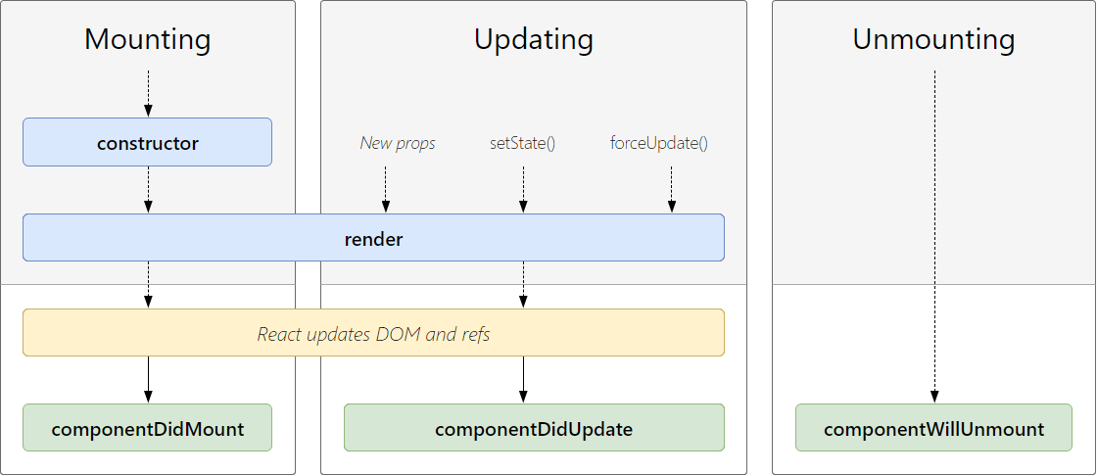
Component lifecycle & Hooks
React
state, setState(...)
useState(...)
componentWillMount
useState(...)
componentDidMount
useEffect(() => {}, [])
componentDidUpdate
useEffect(() => {}, [...dependencies])
shouldComponentUpdate
memo(Component, () => {})
componentWillUnmount
useEffect(() => {return () => {}}, [])

Slide 10
Exercises

Slide 11
Warm up
Exercises
Create a React application with Yarn or NPM
Template with TypeScript
You can choose e.g. my-app as project name
Check what was created
Start application
Do a little cleanup:
Remove CSS file and import in App.tsx
Replace return value of App.tsx to a simple H1 element
yarn create react-app my-app --template typescript
OR
npx create-react-app my-app --template typescript

Slide 12
External props
Exercies
import React, { FC } from "react";
Import "./information.css";
interface InformationProps {
firstName: string;
lastName: string;
age: string;
}
export const Information: FC<InformationProps> = ({
firstName, lastName, age
}) => {
return (
<div className="information">
<div>First Name: {firstName}</div>
<div>Last Name: {lastName}</div>
<div>Age: {age}</div>
</div>
);
};
// index.tsx:
<Information age={28} firstName="David" lastName="Karolyi" />
// information.css:
.information {
text-align: center;
font-size: 20px;
font-weight: 700;
}
Create directory: information
File: information.tsx
Component name: Information
Display the following information
First name
Last name
Age
Define interface and use within the component
Import and add your component to index.tsx
Add and import css into your component
File: information.css
Align text to center
Have a large font size
Make the text a bold

Slide 13
Internal state
Exercises
export const Counter: FC = () => {
const [count, setCounter] = useState<number>(0);
return (
<div className="container">
<div className="counters">{count}</div>
<button
className="buttons"
onClick={() => setCounter(count + 1)}
>Increase</button>
<button
className="buttons"
onClick={() => setCounter(count - 1)}
>Decrease</button>
</div>
);
};
// counter.css:
.container {
text-align: center;
}
.counters {
font-size: 28px;
color: #FF0000;
}
.button {
background-color: black;
color: white;
padding: 16px 8px 8px 12px;
margin-right: 12px;
}
File: counter/counter.tsx
Responsibility: change a counter
Display counter value
Show 2 buttons: increase and decrease
Component name: Counter
When click on any of the buttons change the value accordingly
Add some styling
Have large text for counter with red color
Black buttons with white text
Add your component to index.tsx as well

Slide 14
Effect – state change reaction
Exercises
Update Counter component
Display information about how many times the counter has changed
export const Counter: FC = () => {
const [count, setCounter] = useState<number>(0);
const [countChanged, setCountChanged] = useState<number>(0);
useEffect(() => {
setCountChanged(countChanged + 1);
}, [count]);
return (
<div className="container">
<div className="counters">{count}</div>
<button
className="buttons"
onClick={() => setCounter(count + 1)}
>Increase</button>
<button
className="buttons"
onClick={() => setCounter(count - 1)}
>Decrease</button>
</div>
<div className="counters">Count changed: {count}</div>
);
};

Slide 15
Thank you!
For more information, contact
Jozsef Gal
Senior Software Engineer
jozsef_gal@epam.com
EPAM Debrecen
Tüzér street 4.
HU-4028 Debrecen

