Slide 1
What Solutions Can Analytics Provide To The Worldwide Diabetes Epidemic?
May 1, 2017
Presented by: Neha Adjau, Eric Johnson, Bryan Snyder, Jyoti Thakral, Dolly Tripathy

Slide 2
Introduction
Overview of Diabetes and the Merck Challenge

Slide 3
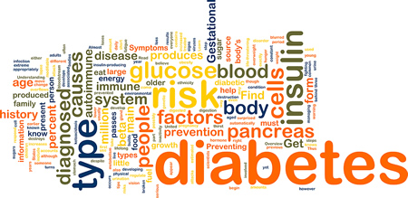
What is Diabetes?
Diabetes is a chronic disease in which the body does not produce or use insulin to maintain blood sugar levels
Can lead to:
Kidney failure
Blindness
Limb amputation
Stroke
Heart attack
Other health problems
Over 90% of all diabetics have type two (adult/onset) diabetes
Linked to obesity and sedentary lifestyles

Slide 4
Diabetes – A Global Health Issue
According to the World Health Organization:
Diabetes will be the seventh-leading cause of death in 2030
Number of diabetics have grown from 108 million in 1980, to 422 million in 2014
Diabetes often remains undetected/undiagnosed for years
Under-performing health systems
Low public awareness
Slow progression of symptoms

Slide 5

The Merck Challenge
Merck is a “global healthcare company with a 125-year history of working to make a difference”
Challenge is to identify the region with the greatest global risk from diabetes through 2030
How can Merck position itself to best combat diabetes in these countries? How does the strategy change across countries?
Find regions with the highest percentage of undiagnosed diabetes to help spread awareness among people in those regions

Slide 6
Background
Substantial amount of research already done to study prevalence of diabetes
International Diabetes Federation (IDF)
Uses Analytical Hierarchy Process to determine best datasets for 219 countries and territories
Estimates for countries without reliable data are modeled from countries with similar geography, ethnicity, and economic status
Undiagnosed Diabetes Mellitus (UDM)
Globally, an estimated 45.8% of all cases of diabetes, or approximately 174.8 million adults, are undiagnosed
The 15 data regions range from 24.1% to 75.1% UDM
Estimated 83.8% UDM from low- and middle-income countries
Pacific Island nations display the highest prevalence of UDM

Slide 7
Data
Diabetes prevalence

Slide 8

IDF Diabetes Atlas
Regional diabetes prevalence information for 2015
Adults 20-79
15 geographic regions, determined by geography and World Bank income classification
228 observations
Variables
Country/territory
Prevalence %
Age-adjusted comparative prevalence
Undiagnosed adults (in 1,000’s)
Mean diabetes-related expenditure/diabetic (USD)
Mean diabetes-related expenditure/diabetic (International Dollar)
Diabetes –related deaths
Children with type one diabetes (1,000’s)
Basis of estimate (oral glucose test, self-reported, other, medical record, HbA1C)

Slide 9
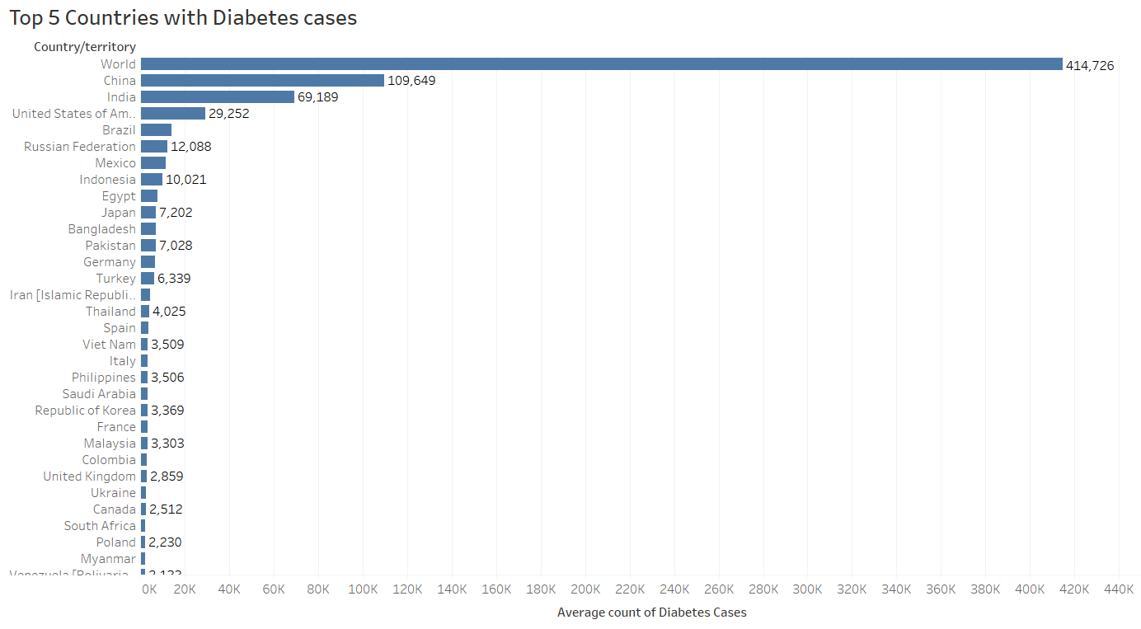
Adults 20-79 with Diagnosed Diabetes (1,000’s) Source: IDF
Top five high risk countries contain 56.03% of the world’s diabetic population
China 109,649
India 69,189
United States 29,252
Brazil 14,251
Russian Federation 12,088

Slide 10
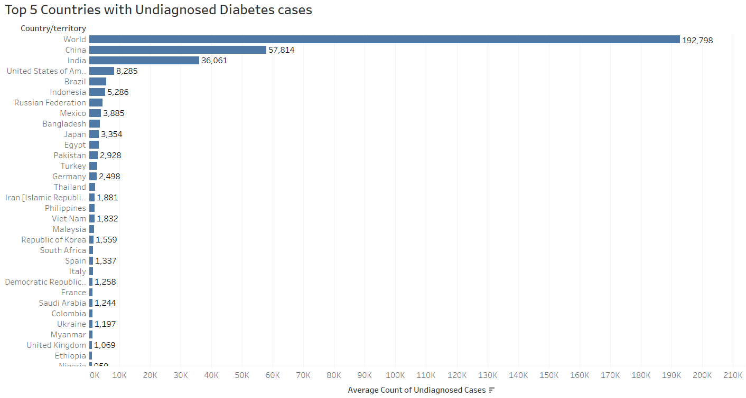
Adults 20-79 with Undiagnosed Diabetes (1,000’s) Source: IDF
China 57,814
India 36,061
United States 8,285
Brazil 5,724

Slide 11
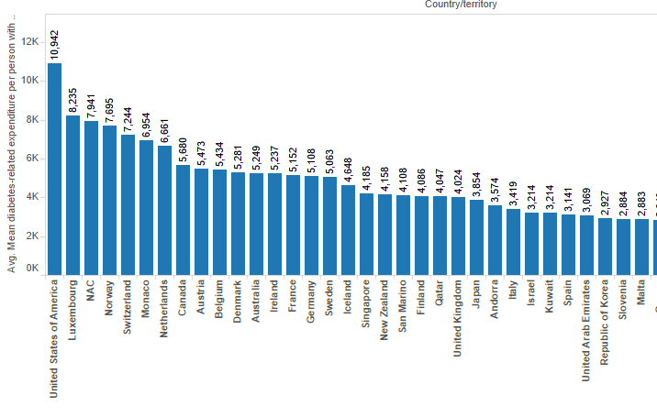
Mean Diabetes-Related Expenditure Per Person with Diabetes Source: IDF
United States has the greatest expenditure of all nations, and well above other nations with higher prevalence of diabetes

Slide 12

Diabetes in the United States
Nearly 30 million adults diagnosed with diabetes, third highest volume in the world
Over 8 million adults estimated to have diabetes but not diagnosed, third highest volume in the world
The mean expenditure for diabetes-related expenses is by far the most in the world compared to nations with high volumes of cases

Slide 13

CDC Chronic Disease Indicators – US Diabetes
Center for Disease Control and Prevention dataset with US diabetes prevalence information on states and select large metropolitan areas
110 observations
Variables
Adults diagnosed with diabetes
Dilated eye exams for adult diabetics
Foot examinations for adult diabetics
Glycosylated hemoglobin measurements for adult diabetics
Prevalence of depressive disorders among adult diabetics
Flu vaccinations among non-institutionalized seniors (>=65) with diabetes
Flu vaccinations among non-institutionalized adults (18-64) with diabetes
Prevalence of high blood pressure among adult diabetics
Prevalence of high cholesterol among adult diabetics
Prevalence of diagnosed diabetes among all adults (target/dependent variable)
Missing values were imputed with mean values

Slide 14
Diabetes Public Health Resource
The final Dataset Diabetes Public Health Resource focuses on the number of U.S. adults aged 18 years or older with diagnosed diabetes (From 1980 through 2014)
35 observation
Variables
Year
Number (in Millions) of Civilian, Non-institutionalized Adults with Diagnosed Diabetes, United States, 1980-2014

Slide 15

USDA Food Environment Atlas
Food environment factors in the United States distributes across communities, such as:
Store/restaurant proximity
Food prices
Food and nutrition assistance programs
28 Columns
3,094 observations
Data cleaning
Columns with 40%+ missing values were omitted
Columns with less were replaced with mean values
Columns with data on children were omitted

Slide 16
Methods
Determining optimal model for predicting diabetes prevalence

Slide 17

Methods
Multiple Linear Regression
Random Forest

Slide 18

Multiple Linear Regression Analysis
Attempts to model relationship between two or more explanatory variables and a response variable by fitting a linear equation to observed data
This model was selected for the CDC Chronic Disease Indicator – US Diabetes dataset
Variables are continuous
Stepwise regression approach for variable selection
Begin with all variables
Backward elimination

Slide 19
Stepwise Regression – CDI Data
Iteration 1
All variables
AIC = 81.34
Iteration 2
Removed “Influenza vaccination among noninstitutionalized adults aged >= 65 years with diagnosed diabetes” [Pr (>F) = 0.833995]
AIC = 79.4
Iteration 3
Removed “Prevalence of depressive disorders among adults aged >= 18 years with diagnosed diabetes” [Pr (>F) = 0.821030]
AIC = 77.46

Slide 20
Stepwise Regression – CDI Data (cont.)
Iteration 4
Removed “Gender” [p (>F) = 0.539685]
AIC = 75.88
Iteration 5
Removed “Dilated eye examination among adults aged >= 18 years with diagnosed diabetes” [p (>F) = 0.459268]
AIC = 74.5
Iteration 6 – Optimal model found
Removed “Foot examination among adults aged >= 18 years with diagnosed diabetes” [p (>F) = 0.25218]
AIC = 73.95

Slide 21
Stepwise Regression – CDI Data (cont..)
Final model
Independent variables
89.62% accurate on test data
Adult with diagnosed diabetes(Age AdjPrev)
Glycosylated hemoglobin measurement among adults aged >= 18 years with diagnosed diabetes
Influenza vaccination among noninstitutionalized adults aged 18-64 years with diagnosed diabetes
Prevalence of high blood pressure among adults aged >= 18 years with diagnosed diabetes
Prevalence of high cholesterol among adults aged >= 18 years with diagnosed diabetes
Residual standard error | 1.567
Multiple R-squared | 0.3849
Adjusted R-squared | 0.3322
F-statistic | 7.301
p-value | 4.42E-06

Slide 22
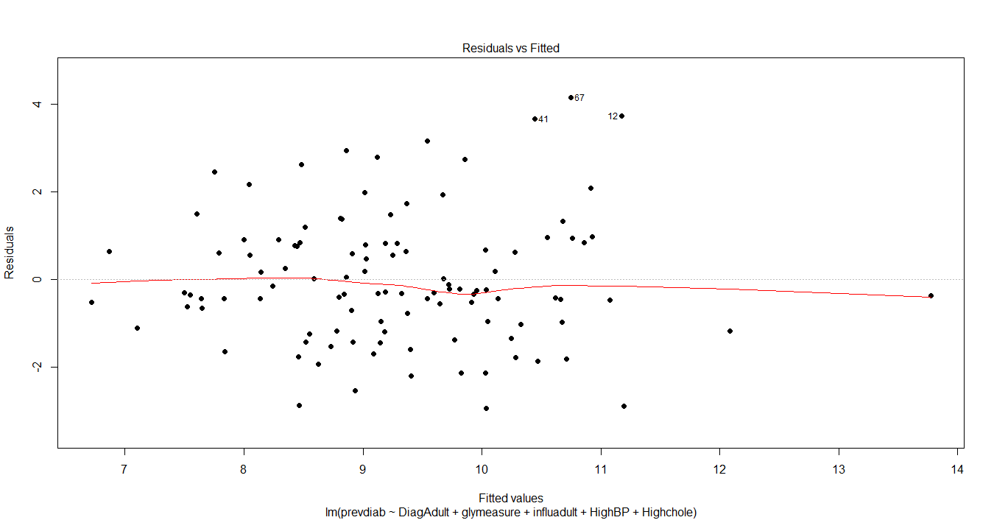
Final Model Residuals
Plot shows no systemic patterns and the variation in the residuals does not seem to change with the size of the fitted value

Slide 23

Random Forest – CDI Data
Ensemble learning method for classification, regression, and other tasks, that operate by creating multiple decision trees at training time, and outputs the class that is the:
Mode of classes (classification)
Mean prediction of individual trees (regression)
In order to find the minimum Out-of-Bag (OOB) error rate, we tune:
Number of decision trees in the forest (ntree)
OOB error stabilized at ntree = 100
Number of random variables in each tree (mtry)
OOB error stabilized at mtry = 2

Slide 24
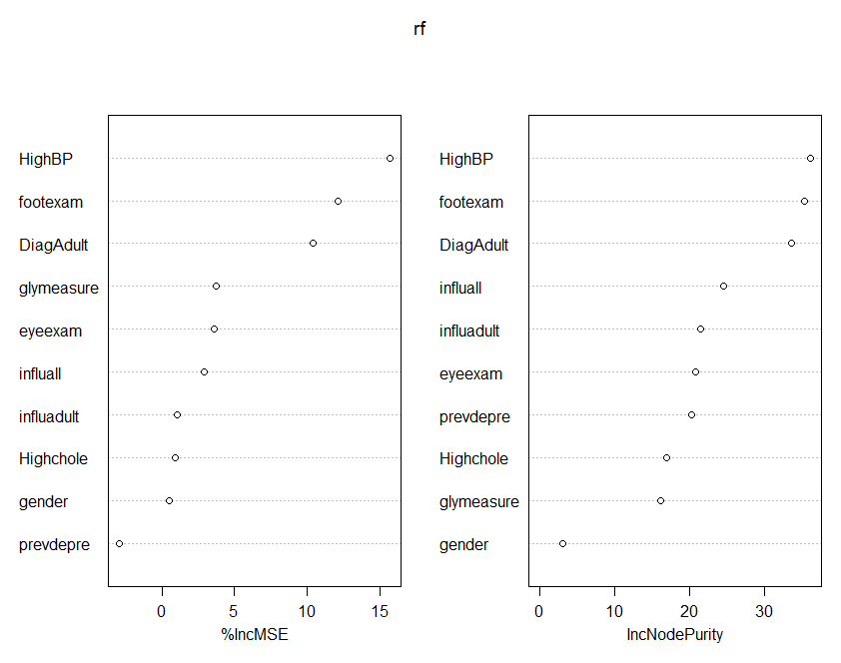
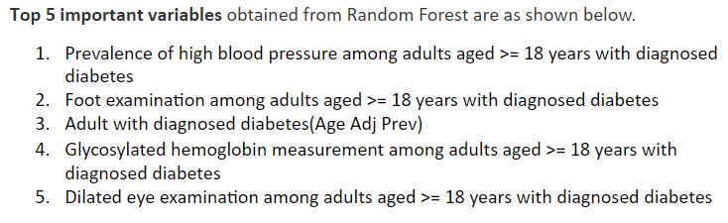
Random Forest – CDI Data (cont.)
Variable importance

Slide 25
Model Evaluation
 | Stepwise Multilinear Regression | Random Forest Regression | Best Fit
Variance Explained | 33.22% | 14.58% | Stepwise Multilinear Regression
Error | RMSE = 2.276 | MSE = 2.777 | Stepwise Multilinear Regression

Slide 26
Diabetes in the US
Applying the model to targeted areas of high prevalence

Slide 27
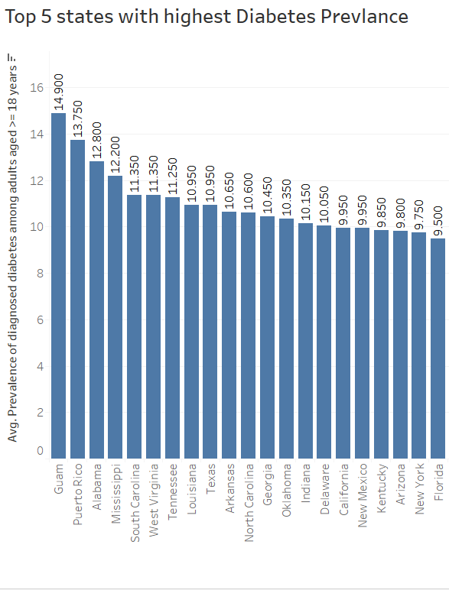
Diabetes Prevalence by State/Territory
Top States/Territories
Guam 14.90
Puerto Rico 13.75
Alabama 12.80
Mississippi 12.20
South Carolina 11.35

Slide 28
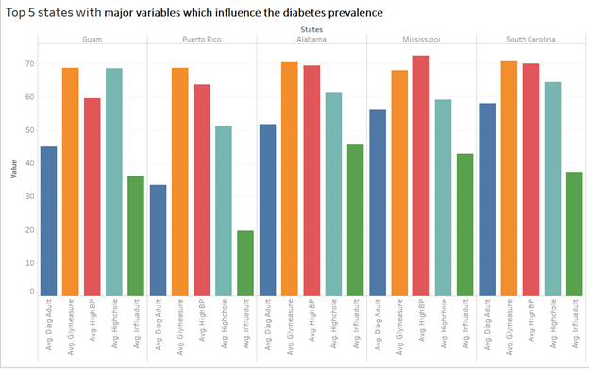

Slide 29
Analysis Methods for Diabetes Prevalence by Region
Random Forest
Gradient Boosting Method (GBM)

Slide 30
Random Forest
Trained with 60% of the data
ntree = 80
mtry = 2
OOB = 21.1%
CONFUSION MATRIX
 | Actual
Predicted |  | Yes | No
 | Yes | 456 | 195
 | No | 23 | 254

Slide 31
Gradient Boosting Method (GBM)
Trained using 60% of the data
Most important variables:
CONFUSION MATRIX
 | Actual
Predicted |  | Yes | No
 | Yes | 478 | 365
 | No | 1 | 84
SL NO | VARIABLE | REL INFO
1. | PCT_OBESE_ADULTS10 | % Obesity in adults
2. | PCT_FREE_LUNCH10 | % Student eligible for free lunch
3. | PCT_65OLDER10 | % population 65 years or older
4. | PCT_HISP10 | % Hispanic population
5. | MEDHHINC10 | Median household income
6. | PCT_NHBLACK10 | % Black population
7. | PCT_NHASIAN10 | % Asian population
8. | PCH_NSLP_09_14 | % participants for national school program from 2009-2014
9. | PCH_SNAP_09_14 | % SNAP authorized stores
10. | PCH_SPECSPTH_07_12 | % change in super markets from 2007 -2012

Slide 32
Comparing Models
 | Accuracy | Sensitivity | Specificity
Random Forest | 76.51% | 95.20% | 56.57%
Gradient Boosting Method | 60.56% | 99.79% | 18.71%

Slide 33
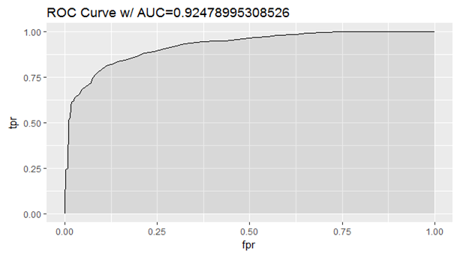
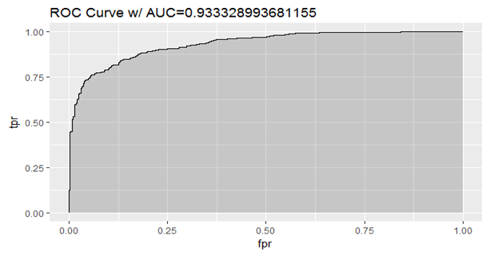
Comparing Models (cont.)
Random Forest
Gradient Boosting Method

Slide 34
Shiny APP for visual comparison of variables
Map Visualization of the variables with diabetes
https://dtripat-merk.shinyapps.io/shiny/
Conclusions
1) GBM best predicts the regions with high diabetes prevalence
2) Regions with a high obesity rate coincide with regions that have a high diabetes rate, as observed in the visuals.

Slide 35
Forecasting Future Diabetes Prevalence in the US
ARIMA Model

Slide 36
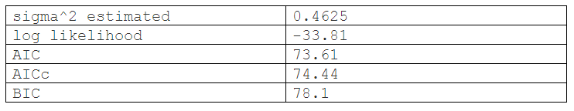
Autoregressive Integrated Moving Average (ARIMA) Model
ARIMA(2,2,2) | INF
ARIMA(0,2,0) | 96.11724
ARIMA(1,2,0) | 84.50387
ARIMA(0,2,1) | 74.65333
ARIMA(1,2,1) | 74.4423
ARIMA(1,2,2) | Inf
ARIMA(2,2,1) | 75.83526
Best model -> ARIMA (1, 2, 1)

Slide 37
Autoregressive Integrated Moving Average (ARIMA) Model
$pred Time Series:
Start = 2015
End = 2030
Frequency = 1
Years | 2015 | 2016 | 2017 | 2018 | 2019 | 2020 | 2021 | 2022 | 2023 | 2024 | 2025 | 2026 | 2027 | 2028 | 2029 | 2030
Diagnosed Diabetes Count | 22.70493 | 23.16022 | 23.72615 | 24.25706 | 24.79906 | 25.33755 | 25.87714 | 26.41639 | 26.95575 | 27.49507 | 28.03441 | 28.57374 | 29.11307 | 29.6524 | 30.19173 | 30.73107

Slide 38
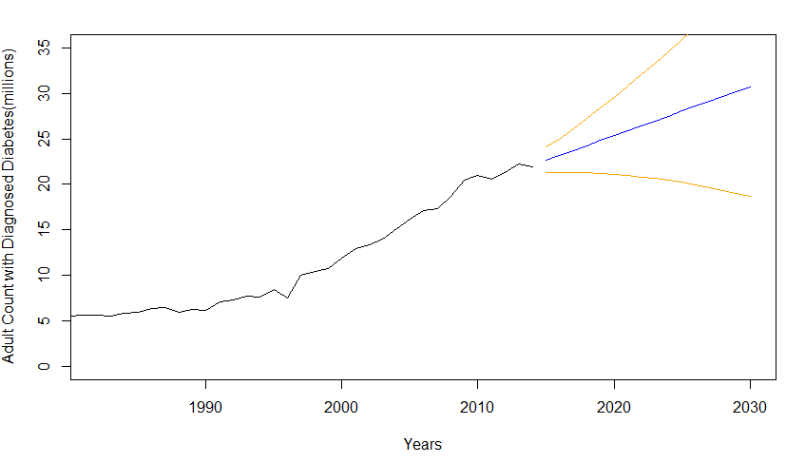
Time Forecast Number of Diagnosed Diabetes (2015 – 2030)

Slide 39
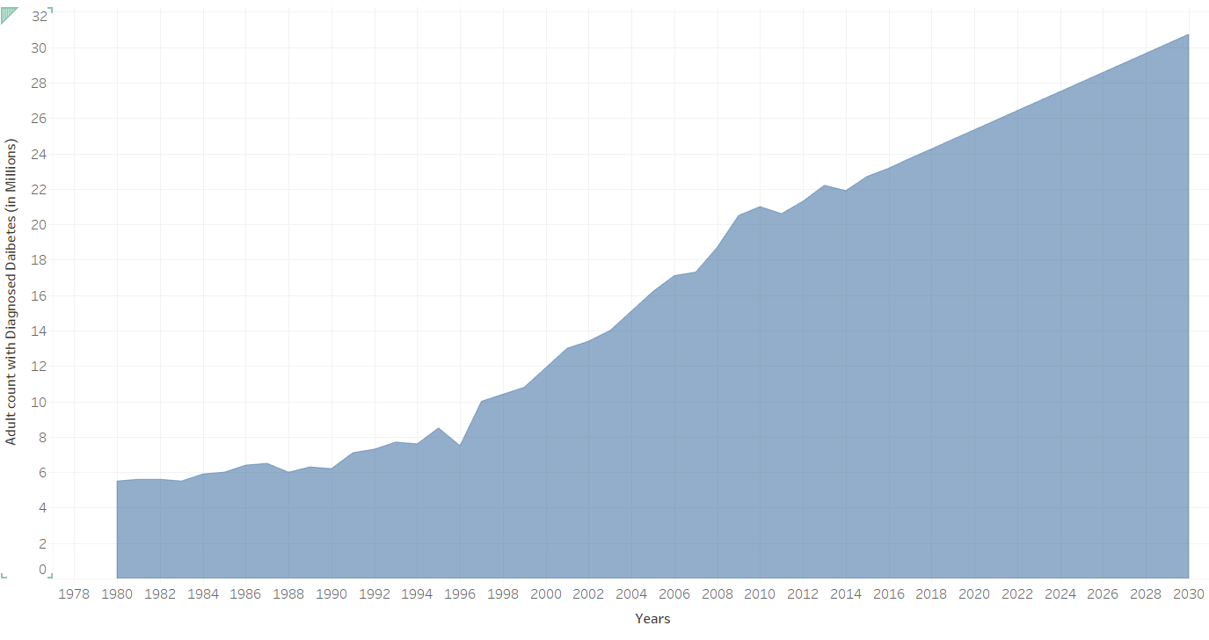
Diagnosed Diabetes Count (1980 – 2030)

Slide 40
Conclusion
Results & Recommendations

Slide 41
Results
United States was found to be the country where Merck should focus its resources
Rationale includes high prevalence and world’s highest expenditures per person
States within the US at highest risk include:
Guam
Puerto Rico
Alabama
Mississippi
South Carolina

Slide 42
Results (cont.)
Stepwise Regression is the best model to predict adult diabetes prevalence
Confirmed by variance estimate and RMSE
Specific factors identified as most impactful to different areas
Alabama/Puerto Rico/Guam – glycosylated hemoglobin measure among adults
Alabama, Mississippi, South Carolina – Prevalence of High BP among adults aged >= 18 years

Slide 43
Results (cont.)
GBM is the best model to predict adult diabetes prevalence based on food environment
Confirmed by confusion matrix & AUC curve
Specific factors identified as most impactful to different areas
Time series forecast from 2015 (22.70) to 2030 (30.73) millions of adults diagnosed with diabetes

Slide 44
Recommendations
Merck should target its resources within the United States to help combat the increased prevalence of type 2 diabetes by 2030 (30.73) millions which predicted to increase by 41.31%.
Initial analysis showed increased % of undiagnosed diabetes, hence the methods and symptoms chosen to detect diabetes should include:
Glycosylated hemoglobin test shows what a person's average blood glucose level was for the 2 to 3 months before the test. This can help determine how well a person's diabetes is being controlled over time.
Flu complications and regular occurrence could be symptomatic of diabetes
Most people with diabetes have high BP so, if diagnosed with it, this could mean that the reason might be diabetes
Diabetes tends to increase bad cholesterol in the body, so high triglycerides or bad cholesterol in the body could be a symptom of diabetes

Slide 45
Recommendations (cont.)
Merck should invest in spreading awareness on diabetes in the high prevalence zones which can be achieved by targeting the zones with the following
High obesity rates in adults
High population of 65 years or older
High Hispano population
Low median household income
High Black population.

Slide 46
Recommendations (cont.)
Resources should be directed towards existing programs such as :-
Supplemental Nutrition Assistance Program(SNAP)
WIC Nutrition Program - Healthy food for your family
National School Lunch Program (NSLP)

Slide 47
Questions
What Solutions Can Analytics Provide to the Worldwide Diabetes Epidemic?

