Slide 1
Workers compensation claim processing Big data Analytics for Competitive advantage Group Project
Bhavya Pilli
Dolly tripathy
Ryne Andrews
Deepika Deewangan
Pradeep Edwin samuel
Hari Charan shivram suresh Chandra Kumar

Slide 2
oVERVIEW
Merged Claim dataset with transaction dataset
New independent and dependant variables were added to the merged dataset
The dataset has been analyzed using Tableau and the additional insights drawn have been noted
Predictive analysis modelling for final dataset

Slide 3
Key findings
Claimant type Indemnity has higher odds to be a high risk claim.
Injury nature Strain has lower odds to be a high risk claim compared to the other type injury nature
High deviations in the Indemnity paid for high risk claims.
Claimant type indemnity has more number of open and re-opened claims as compared to others.
Undeclared payments found for most of the high risk claims.

Slide 4
Derived ATTRIBUTES
Processing_Time
Claim Received month and Claim Received year
Claim closed month and Claim closed year
Days_To_Recover
Total_Medical
Risk
Undeclared _Payments
Total_Transaction

Slide 5
vISUALIZATIONS
Risk Analysis over time
Average Processing Time Vs Body Part
Number of Claims opened Vs Total Medical
Medical Bills for injury cause
Body Part Vs Days to recover
Days to recover Vs Injury Cause

Slide 6
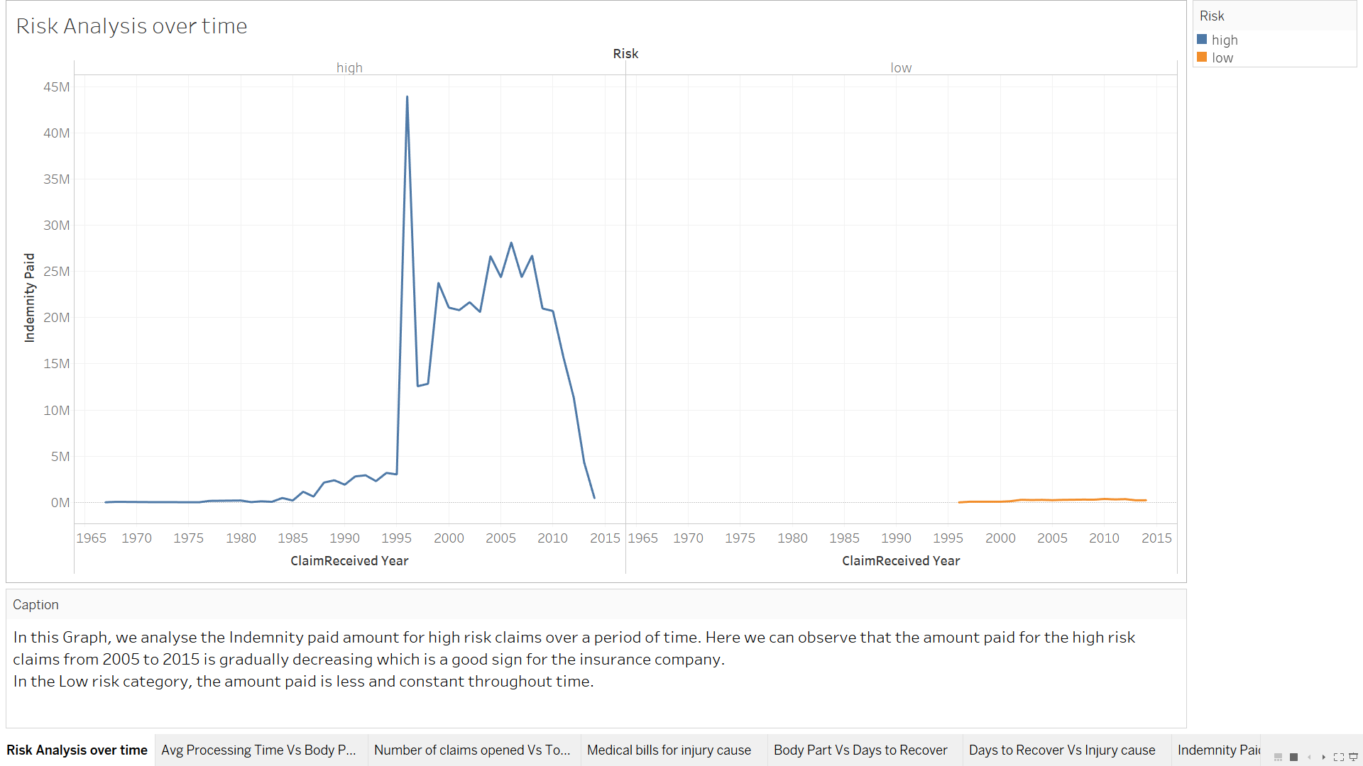
Risk Analysis over time

Slide 7
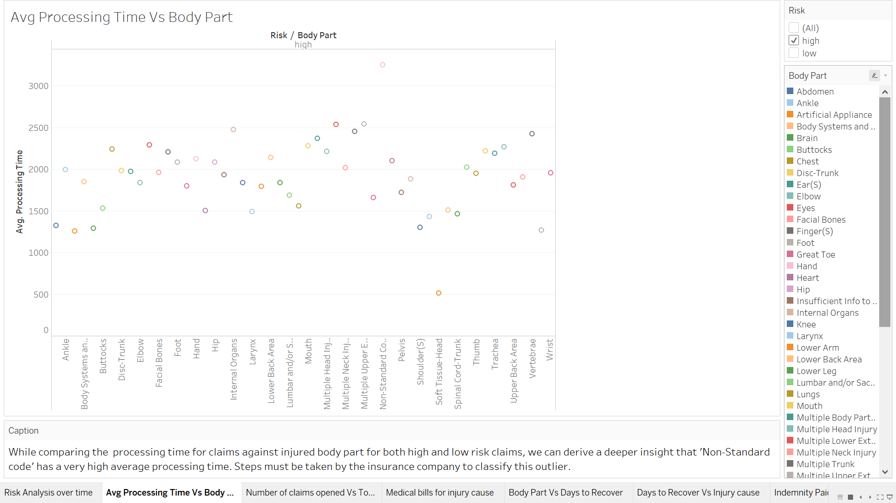
AVERAGE PROCESSING TIME VS BODY PART

Slide 8
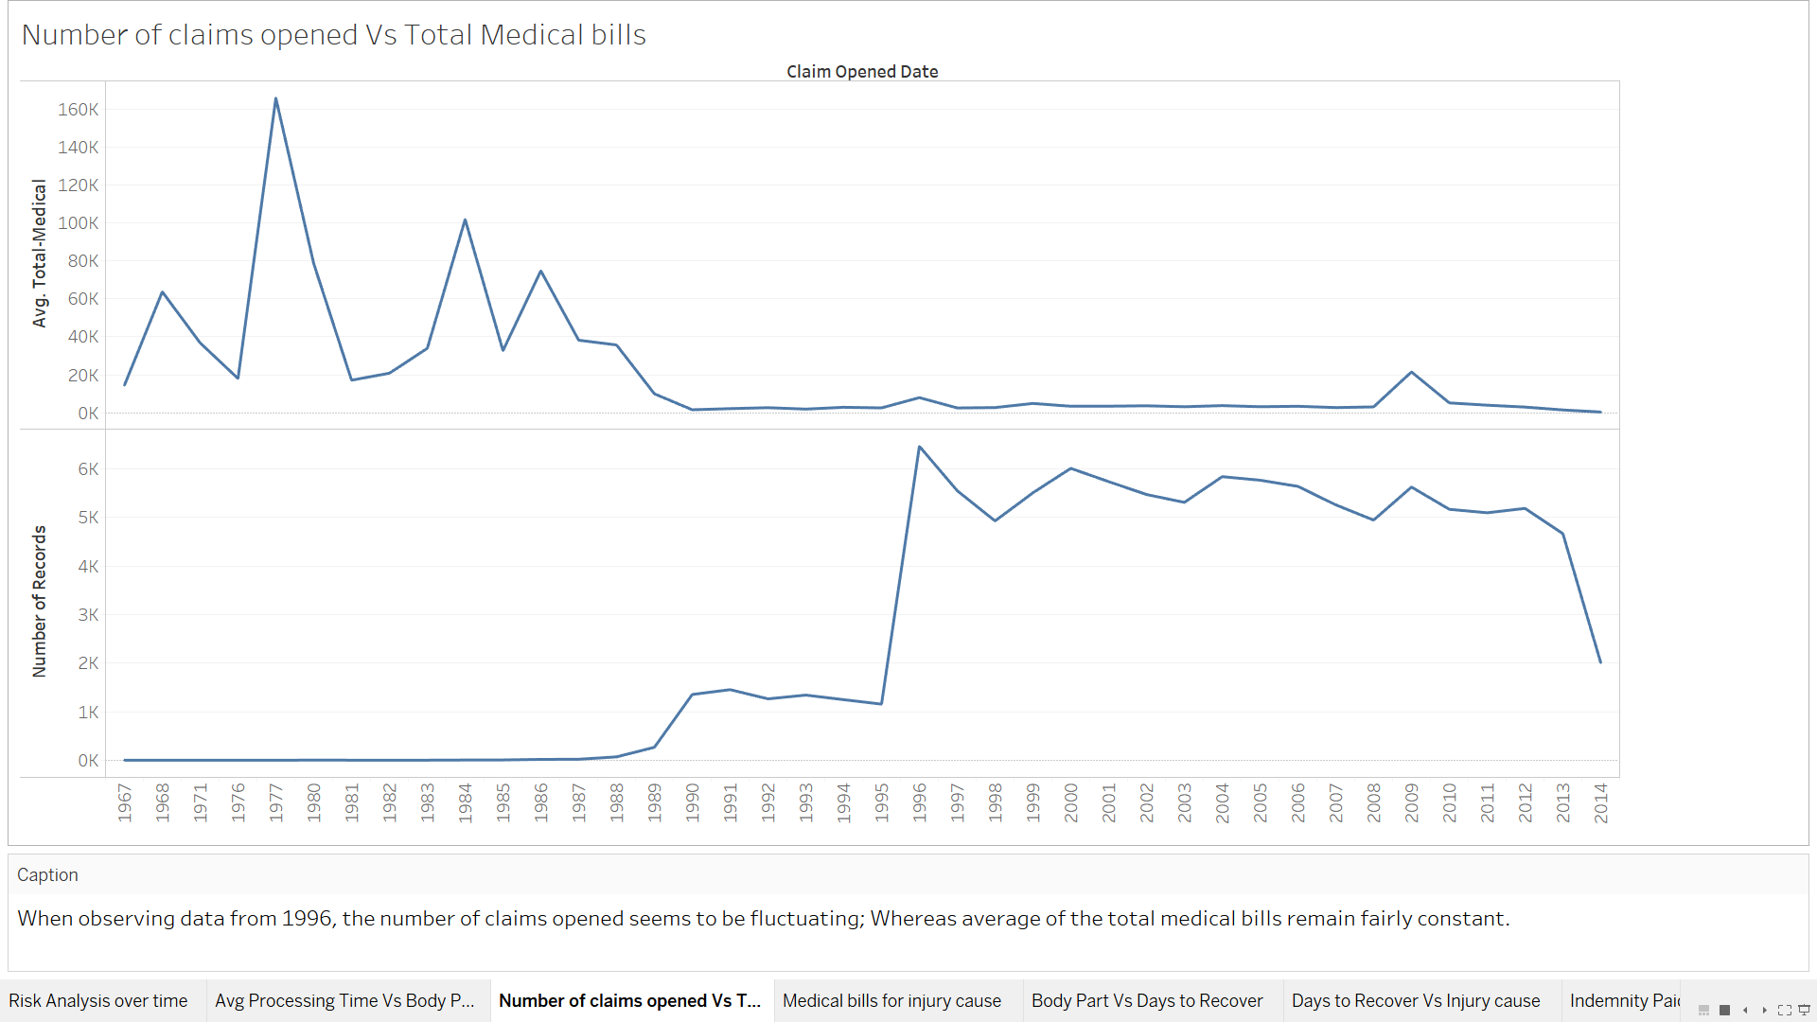
Number of claims opened vs total medical

Slide 9
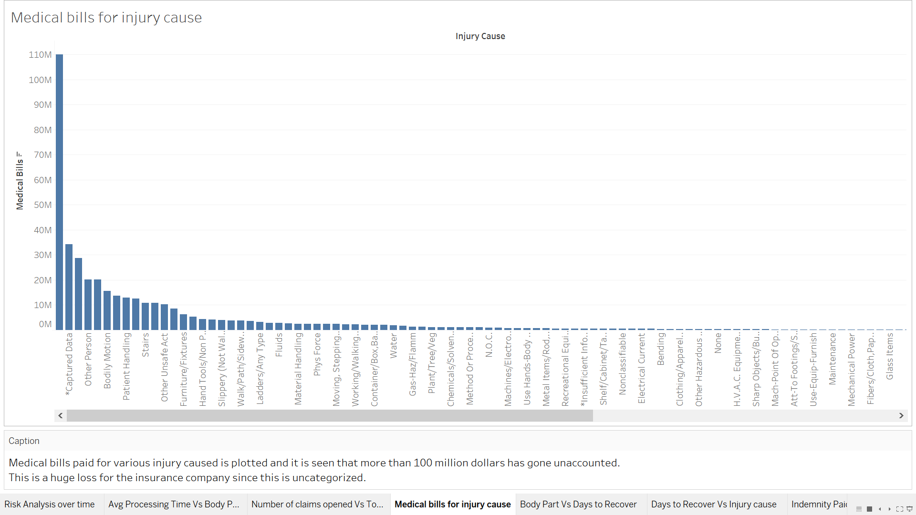
Medical Bills for injury cause

Slide 10
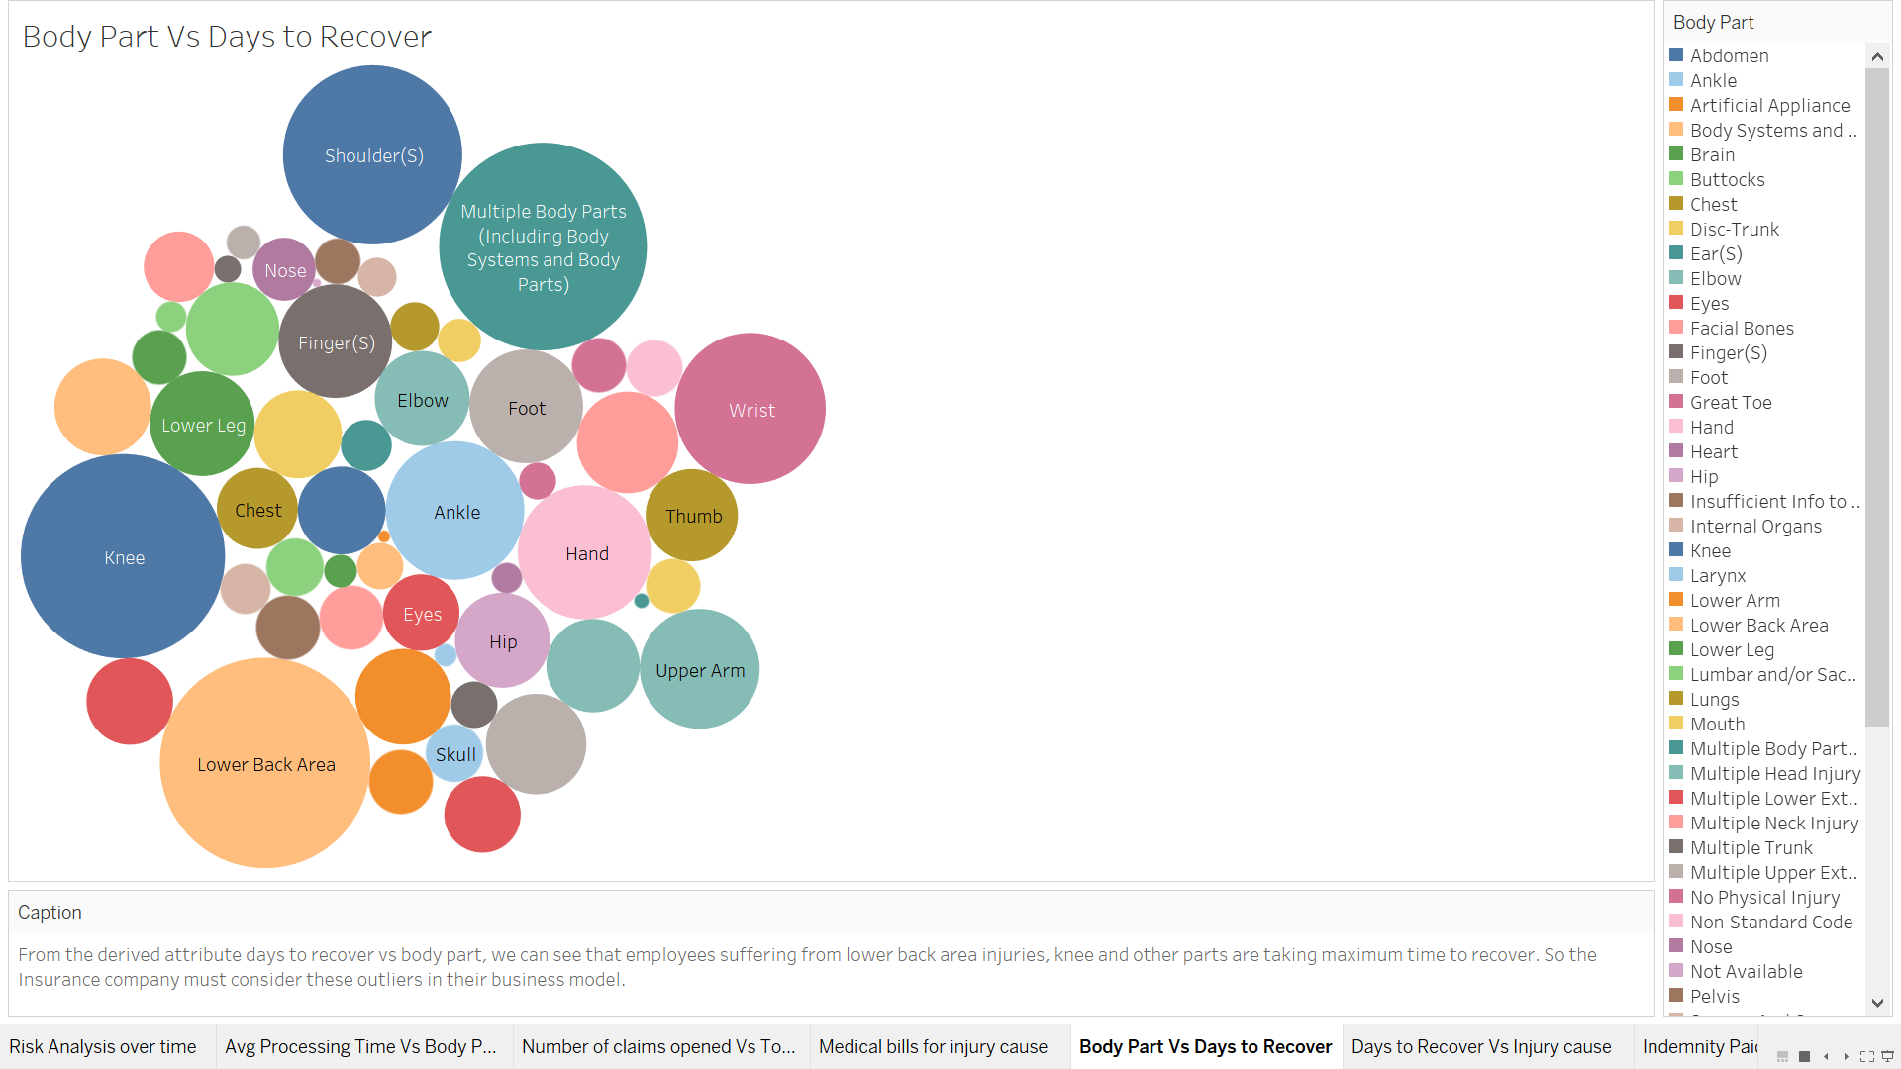
BODY PART VS DAYS TO RECOVER

Slide 11
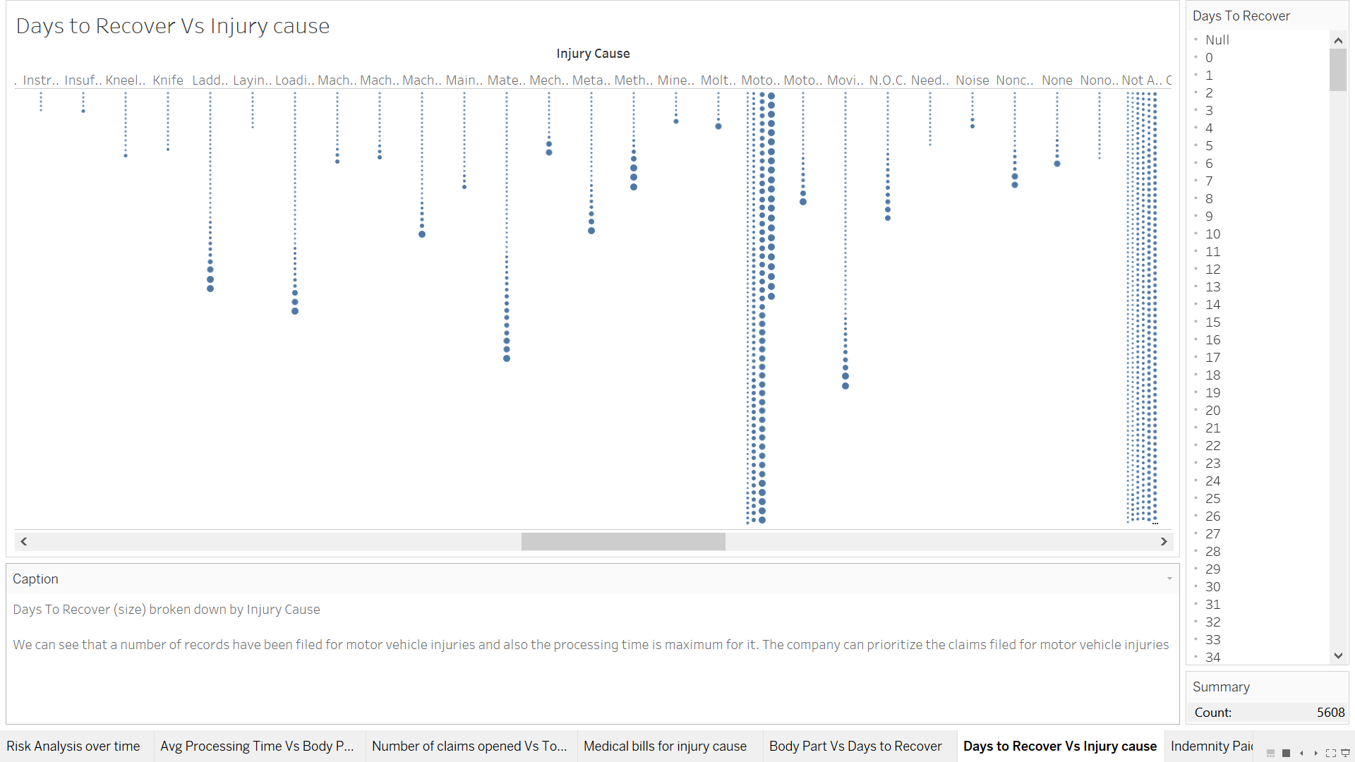
Days to recover vs injury cause

Slide 12
Predictive model comparison
Time Series forecasting -Time series is more effective if the sequence taken is successively spaced.
Linear Regression- The models sensitivity to outliers.
Decision Tree – Injury Nature with more than two categories.
Association Rule Mining- Difficult interpreting the impact on the main event.
Logistics Regression -Logistic Regression on risk which is the binary dependent variable is a suitable modeling technique

Slide 13
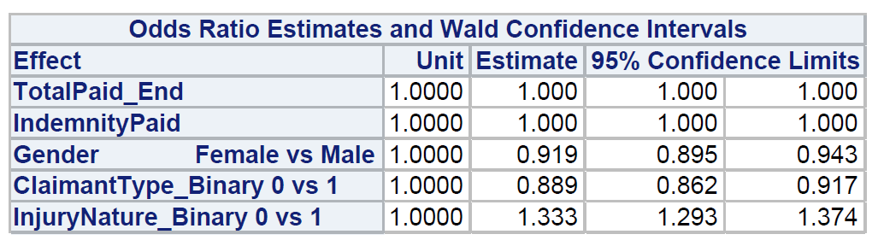
Predictive model
Logistic Regression on Risk(Processing_Time)

Slide 14
Recommendations
Regulation in the workers environment which the Insurance Company must take a firm decision on, along with the Employer.
Separate workflow assigned for claimant type Indemnity .
Mandatory input fields to put valid values or predefined values to get a valid value.

Slide 15
Thank you

