Slide 1

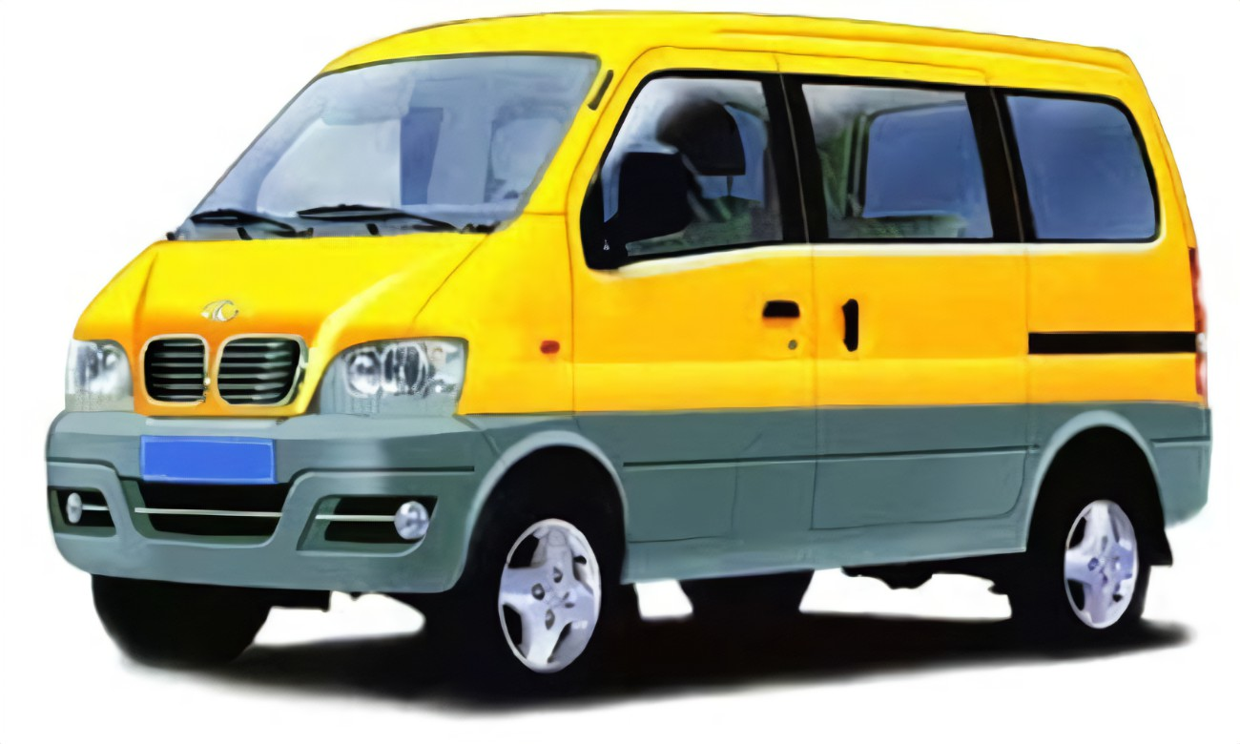

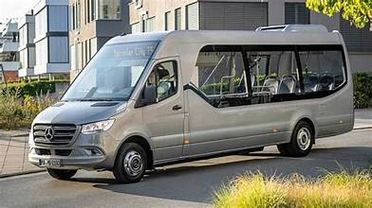

City Bus
Mini Bus
SVCGS – SMART VEHICLE CENTRAL GATEWAY SYSTEM

Slide 2
Definitions

Slide 3
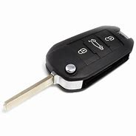
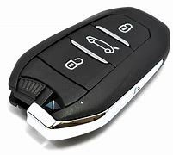
Technical Words
ACTUATOR Key
Vehicle Key
Ignition ON/OFF for Base Veh
Base Veh Key
Base Veh
Base Veh

Slide 4
DEFINITIONS
VEHICLE TYPES
City Bus
Mini Bus
EV Vehicle
EV Vehicle
Base Veh
Base Veh

Slide 5





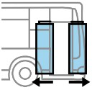




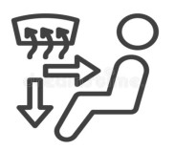
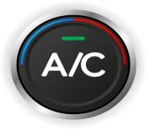

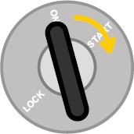
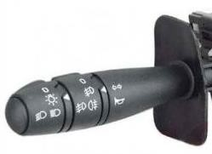
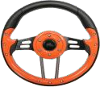




DEFINITIONS
SHUTTLE TYPES
City Bus
Mini Bus
Passengers Stop Request
Smoke & Heat Detector
TPMS
Passengers Stop Request
Smoke & Heat Detector
Exterior/ Interior Access required for disabled person
Warning lights blinks
EV Vehicle
EV Vehicle
ITS
ITS SYSTEM
ITS
ITS SYSTEM
TPMS
ITS
DRIVER’S COMMAND
ITS
DRIVER’S COMMAND
ITS DISPLAYS
ITS DISPLAYS
Front Door Central Lock
Front Door Central Lock
Voip for passengers
Warning lights blinks
Voip for passengers

Slide 6
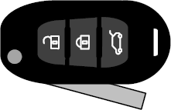

A total of 2 keys :
DEFINITIONS
Power ON
LOCK
Start
BASE VEHICLE KEY
vehicle
BASE VEH Status
Power ON
LOCK
AD drive Manual Drive
Actuators KEY
Potential device : key, badge, code.
AV
20

Slide 7
DRIVE MODES
VEHICLE MODES -
VEHICLE Status | K.O
 | MANUAL DRIVING
 | READY | NOT READY
ACTUATORS Status | K.O | ACTIVE
 | READY | NOT READY
GTW Status | ON | NOT READY
BASE VEH Status | READY | AUTO ACC

Slide 8
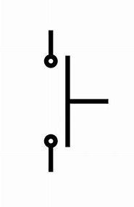

DEFINITIONS
SHUTTLE TYPES
City/Mini Bus
HOT SWITCH
Base Vehicle

Slide 9
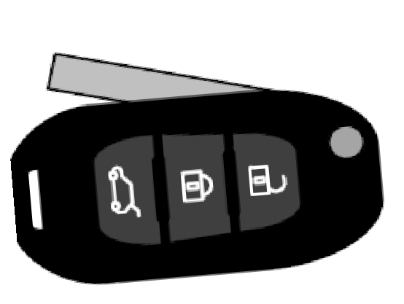


DRIVE MODES
Opening, starting, manual driving the vehicle :
1
2
VEHICLE Status
ACTUATORS Status
GTW Status | ON
Base veh status
The vehicle is parked, locked.
VEHICLE Status | NOT READY
ACTUATORS Status | NOT READY
GTW Status | ON
BASE VEH Status Status | AutoACC
The driver approaches the vehicle,
and using the BASE VEH Status key, unlocks the vehicle.
BASE VEHICLE KEY
3
4
5
VEHICLEStatus | NOT READY
ACTUATORS Status | NOT READY
GTW Status | ON
BASE VEH Status Status | AutoACC
Power ON
The driver gets into the vehicle, sits in the driver's seat,
and using the BASE VEH Status key, turns on the ignition.
LOCK
Start
vehicle
BASE VEH Status
Power ON
VEHICLEStatus | NOT READY
ACTUATORS Status | NOT READY
GTW Status | ON
BASE VEH Status Status | READY
Start
The driver turns the BASE VEH Status key to start the motor
LOCK
vehicle
BASE VEH Status
READY
VEHICLEStatus | Manual Driving
ACTUATORS Status | NOT READY
GTW Status | ON
BASE VEH Status Status | READY
The vehicle is running, driven manually
9

Slide 10

DRIVE MODES
Launching Actuators mode :
1
2
3
4
5
6
Power ON
VEHICLE Status | Manual Driving
ACTUATORS Status | READY
GTW Status | ON
BASE VEH Status | READY
Power ON
The vehicle is running, driven manually.
The driver turns the "Actuator" key to the “Power ON" position
Conditions
to be validated
P
VEHICLE Status | Manual Driving
ACTUATORS Status | READY
GTW Status | ON
BASE VEH Status | READY
The necessary conditions to switch to actuator mode are met.
Power ON
VEHICLE Status | Manual Driving
ACTUATORS Status | Confirmation
GTW Status | ON
BASE VEH Status | READY
The driver turns the "Actuator" key to the "available for actuator mode driving" position.
LOCK
AoD drive
AoV
MCU Supervision
VEHICLE Status | Manual Driving
ACTUATORS Status | ACTIVE
GTW Status | ON
BASE VEH Status | READY
Actuators On-board Driving Validated
the MCU takes control of the vehicle.
Technical reminder : ways to
close the vehicle to be defined
VEHICLE Status | Manual Driving
ACTUATORS Status | ACTIVE
GTW Status | ON
BASE VEH Status | READY
The driver locks the driver's compartment door, and then drives the vehicle.
VEHICLE Status | Manual Driving
ACTUATORS Status | ACTIVE
GTW Status | ON
BASE VEH Status | READY
The vehicle is running,
driven by the Driver.
10

Slide 11
1
DRIVE MODES
Ending Autonomous Driving (normal ending) :
The vehicle is running, driven by the Driver. | Vehicle Status | Manual Driving
 | ACTUATORS Status | ACTIVE
 | GTW Status | ON
 | BASE VEH Status | READY
2
3
4
5
6
^{Conditions} P The necessary conditions to release to be validated actuator mode driving are met. | Vehicle Status | Manual Driving
 | ACTUATORS Status | ACTIVE
 | GTW Status | ON
 | BASE VEH Status | READY
Power ON
The driver turns the "Actuator" key to the "available for autonomous driving" position.
VEHICLE Status | Manual Driving
ACTUATORS Status | Confirmation
GTW Status | ON
BASE VEH Status | READY
LOCK
Manual drive
the MCU releases control of the actuators.
READY READY
AV
ON
VEHICLE Status | Manual Driving
ACTUATORS Status | READY
GTW Status | ON
BASE VEH Status | READY
Technical reminder : ways to open the vehicle to be defined
The driver unlocks the driver's compartment
MCU Supervision
Vehicle Status | Manual Driving
ACTUATORS Status | INACTIVE
GTW Status | ON
BASE VEH Status | READY
The MCU releases control of the actuators
Actuators On-board Driving Ended
 | Vehicle Status | Manual Driving
 | ACTUATOR Status | INACTIVE
 | GTW Status | ON
 | BASE VEH Status | READY
The vehicle is running, driven manually
23

Slide 12
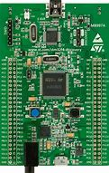
Smoke & Heat Detector
TPMS
Warning lights blinks
Passengers Stop Request
SVCGS

