Slide 1
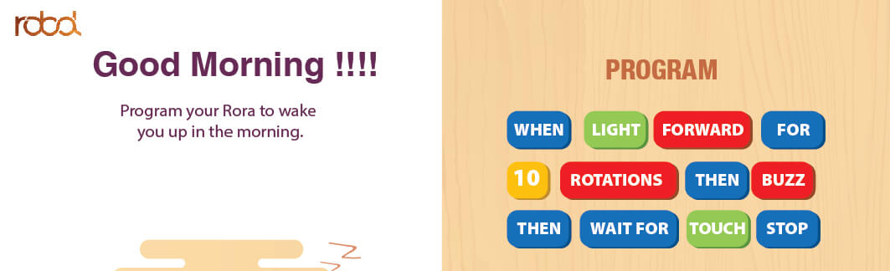
WHEN LIGHT FORWARD FOR
5 SECONDS THEN BUZZ
THEN WAITFOR SOUND STOP
TEST RESULT: fail
COMMENT: when light BOT forward for 5 seconds then buzz then it wont wait
for sound but stop
If command is “WHEN LIGHT FORWARD FOR 5 SECONDS THEN BUZZ THEN WAITFOR
WALL THEN REVERSE” then bot forward for 5 seconds then buzz but don’t wait for
Wall but starts the reverse command simultaneously with buzz.

Slide 2
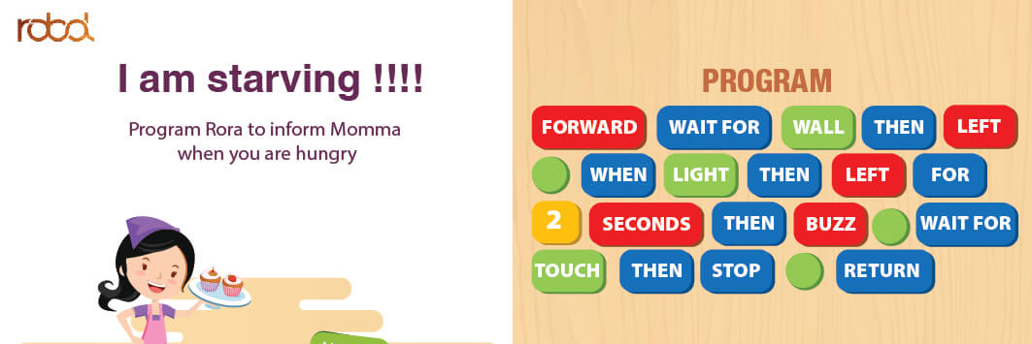
FORWARD WAITFOR WALL THEN LEFT
WHEN LIGHT THEN LEFT FOR
2 SECONDS THEN BUZZ WAITFOR
SOUND THEN STOP RETURN
TEST RESULT: fail
COMMENT: Works when we command as “GO FORWARD”,
doesn’t work for “FORWARD”
And after BOT detects wall, it stops all its action, it doesn’t turn left
and hence it won’t jump to further commands.

Slide 3
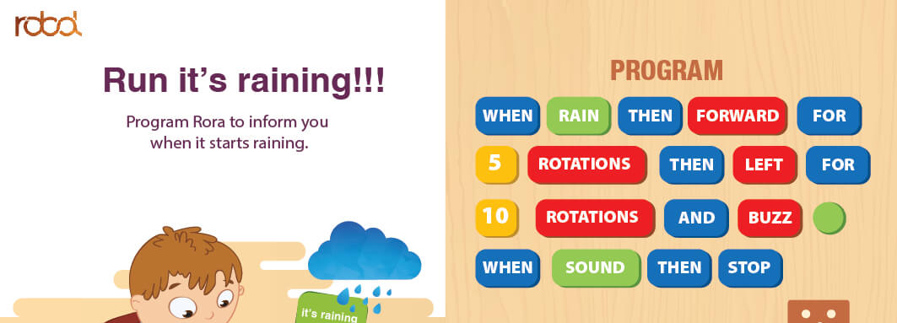
WHEN LIGHT THEN FORWARD FOR
5 FOOT THEN LEFT FOR
8 FOOT AND BUZZ
WHEN SOUND THEN STOP
TEST RESULT: fail
COMMENT: when light bot forward for 5 foot then left (here it wont enter for
Command but execute till 8 foot ) , then control is not entering “AND BUZZ” command
But directly it waits for sound (whether it detects or not) Bot execution will be stopped

Slide 4
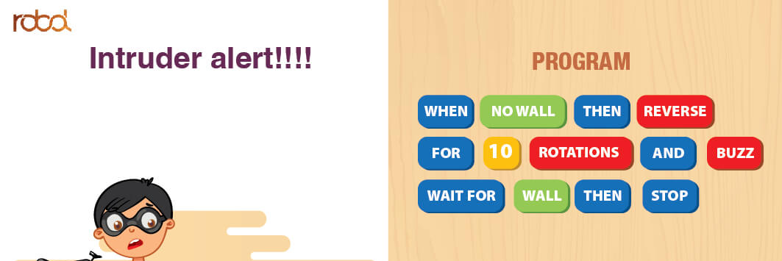
WHEN NOWALL THEN REVERSE
FOR 8 FOOT AND BUZZ
WAITFOR WALL THEN STOP
TEST RESULT: fail
COMMENT: Irrespective of wall or nowall, bot will reverse for 8 foot and
stop and repeats the cycle
Here after 8 foot of reverse control is not entering the “AND BUZZ” commands
Hence no further commands will work
But as we don’t have wall sensor back side or as we are not making bot to rotate
and then to reverse the bot couldn’t sense the wall to stop.

Slide 5
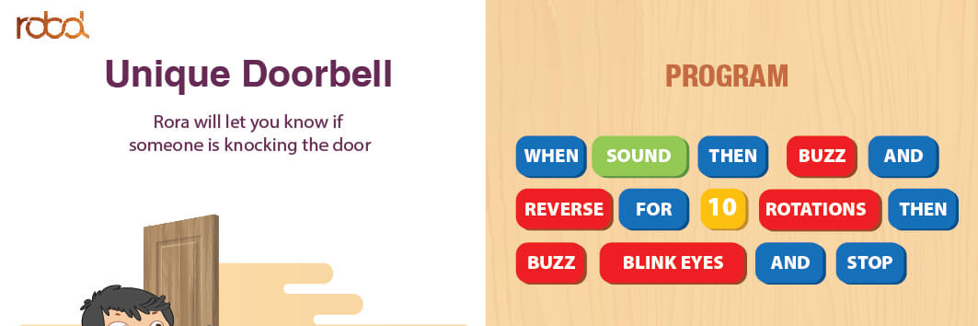
WHEN SOUND THEN BUZZ AND
REVERSE FOR 10 FOOT THEN
BUZZ BLINK EYES AND STOP
TEST RESULT: fail
COMMENT: when sound (detects the fan sound) then buzz and reverse for 6 foot s
Simultaneously then control enters the buzzer but buzzer will not on and stops.
Control doesnot enter the blink eyes and stop.

Slide 6
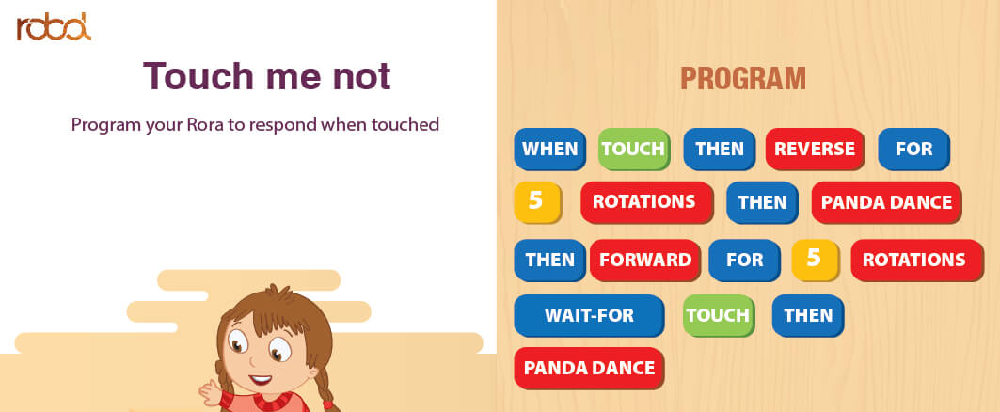
WHEN SOUND THEN REVERSE FOR
5 FOOT THEN PANDA DANCE
THEN FORWARD FOR 5 FOOT
WAITFOR SOUND THEN PANDA DANCE
TEST RESULT: fail
COMMENT: when sound then reverse for 5 foot then panda dance then forward
for 5 foot then it starts executing from the first
Control is not entering the commands after 5 foot.

Slide 7
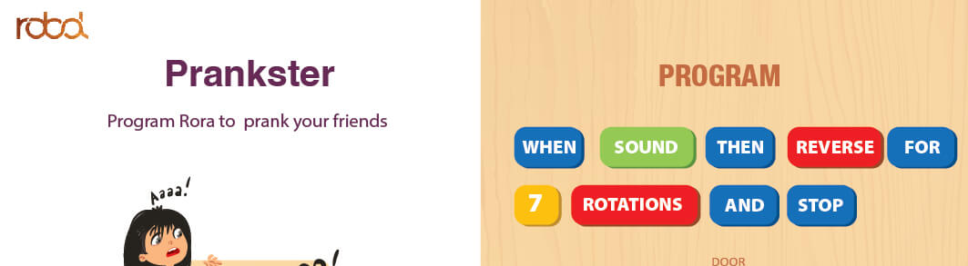
WHEN SOUND THEN REVERSE FOR
7 FOOT AND STOP
TEST RESULT: pass

Slide 8
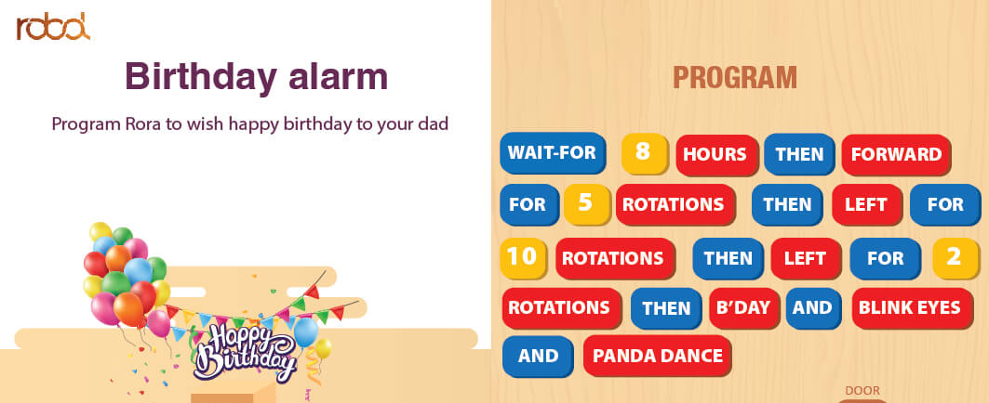
WAITFOR 8 HOURS THEN FORWARD
FOR 5 FOOT THEN LEFT FOR
10 FOOT THEN LEFT FOR 2
FOOT THEN B’DAY AND BLINK EYES
AND PANDA DANCE
TEST RESULT: fail
COMMENT: enters waitfor and 8 command then doesnot execute any .

Slide 9
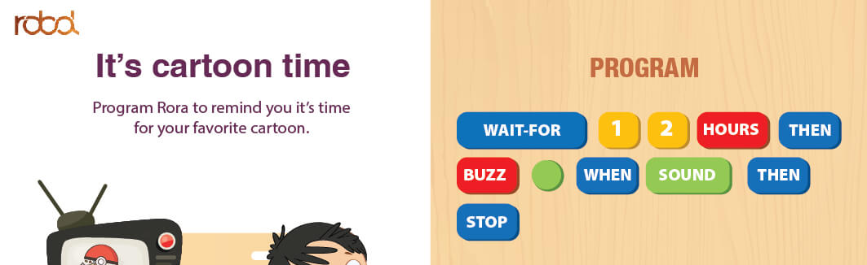
WAITFOR 1 2 HOURS THEN
BUZZ WHEN SOUND THEN
STOP
TEST RESULT:fail

Slide 10
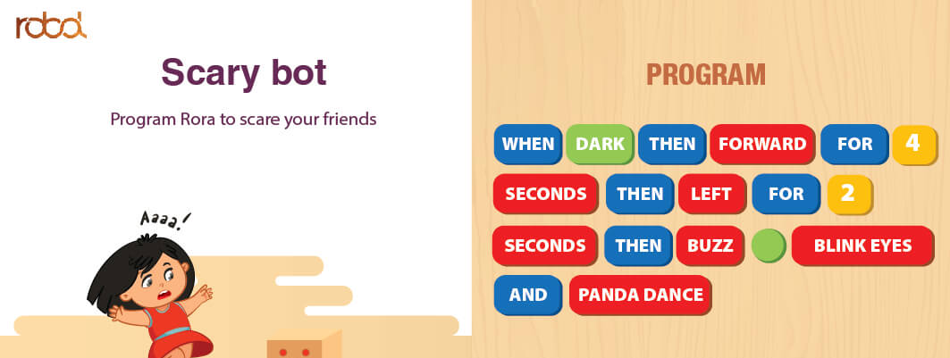
WHEN DARK THEN FORWARD FOR 4
SECONDS THEN LEFT FOR 2
SECONDS THEN BUZZ BLINK EYES
AND PANDA DANCE
TEST RESULT: pass

Slide 11
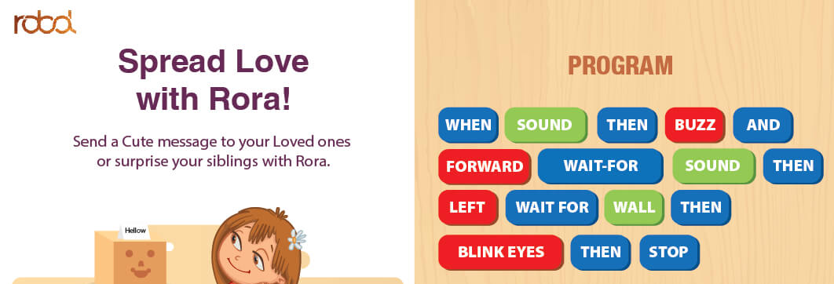
WHEN SOUND THEN BUZZ AND
FORWARD WAITFOR SOUND THEN
LEFT WAITFOR WALL THEN
BLINK EYES THEN STOP
TEST RESULT: fail
COMMENT: when sound then bot buzz and stop.
Even though control enters the further commands bot is not executing

Slide 12
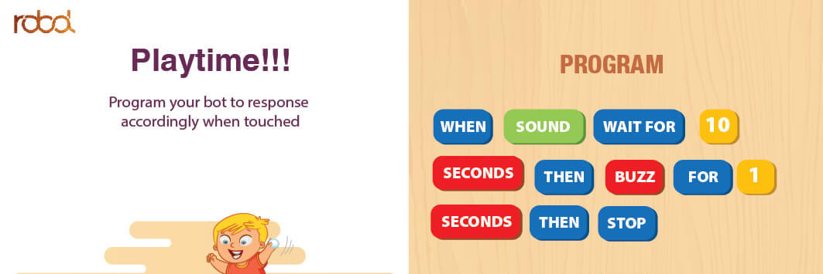
WHEN SOUND WAITFOR 10
SECONDS THEN BUZZ FOR 1
SECOND THEN STOP
TEST RESULT: pass

Slide 13
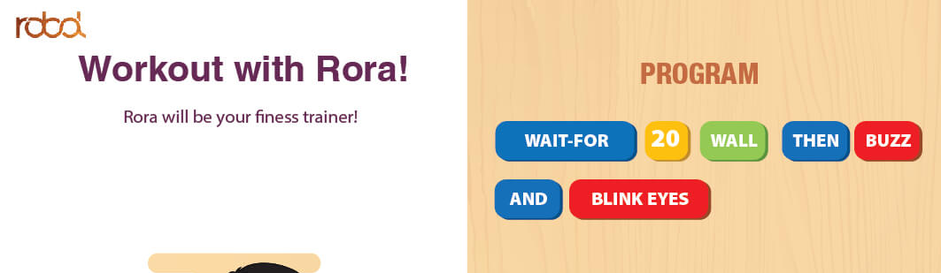
WAITFOR 3 WALL THEN BUZZ
AND BLINK EYES
TEST RESULT: fail
COMMENT: control enter the waitfor command then to 3 before it encounter the
3 counts it enters the then command and so further commands

Slide 14
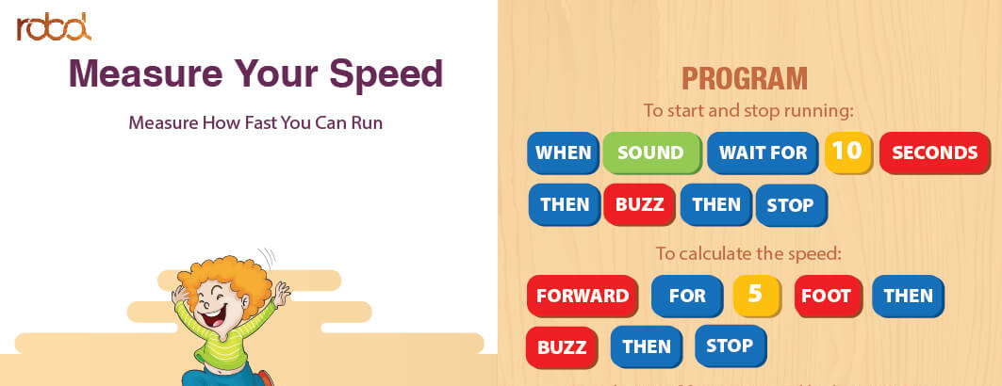
WHEN SOUND WAITFOR 10 SECONDS
THEN BUZZ THEN STOP
FORWARD FOR 5 FOOT THEN
BUZZ THEN STOP
TEST RESULT: fail
COMMENT: when sound waitfor 8 seconds then control not entering to buzz
And hence no further commands exxecute

Slide 15
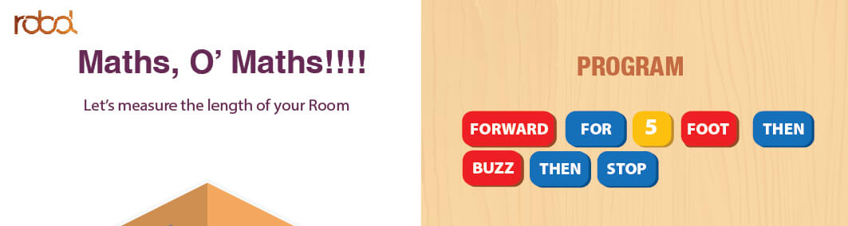
FORWARD FOR 5 FOOT THEN
BUZZ THEN STOP
TEST RESULT: pass
COMMENT : works for “GO FORWARD”
After buzzer and stop cycle repeats

Slide 16
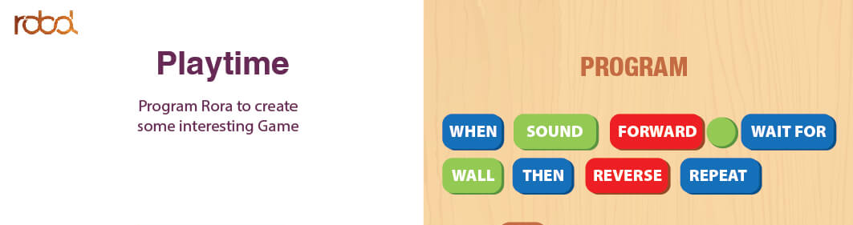
WHEN SOUND FORWARD WAITFOR
WALL THEN REVERSE REPEAT
TEST RESULT: fail
COMMENT: when sound forward but when it detects wall bot stops by default

Slide 17
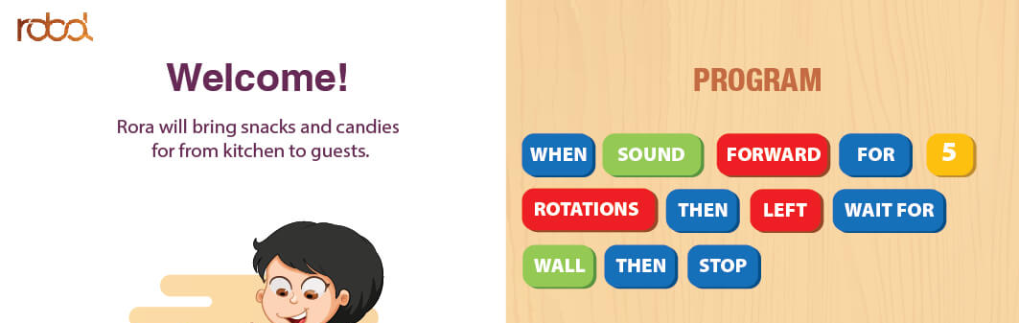
WHEN SOUND FORWARD FOR 5
FOOT THEN LEFT WAITFOR
WALL THEN STOP
TEST RESULT: pass

Slide 18
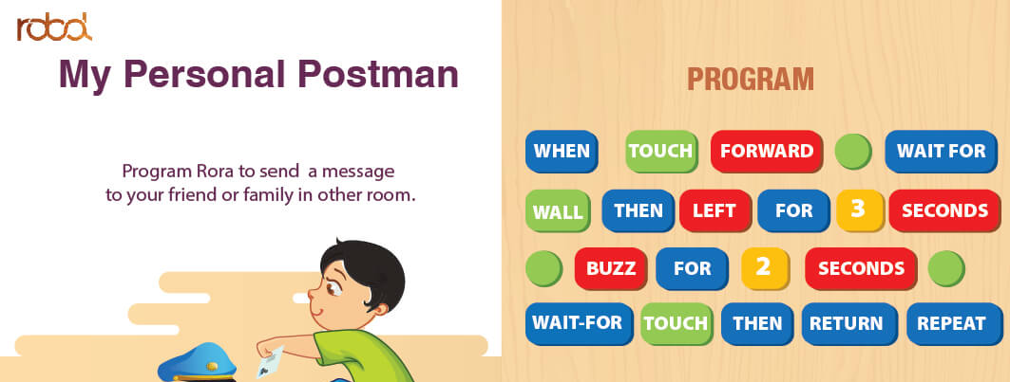
WHEN SOUND FORWARD WAITFOR
WALL THEN LEFT FOR 3 SECONDS
BUZZ FOR 2 SECONDS
WAITFOR SOUND THEN RETURN REPEAT
TEST RESULT:fail
COMMENT: when sound forward wait for wall then stops

Slide 19
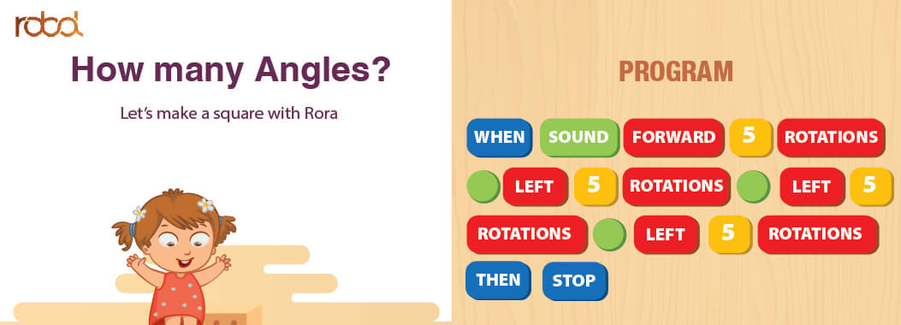
WHEN SOUND FORWARD 5 FOOT
LEFT 5 FOOT LEFT 5
FOOT LEFT 5 FOOT
THEN STOP
TEST RESULT:pass

Slide 20
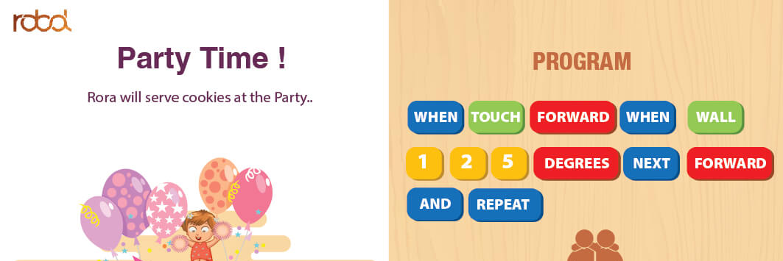
WHEN SOUND FORWARD WHEN WALL
1 2 5 DEGREES NEXT FORWARD
AND REPEAT
TEST RESULT:fail
COMMENT : degree is not implemented yet.

