Slide 1
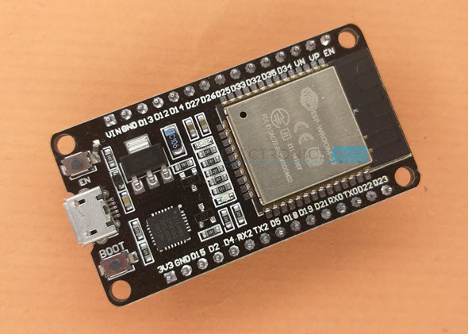
ESP 32 Configuration and Controller
ESP 32 is a input low power microcontroller with an output integrated wifi and Bluetooth . It is application the successor to the esp8266 . Which is also a low cost wifi microchip with limited vastly limited functionality .
Manufacturer : Espressif Systems
Type: Microcontroller
Release date: September 6,2016
CPU: Tensilica Xtensa LX6 microprocessor @160 or 240 MHz
Memory: 320 KIB SRAM
Power:3.3 V DC
Predecessor : ESP8266

Slide 2
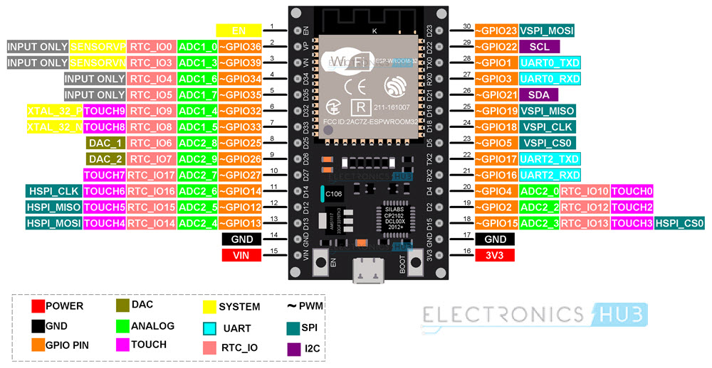
ESP32 Configuration :

Slide 3
ESP32 Peripherals
34 programmable GPIOs
18 12-bit ADC channels
2 8 bit DAC channels
16 PWM channels
3 UART interfaces
3 SPI interfaces
2 I2C interfaces
2 I2S interfaces
10 capacities touch sensing GPIOs
16 RTC GPIOs

Slide 4
GPIOs :
The most commonly used peripheral is the GPIO. ESP32 has 34GPIO pins with each pin carrying out more than one function. You can configure a pin as either a GPIO or an ADC or an UART in the program.
ADC:
ESP32 has two 12-bit SAR(Successive approximation register) analog to digital converter modules with 8-channels and 10- channels each. So, ADC1 and ADC2 combine together have 18-channels of 12-bit ADC.
With 12-bit resolution the output digital values will be in the range of 0-4093.
DAC:
The DAC has internal resistor network and uses power supply as input refernce voltage.
ESP32 micro controller has two independent 8-bit digital to analog converter channels to convert digital values to analog voltage signals.

Slide 5
The following two GPIO pins are associated with DAC functionalities.
DAC1 - GPIO25
DAC2 – GPIO26
PMW :
PWM controller in ESP32 have 16 independent PWM wave form channels wiith configurable frequency and duty cycle. The PWM wave form can be used to drive motors and LEDs. You can configure the PWM signal frequency , channel, GPIO pin and also the duty cycle.
UART :
A UART channel has two data lines one each device there is an RX pin and a TX pin (RX for receive and TX for transmit). The RX pin of each device is connected to the TX pin of the other device.
SPI :
The ESP32 wifi chip features has 3 SPI blocks(SPI,HSPI and VSPI) in both masters and slave modes. SPI2 is used to interface with flash memory. So, you have two interfaces.
I2C:
There are two I2C interfaces in ESP32 with complete flexibility on assigning pins that is SCL and SDA pins for both I2C interfaces can be assignied in the program by the user .
If you are using Arduino IDE, then the default I2C pins are
SDA - GPIO21 SCL - GPIO22

Slide 6
I2S :
I2S(inter -ic sound) is a serial , synchronous communication protocol that is usually used for transmitting audio data between two digital audio devices
ESP32 contains i2S peripherals .these peripherals can be configured to input and output sample data via the I2S driver
Touching sensors:
The ESP32 has 10 capacitive touch GPIOs. These GPIOs can sense variations in any thing that holds an electric charge like the human skin.
So they can detect variations induced when touching the GPIOs with a finger these pins can easily
Integrated into capacitive pads and replace magical buttons.
RTC GPIOs:
ESP32 has 16 RTC GPIOs ,which are part of the RTC lower-power sub station. These pins can be used to wake ESP32 from deep sleep as external wake up source.

Slide 7
ESP32 Controller:
In ESP32 these controllers are used SPI (serial peripheral interface)/SDIO(secure digital input output).
SPI :
SPI is an interface bus is commonly used for communication with flash memory, sensors, real time clocks(RTCs),analog to digital converter.
The serial peripheral interface bus was developed by Motorola to provide full duplex synchronous serial communication between master and slave devices
SPI interface:
A standard SPI Connection involves a master connected to slaves using the serial clock
(SCK),Master out slave In (MOSI),Master in slave out (MISO),and slave select(SS)lines.
The SCK,MOSI and MISO signals can be shared by slaves while each slave has a unique SS line.

Slide 8
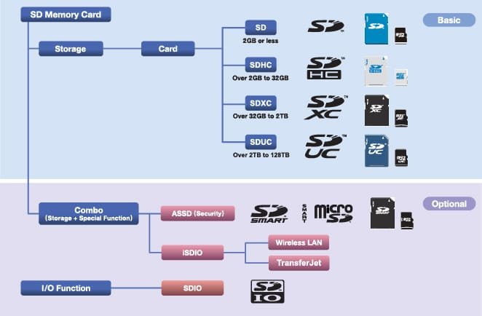
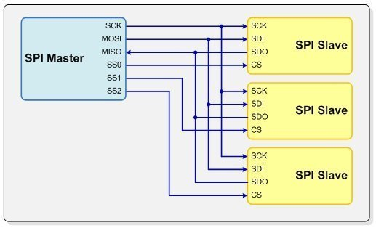
SPI(serial peripheral interface) SDIO (Secure Digital input/output)

Slide 9
SDIO : Secure Digital input/output is an important standard for devices that feature inter changeable memory options. In todays exploding world of portable electronic devices. That’s a large number indeed.
Memory stored on various forms of devices. Portable and non-portable devices store information on both internal hard drivers and external hard drivers have varying degrees of portability, mostly due to the size of the drivers.
One way to store memory is on a smaller hard drive these come in a few shape and size. One is called a memory stick, another is called a secure digital(SD)card. This is where SDIO comes in.
An SDIO card is an advanced form of an SD card.An SDIO card can include much more than just data files. Infact, many SDIO cards approximate a minimum computer or a powerful software application.
SDIO cards can power Bluetooth, adapters, global positioning system(GBS), receivers, television turners, cameras, scanners, voice recorders, and even fingerprinters.

