Slide 1
Setup-1
Setup-2
Setup-3
xxxx dB
MIC
xxxx dB
Motor
Speed in rpm
IR sensor
Obstacle ON/OFF
Buzzer
Speed sensor
Switch
Ultrasonic sensor
PWM
Current
PWM
Distance of object
MIC-BUZZER
MOTOR-SPEED SENSOR
OBSTACLE-IR/ULTRASONIC SENSOR
Setup-5
Setup-4
Setup-6
Heater
Temperature
LED
Luminance
Switch
Smoke/Gas sensor
Smoke/ gas generator(ON/OFF)
PWM
ON/OFF
LDR control/Color sensor
Value of LDR
Temperature sensor
Temp value
LED
PWM
Voltage
LED
LED-LDR SENSOR
SMOKE/GAS-SMOKE/GAS SENSOR
HEATER-TEMP SENSOR

Slide 2
Setup-7
Setup-8
Setup-9
Alcohol sensor
Touch sensor
LEDS
Humidity sensors
Relative humidity
RED LED with Buzzer
Tensil(ON/OFF)
Temperature
ALCOHOL - ALCOHOL SENSOR
TOUCH - TOUCH SENSOR
HUMIDITY - HUMIDITY SENSOR

Slide 3


Setup-1
MIC
xxxx dB
A
MIC
xxxx dB
xxx dB
Buzzer control
Sound level in dB
PWM
Current
t
MIC-BUZZER
BUZZER
0%
100%
PWM control
Time slot (micro sec)
XXX

Slide 4


Setup-2
SPEED SENSOR
Motor
Speed sensor
Switch
graph
PWM
Speed value in xxxx rpm
MOTOR-SPEED SENSOR
MOTOR
0%
PWM control
100%
Switch
PWM

Slide 5

OBSTACLE-IR/ULTRASONIC SENSOR
Setup-3
IR sensor
Obstacle ON/OFF
OBSTACLE PRESENT
AT DIST : XXX m
Ultrasonic sensor
Distance of object
Switch
LCD
OBSTACLE-IR/ULTRASONIC SENSOR
OBSTACLE
Obstacle ON/OFF

Slide 6
Setup-4
LDR SENSOR/COLOUR SENSOR
LED
Luminance
Switch
LUM:xxxxxx
COL:
LDR control
Value of LDR
PWM
Voltage
LDR VALUE
LED/COLOUR - LDR SENSOR
LED
LED
PWM control
0%
100%

Slide 7
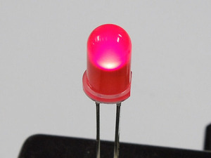
Setup-5
TEMP SENSOR
Heater
Temperature
Temp:XX K
PWM
ON/OFF
Temperature sensor
Temp value
Buzzer
If temp>35
HEATER-TEMP SENSOR
HEATER
PWM control
Heater
0%
100%
PWM

Slide 8
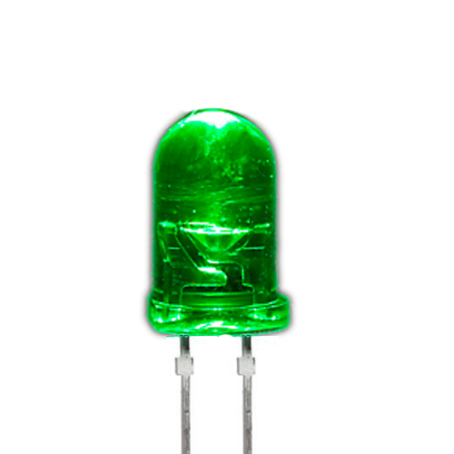
Setup-6
SMOKE/GAS SENSOR
Smoke/Gas sensor
Smoke/ gas generator(ON/OFF)
GAS DETECTED:
XYZ GAS
Smoke detected
LED/Buzzer
No Smoke detected
SMOKE/GAS-SMOKE/GAS SENSOR
SMOKE/GAS UNIT
Smoke/Gas generator
PWM control
0%
100%

Slide 9
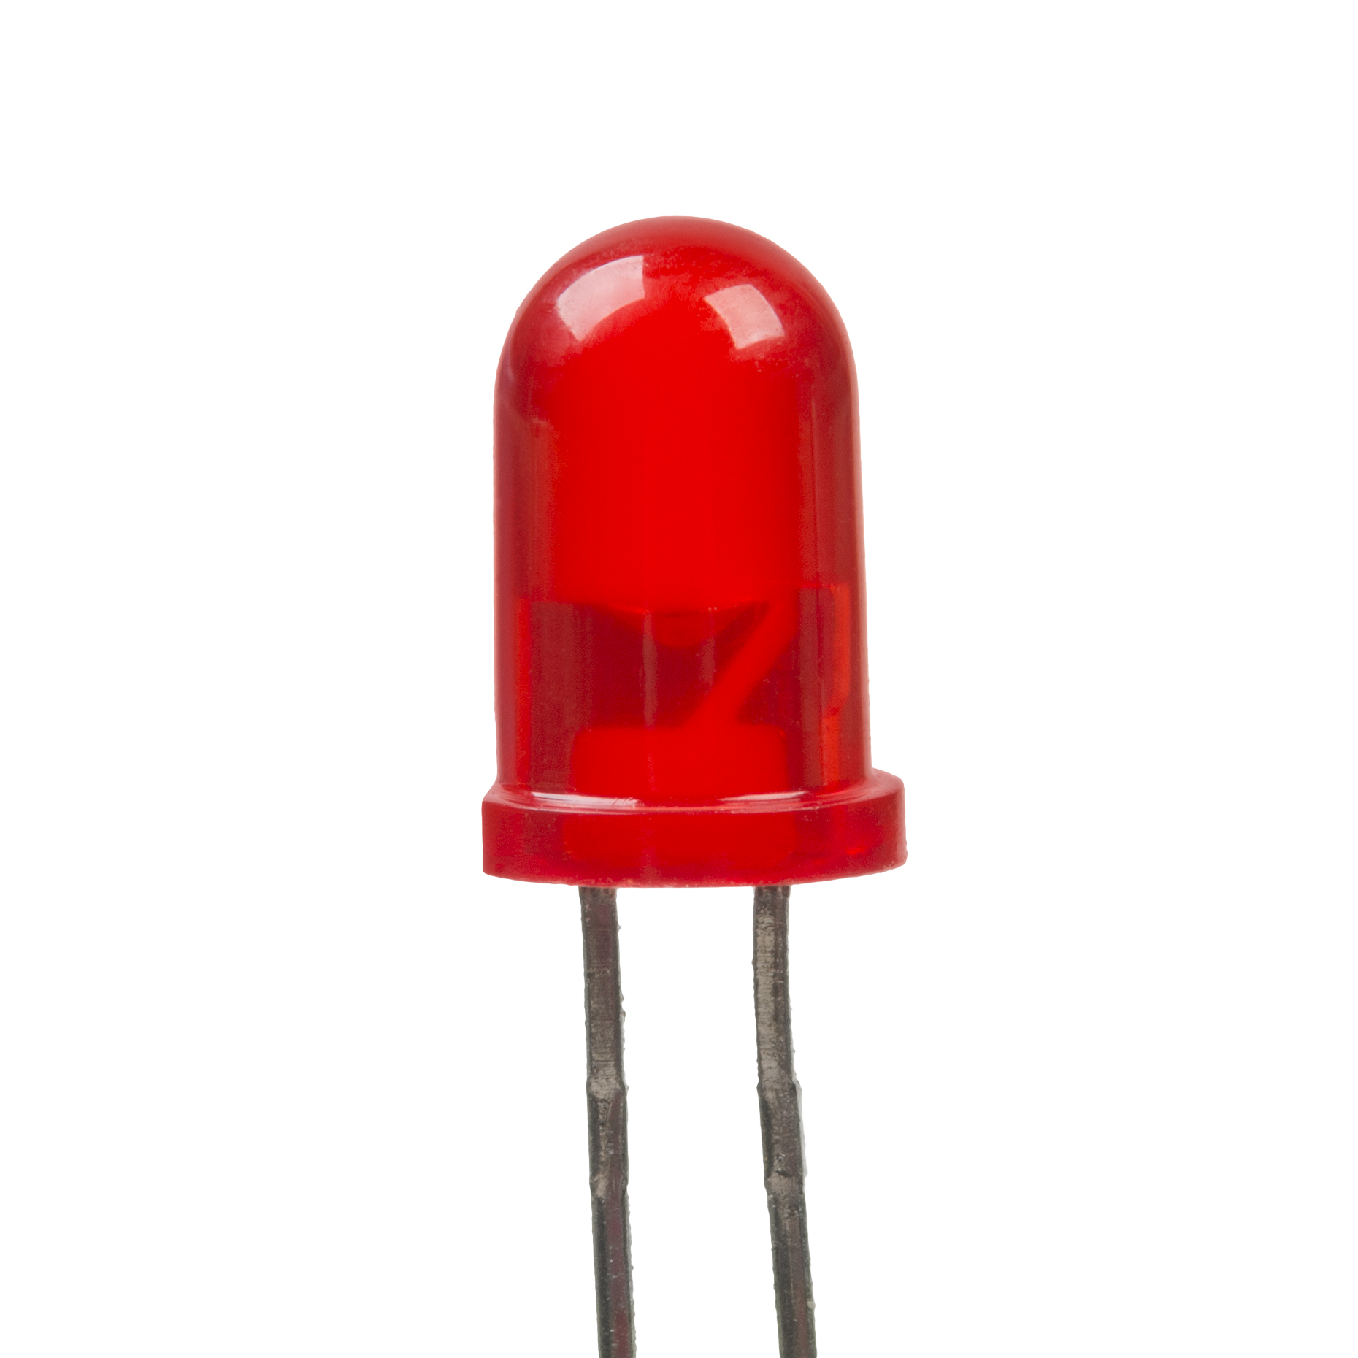
Setup-7
ALCOHOL SENSOR
Alcohol sensor
Alcohol detected
RED LED with Buzzer
Alcohol not detected
ALCOHOL INPUT SETUP
ALCOHOL - ALCOHOL SENSOR
Alcohol input set up
PWM control
0%
100%

Slide 10

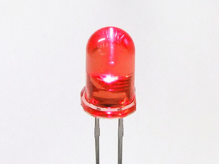
TOUCH - TOUCH SENSOR
Setup-8
LEDS
No Touch detected
Touch sensor
LED OFF
Touch detected
Tensil(ON/OFF)
LED ON
TOUCH - TOUCH SENSOR
TOUCH - TOUCH SENSOR
Tensil
PWM control
0%
100%

Slide 11
HUMIDITY SENSOR
Setup-9
LEDS
Humidity sensors
Relative humidity
Humidity:M=92.3
D=82.6 E=90.4
Temperature
Humidity changing set up
HUMIDITY CHANGING SETUP
HUMIDITY - HUMIDITY SENSOR
Humidity changing set up
PWM control
0%
100%

Slide 12
VM-1
IDEs
USB controller
GUI (Controller App)
Driver SW for USB/COM port
Virtual machine 2
Virtual machine n
COM PORT/USB
Setup-1
MIC
xxxx dB
VIRTUAL BOARD (Pi)
SBB
Buzzer control
PWM
Current
Client Hardware (STM)

Slide 13
PC
(Client)
Virtual Board
(Server)
Resource Request
ACK
Validate resource availability
HANDSHAKING DIAGRAM
Recurring data
Recurring data

Slide 14
PC
(Client)
Virtual Board
(Server)
Send UID
Authenticate
Send ACK/UID
ACK with hardware details
Send configuration parameters
ACK for available resources
Recurring data
Recurring data

Slide 15
Virtual Machine-1
Virtual Board -1
UID/Config data etc
Arduino
Virtual Machine-2
Virtual Board -2
PICX16
Virtual Machine-3
Virtual Board -3
Pi BOard
Virtual Machine-4
Virtual Board -4
Virtual Machine-N
Virtual Board -N

Slide 16
VM - GUI
Virtual board
Virtual board
Setup-1
Setup-1
Setup-2
Setup-2
Arduino

