Slide 1
IBM University Engagement Project Submission
“Exploring the Power of Agentic AI with IBM Granite and IBM Bob”

Slide 2

Project Tile – [Interview Trainer Agent]
Domain of Project – [Educational and Career Development]
Student Name | Recent Passport Photo | Email ID | Mobile number [WhatsApp]
Durgeshwari sangamkar |  | sangamkardurgeshwari@gmail.com | 7517484949
Recommended font style and size: Font Style: Arial Font Size (Heading): 28
Font Size (Content): 20

Slide 3
Problem Statement -
Problem Statement :Interview Trainer Agent
The Challenge :
An Interview Trainer Agent, powered by RAG (Retrieval-Augmented Generation), prepares users for job interviews by generating tailored question sets and preparation strategies based on their profile name, experience level, and job role. It retrieves role-specific interview questions, industry expectations, behavioral scenarios, and HR guidelines from recruitment portals, professional networks, and company interview databases. Users can input their resume or job title, and the agent provides targeted questions, model answers, and improvement tips. It supports both technical and soft skill assessment, ensuring a comprehensive interview prep experience. This AI-driven assistant builds user confidence, sharpens responses, and increases success rates in competitive hiring environments.
The Objective :
To develop an AI-powered Interview Trainer Agent that uses RAG and IBM Granite to generate personalized interview questions, evaluate candidate responses, and provide actionable feedback based on the candidate’s profile, experience, and target job role

Slide 4
Proposed Solution -
Proposed Solution:AI-Powered Interview Trainer Agent
The proposed solution is an AI-powered Interview Trainer Agent built using IBM watsonx.ai, Granite Models, and watsonx Orchestrate to provide personalized interview preparation.
The system uses a RAG pipeline to retrieve relevant technical, behavioral, HR, and role-specific interview knowledge and provide grounded responses.
The agent generates personalized interview questions, model answers, evaluates user responses, provides scores and improvement tips, and asks follow-up questions based on the candidate's profile, experience, skills, and target role.
A user-friendly web dashboard allows candidates to set up their profile, practice interviews, submit or skip questions, view AI-generated feedback, and see their final performance summary.
Overall, the solution provides an end-to-end intelligent interview preparation assistant that helps candidates improve their responses, build confidence, and prepare effectively for competitive job interviews.

Slide 5
Technology Used
IBM Bob – For AI-assisted application development, code generation, debugging, and project development.
IBM watsonx.ai – For IBM Granite model integration.
IBM Granite Model – For interview question generation, answer evaluation, reasoning, and personalized feedback.
IBM watsonx Orchestrate – For agentic workflow orchestration.
RAG – For retrieving relevant interview knowledge before generating responses.
IBM Cloud – For cloud infrastructure and IBM services.
React – For the interactive, responsive frontend.
Knowledge Base / Vector Retrieval – For storing and retrieving interview-preparation knowledge.

Slide 6
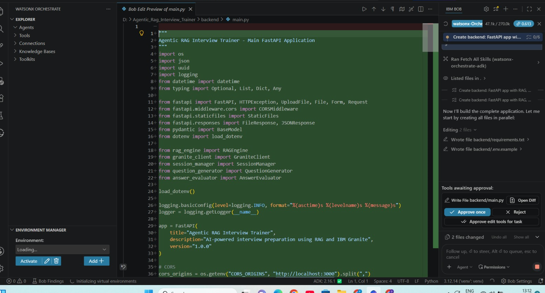
Required Files created using IBM bob -

Slide 7
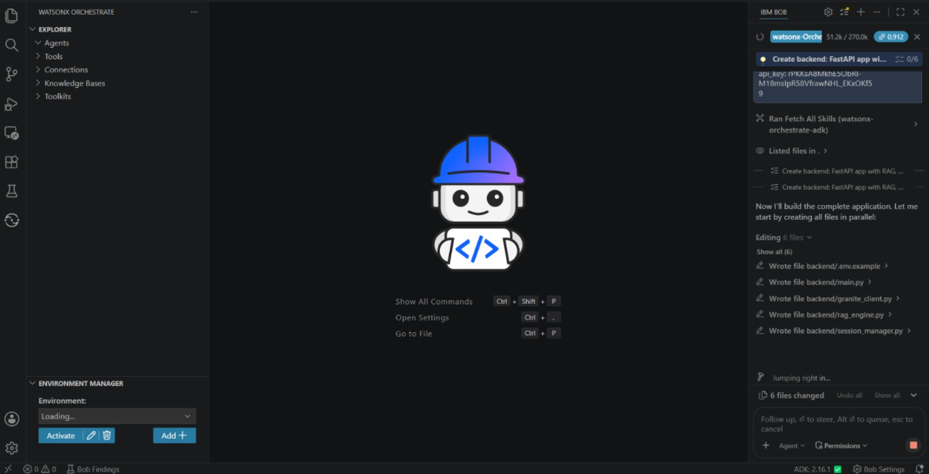
IBM Bob Screenshots:

Slide 8
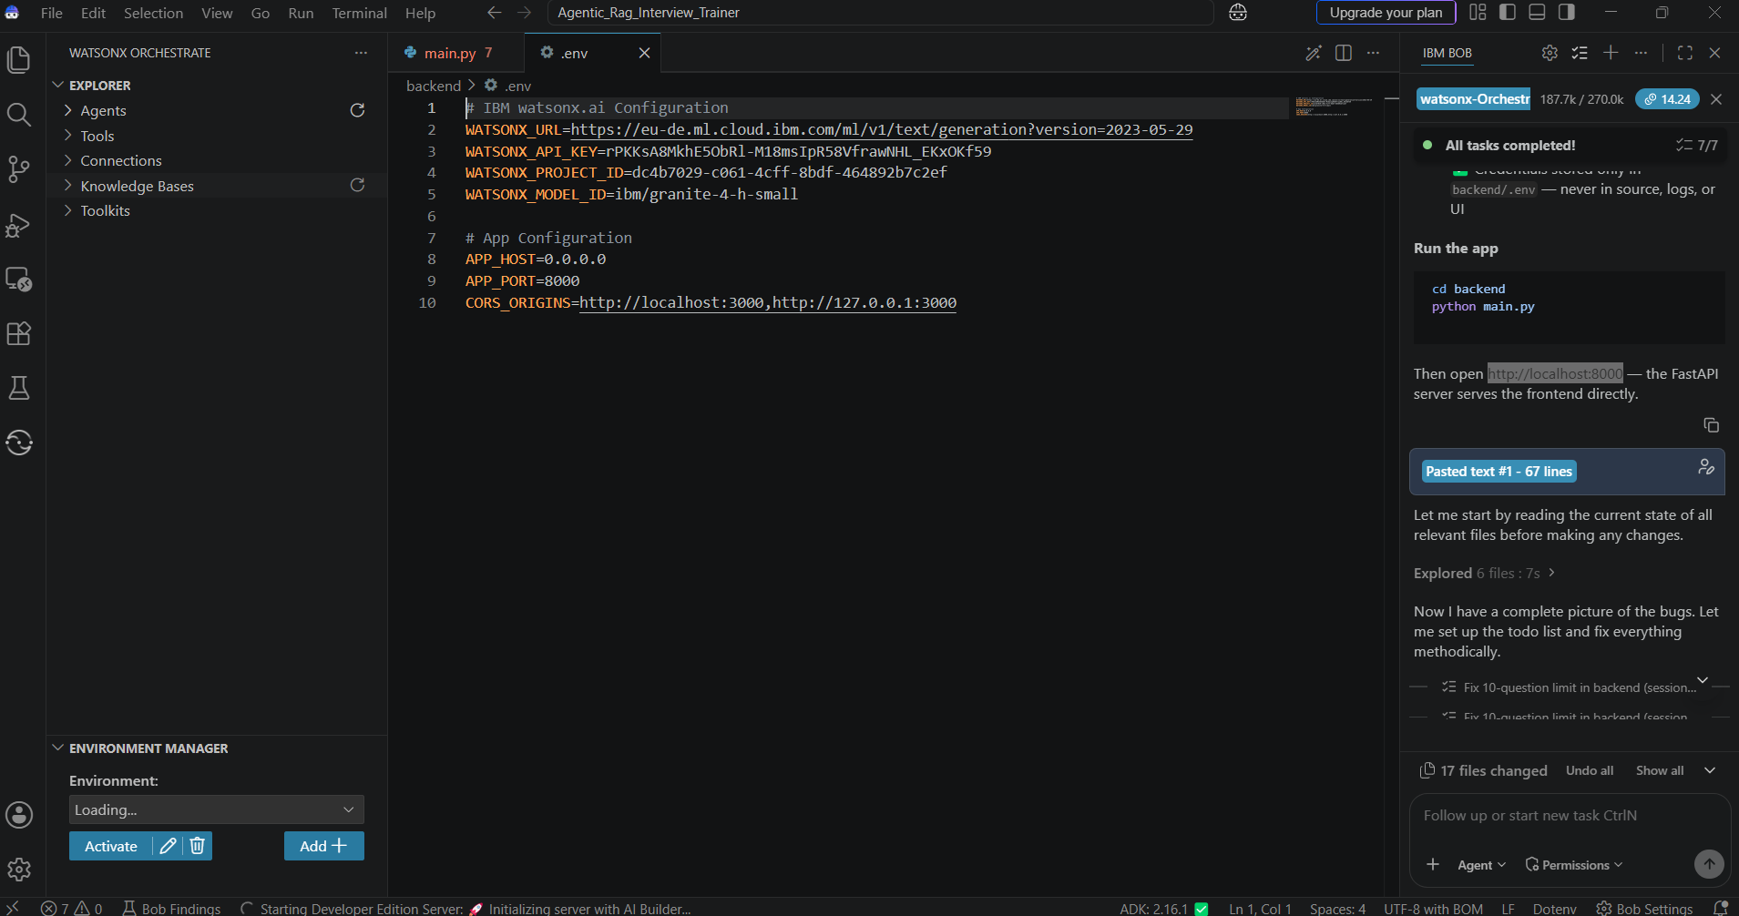

Slide 9
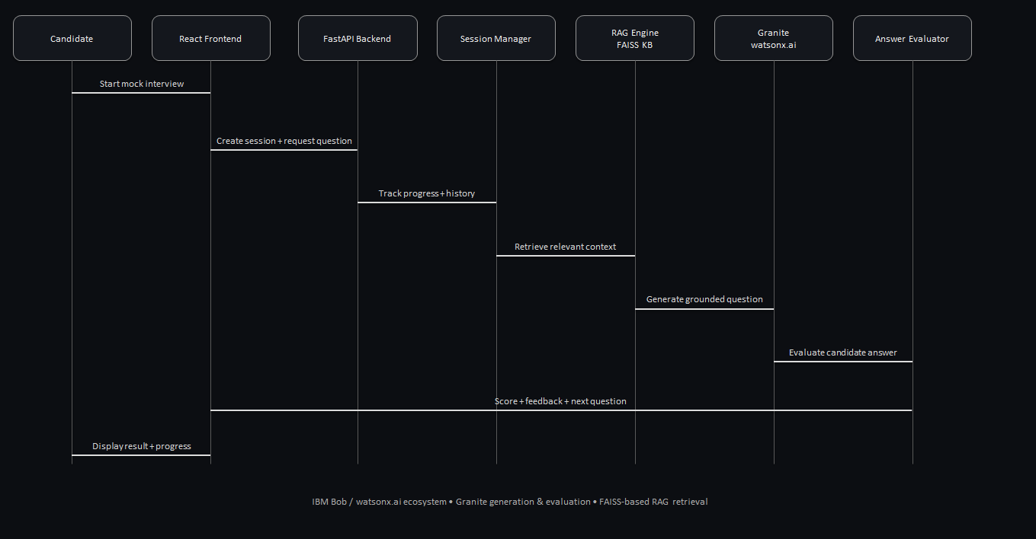
Architecture blueprint for IBM bob:

Slide 10

Role of Agentic AI in the solution
Role of Agentic AI in interview training agent
Agentic AI enables the Agentic RAG Interview Trainer to work as an intelligent and adaptive interview system rather than a simple chatbot. It uses IBM watsonx.ai, IBM Granite models, and RAG to manage the complete mock-interview workflow.
The system performs specialized tasks such as generating interview questions, retrieving relevant knowledge, evaluating candidate answers, and selecting the next question based on the interview context.
Agentic AI provides context awareness by maintaining the candidate's previous questions and answers, allowing the interview to adapt to the candidate's responses and performance.
It also enables autonomous decision-making, such as continuing the interview, evaluating the response, providing feedback, and progressing through the interview session without requiring manual control.
Overall, Agentic AI makes the solution adaptive, interactive, personalized, and goal-driven, acting as an AI-powered mock interviewer and interview coach.

Slide 11
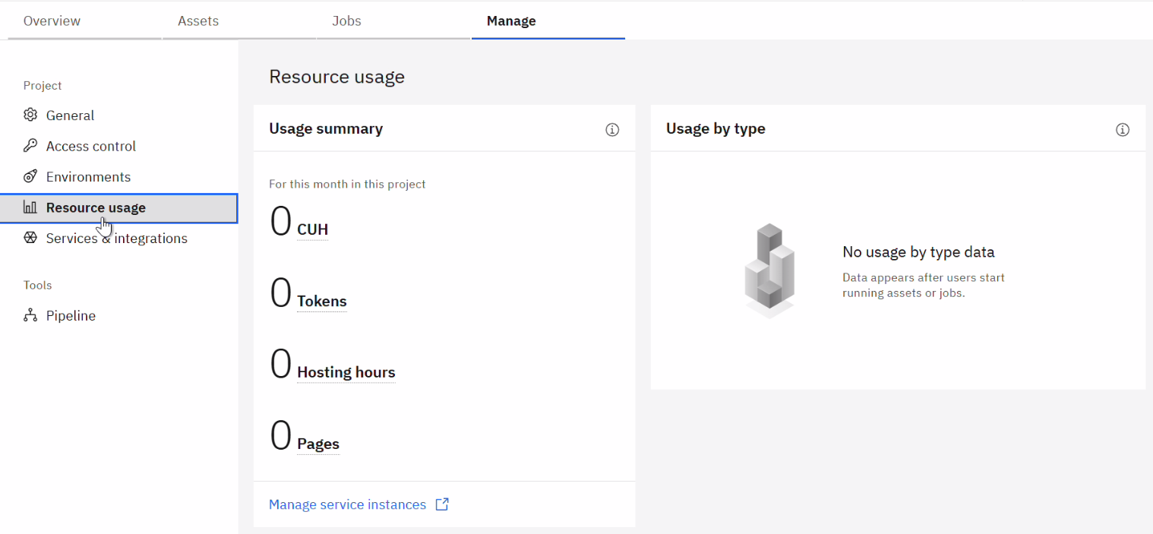
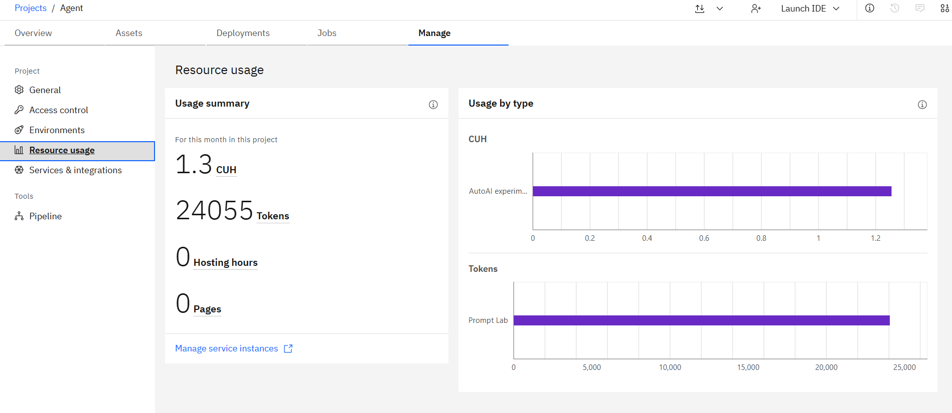
Token Usage
24055 token are used
Before Prompt
After the Prompt
·
·
·

Slide 12
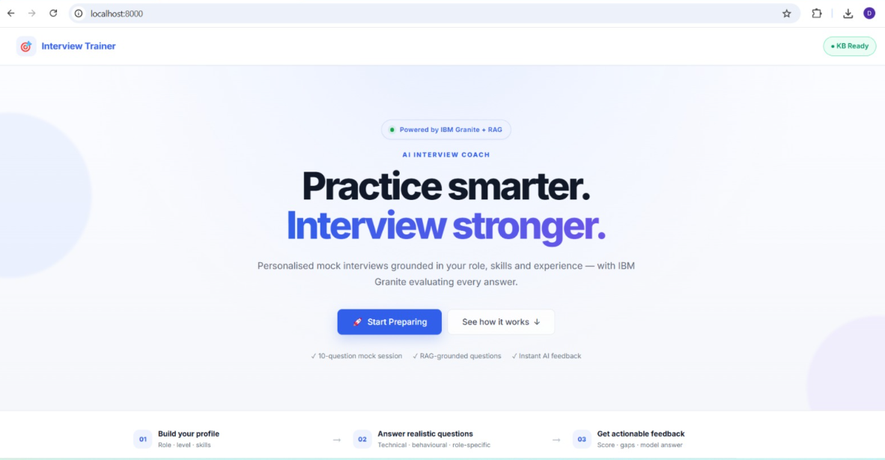
Project Output Screenshot
Please put IBM Bob output screenshots with 2-3 prompts.
You can take 2-3 more slides for each screenshot
·
·
·

Slide 13
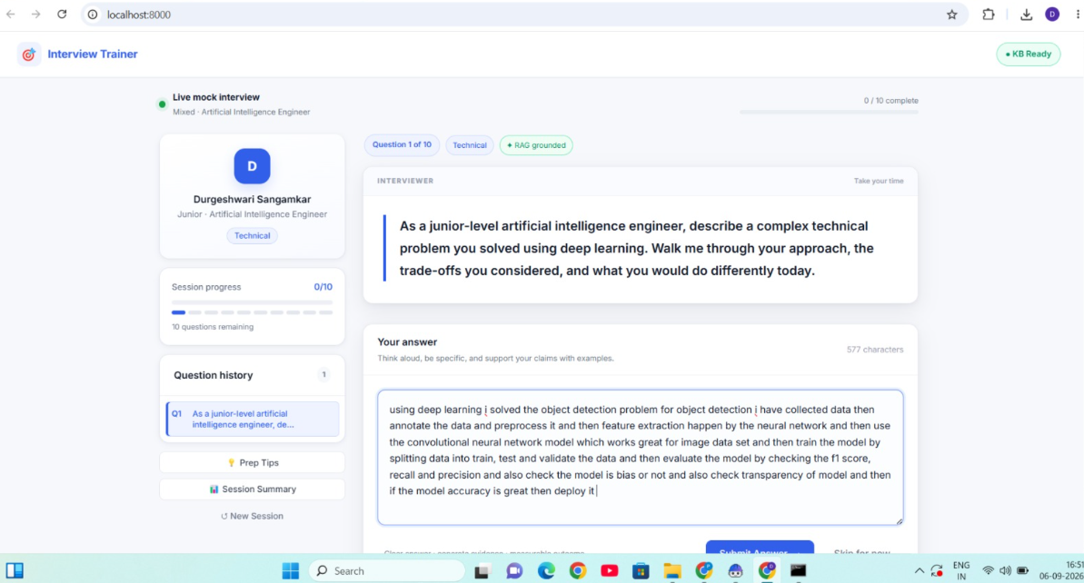
Project Output Screenshot
Please put IBM Bob output screenshots with 2-3 prompts.
You can take 2-3 more slides for each screenshot
·
·
·

Slide 14
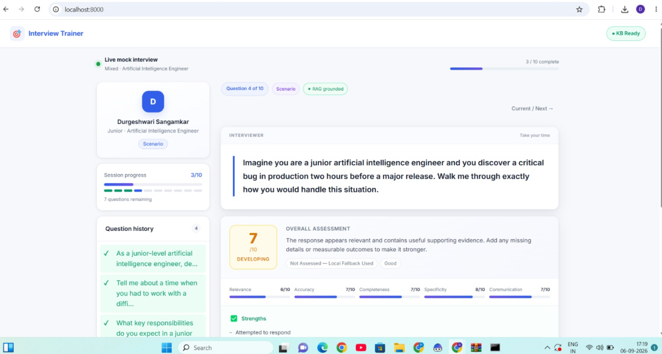
Project Output Screenshot
Please put IBM Bob output screenshots with 2-3 prompts.
You can take 2-3 more slides for each screenshot
·
·
·

Slide 15
Novelty and Uniqueness
The Agentic RAG Interview Trainer is unique because it combines Agentic AI + RAG + IBM Granite to create an adaptive mock-interview experience.
Adaptive interviews – Questions dynamically adjust based on the candidate’s previous answers and performance.
RAG-grounded questions – The system retrieves relevant information from the knowledge base to generate more contextual and reliable interview questions.
AI-based answer evaluation – Answers are evaluated for relevance, accuracy, completeness, specificity, and communication, rather than simply marking them right or wrong.
Personalized feedback – The system identifies strengths and areas for improvement and provides actionable interview guidance.
Context-aware workflow – It maintains the interview session, question history, answers, evaluations, and progress to create a continuous interview experience.
Agentic decision-making – The system autonomously manages question generation, retrieval, evaluation, and interview progression.

Slide 16
Git Hub Link
·https://github.com/Du4ga/AI-Agentic-RAG-Interview-Trainer.git
·
·
·

Slide 17
Future Scope
1. Voice-Based AI Interview Assistant –
The system can be integrated with speech-to-text and text-to-speech technologies to conduct real-time voice-based mock interviews. This will allow candidates to answer naturally through voice while the system evaluates their responses and provides instant feedback.
2. Multilingual Interview Support –
Enhancing the system with multilingual capabilities will allow candidates to practice interviews in their preferred language. This will improve accessibility and make the Interview Trainer suitable for users from diverse linguistic backgrounds.
3. Resume-Based Personalized Interviews –
The system can be enhanced to analyze a candidate’s resume and generate personalized questions based on their skills, projects, education, and experience, providing a more realistic interview experience.
4. Advanced Performance Analytics –
Future versions can provide detailed performance tracking, including progress trends, frequently occurring weaknesses, skill-wise scores, and personalized recommendations for improvement.
·
·
·

Slide 18

Certificates Earned:
Please add your credly certificate(Getting Started with Artificial Intelligence)

Slide 19
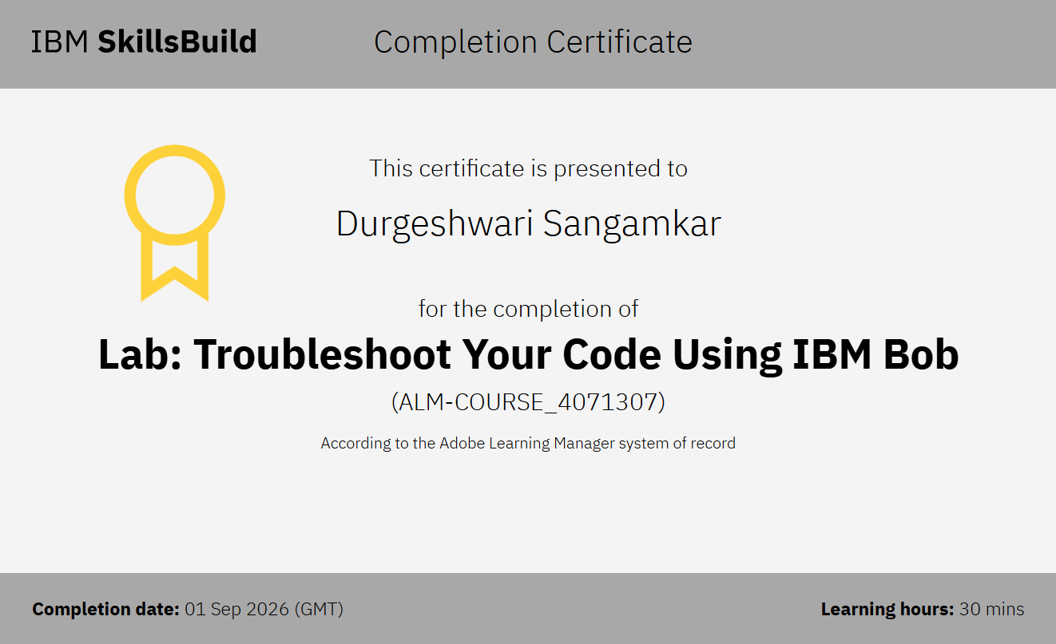
Certificates Earned:​
Add your IBM BOB Certificate

Slide 20


