Slide 1

Charges and Cost Differential for Vaginal Births Among Privately Insured Patients in NYC: A 2021-2024 SPARCS Analysis
Rose Saint Fleur-Calixte, PhD, PStat®,
Senior Biostatistician
Stanley Calixte,
Software Engineer

Slide 2
Background and RAtionale
Vaginal births are among the most frequently billed inpatient procedures in the U.S. [1]
Hospital billing and reimbursement for routine vaginal births vary widely across NYC hospitals, even among clinically similar patients. [2]
Cost variation often overlaps with structural inequities: hospital type, neighborhood resources, and patient demographics. [2]
For privately insured families, childbirth is often the single most expensive health event of the year. High or unpredictable costs can lead to medical debt, delayed postpartum care, or avoidance of future health services. [3]
Public, private, and community hospitals operate under different financial pressures.[2] Understanding how these pressures translate into billing practices helps policymakers evaluate whether certain hospital types systematically overcharge or undercharge for routine maternal care.

Slide 3
Data Source
Statewide Planning and Research Cooperative System (SPARCS) Inpatient De-identified File from (https://healthdata.gov/) from 2021-2024.
Inclusion Criteria:
All Vaginal Delivery with no other additional procedures (N = 96.387)
Hospital County: Bronx, Kings, New York, Queens, and Richmond
Private Insurance or Blue Cross/Blue Shield (No other proprietary names are listed in the data).
Age 18-49 years old
Minor Risk of Mortality
Outcomes
Total charges: Total charges for the discharge
Total costs: Total estimated cost for the discharge
Cost differential: derived as total costs - total charges
Total costs ≥ 50% total charges.

Slide 4
LLM Prompts (Gemini)
I want to understand reimbursement patterns for live births in NYC using SPARCS data among privately insured patients. Do private hospitals receive higher reimbursement than public hospitals? The project is based on publicly available SPARCS data from NYS.
What predictive modeling strategies can be used and compared for best model fit?
Can this project be powered by SAS VFL or R? Which of the two platforms is better to use if we want to use this analysis to power a project that can be prompted to write reports based on the results of the analysis?

Slide 5
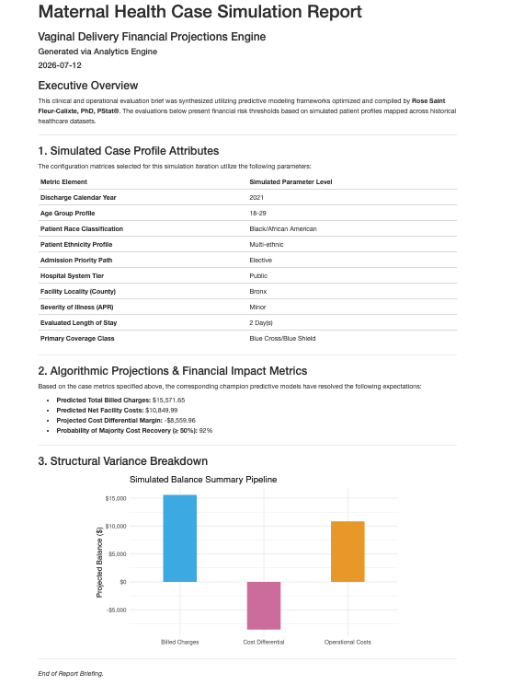
Model/Analysis/Results
We randomly split the data into training set (70%) and test set (30%).
Using tidymodels, we create a set of surpervise machine learning model (linear regression, ridge regression, regression tree, random forest, and gradient boosting) for continuous variables and a classification set of models (logistic regression, decision tree, random forest, and gradient boosting) for the binary variable.
Models were compared to find a champiom model (RMSE for continous, accurary and ROC for binary).
The champion model across each outcome was retained and pushed to the local directory using the vetiver and pins packages.
We then create and launch a shinyapp that display the result of the champion models and summarize the full analytic sample.
End user can generate report based on simulated patient profile to estimate pricing for privately insured pregnant person, expected to have an uncomplicated vaginal delivery.

Slide 6
Conclusions
The full analytic sample revealed some interesting facts about uncomplicated vaginal birth in NYC.
While 21-23% of female in NYC (18-49 yo) are black, only 11% had uncomplicated vaginal birth. What is unknown is what proportion of people given birth in NYC traveled from outside of NYC
Most of the births occurs in New York (Manhttan) County.
The average hospital charge for an uncomplicated birth over the 4 years was $34,867, which steadily increased from $31,276 in 2021 to $38,443 in 2024 (a 23% increase in hospital charge).
The reimbursement averaged $10,156, which increased from $9,093 in 2021 to $11,485 in 2024 (a 26% increase).
The gap in reimbursement increased from $22,183 to $26,958 (a 22% increase)
The reimbursement percentage exceeds 50% in only 30.4% of the cases.

Slide 7
Limitations
The quantitative outcomes are positively skewed. The present model did not use a normalized version of these outcomes.
Due to the nature of the publicly available data, we are unable to identify the percentage of repeat pregnancies within any given calenday year or across the 4 calendar years.
We assume that multiple pregnancies from the same individual should constitute independent billing entities and should not affect the prediction.
Furthermore, only about 0.2% of birthing individuals have two deliveries within any 12-month period.
Lastly cross-sectional data was used. Any observable significant differences should be interpreted in the context of the analysis being presented.

Slide 8
References
Podulka, J. (Thomson Reuters), Stranges, E. (Thomson Reuters), and Steiner, C. (AHRQ). Hospitalizations Related to Childbirth, 2008. HCUP Statistical Brief #110. April 2011. Agency for Healthcare Research and Quality, Rockville, MD. http://www.hcup-us.ahrq.gov/reports/statbriefs/sb110.pdf.
New York State Health Foundation. (2021). Variation in health care prices: The problem starts at birth. https://nyhealthfoundation.org/wp-content/uploads/2021/04/variation-in-health-care-prices-the-problem-starts-at-birth-may-2021.pdf
Peterson‑KFF Health System Tracker. (2024). Health costs associated with pregnancy, childbirth, and postpartum care. https://www.healthsystemtracker.org/brief/health-costs-associated-with-pregnancy-childbirth-and-postpartum-care/

