Slide 1

Landing Page:
Add
User Login
Missing Sock
Login :
User Email :
User Password :
Login
Sign up
Landing Page:
Add

Slide 2
Wait 10sec go back to landing page
Missing Sock
Login Success / Login Failed
Landing Page:
Add

Slide 3
Landing Page:
Add
User Login
Missing Sock
Login :
User Email :
User Password :
Login
Sign up
Landing Page:
Add

Slide 4
Missing Sock
Sign Up Info
User Email :
User Password :
Sign up
Landing Page:
Add

Slide 5
Missing Sock
Add Base Stations
Base Id:
Add Base Station (loop)
Save (go to 1st page)
Landing Page:
Add

Slide 6
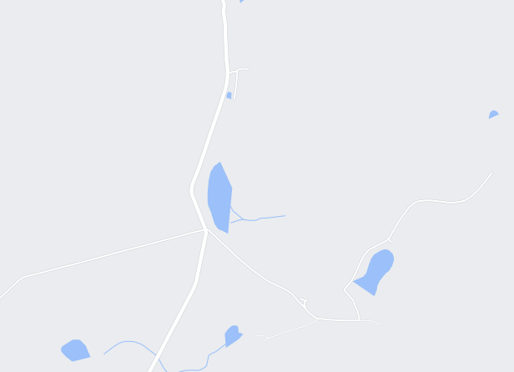
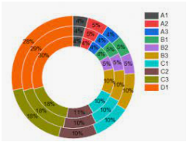

Dashboard
Latest Tracking
Tag not seen
Tag - Current
On mouse over
-nice name
On click
-detail
Tag - History
Base - History
Settings
Tag not seen – 1 Day
On mouse over
-nice name
On click
-detail
last up dated at 2021-11-02 12:23:33

Slide 7
Missing Sock (1st page)
Base | Tag | Date | GPS
Tag - Current
On mouse over
-nice name
On click
-detail
Tag - History
Base - History
Settings
On mouse over
-nice name
On click
-detail

Slide 8
Missing Sock
Base | Tag | Date | GPS
Tag - Current
On mouse over
-nice name
On click
-detail
On double click
Filter only this one
Tag - History
Base - History
Settings
On mouse over
-nice name
On click
-detail

Slide 9
Missing Sock
Base | Tag | Date | GPS
Tag - Current
On mouse over
-nice name
On click
-detail
Tag - History
Base - History
Settings
On mouse over
-nice name
On click
-detail

Slide 10
Missing Sock
Add Nice own name
Change Icon (drop down)
Change base color (drop down)
Tag - Current
Base
Tag - History
Tag
Base - History
Settings

Slide 11

Database Design : Missing Sock
Base_stations
id – Primary auto
Base_ID – varchar(30)
Nice_name – varchar(30)
USER
id – Primary auto
User_email – varchar(50)
Nice_name-varchar(30)
Passwd – varchar(30)
Standing - boolean
1
Create table base_sync {
Id int primary key autoincrement,
Foreign key (base_id) reference base_station (id) ,
Foreign key (tag_id) references tag_name( id)
Created timestamp not null default current_timestamp,
GPS_local point,
Tag_relative_strength decimal ,
Sync_id varchar(30)
);
1
Tag
id – Primary auto
Tag_id – varchar(30)
Nice_name-varchar(30)
1
1
Billing
id – Primary auto
User_id - Foreign Key (user.unique_id)
Bill_Date – varchar(14) YYYYMMDDHH24MISS
Description – Varchar(100)
Amount_Dt - Number
Amount_Ct - Number

Slide 12
Rest - api
/ | GET | List of api
/stations | GET | Stations Detail
/stations/<station name> | GET/PUSH/PUT/DELETE | Station Detail get/insert/update/delete
/tags | GET | Tags Details
/tags/<tag > | GET/PUSH/PUT/DELETE | Tag Detail get/insert/update/delete
/user | GET | User Detail
/user/<user> | GET/PUSH/PUT/DELETE | User Detail get/insert/update/delete

Slide 13
Design
Backend
Python
Frontend
Native javascript
Ui5 (SAP)
react
Testing
Robot / selenium

