Slide 1
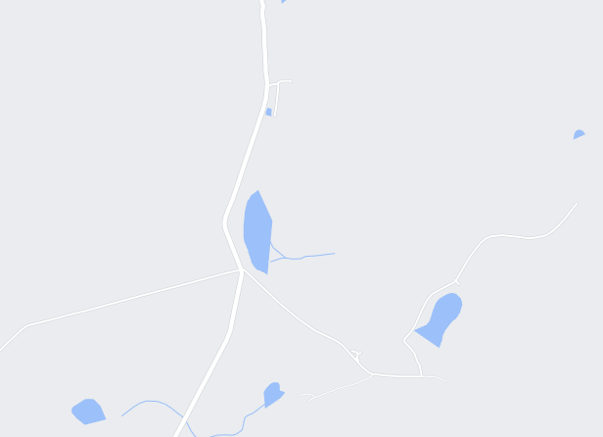
Missing Sock
Base | Tag | Date | GPS
Tag - Current
On mouse over
-nice name
On click
-detail
Tag - History
Base - History
Settings
On mouse over
-nice name
On click
-detail

Slide 2
Missing Sock
Base | Tag | Date | GPS
Tag - Current
On mouse over
-nice name
On click
-detail
On double click
Filter only this one
Tag - History
Base - History
Settings
On mouse over
-nice name
On click
-detail

Slide 3
Missing Sock
Base | Tag | Date | GPS
Tag - Current
On mouse over
-nice name
On click
-detail
Tag - History
Base - History
Settings
On mouse over
-nice name
On click
-detail

Slide 4
Missing Sock
Add Nice own name
Change Icon (drop down)
Change base color (drop down)
Tag - Current
Base
Tag - History
Tag
Base - History
Settings

Slide 5

Database Design : Missing Sock
Base_stations
Unique_id – Primary auto
Base_ID – varchar(30)
Nice_name – varchar(30)
1
Base_sync
Unique_id – Primary auto
Base_ID – varchar(30)
Tag_id – varchar(30)
Timestamp-varchar(14) (yyyymmddhh24miss)
GPS_LOCAL – point
Tag_relative_strength – int
Sync_id – varchar30e
Tag
Unique_id – Primary auto
Tag_id – varchar(30)
Nice_name-varchar(30)
1

Slide 6
Design
Backend
Python
Frontend
Native javascript
Ui5 (SAP)
react
Testing
Robot / selenium

