Slide 1

Landing Page:
Add
User Login
Missing Sock
Login :
User Email :
User Password :
Login
Sign up
Landing Page:
Add

Slide 2
Wait 10sec go back to landing page
Missing Sock
Login Success / Login Failed
Landing Page:
Add

Slide 3
Landing Page:
Add
User Login
Missing Sock
Login :
User Email :
User Password :
Login
Sign up
Landing Page:
Add

Slide 4
Missing Sock
Sign Up Info
User Email :
User Password :
Sign up
Landing Page:
Add

Slide 5
Missing Sock
Add Base Stations
Base Id:
Add Base Station (loop)
Save (go to 1st page)
Landing Page:
Add

Slide 6
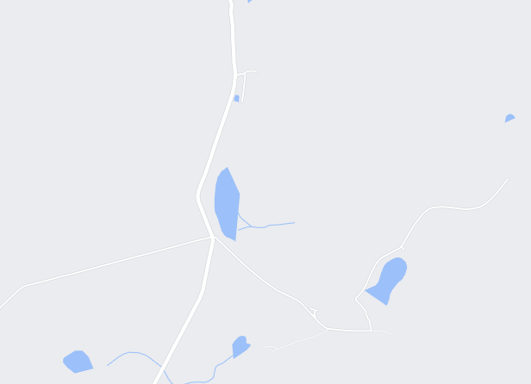
Missing Sock (1st page)
Base | Tag | Date | GPS
Tag - Current
On mouse over
-nice name
On click
-detail
Tag - History
Base - History
Settings
On mouse over
-nice name
On click
-detail

Slide 7
Missing Sock
Base | Tag | Date | GPS
Tag - Current
On mouse over
-nice name
On click
-detail
On double click
Filter only this one
Tag - History
Base - History
Settings
On mouse over
-nice name
On click
-detail

Slide 8
Missing Sock
Base | Tag | Date | GPS
Tag - Current
On mouse over
-nice name
On click
-detail
Tag - History
Base - History
Settings
On mouse over
-nice name
On click
-detail

Slide 9
Missing Sock
Add Nice own name
Change Icon (drop down)
Change base color (drop down)
Tag - Current
Base
Tag - History
Tag
Base - History
Settings

Slide 10

Database Design : Missing Sock
Base_stations
Unique_id – Primary auto
Base_ID – varchar(30)
Nice_name – varchar(30)
USER
Unique_id – Primary auto
User_email – varchar(50)
Nice_name-varchar(30)
Passwd – varchar(30)
Standing - boolean
1
Base_sync
Unique_id – Primary auto
User_id - Foreign Key (user.unique_id)
Base_ID – varchar(30)
Tag_id – varchar(30)
Timestamp-varchar(14) (yyyymmddhh24miss)
GPS_LOCAL – point
Tag_relative_strength – int
Sync_id – varchar30e
1
Tag
Unique_id – Primary auto
Tag_id – varchar(30)
Nice_name-varchar(30)
1
1
USER_Billing
Unique_id – Primary auto
User_id - Foreign Key (user.unique_id)
Bill_Date – varchar(14) YYYYMMDDHH24MISS
Description – Varchar(100)
Amount_Dt - Number
Amount_Ct - Number

Slide 11
Design
Backend
Python
Frontend
Native javascript
Ui5 (SAP)
react
Testing
Robot / selenium

