Slide 1

Welcome to our meeting! <PS>PowerShell for Beginners</PS>

Slide 2




Our sponsors

Slide 3
Agenda
08:15 – 09:00 – Ontvangst
09:00 – 09:15 – Introductie
09:15 – 10:30 – Sessie 1 De basis van Powershell, Mark van de Waarsenburg (Sogeti).
10:30 – 10:45 – Koffie
10:45 – 12:00 – Sessie 2 Powershell remoting: Theorie en praktijk, Robert Prüst (MEOS)
12:00 – 13:00 – Lunch
13:00 – 14:15 – Sessie 3 Powershell en Active Directory, Erik Heeres (Sogeti)
14:15 – 15:30 – Sessie 4 Powershell binnen Microsoft Azure, Erik van der Plas (Sogeti)
15:30 – 15:45 – Koffie
15:45 – 17:00 – Sessie 5 Basis van Desired State configuration, Danny den Braver (OSC)

Slide 4





Niet te vergeten…

Slide 5
PowerShell training?

Slide 6
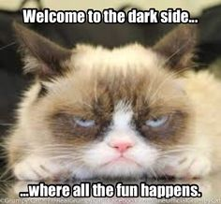
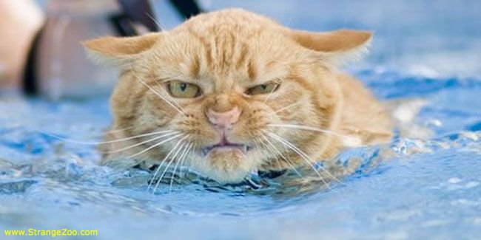
Don’t orget to have fun…!

