Slide 1
PowerShell as a Service Managing clouds, Windows, Linux, on-premises or public with Microsoft Operations Management Suite
Ed Wilson @Scriptingguys
OMS Team

Slide 2
Session Objectives And Takeaways
Session Objectives:
Why bring PowerShell automation to the cloud
What core capabilities does the automation service provide
How to bring your investments in PowerShell to the automation service
Integrating automation into the other Operations Management Suite / Azure services / on-premises environments
Extending Automation with Modules / SDK / ARM
Takeaways:
We are deeply invested in PowerShell and DSC as we bring these capabilities to the cloud.
Automation is dependent on the community and the shared content. Please continue to be involved and let us know how we can help from engineering team.
Notes:
Ed

Slide 3
Automation Trend
Adopt Cloud Technologies
Modern Management
Integrate into different cloud providers
Enable self service of IT offerings
Enable DevOps (Infrastructure as code)
Management as a Service
Heterogeneous environments
Automation at scale
Notes:
Eamon

Slide 4







Managing across the entire lifecycle
.
COST
POLICY
SUBSCRIPTION
DEVOPS TOOLING
PACKAGING
GOVERN
BUILD
Configuration & Automation
SECURE
DETECT
PREVENT
ORCHESTRATION
PATCHING
CONFIG
CONFIG MONITORING
PROTECT
MONITOR
BACKUP
RECOVERY
ANALYTICS
DISCOVERY
ALERTS

Slide 5
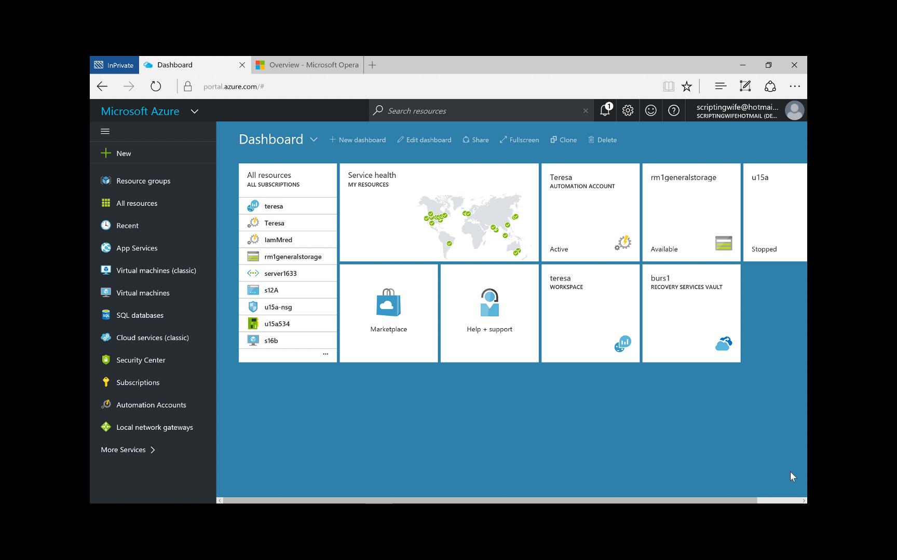
Automation Account Overview
Notes:
DEMO: Automation Account Overview

Slide 6

Creating an Automation Account
Notes:
DEMO: Creating an automation account, a variable and a credential

Slide 7
Cloud Configuration & Automation
One Automation Solution for datacenter, private, and public clouds
User Interface Web portal Access Permissions (RBAC) Source control & versioning
Authoring Graphical Authoring to visualize end-to-end orchestration PowerShell Authoring Gallery PowerShell Desired State Configuration support
Runbook Engine Highly available PowerShell-Workflow-based engine Hybrid runbook worker to enable management across public and private clouds. REST web service and PowerShell modules to enable integration from 3rd party systems / web portals
Integration Based on PowerShell modules with a rich ecosystem Use existing PowerShell modules for Microsoft and 3rd party systems Create PowerShell modules for additional resources/systems Webhooks
Tools Tools to convert Orchestrator Integration Packs and runbooks and import into Azure Automation
Notes:
Eamon

Slide 8
Moving your investments to the cloud
Bring your scripts into the service
Taking advantage of automation assets
Modularize your scripts to enable easier reuse
Taking advantage of scheduler to trigger your automation
Using PowerShell workflow or PowerShell native scripts
Require checkpoints within your process or making Runbooks idempotent
Require parallel capabilities or leveraging Start-AzureRMAutomationRunbook
Authoring in the ISE or within the service
ISE offers richer debugging / intellisense / offline / additional add-on capabilities
Web authoring allows for easy access on any device / OS.
Notes:
Ed

Slide 9
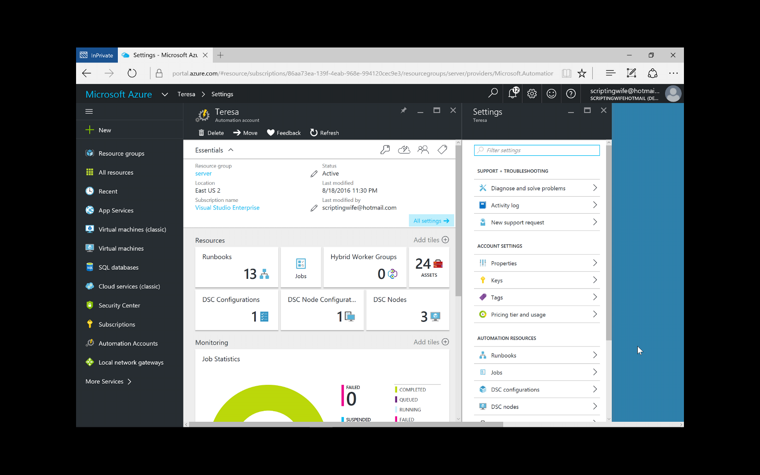
Demo writing output
Notes:
DEMO: Create, Run, Publish runbook illustrating writing output

Slide 10
Integrating into other OMS / Azure services
Integration with Log Analytics
Trigger automation based on search results.
Querying Log Analytics from automation service
Azure Site Recovery pre & post scripts
Before failover, run automation runbook to do any pre work required
After failover, run automation runbook to ensure failover is successful.
Azure Alerts integration
Trigger any runbook based on VM alert leveraging webhooks
Run system runbooks automatically based on VM alerts
Notes:
Eamon

Slide 11
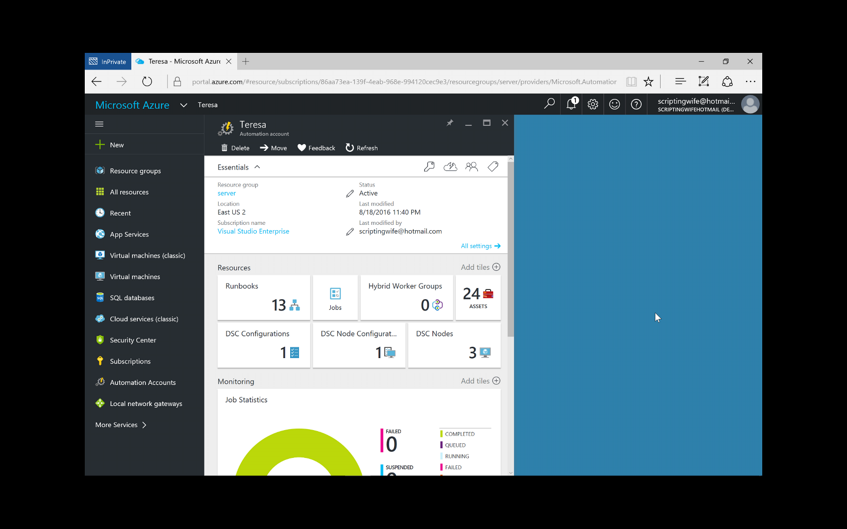
Scheduling Runbooks

Slide 12

View Job Results

Slide 13
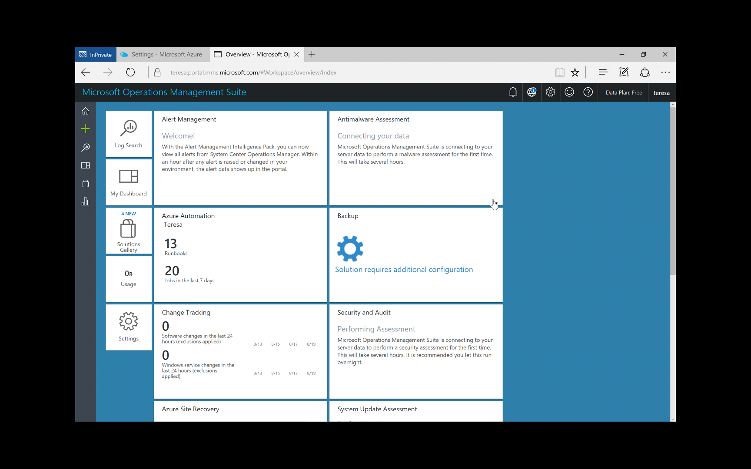
Configure Alerts

Slide 14
Extending Automation: Modules / SDK / ARM
Authoring your own PowerShell Modules
Standard guidelines when writing modules
Ensure all dependencies are within the module so it is xcopyable
Automation option json file to create connection object to make it easier to define common values to use when managing the system.
Using the SDK / REST API
https://www.nuget.org/packages/Microsoft.Azure.Management.Automation/2.0.0
Look at ISE Add-On for example usage on GitHub
Authoring with Azure Resource Manager
See examples on https://github.com/azureautomation/automation-packs
Notes:
Eamon

Slide 15
In Review: Session Objectives And Takeaways
Session Objectives:
Why bring PowerShell automation to the cloud
What core capabilities does the automation service provide
How to bring your investments in PowerShell to the automation service
Integrating automation into the other Operations Management Suite / Azure services
Takeaways:
We are deeply invested in PowerShell and DSC as we bring these capabilities to the cloud.
Automation is dependent on the community and the shared content. Please continue to be involved and let us know how we can help from engineering team.
Notes:
Ed

Slide 16
Join the Monthly Automation calls If interested, see us later to be added to the monthly invite.
Notes:
Eamon

Slide 17
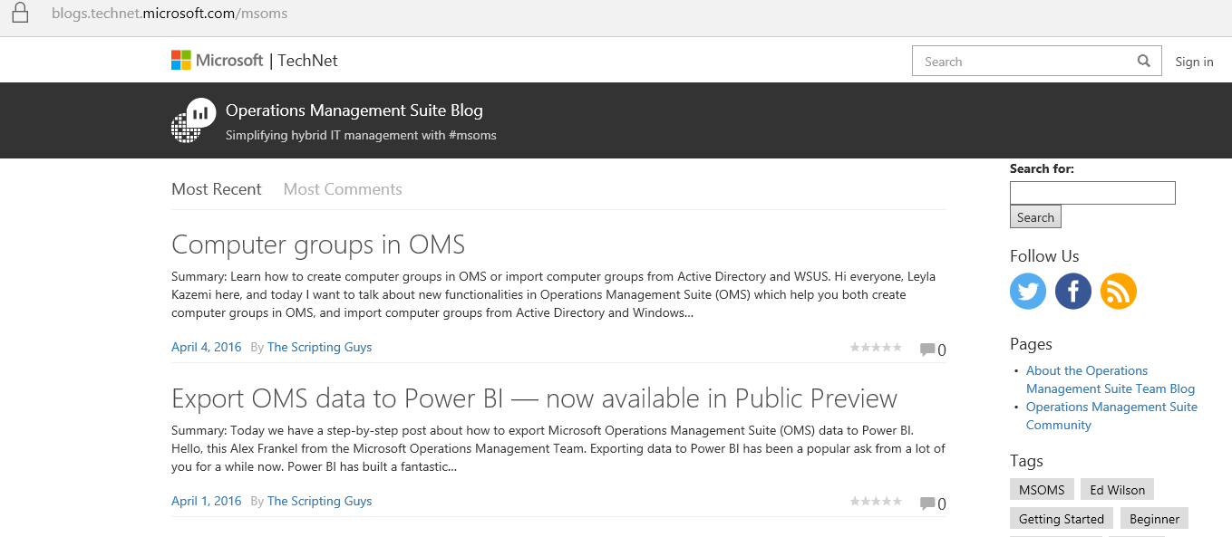
OMS Team blog
Http://aka.ms/omsblog

Slide 18
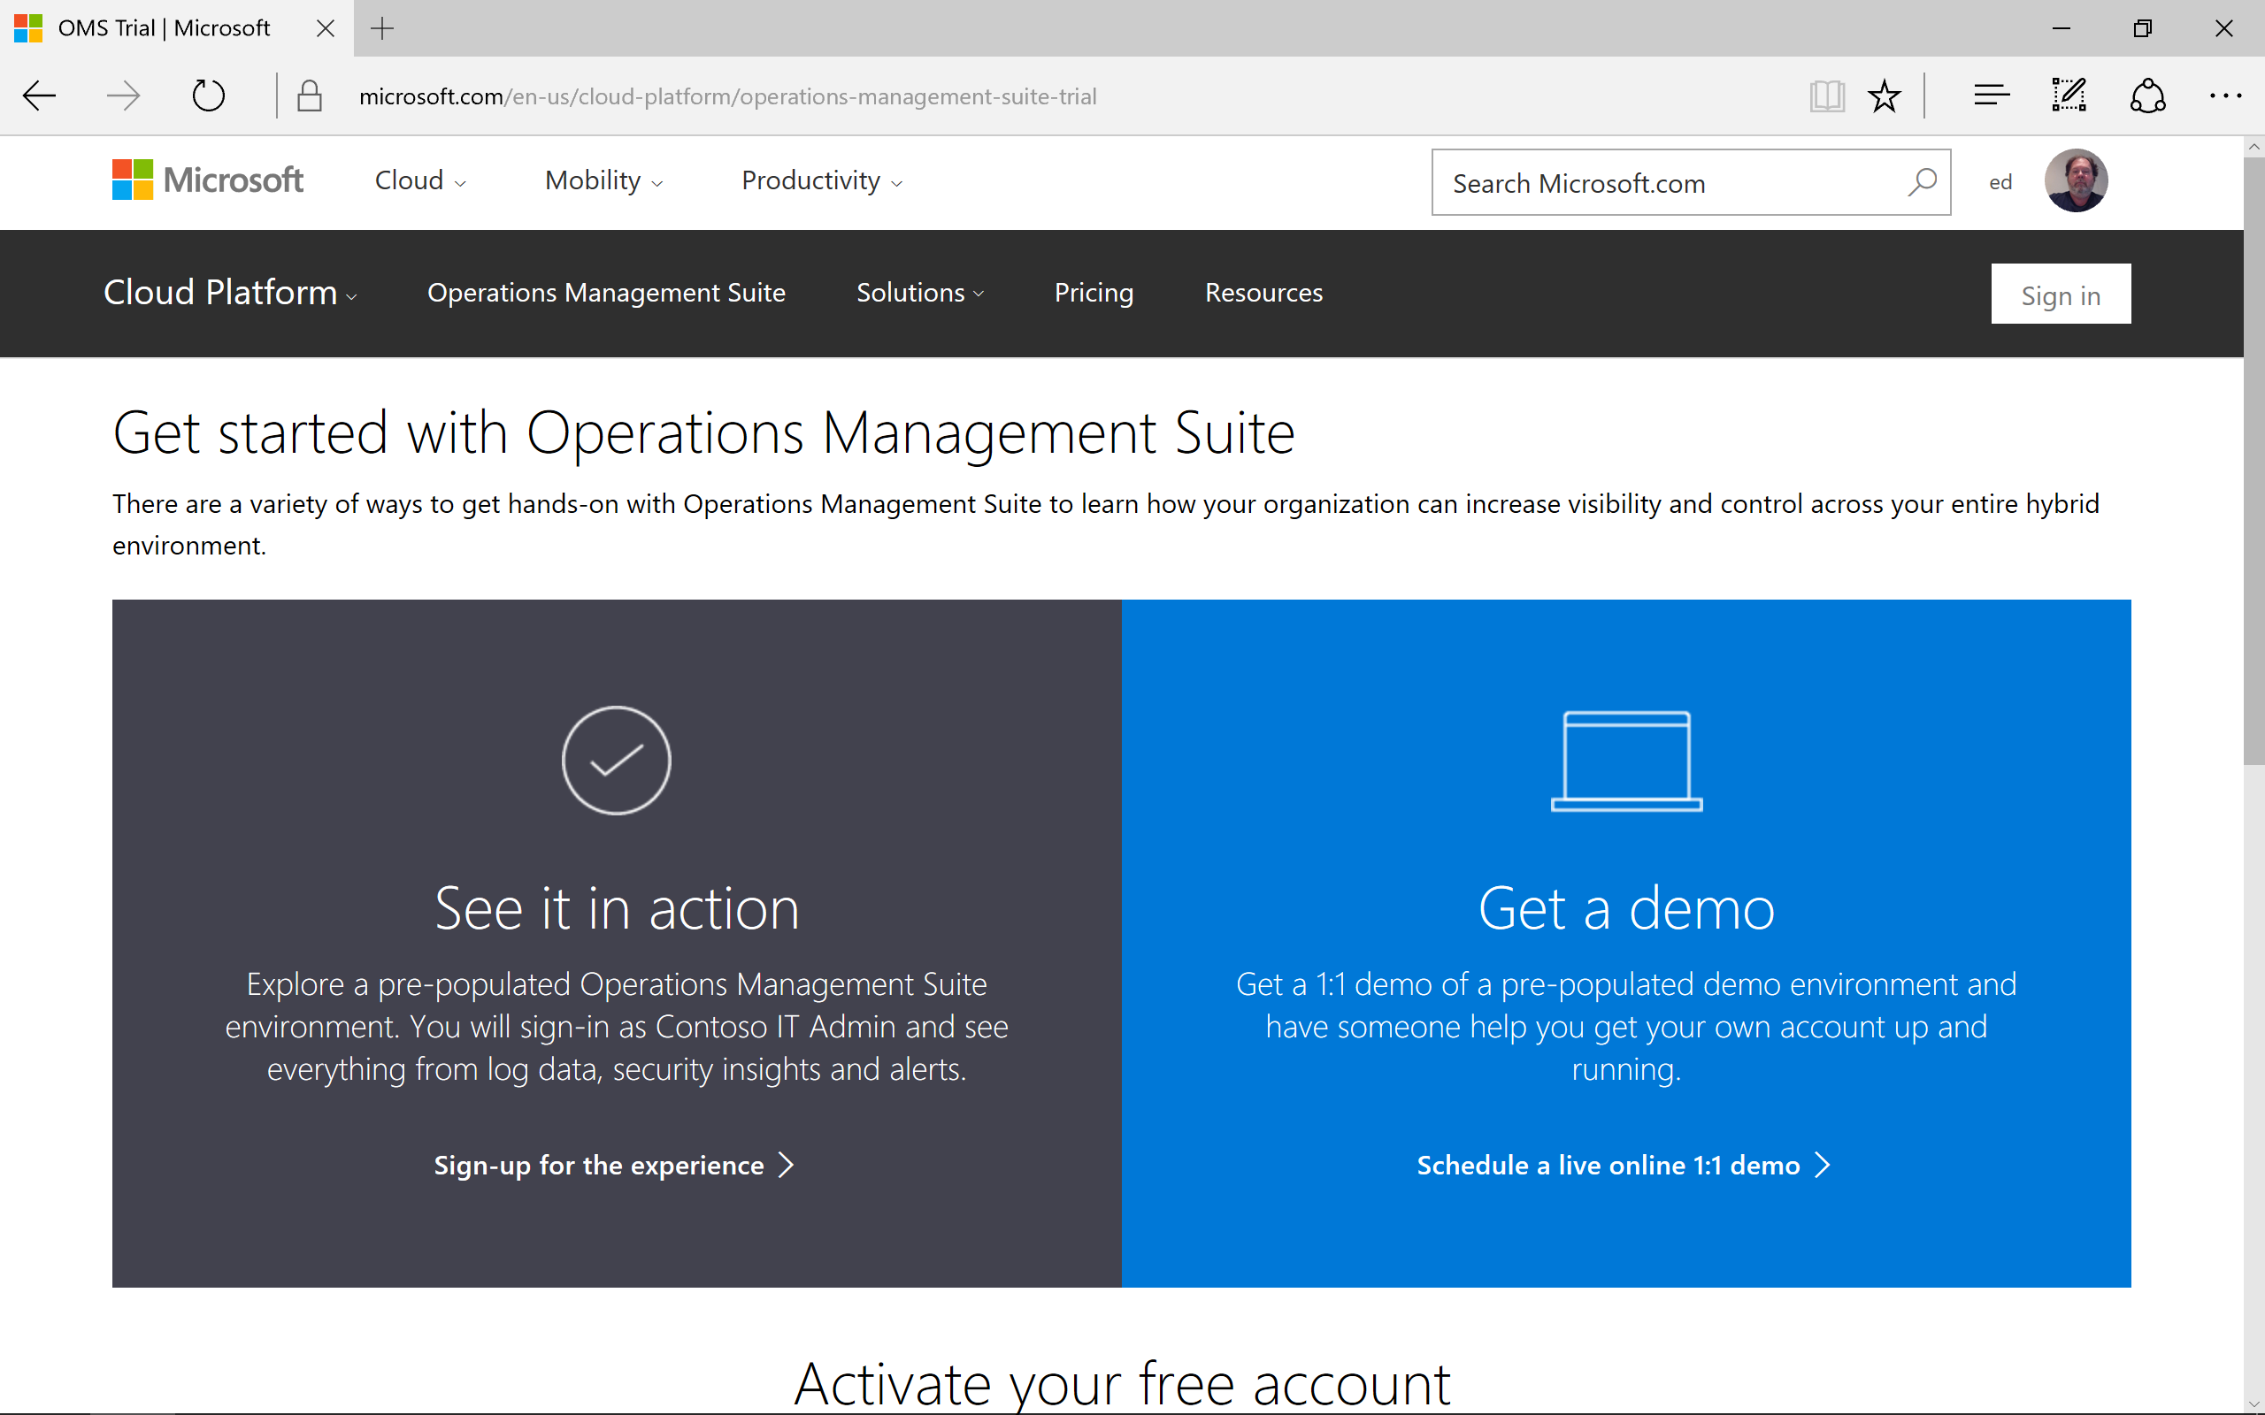
Try OMS
Http:/Aka.ms/getoms

Slide 19
PowerShell Open Source
Notes:
Created by Neema Saeedi (neemas) for presentation to Microsoft IT, Service Deployment and Operations Team
Notes attached to slides.
Additional Resources mentioned:
PowerShell Gallery - https://www.powershellgallery.com/
WMF 5.0 Preview April 2015 - http://www.microsoft.com/en-us/download/details.aspx?id=46889

Slide 20
PowerShell Sustained Investment
2006: PowerShell v1 → 2016: PowerShell v5
WMF provides downlevel support
Windows not has over 3000 cmdlets
Not just a shell: task-based scripting language
Desired State Configuration
Pester
Moving beyond Windows:
PowerShell Gallery
Azure Automation

Slide 21
What’s going on
Availability of PowerShell on Linux and Mac
Ubuntu 14.04/16.04
CentOS 7.1
RHEL 7
Mac OS X 10.11
We’re open sourcing Windows PowerShell (.NET) and PowerShell Core (.NET Core)
Single codebase for Windows and *nix editions
Alpha / developer preview builds w/ community support
One repository: https://github.com/PowerShell/PowerShell
MIT License

Slide 22
PowerShell Core enables heterogeneous management
Azure, AWS, VMWare, Chef
OpenSSH (including PSRP support)
PowerShell and Microsoft are good citizens in a Linux world
Easy to wrap native Linux binaries (crontab, Python)
Templatizing configuration files (Apache)
Editor Services working with multiple editors (VS Code, Sublime Text)
PowerShell is cool and unique
Structured data as objects
REALLY easy to wrap native Linux binaries that output JSON (journalctl)
Awesome as a REST shell

